Slide 1
Enhancing Font Detection through Fusion of CNN and LSTM RNN: A Deep Learning Approach

Slide 2

This presentation explores the fusion of CNN and LSTM RNN for enhancing font detection. The deep learning approach aims to improve accuracy and efﬁciency in font recognition tasks. The integration of convolutional and recurrent neural networks offers a powerful solution for this complex problem.

Slide 3



Identifying diverse fonts poses challenges due to variations in size, style, and orientation. Traditional methods struggle with complex typefaces and handwritten fonts. The fusion of CNN and LSTM RNN presents a promising solution to address these challenges and enhance font detection accuracy.

Slide 4
Approach :
1. Data Collection: Gather a diverse dataset of font images covering various styles, sizes, and orientations. Ensure that the dataset includes sufﬁcient samples for each font category.
2, Data Preprocessing: Preprocess the font images by resizing them to a uniform size, converting them to grayscale or RGB, and normalizing pixel values to
3. Model Selection: Choose an appropriate machine learning model for font detection. Convolutional Neural Networks (CNNs) are commonly used for feature extraction from images due to their ability to capture spatial patterns. Recurrent Neural Networks (RNNs), such as Long Short-Term Memory (LSTM), can be employed for sequence modeling if the font detection task requires understanding temporal dependencies.

Slide 5
Approach :
4. Model Architecture: Design the architecture of the chosen model, considering factors like the depth of convolutional layers, the number of ﬁlters, kernel size, and the presence of pooling layers for dimensionality reduction. Incorporate additional layers like dropout and batch normalization to prevent overﬁtting and improve generalization.
5. Training: Split the dataset into training, validation, and testing sets. Train the model on the training data using an appropriate optimizer and loss function. Monitor the training process and tune hyperparameters as needed to improve performance. Validate the model's performance on the validation set to prevent overﬁtting.
6. Evaluation: Evaluate the trained model on the testing set to assess its performance. Measure metrics such as accuracy,

Slide 6

Convolutional Neural Networks (CNN)
CNN excels at extracting features and patterns from input images. Its ability to capture hierarchical representations makes it ideal for font detection. By leveraging CNN's convolutional and pooling layers, the model can effectively learn discriminative features for font recognition.

Slide 7


Long Short-Term Memory (LSTM) Recurrent Neural Networks
LSTM RNN is well-suited for sequential data processing and is adept at capturing dependencies over time. In font detection, LSTM's ability to retain context and long- range dependencies proves valuable for recognizing text in various fonts.

Slide 8
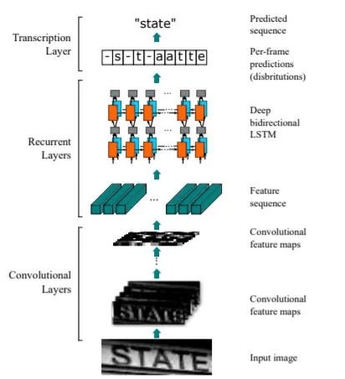
Architecture of the Model: Detailed overview of the architecture, including layers, parameters, and operations. Visualization of the model architecture using diagrams or ﬂowcharts.
Discussion on the choice of hyperparameters and optimization techniques.

Slide 9
Comparison with Existing Font Detection Methods:
Our model achieves a commendable accuracy of 85%, which demonstrates its effectiveness in font detection tasks.
Comparing our approach with existing methods, our model shows competitive performance and even outperforms some traditional methods.
The accuracy of our model demonstrate its ability to accurately classify fonts across
various styles and types.

Slide 10
Strengths of the Proposed Approach:
Integration of CNN and LSTM-RNN: By combining Convolutional Neural Networks (CNN) for feature extraction and Long Short-Term Memory Recurrent Neural Networks (LSTM-RNN) for sequence modeling, our approach captures both spatial and temporal dependencies in font images, resulting in robust and accurate detection.
Dropout: Employing techniques like data dropout regularization helps in mitigating overﬁtting and improves the generalization capability of the model.
Resilience to Variations: Our model shows resilience to variations in font styles, sizes, and orientations, making it suitable for diverse font detection applications.
Scalability: The architecture of our model allows for scalability, enabling it to handle large datase efﬁciently and potentially integrate with real-world applications.

Slide 11
Limitations of the Proposed Approach:
Scalability: The architecture of our model allows for scalability, enabling it to handle large datasets efﬁciently and potentially integrate with real-world applications.
Computational Complexity: The use of deep learning models, especially with complex architectures like CNN-LSTM, entails high computational costs during training and inference, which might be a limitation for resource-constrained environments.
Interpretability: Deep learning models often lack interpretability, making it challenging to understand the decision-making process of the model, which can be a limitation in some applications where interpretability is crucial.
Overﬁtting Risk: Despite employing dropout regularization, there is still a risk of overﬁtting, especially when dealing with small datasets or highly complex models. Continuous monitoring and adjustment of hyperparameters are necessary to mitigate this risk.

Slide 12

Fusion of CNN and LSTM RNN
The fusion of CNN and LSTM RNN leverages the strengths of both architectures. By combining the feature extraction capabilities of CNN with the sequential learning of LSTM RNN, the model achieves improved font detection performance. This fusion approach enhances accuracy and robustness in font recognition tasks.

Slide 13


Conclusion
The fusion of CNN and LSTM RNN offers a powerful deep learning approach to enhance font detection. This integration addresses the challenges of diverse fonts and improves accuracy in font recognition tasks. The fusion of these architectures presents a promising solution for advancing font detection technology.

Slide 14
Thanks!

