Slide 1
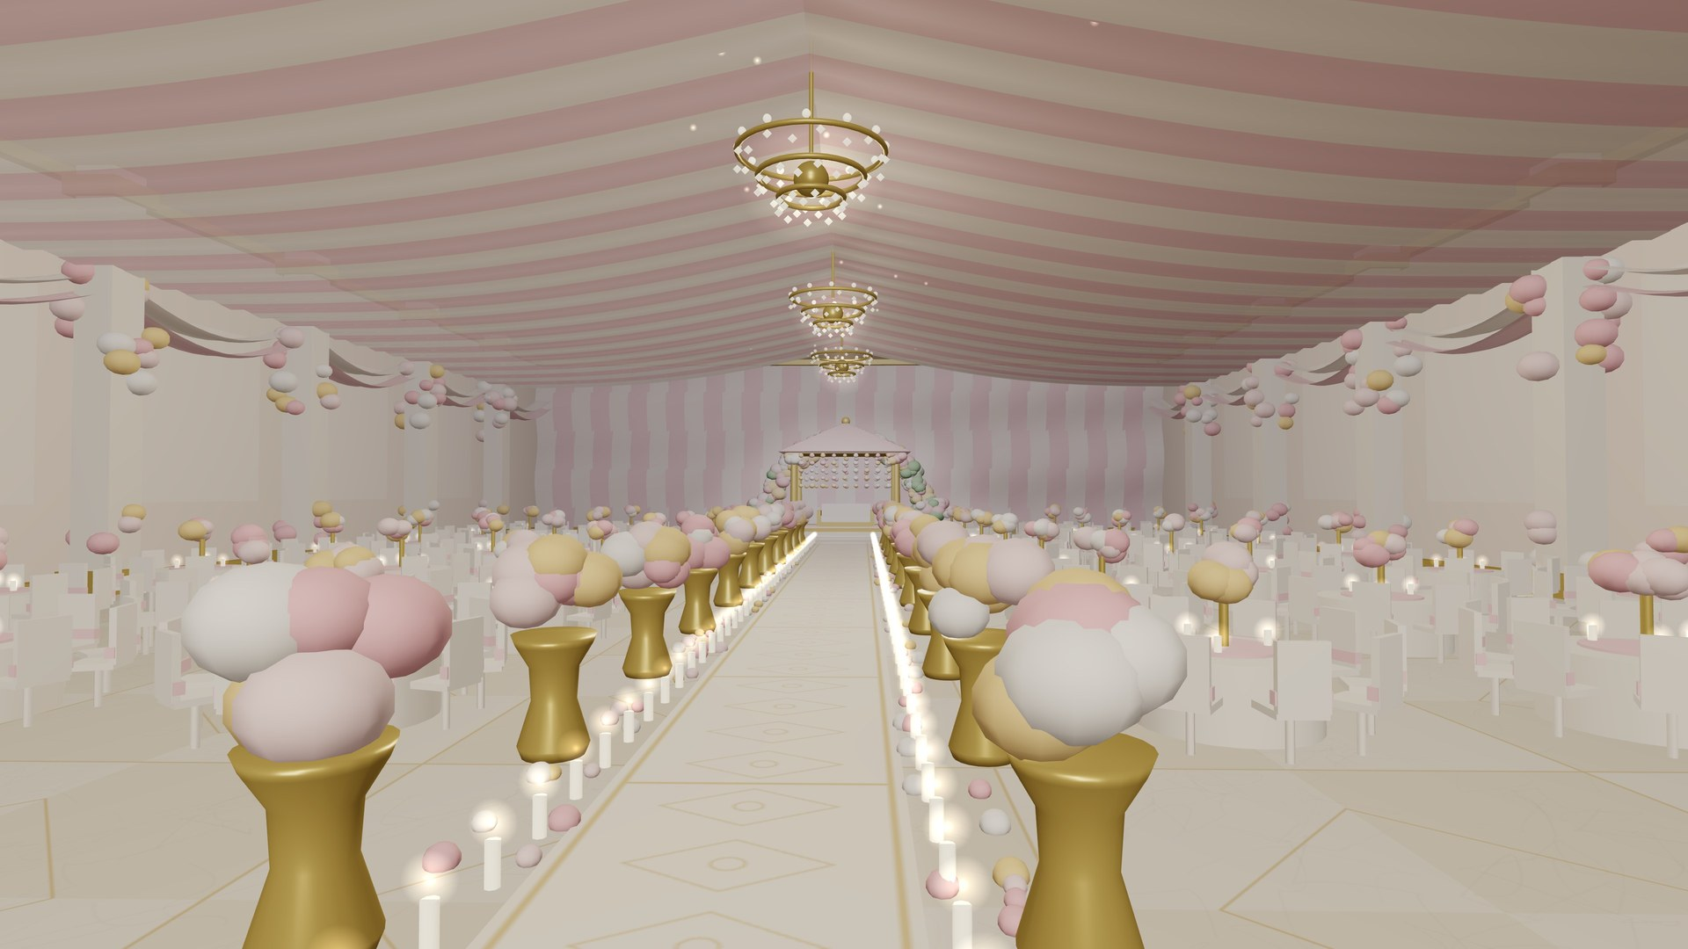

✦
WEDVERSE
PLAN · VISUALIZE · CELEBRATE
WedVerse AI
See your wedding before
you spend on it.
SEED ROUND · ₹1.5 Cr for 5%
Notes:
OPEN (15 sec): "Sharks, a typical Indian family will spend ₹25 lakh on a wedding. Today they sign that cheque before they have seen a single thing. We fix that." Pause, then move on.

Slide 2
A ₹25 lakh decision with no preview
₹25,00,000
01
Photos & Pinterest
Inspiration, not your venue
02
average spend on one big-fat Indian wedding — committed months before anyone sees the décor, the layout or the final bill.
Verbal quotes
Hard to compare, easy to inflate
03
Day-of surprises
"This isn't what we imagined"
Notes:
Make it personal: "Imagine buying a car you can only see after you have paid." Let the number land.

Slide 3



Three problems every couple faces
01
02
03
Imagination gap
Quote chaos
Budget overruns
Couples cannot picture their own venue with a theme, layout and lighting.
Every décor vendor quotes differently. No way to compare like-for-like.
Changes after booking cost 20–30% more. Planners juggle it in spreadsheets.
Notes:
Three pains: they cannot see it, they cannot compare it, they cannot control the cost. Planners feel all three, every week.

Slide 4




Preview. Optimise. Book.
Upload your venue
Photos, floor plan or video become a 3D digital twin.
Design it in 3D
Swap themes, layouts and lighting in seconds. Walk it in VR.
Optimise the budget
Live quote, material list and AI savings ideas as you design.
Notes:
Walk the three steps in one breath. Then go to the live demo.

Slide 5
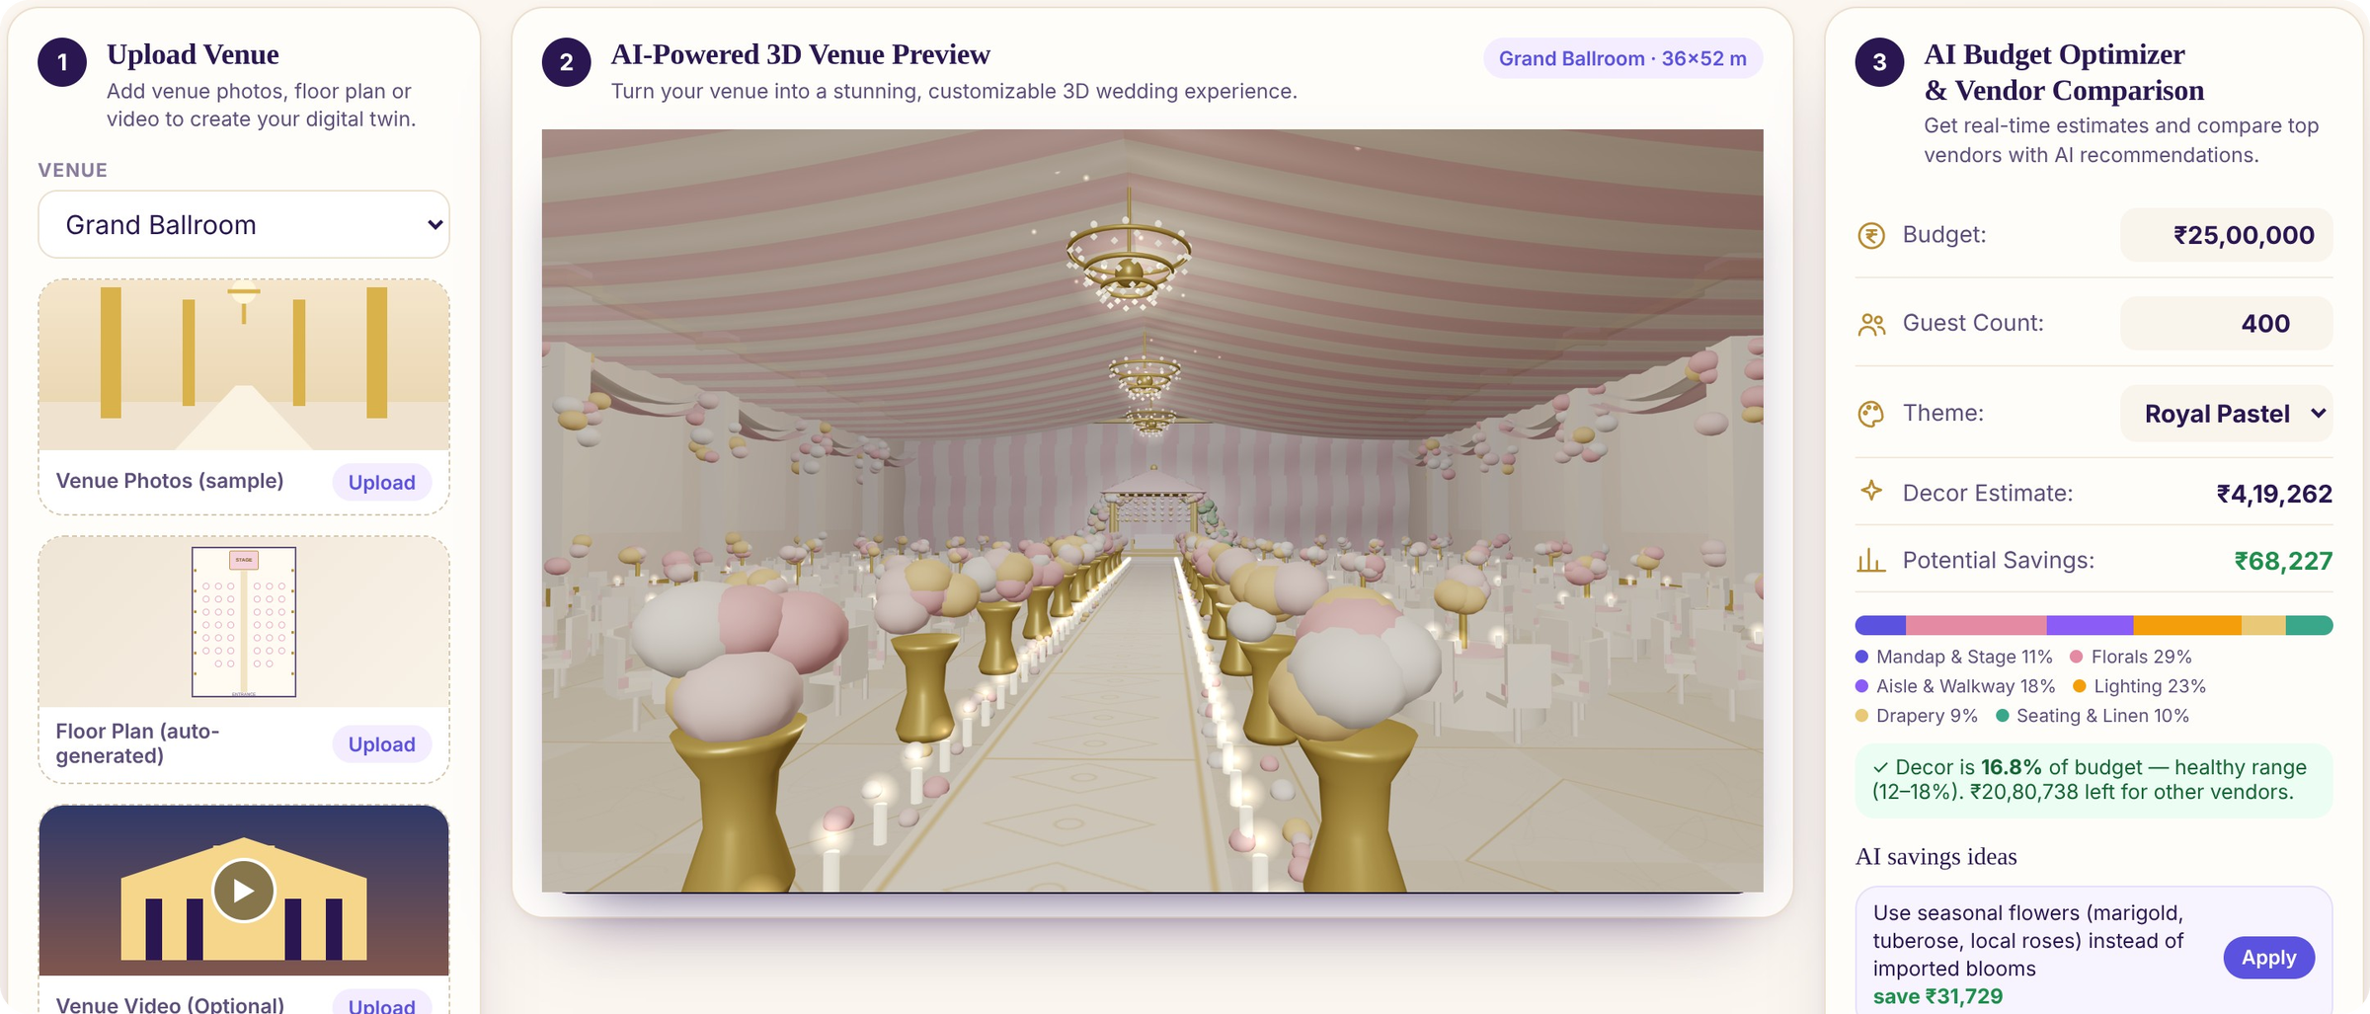
Live product — not a mock-up
Real-time 3D · 4 themes, 3 layouts · capacity check · VR walkthrough · auto-quote · couple + planner modes
Notes:
DEMO (45 sec): open index.html. Switch theme live, drag guests to 700 to trigger the capacity warning, open Quote. Say: "Every number you see updates from what is in the 3D scene."

Slide 6

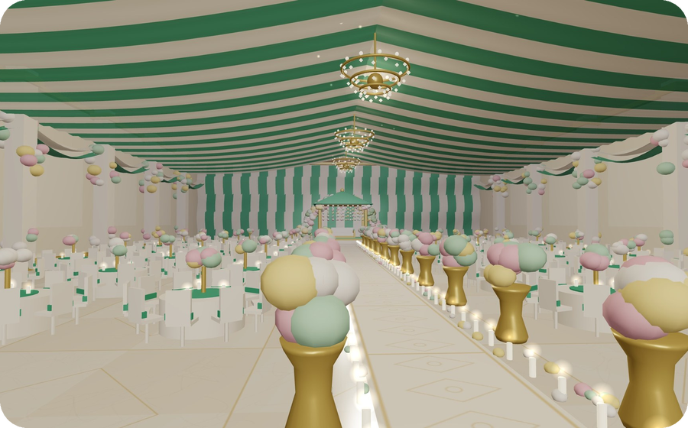
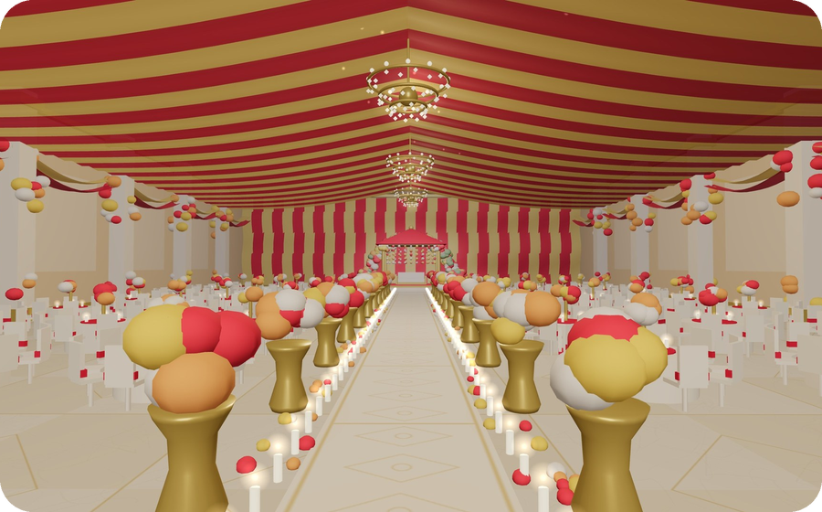
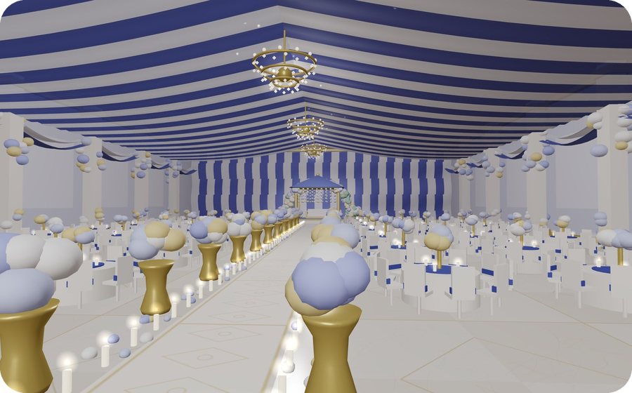
Same venue. Four looks. Zero rework
4
themes
3
Royal Pastel
Emerald Heritage
layouts
<1s
to switch
Crimson Maharaja
Midnight Gala
Notes:
Click through the four themes live. This is the "wow": the couple argues about colours in minutes, not weeks.

Slide 7
A huge, emotional, under-digitised market
~10M
~$130B
10–15%
weddings a year in India
estimated annual wedding spend
of budget goes to décor — our wedge
Beachhead: metro planners & décor-led weddings (₹15L–₹1 Cr budgets). Then vendors, venues and NRI weddings.
Notes:
Market sizes are widely cited industry estimates — verify and cite your own source before pitching. The wedge is décor: visual, high-ticket, high-regret.

Slide 8



Three ways we make money
Planner SaaS
Unlimited client previews, branded quotes, share links.
₹2,999–₹9,999 / month
Vendor lead fees
Vendors pay for design-ready, budget-matched leads.
₹1,500–₹4,000 per qualified quote
Booking commission
Closed-loop booking through the platform.
2–4% on bookings
Notes:
Prices are proposed placeholders — replace with your validated pricing. Lead with SaaS (predictable), vendors (scale), commission (upside).

Slide 9
Why we win
 | Mood boards | Vendor marketplaces | Planner spreadsheets | WedVerse AI
Sees YOUR venue in 3D | – | – | – | ✓
Instant theme & layout changes | – | – | – | ✓
Live cost as you design | – | – | ✓ | ✓
Compare vendors like-for-like | – | ✓ | – | ✓
Quote + material list from design | – | – | – | ✓
Moat: proprietary venue library + planner workflow data + vendor price intelligence.
Notes:
Be ready: "Can we not just hire a designer for renders?" — Yes, for ₹30–50k per render, days later. We do unlimited, instant, and attach the quote.

Slide 10
Go-to-market: planners first
0–6 MONTHS
6–12 MONTHS
12–24 MONTHS
Pilot
Monetise
Scale
Onboard 50 metro wedding planners free. Collect 200 real venues.
Launch SaaS tiers + vendor lead marketplace in 3 cities.
Booking commissions, venue partnerships, NRI & destination weddings.
Notes:
Planners are the distribution: each planner runs 10–40 weddings a year and brings couples + vendors with them.

Slide 11
Projected revenue: ₹0.6 Cr to ₹14.5 Cr in 3 years
75%
target gross margin
<4 mo
CAC payback target
3×
LTV : CAC target
Notes:
All figures are illustrative targets, not actuals. Replace with your model before pitching. Expect: "What are your sales today?" — answer honestly (pre-revenue prototype) and pivot to the pilot plan.

Slide 12
The ask
₹1.5 Cr
for 5% equity
₹30 Cr post-money · 18-month runway
Beyond cash: wedding-industry distribution, vendor introductions and brand credibility.
Notes:
Say the ask clearly, once: "₹1.5 crore for 5 percent." Then stop talking. Valuation and split are placeholders — adjust to your numbers.

Slide 13


Let's make every wedding a masterpiece
WedVerse AI — See your wedding before you spend on it.
WHO'S IN?
Notes:
Close with eye contact. Then Q&A. Prep: CAC, pricing proof, why now (3D in browser + AI), defensibility, founder-market fit.

