Slide 1
Integrity: Plagiarism Detector
Darshan Panse, Samanjate Sood, Shail Shah, Vaibhav Dave

Slide 2
Introduction
System Functionality
Job Quality
Process and Teamwork
Technology Transfer

Slide 3
System Functionality
Did the team accomplish a sufficient amount of functionality?
choose folders; Student info
Select algorithm
View Summary for algorithm
View Similar snippets
Save Report. Email Students
View Global Statistics
Anonymize student details
- Yes, we delivered more than promised!

Slide 4
System Functionality
Did the team achieve what it set out to do?
choose folders; Student info
Select algorithm
View Summary for algorithm
View Similar snippets
Save Report. Email Students
View Global Statistics
Anonymize student details
- Yes, we achieved more!

Slide 5
System Functionality
Is it useful for the client?
choose folders; Student info
Select algorithm
View Summary for algorithm
View Similar snippets
Save Report. Email Students
View Global Statistics
Anonymize student details
- We hope so!

Slide 6
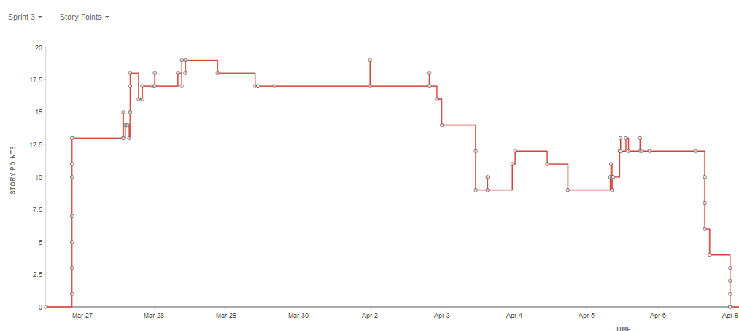
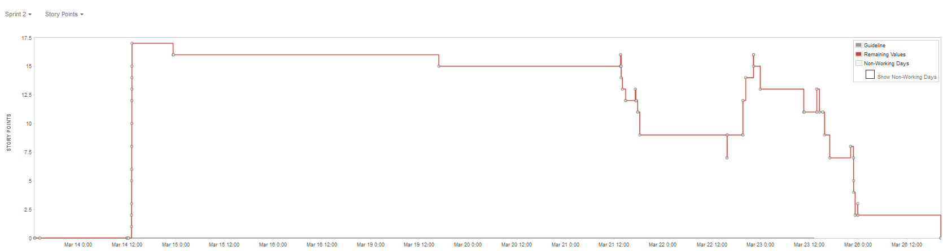
System Functionality
Is there evidence from the backlog/requirements to support these claims?
Yes!

Slide 7
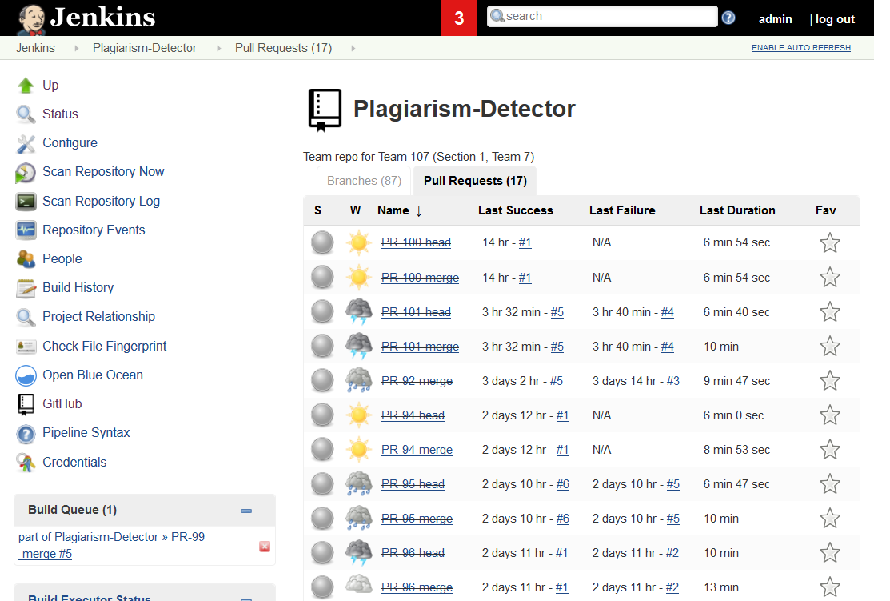
Job Quality
Did the team present evidence that it did a quality job?
Yes, Jenkins and SonarQube helped us maintain quality!

Slide 8
Job Quality
Did the team improve performance with time?
Yes, we added more features and resolved bugs over time.
Listened to feedback given by others and made changes.

Slide 9
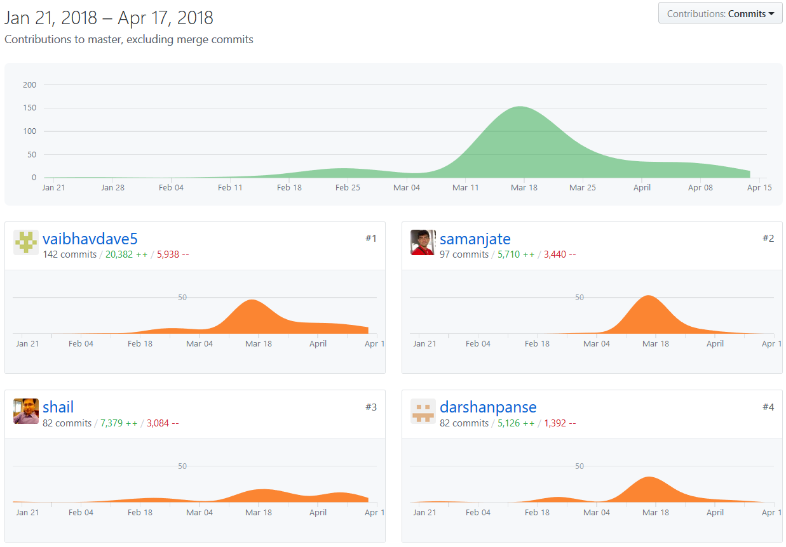
Process and Teamwork
Did the team work as a team?
Yes, we met in-person most of the times and helped each other with design and implementation

Slide 10
Process and Teamwork
Did the team use process well?
Yes, agile methodology was followed
Add to Backlog
Move to Sprint board
Move to ‘In Progress’ swimlane
Add interface
Write Tests
Implement interface
Create PR
Review, Approve and Merge
Move to ‘closed’ swimlane

Slide 11
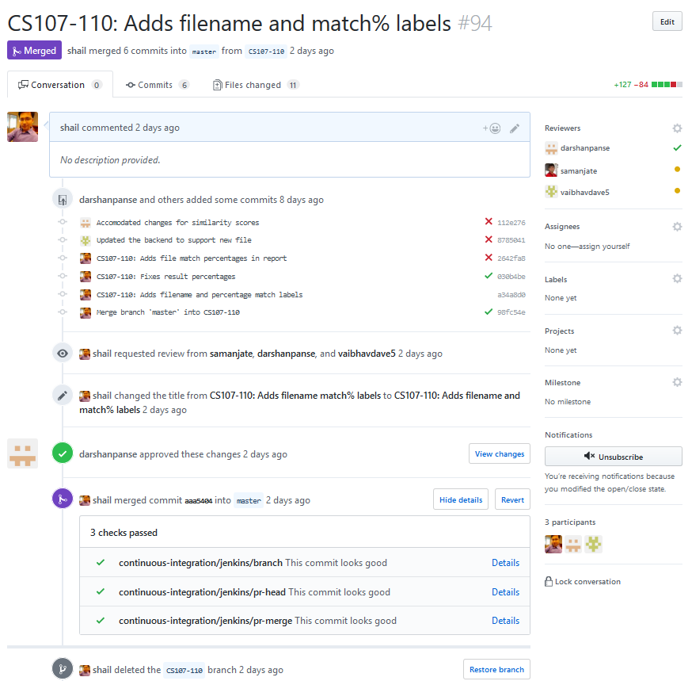
Process and Teamwork
Was the team able to automate the build, test, and promote processes?
Yes, Jenkins was used for Continuous Integration.
Merging was allowed only after build passed

Slide 12
Process and Teamwork
Did the team recognize short-comings? If so, how well did they work around the challenges?
Configuring Jenkins was a big hurdle
Faced a lot of downtimes with Jenkins
Alex helped us with the operations aspect of the project
Moss Integration was problematic
Did not get credentials for Moss for a long time
Finally got it on the 7th try!

Slide 13
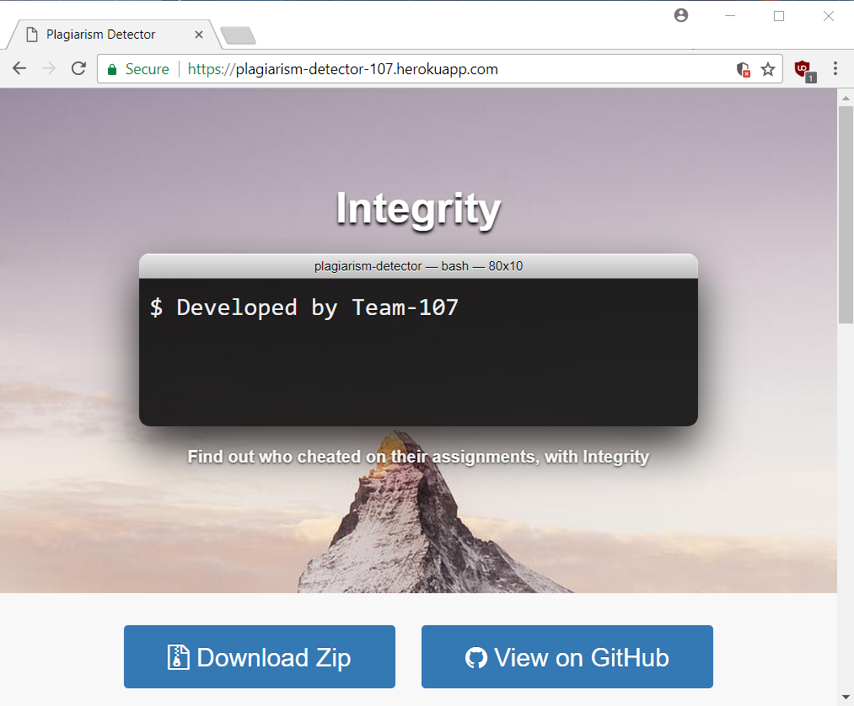
Technology Transfer
Is the system in shape to be handed over to the client?
Yes, download the app today! https://plagiarism-detector-107.herokuapp.com

Slide 14
Technology Transfer
Next Steps
Continue refactoring the code
Add support for other programming languages
Provide support to the instructors and TAs

Slide 15
Thank you!

