Slide 1
Customer and Vendor Master Data in SAP S/4HANA
Excel download and upload - the requirement and the solution, from a reference implementation
October 2026
Notes:
Reference implementation for a pharmaceutical client. Client name and data withheld; all sample values in the illustrations are invented.

Slide 2
The short version
2
24
79
9
programs - customer and vendor, each downloading and uploading
customer Excel layouts, picked automatically
country / region and account group combinations covered
vendor scenarios, from creation to block / unblock
Each program downloads the client’s own Excel template - empty, or filled with existing data - and uploads the filled template back. Every posting goes through SAP’s standard Business Partner interface, with a test run before anything is saved.

Slide 3
The requirement
PART 1

Slide 4


Why the existing loads had to be replaced
Before - SAP ECC
Now - SAP S/4HANA
Customer and vendor master loaded with LSMW recordings of XD01, XK01, XK02 and XK05
One recording per Excel layout, replaying the screens field by field
A new layout meant a new recording
Customers and vendors are Business Partners, maintained in transaction BP
The old customer and vendor transactions are redirected or removed (SAP Note 2265093)
Screen recordings against them can no longer run
So: the Excel layouts the business knows could stay - only the engine underneath had to change.

Slide 5






What the business asked for - customers
A template per country and account group
Download
Simple selection
Every country / region and account group has its own Excel layout. The user should never have to choose it.
Get the right template - empty, or filled with existing customers to start from.
Country / region from a dropdown; the account group list limited to that region.
Upload
Test before posting
Clear messages
Create customers, extend them to a new sales area, and block or unblock them.
A test run that makes every check and saves nothing.
One result line per Excel row, naming the field at fault.

Slide 6
What the business asked for - vendors
The existing vendor workbook had to keep working as it is.
One tab per scenario, the same columns as before - no re-keying and no new formats. Each scenario had to be loadable on its own, in test mode first.
1
2
3
Vendor / BP creation - all company codes
Withholding tax / TDS
TAN exemption details
4
5
6
Bank key creation
Vendor bank details
Vendor extension
7
8
9
CIN details
Partner functions
Block / unblock
The nine tabs of the vendor workbook

Slide 7
What we built
PART 2

Slide 8



One program per master, in both directions
Excel workbook
Download
Program
Download
SAP Business Partner
The client’s own template, one tab per layout or scenario
One column map per template - used to write the download and to read the upload
Customer or vendor, through SAP’s standard interface
Upload
Upload
The same column map writes the download and reads the upload, so a downloaded file always uploads back.
Columns are found by their headings: a moved or an extra column still loads into the right field.
Every posting uses SAP’s standard Business Partner interface - no screen recordings, no direct updates of SAP tables.

Slide 9
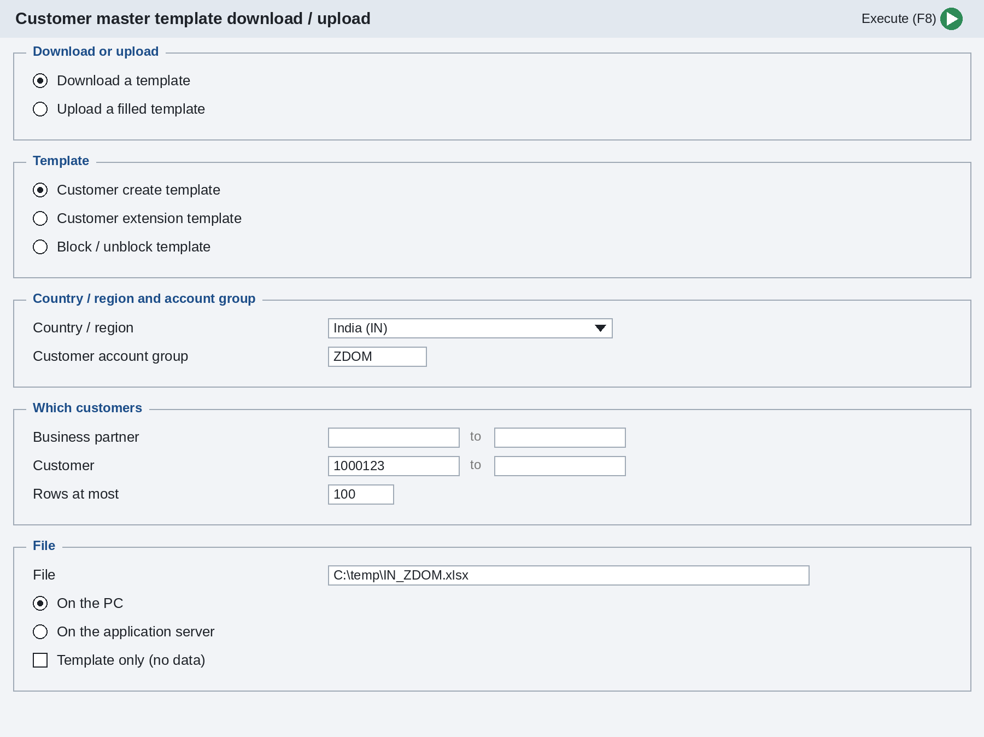
Customer program - selection screen
1
Download or upload
One program for both directions; fields that do not apply are greyed out.
2
Template
Create, extension or block / unblock.
3
Country / region and account group
Picked from lists - the program finds the right layout from the pair.
4
Which customers
Existing customers to download, or upload options: test run, stop at the first error.
5
File
On the PC or the application server; a name is proposed for a download.
Illustration of the selection screen

Slide 10
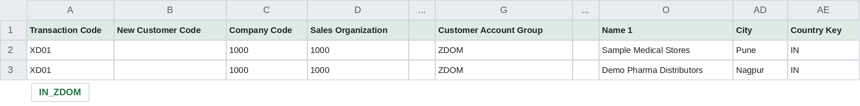



Customer Excel format
Illustration - a create template, selected columns; sample values are invented
The client’s own headings
Named after the selection
Create or change
Each of the 24 layouts keeps its columns and wording - up to 136 columns.
The tab is named after the region and account group, for example IN_ZDOM.
An empty customer code creates a new customer; a filled one changes that customer.

Slide 11
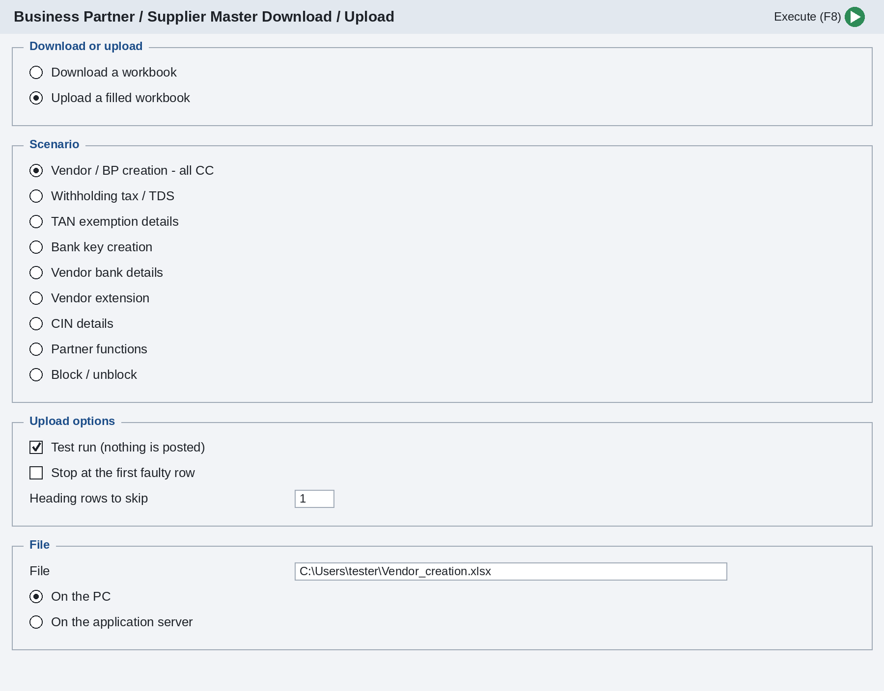
Vendor program - selection screen
1
Download or upload
The same program writes a tab from existing vendors or posts a filled one.
2
Scenario
Nine scenarios, one per tab of the vendor workbook.
3
Upload options
Test run ticked by default; optionally stop at the first faulty row.
4
File
F4 picks the workbook to upload; a download proposes a name per scenario.
Illustration of the selection screen

Slide 12
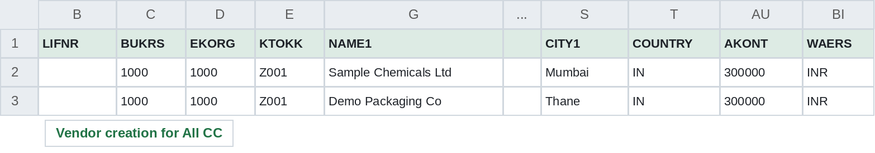
Vendor Excel format and loading order
Technical field names as headings, as in the existing workbook. An empty vendor number creates a new vendor from the account group’s number range.
Illustration - vendor creation tab, selected columns; sample values are invented
Scenarios build on each other, so they are loaded in this order
1
2
3
4
5
Bank keys
Vendor creation
Vendor extension
TDS, TAN, bank details, CIN, partner functions
Block / unblock
A row that needs data not there yet - tax data for a company code the vendor is not in - is refused with a message, not posted halfway.

Slide 13
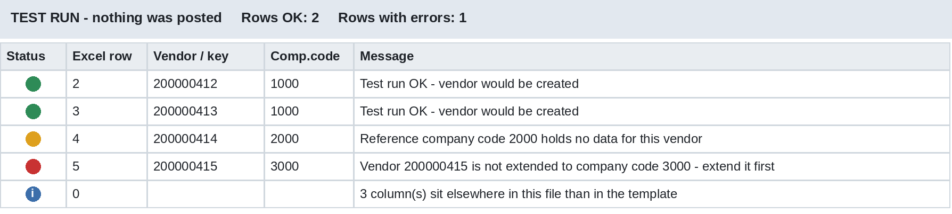

Every Excel row gets a clear result
Done posted - or, in a test run, would be
Warning went through; read the message
Error nothing posted for this row
Information about the run, not a row
Illustration of the result list after a test run
Test run first, then post. The test run makes every check SAP would make and saves nothing. The same list names the Excel row, the record and the field at fault, so the file can be corrected and run again. Only then is the test run switched off to post.

Slide 14





Built to SAP S/4HANA standards
Standard interfaces
No direct table updates
Test mode built in
Business Partner maintained through SAP’s customer / vendor integration API, with every commit checked.
SAP data changes only through standard interfaces; client-owned custom tables only where agreed.
A full check of every row before anything is saved.
Read by heading
Clean core aware
Automated checks
Columns found by their headings, so a changed layout cannot load a value into the wrong field.
Classic ABAP extension (tier 2 in SAP’s clean core model), ATC readiness check documented.
Every issue found in testing became an automated check, so it cannot come back.

Slide 15
How we delivered it
1
2
3
4
5
Analyse
Map
Build
Test
Hand over
The client’s templates: layouts, country and account group combinations, every column.
Every column to its Business Partner field - generated from the templates, not typed by hand.
Download and upload in one program per master, on one column map.
With the business, against a test script with expected results and sign-off.
User and test guide; programs and texts ready to transport.
1,986
template columns mapped from the client’s customer workbook
33
user tests in the sign-off script, with expected results
0
screen recordings - everything through standard interfaces

Slide 16
What we need from you to start
NEXT STEPS
Your Excel templates - every country, account group and scenario in use
Which objects are in scope: customers, vendors, or both
SAP release, and access to a development and a test system
Account groups, BP groupings and number ranges
Sample data for testing
A business contact to confirm the field mapping

