Slide 1

Major Project Presentation
On
NETWORK INTRUSION DETECTION SYSTEM
Vaibhav Dingreja ( 2011775)
Major Project
CSE-CC VIII Semester
Department of Computer Science and Engineering
Graphic Era Deemed to be University,
Dehradun, Uttarakhand.

Slide 2
Table of Content
Objectives
Uses and Needs of NIDS
Wireshark
Flowtbag
Dataset
Machine Learning Algorithms
Artificial Neural Network Algorithm
Reinforcement Learning
Deep Q Learning
Results and Testing
Conclusion

Slide 3
Problem Statement
To create a NIDS
To train them on a dataset which have normal traffic mixed with attack
To extract features
To use different Machine-Learning Algorithms
To use Artificial Neural Network
To use Model-Free Learning

Slide 4
Objectives
The accurate and timely identification of an intruder.
Protecting your computer system from hackers.
To detect both signature based and anomaly based attacks
Comparing different machine learning models
Which Algorithm is more suitable in different cases
To predict the attack and to reduce the number of false alarms.

Slide 5
Types of NIDS
Signature-Based Method: Signature based IDS detects the attack on the basis of the specific patterns such as number of bytes or number of 1’s or number of 0’s in the network traffic.
Anomaly-based Method: Anomaly based IDS was introduced to detect the unknown malware attacks as new malware are developed rapidly.

Slide 6
Uses of NIDS
As we all know that digitization has transformed our world. How we live, work, play and learn have all changed. Every organization that wants to deliver the services that customers and employees demand must protect its network.
Banking Sector
Aviation Sector
Military and Governement Sites
Organization and IT Industry Sector

Slide 7
Proposed Model of NIDS
The Intrusion Detection System detects the point of attack in the system using various machine learning model and detects the IP address that is sending attack. It is trained on the dataset of previous attacks using Network Capture tool and feature extraction tool to extract more features and train our models in best possible way.
It is a comparison based model where it gives the accuracy and precision of detecting the attacks.
Our Model also detects if the traffic coming is the normal traffic or the attack

Slide 8
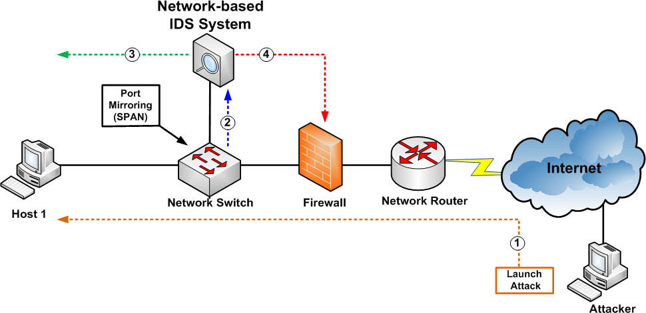

Slide 9
Wireshark
Wireshark is an open-source packet analyser, which is used for education, analysis, software development, communication protocol development, and network troubleshooting. It is used to track the packets so that each one is filtered to meet our specific needs. It is commonly called as a sniffer, network protocol analyser, and network analyser. It is also used by network security engineers to examine security problems.

Slide 10
T-Shark
TShark, a well-known and powerful command-line tool and is used as a network analyser. It is developed by Wireshark. It’s working structure is quite similar to Tcp dump, but it has some powerful decoders and filters. TShark is capable of capturing the data packets information of different network layers and display them in different formats.

Slide 11
Flowtbag Tool
The purpose of this tool is to calculate flow statistics from a given capture file. Flowtbag was designed with offline processing as the primary focus.
Some of its features are:
srcip - (string) The source ip address
srcport - The source port number
dstip - (string) The destination ip address
dstport - The destination port number

Slide 12
Anaconda
Anaconda is a free and open-source distribution of the Python and R programming languages for scientific computing, that aims to simplify package management and deployment. The distribution includes data-science packages suitable for Windows, Linux, and macOS. It is developed and maintained by Anaconda, Inc.,

Slide 13
Spyder
Spyder is a powerful scientific environment written in python, for python and designed by and for scientists, engineers and data analysis. It offers a unique combination of the advanced editing, analysis, debugging and profiling of a comprehensive development tool with data exploration and interactive execution

Slide 14
Machine Learning Libraries
• Gym: Reinforcement algorithm libraries. More speciﬁcally this toolkit used for developing and comparing Deep Q network algorithm. The main task is to supports the teaching agents. To update the Q value we have used Gym.
• Tensorﬂow: Numerical computation using data ﬂow graphs and convolution neural network building. We used tensorﬂow to build 4 hidden layer to compute.
• Scikit-learn: Machine learning module, an eﬀective tool for data mining and data analysis. We have used for analysing our data.
• Python: as the scripting language for automating experiments and extracting data.
• Keras: Keras API integrates very easy with the TensorFlow workﬂows. It’s very useful in Reinforcement Learning algorithm.

Slide 15
Machine Learning Models
KNN
K Nearest Neighbour is a simple algorithm that stores all the available cases and classifies the new data or case based on a similarity measure. It is mostly used to classifies a data point based on how its neighbours are classified.
Logestic Regression
Logistic regression is a statistical model that in its basic form uses a logistic function to model a binary dependent variable, although many more complex extensions exist. In regression analysis, logistic regression (or logit regression) is estimating the parameters of a logistic model (a form of binary regression ).

Slide 16
Machine Learning Models
Decision Tree
A decision tree is a decision support tool that uses a tree-like model of decisions and their possible consequences, including chance event outcomes, resource costs, and utility. It is one way to display an algorithm that only contains conditional control statements.
GaussianNB
Mathematically, Gaussian mixture models are an example of a parametric probability density function, which can be represented as a weighted sum of all densities of Gaussian components

Slide 17
Machine Learning Models
Random Forest
Random forests or random decision forests are an ensemble learning method for classification, regression and other tasks that operate by constructing a multitude of decision trees at training time and outputting the class that is the mode of the classes (classification) or mean prediction (regression) of the individual trees.

Slide 18
Artificial Neural Network
CNN
Convolutional neural network. In deep learning, a convolutional neural network ( CNN, or ConvNet) is a class of deep, feed-forward artificial neural networks, most commonly applied to analyzing visual imagery. CNNs use a variation of multilayer perceptron's designed to require minimal preprocessing.

Slide 19
Artificial Neural Network
RNN
A recurrent neural network (RNN) is a class of artificial neural networks where connections between nodes form a directed graph along a temporal sequence. This allows it to exhibit temporal dynamic behavior. Derived from feedforward neural networks, RNNs can use their internal state (memory) to process variable length sequences of inputs. This makes them applicable to tasks such as unsegmented, connected handwriting recognition or speech recognition.

Slide 20
Artificial Neural Network
LSTM
The Long Short-Term Memory (LSTM) cell can process data sequentially and keep its hidden state through time. Long short-term memory (LSTM) is an artificial recurrent neural network (RNN) architecture used in the field of deep learning. Unlike standard feedforward neural networks, LSTM has feedback connections.

Slide 21
Artificial Neural Network
GRU
GRU (Gated Recurrent Unit) aims to solve the vanishing gradient problem which comes with a standard recurrent neural network. GRU can also be considered as a variation on the LSTM because both are designed similarly and, in some cases, produce equally excellent results. To solve the vanishing gradient problem of a standard RNN, GRU uses, so-called, update gate and reset gate. Basically, these are two vectors which decide what information should be passed to the output. The special thing about them is that they can be trained to keep information from long ago, without washing it through time or remove information which is irrelevant to the prediction.

Slide 22
Artificial Neural Network
DNN
Deep learning is a class of machine learning algorithms that use multiple layers to progressively extract higher level features from raw input. Deep learning is a modern variation which is concerned with an unbounded number of layers of bounded size, which permits practical application and optimized implementation, while retaining theoretical universality under mild conditions. In deep learning the layers are also permitted to be heterogeneous and to deviate widely from biologically informed connectionist models, for the sake of efficiency, trainability and understandability

Slide 23
Reinforcement Learning
Reinforcement learning, in the context of artificial intelligence, is a type of dynamic programming that trains algorithms using a system of reward and punishment.
A reinforcement learning algorithm, or agent, learns by interacting with its environment. The agent receives rewards by performing correctly and penalties for performing incorrectly. The agent learns without intervention from a human by maximizing its reward and minimizing its penalty.

Slide 24
Reinforcement Learning
Deep Q Learning
Q-learning is a model-free reinforcement learning algorithm to learn a policy telling an agent what action to take under what circumstances. It does not require a model (hence the connotation "model-free") of the environment, and it can handle problems with stochastic transitions and rewards, without requiring adaptations. The goal of the agent is to maximize its total reward. It does this by adding the maximum reward attainable from future states to the reward for achieving its current state

Slide 25
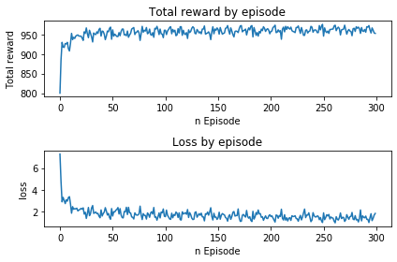
Reinforcement Learning

Slide 26
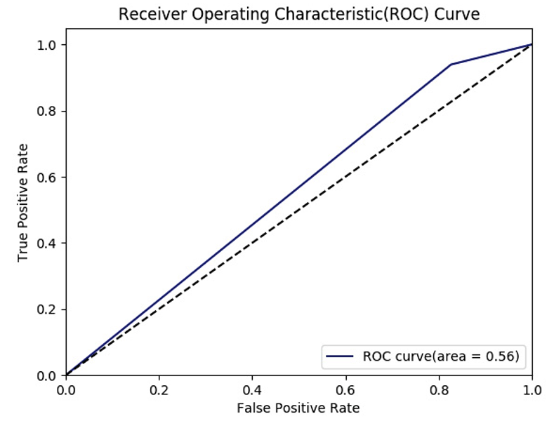
Results

Slide 27
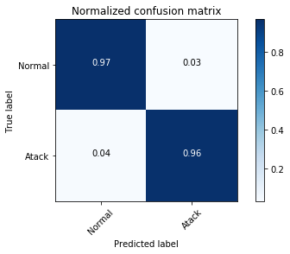
Results

Slide 28
Results

Slide 29
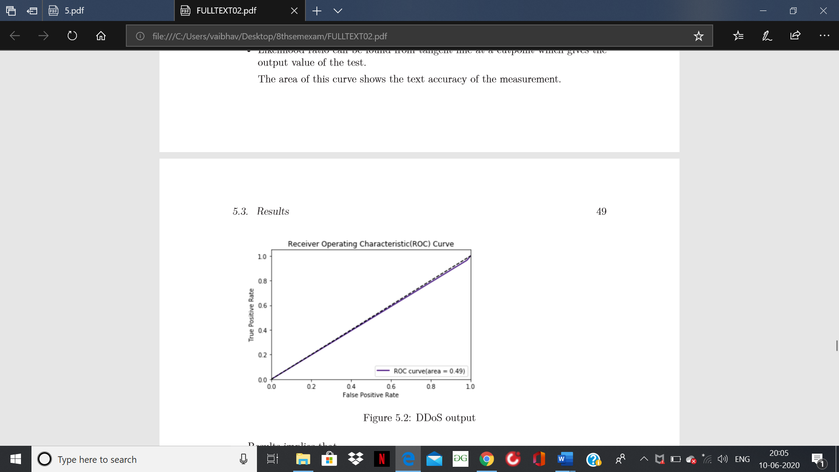
Conclusion

Slide 30
Conclusion
Achieved an accuracy of 97 percent
Compared Different machine learning models
Tested them on 3 Standard datasets.
Made a new ANN model
Best Approach is Deep Q Learning

Slide 31
THANK YOU

