Slide 1




GOOGLE PLAY STORE APPS SENTIMENT ANALYSIS
JUILEE BHOSALE | VAIBHAV DIYORA | ROHIT KAUL | KARMA PATEL

Slide 2
WHY SENTIMENT ANALYSIS ?
Definition: Sentiment analysis is the detection of attitudes
Movie: is this review positive or negative?
Products: what do people think about the new iPhone?
Public sentiment: how is consumer confidence? Is despair increasing?
Politics: what do people think about this candidate or issue?
Prediction: predict election outcomes or market trends from sentiment
Notes:
First let us understand what is Sentiment Analysis and how it can be leveraged to deliver value to businesses.
Sentiment analysis in simple words is the process of computationally identifying and categorizing opinions expressed in a piece of text.
Being able to quickly see the sentiment behind user reviews and consumer feedback gives you better insight into consumer perception about your product or company. Not only can you see what people think of your own products or services, you can also see what are the key factors they like about your product and issues they want improved. The ability to quickly understand consumer attitudes will help organisations devise better strategic tactics to react and increase chances of success

Slide 3
PROBLEM STATEMENT
Analyze user reviews to determine favorable features and key issues of apps in a particular category
Test the effect of various parameters on the popularity of an app
We plan to sell the model to future app developers to enable them to understand what kind of apps they should consider developing in the future
Notes:
Our Problem statement is two fold
First we are trying to run sentiment analysis on user reviews for all apps in a particular category to understand preferred features or factors that make an app likable and key issues faced by users . For eg Users for Music apps really prefer customized playlists and do not like popup ads
Second we are trying to understand how various features of your app affect the popularity of the app For eg, whether your app may be likely to be more popular if it has no in app ads vs if your app has in app ads.
We chose this problem because sentiment analysis can not only help predict reaction to your app based on app features but also help you understand what are the crucial factors that makes an app favorable and what are the key areas of improvement
Let us understand how we approached the problem and developed a robust solution

Slide 4
COLLECTING AND CLEANING THE DATA
654,410 APP URLs
#search_results_scraping
31,040 APP Details - 2,547,151 Reviews
#selenium
24,115 APPs
#remove_NAs
5,700 APPs - 467244 Reviews
#random_sample_selection
Notes:
The first step was collecting and preprocessing of the data:
We scraped 2.5 million user reviews for 31 thousand apps from Google Play using Selenium.
Mimic scroll action using selenium. Since Google Play has dynamic scrolling.
After eliminating apps with inconsistent data and incomplete data, we were left with close to 6000 apps and 467K reviews across X categories

Slide 5
SENTIMENT ANALYSIS - STEP 1
Text cleaning and processing:
Strip whitespace and convert to lowercase
Remove stop words, punctuations
Remove regional language text
Transform emojis, emoticons to equivalent words
Remove stray and meaningless words
Notes:
Next we perform sentiment analysis to extract useful information from user reviews:
First we perform text cleaning where we transform unprocessed text into clean text by removing whitespace, punctuations and stop words. We also removed words having characters other than A-Z or 0-9 to remove regional language texts from the data. Text cleaning functions were used to transform emojis and emoticons to appropriate word equivalents
Ignore:
The Syuzhet package attempts to reveal the latent structure of narrative by means of sentiment analysis. Instead of detecting shifts in the topic or subject matter of the narrative (as Ben Schmidt has done), the Syuzhet package reveals the emotional shifts that serve as proxies for the narrative movement between conflict and conflict resolution. This was an idea inspired by the late Kurt Vonnegut in an essay titled "Here's a Lesson in Creative Writing" in his collection A Man Without A Country ( Random House, 2007). A lecture Vonnegut gave on this subject is available via youTube

Slide 6
SENTIMENT ANALYSIS - STEP 2
Sentiment Score:
The Syuzhet R package is used to score user reviews based on 10 sentiments – anger, disgust, anticipation, fear, joy, sadness, surprise, trust, negative, positive
The sentiment score reveals the emotional shifts that serve as proxies for what users like and do not like
Notes:
Next we use the ‘nrc’ method in the Syuzhet package in R is used to score reviews based on 10 sentiments : anger, disgust, anticipation, fear, joy, sadness, surprise, trust, negative, positive
The get_nrc_sentiment implements a method propsed by standford alum Saif Mohammad’s where NRC Emotion lexicon is a list of words and their associations with eight emotions (anger, fear, anticipation, trust, surprise, sadness, joy, and disgust) and two sentiments (negative and positive)” The get_nrc_sentiment function returns a data frame in which each row represents a sentence from the original file.

Slide 7
SENTIMENT ANALYSIS : STEP 3
Categorization of reviews: Based on these sentiment score reviews are classified into good and bad reviews to extract positive features and negatives issues
“Good” and “Bad” in this context is a combination of the 10 emotions highlighted earlier:
Good - anger, disgust, fear, sadness, negative < 0 , joy, surprise, trust > 0
Bad - anger, disgust, fear, sadness, negative, joy < 0, negative > 0
Notes:
Next we categorized all reviews into good and bad based on the sentiment score. This was done to extract positive or favorable features from positive reviews and issues or problems from negative reviews for a particular category.
We defined good or positive reviews as the ones having less negative sentiment score and a higher positive sentiment score and bad reviews as ones having higher negative score and lower positive score

Slide 8
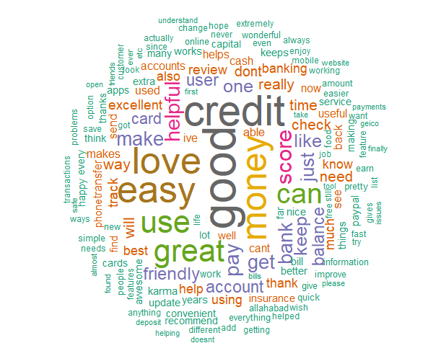
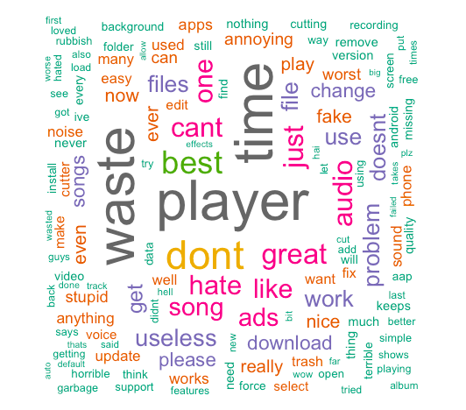
WORD CLOUDS TO UNDERSTAND MOST IMPORTANT POSITIVE AND NEGATIVE TERMS
“Good” words
“Bad” words
Notes:
Then we generated word cloud for all positive and negative reviews for different categories to understand most commonly occuring terms in positive reviews and negative reviews.
For eg, The word cloud for postitve reviews for Finance apps shows easy and helpful as more frequent themes indicating that ease of use is something that Finance users prefer. On the other hand bad reviews wordcloud for Music apps shows ads, player, time as the top theme indicating users do not like ads or time taken for song downloads

Slide 9
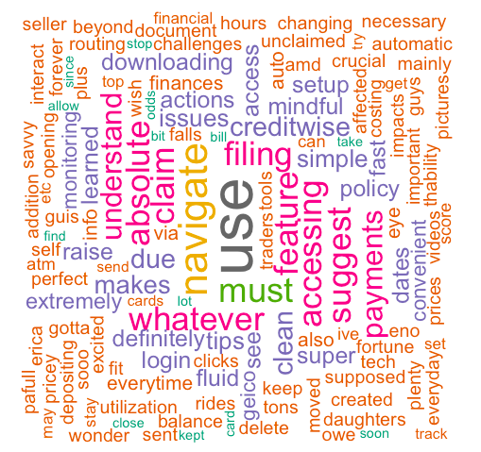
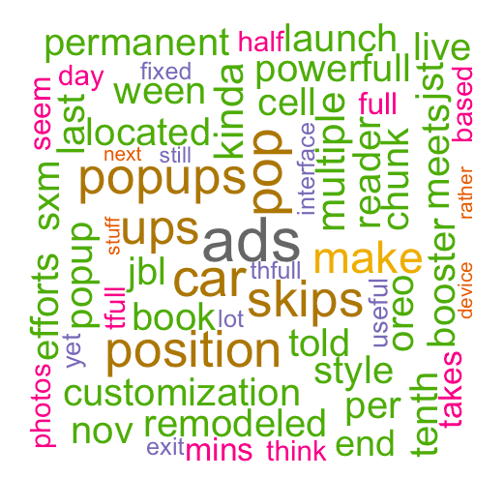
WORD ASSOCIATIONS
Word associations shows which are the most commonly occurring terms with specific words
We used association methods to find words most associated with various themes occuring in reviews to further understand what factors are most responsible for these themes
For example
“Easy” Associations - Finance
“Annoying” Associations - Music
Notes:
Word associations shows most commonly occuring words with specific words.
For eg we see easy is a common theme in positive reviews in Finance apps. On looking at word associations, we see easy appears most frequently with navigatie and understand and access, indicating ease of navigation and understanding are some factors which users prefer
Similarly, annoying app associations in Music category show ads and position and customisation as common issues

Slide 10
UNDERSTANDING POPULARITY OF APPS
We also looked at how sentiments and features of an app can be leveraged to guarantee higher popularity.
Some of the hypothesis we tested were:
Can you estimate response to your app based on app features?
Does higher rating mean higher downloads?
Which sentiments translate to more popularity?
Is popularity impacted by category?
Notes:
So the review comments do affect the number of downloads, but by how much?
So to understand that, we decided to do some statistical analysis on not just the review comment but other features of apps as well.
So we checked for the following hypotheses in our statistical analysis:
Can you estimate response to your app based on app features
Does higher rating mean higher downloads
Which sentiments translate to popularity
Is popularity impacted by category

Slide 11
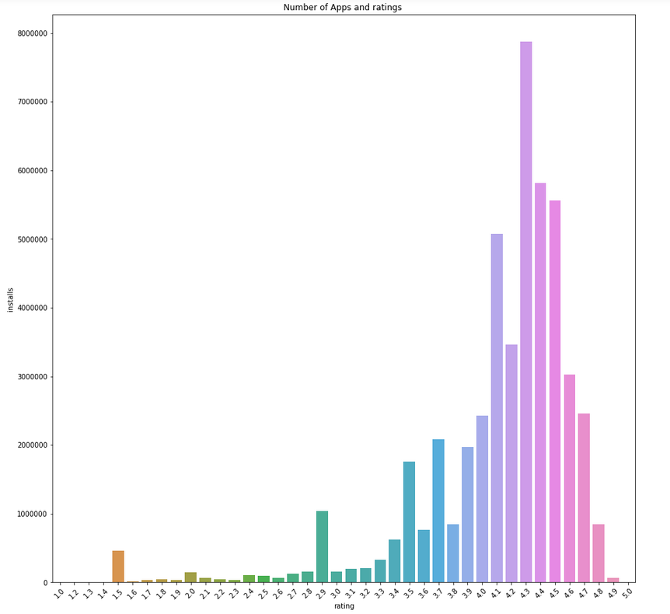
Apps with higher ratings are more likely to be downloaded
Apps with higher average rating have higher popularity and are more likely to be downloaded
This indicates it is important for an app to have good ratings in its initial phases to become more popular
Notes:
we build a multi class logistic model to understand how different features and sentiments influence popularity of an app. We divided apps into 3 popularity categories based on number of installs Based on the model we see avg rating of an app is a significant influencer of popularity. Between the average number of downloads vs overall app rating, the trend suggests that the average number of downloads per app increases consistently till the rating of 4.3/5 indicating that apps with higher average rating have higher popularity and are more likely to be downloaded. That is visible from EDA of the data as well as the model.

Slide 12
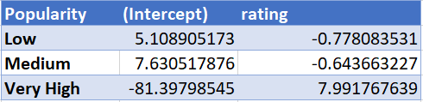
Very few apps are likely to be popular by default
Ratings: Negative Coefficient for “medium” and “low” class and positive for “very high” class (Popularity) indicate apps having higher rating are likely to get popular
Intercept: Intercept is negative. There is very less percent of apps which are likely to be popular by default and popularity depends on various other factors, like category and sentiments
Notes:
In the model our predictor is number of installs or you can say popularity. we can infer from the intercept that there is very less percent of apps which are likely to be popular by default and popularity depends on various other factors, like category and various sentiments.

Slide 13
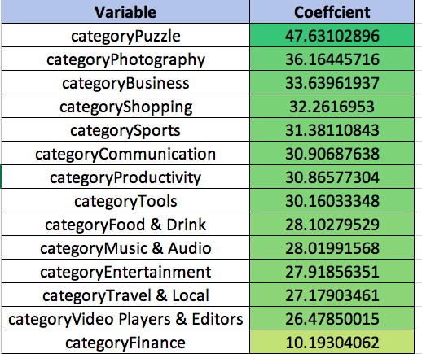
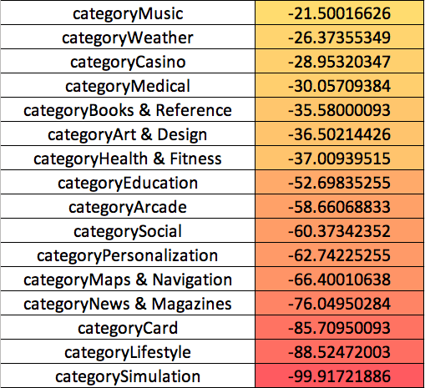
Chances of popularity depend on category of apps
Puzzles, photography, Communication, Shopping, Entertainment apps have higher chances of being popular
Whereas simulation, social, weather, medical apps are less likely to have high downloads
Notes:
These are other various factors that affect the probability of getting popular. The ones that are in green have positve logistic coefficients for higher popularity segment and negative for lower popularity category, indicating these categories have a higher probability of being downloaded. The apps in red whereas are less likely to have higher downloads

Slide 14
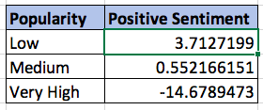
App sentiments are important in initial phases
Coefficient of positive sentiment score for higher popularity is negative, while for lower popularity it is negative
This indicates for already popular apps, positive sentiment does not have an impact on likelihood of popularity, however for less popular apps, it is necessary to have positive reviews
Notes:
Coefficient of positive sentiment score for higher popularity is negative, while for lower popularity it is negative
This indicates for already popular apps, positive sentiment does not have an impact on likelihood of popularity, however for less popular apps, it is necessary to have positive reviews

Slide 15
Conclusion
Notes:
In conclusion, we see how sentiment analysis can be used to find favorable features and problem areas for apps of different categories
We also realised the app reviews and positive sentiments play an important role in inital phases of app deployment but after achieving success reviews do not have an impact
App success also depends on category of app
We can use these findings and insights to build succesful products

Slide 16
Thank You
Questions?

Slide 17
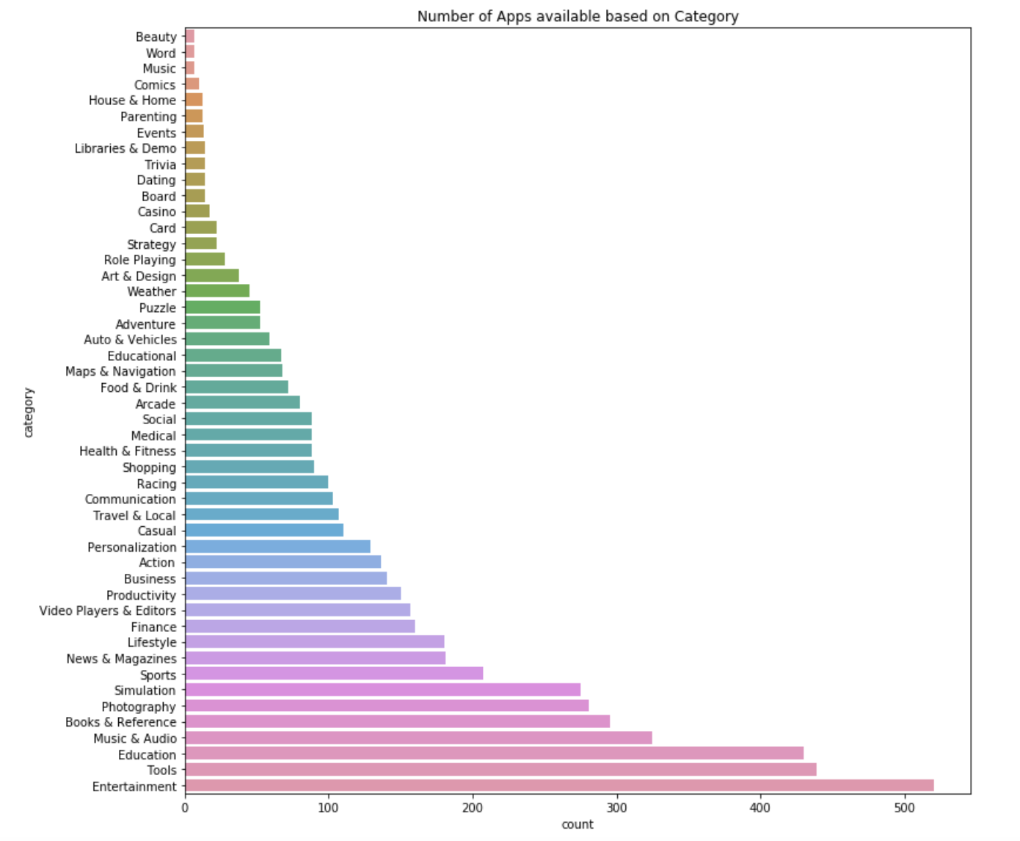
EXPLORATORY DATA ANALYSIS
NUMBER OF INSTALLS BASIS CATEGORY

Slide 18
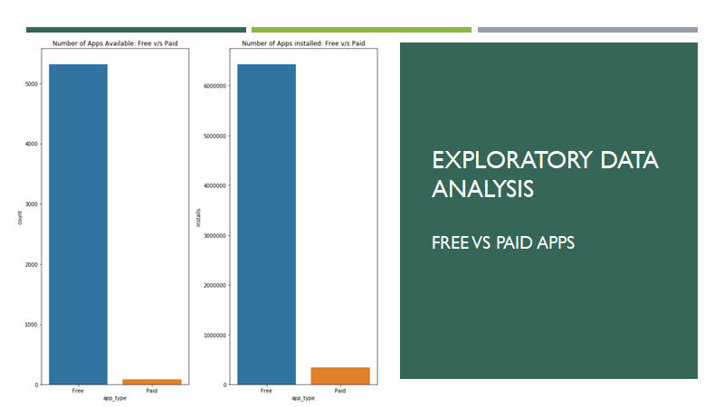
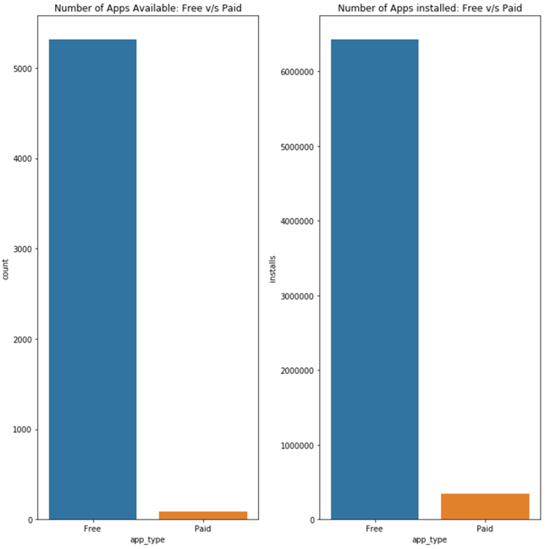

Slide 19
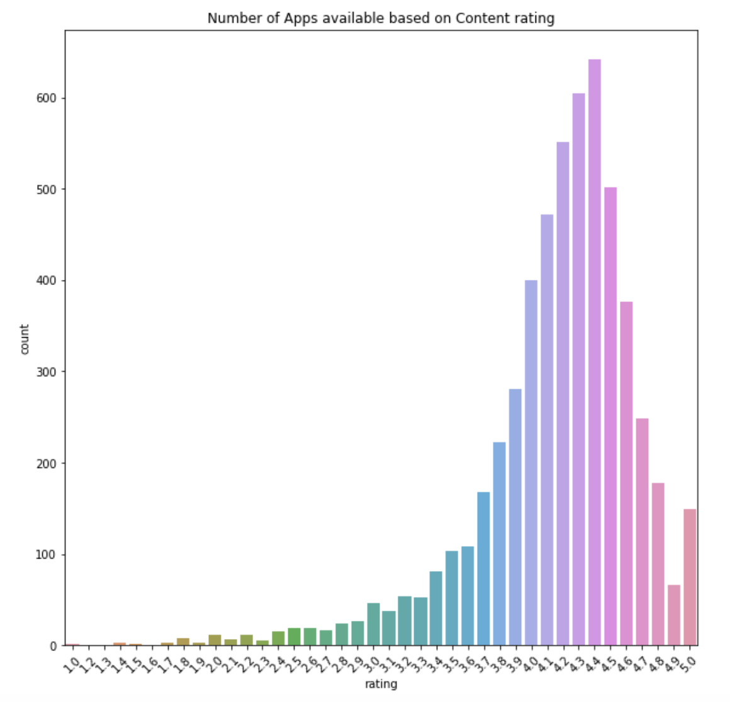
Apps with higher ratings are more likely to be downloaded
Apps with higher average rating have higher popularity and are more likely to be downloaded
This indicates it is important for an app to have good ratings in its initial phases to become more popular
Notes:
To understand the effect of overall app ratings on the number of downloads

Slide 20
BUSINESS INSIGHTS
download (time, size)
update (size)
ads (popup, annoying)
awesome (handle, mayhem, graphic)
groups (friends)
GAMES
Notes:
So how can these word clouds help our customers? Let’s take the example of Games. From the word clouds, we found that the words “download”, “update” and “ads” are some common themes across all negative reviews for Games. The word associations indicates that download size, download time, update size, annoying ads, popup ads are some common issues which will led to negative reviews.
On the other hand, words like “awesome” and “groups” are common themes used to express positive sentiments. On looking into word associations, we found that awesome handling, awesome mayhem, awesome graphics and friend groups are some of the most attractive features in Games and can be considered as main selling points needed to get into the top charts.
We can also look into the word associations of specific words and specific emotion to figure out what the users have to say on them. For example, in Finance apps, on checking the word association for “easy” suggested that easy navigation and easy accessibility are the things which users found easy in the highly downloaded apps.

