Slide 1
☀️ SURYASARTHI 108
Smart Daily Surya Namaskara App, Gita Shloka Engine & 9:16 HD Reel Generator
Comprehensive Presentation of Product Architecture, Core Functions & Mobile Capabilities
🧘 Audio-Guided Workout
108 Round Target with Pace & Grace Control
📜 Gita Shloka Engine
Sanskrit Shlokas & Voice Audio Pre-Workout
🎬 9:16 HD Reel Generator
Auto-Video Creation for WhatsApp & Socials

Slide 2
OVERVIEW & TECHNOLOGY STACK
Executive Summary & System Architecture
🎯 Product Mission & Value Delivered
• Holistic Daily Fitness: Guides users step-by-step to complete 108 Surya Namaskaras.
• Spiritual Integration: Opens every workout with authentic Bhagavad Gita Shlokas & spoken meaning.
• Social Engagement Engine: Renders 15-second 9:16 HD Reels (Scene 1: Gita, Scene 2: Stats Grid) for WhatsApp Status & Instagram.
• Zero-Latency PWA: Functions 100% offline via Service Worker caching with zero network dependency.
• Comprehensive Wellness: Includes Classical 8-Phase Pranayama, Ayurvedic Diet & Protein Trackers.
📱 Core PWA & Offline Engine
Built with HTML5, Vanilla CSS3 & JS. Service Worker (sw.js v71) cache-busting ensures instant offline loading.
🔊 Speech Synthesis & Audio Engine
Native SpeechSynthesis API for Hindi & English voice counting, Sanskrit mantra audio & gesture unlock.
🎬 HTML5 Canvas Video Generator
Renders 450 frames @ 30 FPS 9:16 HD Video via MediaRecorder API & Canvas toBlob/DataURL fallbacks.

Slide 3
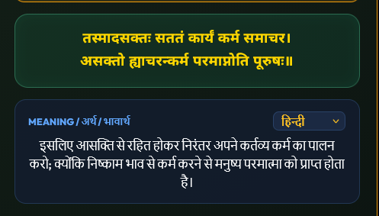
FEATURE MODULE 1
Bhagavad Gita Shloka Engine & Pre-Workout Alignment
⚡ Key Implementation Function
// app.js — Bhagavad Gita Shloka Engine
function getDailyGitaQuote() {
const dKey = todayKey();
return BHAGAVAD_GITA_SHLOKAS[dayIndex % total];
}
function speakShlokaOutLoud() {
speechSynthesis.resume(); // Unlock gesture
const u = new SpeechSynthesisUtterance(quote.shloka);
u.lang = 'hi-IN'; u.rate = 0.92;
qSpeak(u);
}
• Pre-Workout Ritual: Automatically presents today's Sanskrit Shloka and Hindi/English meaning before session starts.
• Gesture Speech Unlock: Uses speechSynthesis.resume() to guarantee instant voice audio without browser autoplay blocks.

Slide 4
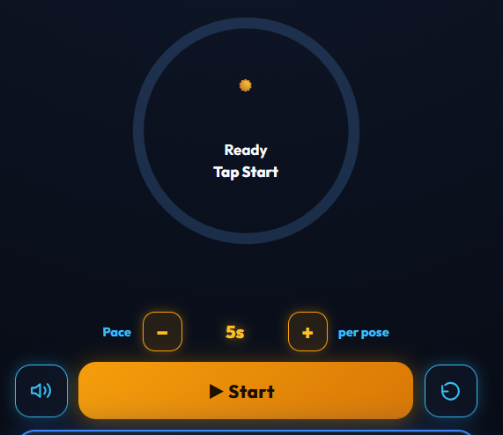
FEATURE MODULE 2
Audio-Guided Workout & Real-Time Solar Engine
⚡ Key Implementation Function
// app.js — Real-Time Workout Pace & Pose Advance
function advanceStep() {
sess.currentPose++;
if (sess.currentPose > 12) {
sess.currentPose = 1;
sess.completedSets++;
speakMantra(`Set ${sess.completedSets} Complete!`);
}
render(); // Updates Solar Ring & Stats
}
• Solar Ring Dashboard: Displays real-time round progress, current posture name, and voice counting.
• Configurable Pace & Grace: Users set pose duration (2s–30s) & grace timing.
• Automatic Rest Breaks: Guided 30-second rest intervals every 12 sets.

Slide 5
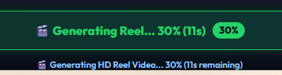
FEATURE MODULE 3
Automated 9:16 HD Reel Video Generator
⚡ Key Implementation Function
// app.js — 2-Scene 9:16 Canvas Reel Engine
async function autoGenerateWorkoutReel(info) {
const canvas = document.createElement('canvas');
canvas.width = 720; canvas.height = 1280; // 9:16 HD
// Scene 1 (0s-5s): Gita Shloka + Solar Aura
// Scene 2 (5s-15s): Workout Grid, Streak & Lifetime Sets
recorder.stop();
showReelSocialModal(info);
}
• 15-Second Vertical 9:16 HD Format: Designed specifically for WhatsApp Status and Instagram Reels.
• Dual Scene Animation: Scene 1 highlights Bhagavad Gita wisdom; Scene 2 renders personal workout stats grid & solar badge.
• Multi-Format Engine: Exports .webm / .mp4 video with automatic PNG image card fallback for older mobile WebViews.

Slide 6
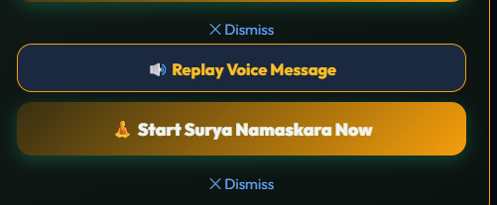
FEATURE MODULE 4
Reel Preview Popup, WhatsApp Share & Direct Download
⚡ Key Implementation Function
// app.js — WhatsApp Status Share & Download
async function shareReelToSocialMedia() {
const file = new File([generatedReelBlob], 'Reel.mp4', { type: generatedReelBlob.type });
if (navigator.canShare && navigator.canShare({ files: [file] })) {
await navigator.share({ files: [file], text: 'Workout Completed! ☀️' });
} else {
downloadReelVideo();
}
}
• Universal Popup Modal: Automatically launches video player upon generation complete with high-priority z-index (999999).
• Live Single Percentage Indicator: Displays real-time creation progress cleanly on action button (0% → 100%).
• Web Share API Integration: Directly opens native WhatsApp Status sharing sheet.

Slide 7
FEATURE MODULE 5
Classical 8-Phase Pranayama & Ayurvedic Diet Engine
🫁 8-Phase Classical Pranayama
Includes Dirgha, Kapalabhati, Bhastrika, Anulom Vilom, Nadi Shodhana, Ujjayi, Bhramari & Dhyana with step-by-step ratios & audio guidance.
🥗 Ayurvedic Diet Recommendations
Calculates customized protein & meal requirements based on user body weight & total completed rounds.
💧 Personal Hydration Target
Computes daily water target (e.g. 2.8L / 11 Glasses) with quick-logging controls.

Slide 8
PERFORMANCE & SECURITY
PWA Architecture, Offline Caching & Privacy
📱 Progressive Web App (PWA)
Installable on Android, iOS, Windows & Mac. Service Worker (sw.js v71) caches assets locally for 100% offline access.
🔒 100% Local Data Privacy
All workout history, streak logs & user preferences are stored securely in local browser storage without third-party servers.
💡 Screen Wake Lock API
Utilizes navigator.wakeLock to keep screen illuminated during active workout and breathing sessions.
🛡️ Scan & Recover Backup Engine
Built-in JSON backup export and deep-scan recovery tool in Settings drawer to protect user data.

Slide 9

USER INTERFACE & EXPERIENCE
Mobile UX Optimization & Null-Safe Stability
📱 Defensive Mobile Engineering
• 100% Crash-Proof Settings Drawer: Re-engineered openSettings() and closeSettings() with defensive DOM element helpers (setElVal, getElVal, getElNum) to eliminate null property crashes on mobile WebViews.
• Zero-Delay Touch Response: Bound direct onclick='openSettings()' handlers to gear icons to bypass mobile web touch delays.
• High-Contrast Dark Theme: Premium dark obsidian aesthetic tailored for OLED mobile displays.
• Auto-Cleaning Reel Storage: Built-in cleanupOldWorkoutReels() purges un-shared video blobs older than 2 days to conserve mobile storage space.

Slide 10
SUMMARY & CLOSING
Suryasarathi 108 — Impact & Next Steps
🎉 Ready for User Presentation & Daily Workouts!
✅ Audio-guided 108 Surya Namaskara workout engine with real-time pace controls.
✅ Dynamic Bhagavad Gita Shloka engine with spoken Sanskrit audio.
✅ Automated 15-second 9:16 HD Reel Generator for 1-tap WhatsApp Status sharing.
✅ Classical 8-Phase Pranayama guide, Ayurvedic diet recommendations & hydration tracking.
✅ 100% Offline PWA functionality with robust mobile WebView stability.
☀️ Suryasarathi 108 — Bringing Ancient Wellness to Modern Digital Life

