Slide 2
Intro
UML notacion
Patterns Catalog
Literature
Intro
UML notacion
Patterns Catalog
Literature

Slide 3
What is a pattern
Intro
UML notacion
Patterns Catalog
Literature
Architect Cristopher Alexsander invented “design pattern” for a buildings
Pattern: “A solution to a problem in a context”
Can be applied to a different areas(e.g. Software developement)

Slide 4
Why Pattern
Intro
UML notacion
Patterns Catalog
Literature
"Designing object-oriented software is hard and designing
reusable object-oriented software is even harder." - Erich Gamma
Experienced designers used common solutions
Increase productivity, introduce flexibility and resuability

Slide 5
Pattern’s history in a software
1987 - Cunningham & Beck used Alexander’s ideas, developed pattern language for Smalltalk
1990 - The Gang of Four (Gamma, Helm, Johnson and Vlissides) start to work on pattern’s catalog
1991 - Bruce Anderson, first workshop (OOPSLA)
1993 - Kent Back & Grady Booch established Hillside group
1994 - first PLOP(Patterns languages of Programs) conference
1995 – GoF published a book: Design patterns
Intro
UML notacion
Patterns Catalog
Literature

Slide 6
Types of the patterns in software
Intro
UML notacion
Patterns Catalog
Literature
3 common types
  Conceptual
  concept in application domain
  Design
  objects, classes, inheritance, relations, ...
  Programing
    Constructions inside programming languages

Slide 7
GoF abstractions
Intro
UML notacion
Patterns Catalog
Literature
Complex design for an application or a subsystem
Solution for common design problems
Simple solutions like linked lists, hash tables, ...
GoF Design Patterns
Solutions for common problems
“A design pattern names, abstracts, and identifies key aspects of a common design structure that makes it useful for creating a reusable object-oriented design.”
“descriptions of communicating objects and classes that are customized to solve a general design problem in a particular context”

Slide 8
GoF classification
Intro
UML notacion
Patterns Catalog
Literature
What
  Creational
    Creation of the objects
  Structural
    Composition of the classes and objects
  Behavioral
    Interaction between classes and objects

Slide 9
GoF klasifikacija
Intro
UML notacion
Patterns Catalog
Literature
Scope(Where)
  Class patterns
    Relations btw classes and subclasses
    Inheritance
  Object patterns
    Composition btw classes and objects

Slide 10
Pattern elements
Intro
UML notacion
Patterns Catalog
Literature
Name
  Simple name
Problem
  Where we can apply a pattern
  Preconditions
Solution
  Descriptions of the pattern elements
  Relations, responsabilities btw elements
  Abstraction
Consequences
  Pro & cons

Slide 11
Pattern Template
Intro
UML notacion
Patterns Catalog
Literature
Name
  Simple name
Intent
  What does the design pattern do? What particular design issue or problem does it address?
Also known as
  Other well-known names for the pattern
Motivation
  A scenario that illustrates a design problem and how the class and object structures in the pattern solve the problem

Slide 12
Pattern Template ...
Intro
UML notacion
Patterns Catalog
Literature
Known uses
  Examples of the pattern found in real systems
Structure
  Graphical representation
Collaborations
  How the participants collaborate to carry out their responsibilities
Consequences
  How does the pattern support its objectives?
Implemention
  How to implement

Slide 13
Pattern Template ...
Intro
UML notacion
Patterns Catalog
Literature
Sample Code
  Code fragments
Related patterns
  What design patterns are closely related to this one?

Slide 14
Benefits
Intro
UML notacion
Patterns Catalog
Literature
Expert knowledge can be used by non-experts
Common understanding btw developers
Better documentation
Better understanding of the design

Slide 15
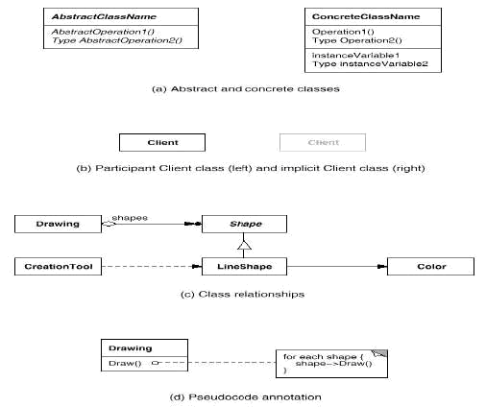
UML notacion
Intro
UML notacion
Patterns Catalog
Literature

Slide 16
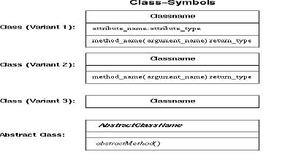
UML notacion ...
Intro
UML notacion
Patterns Catalog
Literature

Slide 17
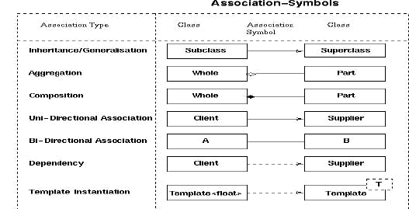
UML notacion ...
Intro
UML notacion
Patterns Catalog
Literature

Slide 18

UML relationship ...
Intro
UML notacion
Patterns Catalog
Literature
Association
  represents a family of links

Slide 19

UML relationship ...
Intro
UML notacion
Patterns Catalog
Literature
Aggregation
  is a variant of the "has a" or association relationship
  is more specific than association

Slide 20
UML relationship ...
Intro
UML notacion
Patterns Catalog
Literature
Composition
  is a stronger variant of the "owns a" or association relationship
  is more specific than aggregation

Slide 21
Catalog patterns
Intro
UML notacion
Patterns Catalog
Literature
Creational
  Abstract Factory
  Builder
  Singleton
  Prototype
  Factory Method
Structural
  Adapter
  Bridge
  Composite
  Decorator

Slide 22
Catalog patterna ...
Intro
UML notacion
Patterns Catalog
Literature
Structural ...
  Facade
  Flyweight
  Proxy
Behavorial
  Chain Of Responsability
  Command
  Interpreter
  Iterator
  Mediator
  Memento

Slide 23
Catalog patterna ...
Intro
UML notacion
Patterns Catalog
Literature
Behavorial ...
  Observer
  State
  Strategy
  Template
  Visitor

Slide 24
Literature
Intro
UML notacion
Patterns Catalog
Literature
Design Patterns: Elements of Reusable Object-Oriented Software, Gamma, Helm, Johnson and Vlissides, Addison-Wesley, 1995
Pattern Oriented Software Architecture : A System of Patterns,Frank Buschmann (Editor), Wiley, 1996
...

Slide 25
Intro
UML notacion
Patterns Catalog
Literature
End

