Slide 2
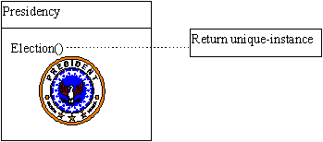
Intent
Structure
Applicability
Implementation
Benefits &
Drawbacks
Usage
Intent
“ Ensure a class has only one instance and provide global point of access to it”

Slide 3
Intent
Structure
Applicability
Implementation
Benefits &
Drawbacks
Usage
Intent
we need “global” object
class must have one instance
one possibility is global object which can be used by anyone
a global variable makes an object accessible, but it doesn't keep you from instantiating multiple objects

Slide 4
Intent
Structure
Applicability
Implementation
Benefits &
Drawbacks
Usage
Intent
second possibility
  public static variable
  everyone can acces to the object
solution: make the class itself responsible for keeping track of its sole instance
singleton ensures that only one object is created

Slide 5
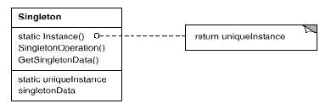
Intent
Structure
Applicability
Implementation
Benefits &
Drawbacks
Usage
Structure

Slide 6
Intent
Structure
Applicability
Implementation
Benefits &
Drawbacks
Usage
Structure
defines creational operation and ensure unique instance to the client
responsible for creation of the instance
example: one president of the US

Slide 7
Intent
Structure
Applicability
Implementation
Benefits &
Drawbacks
Usage
Applicability
use Singleton when you need one instance of the class which everyone can access

Slide 8
Intent
Structure
Applicability
Implementation
Benefits &
Drawbacks
Usage
Implementation
public class Singleton {
private static Singleton uniqueInstance = null;
private Singleton() {
// Exists only to defeat instantiation.
}
public static Singleton instance() {
if (uniqueInstance == null)
uniqueInstance = new Singleton();
return uniqueInstance;
}
....
}

Slide 9
Intent
Structure
Applicability
Implementation
Benefits &
Drawbacks
Usage
Implementation ...
object is created when first time is used, “lazy instantiation”
what if two threads used instance() method on a same time
1. solution: method instance() must be synhronized
2. solution: static inicializator

Slide 10
Intent
Structure
Applicability
Implementation
Benefits &
Drawbacks
Usage
Implementation
public class Singleton1 {
private static Singleton1 uniqueInstance = new Singleton1();
public static Singleton1 instance() {
return uniqueInstance;
}
private Singleton1() {
}
....
}

Slide 11
Intent
Structure
Applicability
Implementation
Benefits &
Drawbacks
Usage
Benefits & Drawbacks
only Singleton can create him self
problems multithreadings

Slide 12
Intent
Structure
Applicability
Implementation
Benefits &
Drawbacks
Usage
Usage
java.awt.Toolkit::getDeafultToolkit()

Slide 13
Intent
Structure
Applicability
Implementation
Benefits &
Drawbacks
Usage
End

