Slide 2
Intent
Motivation
Structure
Applicability
Implementation
Benefits &
Drawbacks
Usage
Intent
“Provide an interface for creating families of related or dependent objects without specifying their concrete classes”
similar to Factory Method pattern
AF class delegates responsability for creation of the object, FM subclass defines wich object type will be created

Slide 3
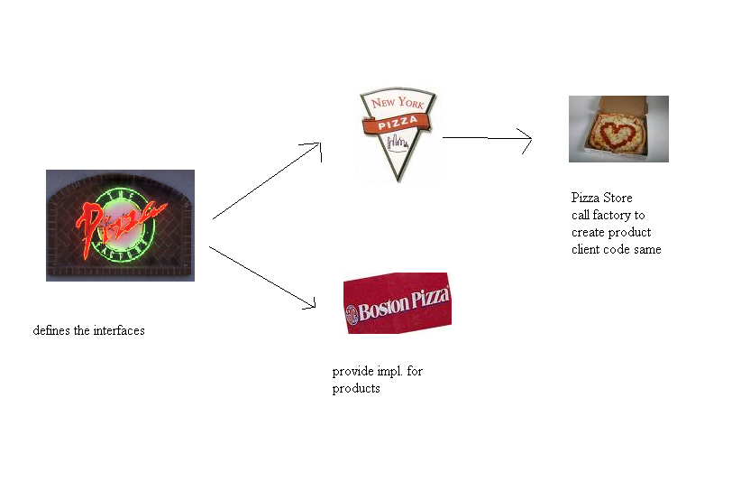
Intent
Motivation
Structure
Applicability
Implementation
Benefits &
Drawbacks
Usage
Motivation

Slide 4
Intent
Motivation
Structure
Applicability
Implementation
Benefits &
Drawbacks
Usage
Motivation
we have pizzeria wich implements Factory Method
Pizzas are build on a same way but each town has it own ingrediens
New York has its own ingredients
Boston has its own tip ingredients

Slide 5
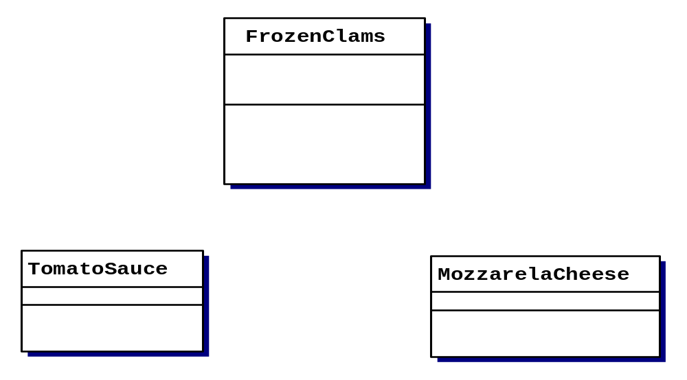
Intent
Motivation
Structure
Applicability
Implementation
Benefits &
Drawbacks
Usage
Motivation
New York

Slide 6
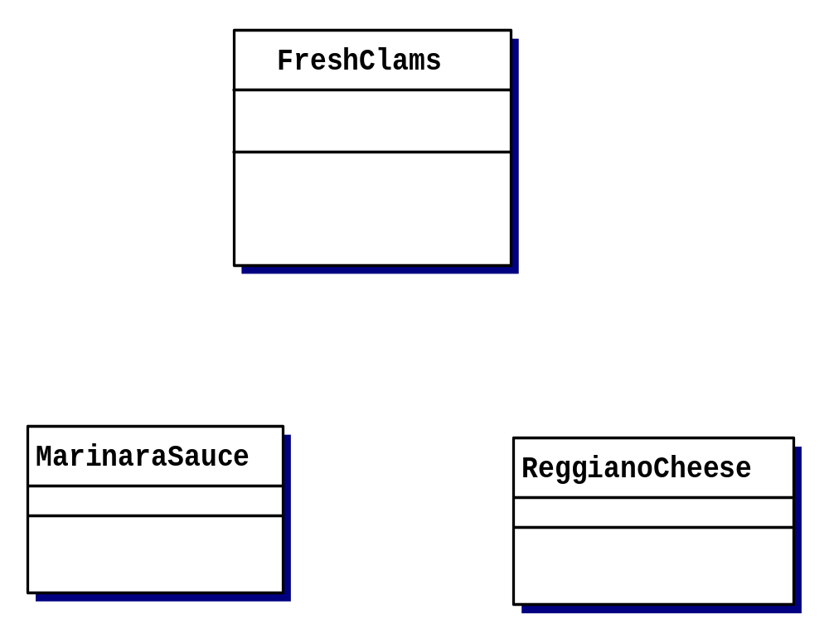
Intent
Motivation
Structure
Applicability
Implementation
Benefits &
Drawbacks
Usage
Motivation
Boston

Slide 7
Intent
Motivation
Structure
Applicability
Implementation
Benefits &
Drawbacks
Usage
Motivation
define an interface
public interface PizzaIngredientFactory{
public Clams createClams();
public Sauce createSauce();
public Cheese createCheese();
}
problem:
  new classes
  each ingredient has its own create method

Slide 8
Intent
Structure
Applicability
Implementation
Benefits &
Drawbacks
Usage
Motivation
implements PizzaIngredientFactory interfaces
public class NYPizzaIngredientFactory implements PizzaIngredientFactory {
public Clams createClams(){
return new FrozenCalms();
}
public Sauce createSauce(){
return new TomatoSauce();
}
public Cheese createCheese(){
return new MozzarellaCheese();
}
}

Slide 9
Intent
Motivation
Structure
Applicability
Implementation
Benefits &
Drawbacks
Usage
Intent
implements PizzaIngredientFactory interfaces
public class BostonPizzaIngredientFactory implements PizzaIngredientFactory {
public Clams createClams(){
return new FreshCalms();
}
public Sauce createSauce(){
return new MarinaraSauce();
}
public Cheese createCheese(){
return new ReggianoCheese();
}
}

Slide 10
Intent
Motivation
Structure
Applicability
Implementation
Benefits &
Drawbacks
Usage
Motivation
adapt class Pizza
public abstract class Pizza {
Cheese cheese;
Clams clams;
Sauce sauce;
abstract void prepare();
public bake(){
…
}
…
}

Slide 11
Intent
Motivation
Structure
Applicability
Implementation
Benefits &
Drawbacks
Usage
Motivation
implements CheesePizza
public class CheesePizza extends Pizza {
PizzaIngredientsFactory ingredientsFactory;
public CheesePizza(PizzaIngredientsFactory pif){
this.ingredientsFactory = pif;
}
void prepare(){
sauce = ingredientsFactory.createSauce();
clams = ingredientsFactory.createClams();
cheese = ingredientsFactory.createCheese();
}
}

Slide 12
Intent
Motivation
Structure
Applicability
Implementation
Benefits &
Drawbacks
Usage
Motivation
NYPizzaStore
public class NYPizzaStore extends PizzaStore {
public Pizza createPizza(String item){
PizzaIngredientsFactory ingredientsFactory =
new NYPizzaIngredientsFactory();
if(item.equals(“cheese”){
pizza = new CheesePizza(ingreadientsFactory);
}
…
}
}

Slide 13
Intent
Motivation
Structure
Applicability
Implementation
Benefits &
Drawbacks
Usage
Motivation
creates “family” of ingredients with help of the Abstract Factory
“family” – pizza’s ingredients

Slide 14
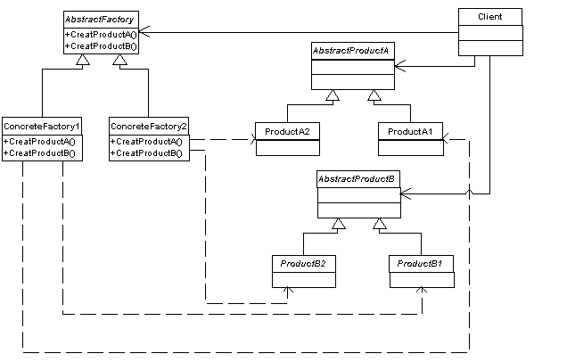
Intent
Motivation
Structure
Applicability
Implementation
Benefits &
Drawbacks
Usage
Structure

Slide 15
Intent
Motivation
Structure
Applicability
Implementation
Benefits &
Drawbacks
Usage
Structure
Abstract Factory – define interface for creation of the abstract product objects
Abstract Product – define interface for product objects
ConcreteFactory – implements creation of the concrete product objects
ConcreteProduct – implements AbstractProduct interface
Client – use AbstractFactory & AbstractProduct intefaces

Slide 16
Intent
Motivation
Structure
Applicability
Implementation
Benefits &
Drawbacks
Usage
Applicability
a system should be independent of how its products are created, composed, and represented
a system should be configured with one of multiple families of products
a family of related product objects is designed to be used together, and you need to enforce this constraint
you want to provide a class library of products, and you want to reveal just their interfaces, not their implementations

Slide 17
Intent
Motivation
Structure
Applicability
Implementation
Benefits &
Drawbacks
Usage
Implementation
public class Client {
public static void main(String[] args) {
AbstractFactory fact;
long now = System.currentTimeMillis();
if ((now % 2) == 0)
fact=new ConcreteFactory1();
else
fact=new ConcreteFactory2();
// factory independent code
fact.createProductA();
fact.createProductB();
}
}

Slide 18
Intent
Motivation
Structure
Applicability
Implementation
Benefits &
Drawbacks
Usage
Benefits & Drawbacks
easy change of the product families
products are consistents
easy test,

Slide 19
Intent
Motivation
Structure
Applicability
Implementation
Benefits &
Drawbacks
Usage
Usage
JDBC Framework
java.sql.Connection – koristi AF
code does not depends of the database wich is used

Slide 20
Intent
Structure
Applicability
Implementation
Benefits &
Drawbacks
Usage
End

