Slide 2
Intent
Motivation
Structure
Applicability
Implementation
Benefits &
Drawbacks
Usage
Intent
“Separate the construction of the complex object from its representation so that the same construction process can create different representations”.

Slide 3
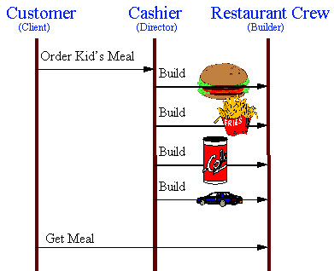
Intent
Motivation
Structure
Applicability
Implementation
Benefits &
Drawbacks
Usage
Motivation

Slide 4
Intent
Motivation
Structure
Applicability
Implementation
Benefits &
Drawbacks
Usage
Motivation
Fastfood offers childs menu
menu has a same items (main item, side item, drink, toy)
if customer order a hamburger or cheeseburger creation process is same

Slide 5
Intent
Motivation
Structure
Applicability
Implementation
Benefits &
Drawbacks
Usage
Motivation
define interface BuildMeal
public interface BuildMeal {
void buildMainItem();
void buildSideItem();
void buildDrink();
void buildToy();
}

Slide 6
Intent
Motivation
Structure
Applicability
Implementation
Benefits &
Drawbacks
Usage
Motivation
FastfoodCrew implements BuildMeal
public class FastfoodCrew implements BuildMeal {
void buildMainItem(){
product=new KidsMeal();
product.addPart("MainItem - Hamburger"); }
void buildSideItem(){}
void buildDrink(){}
void buildToy(){}
}

Slide 7
Intent
Motivation
Structure
Applicability
Implementation
Benefits &
Drawbacks
Usage
Motivation
KidsMeal is product
public class KidsMeal {
private ArrayList parts=new ArrayList();
public void addPart(String part) {
parts.add(part);
}
public void display(){
…
}
}

Slide 8
Intent
Motivation
Structure
Applicability
Implementation
Benefits &
Drawbacks
Usage
Motivation
Cashier combines items into product
public class Cashier {
private BuildMeal builder;
public void construct() {
builder.buildMainItem(); builder.buildSideItem(); builder.buildDrink();
builder.buildToy();
}
}

Slide 9
Intent
Motivation
Structure
Applicability
Implementation
Benefits &
Drawbacks
Usage
Motivation
Customer orders
public class Customer {
public static void main(String[] args) {
FastfoodCrew b = new FastfoodCrew();
Cashier d = new Cashier(b);
d.construct();
KidsMeal p = b.getResult();
p.display();
}
}

Slide 10
Intent
Motivation
Structure
Applicability
Implementation
Benefits &
Drawbacks
Usage
Motivation
product is finish
public class Customer {
public static void main(String[] args) {
FastfoodCrew b = new FastfoodCrew();
Cashier d = new Cashier(b);
d.construct();
KidsMeal p = b.getResult();
p.display();
}
}

Slide 11
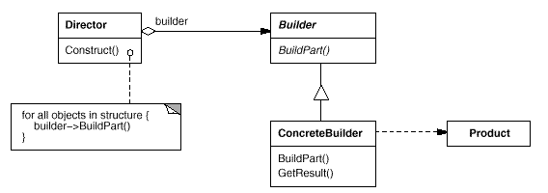
Intent
Motivation
Structure
Applicability
Implementation
Benefits &
Drawbacks
Usage
Structure

Slide 12
Intent
Motivation
Structure
Applicability
Implementation
Benefits &
Drawbacks
Usage
Structure
Builder – specifies an abstract interface for creating parts of a Product object
ConcreteBuilder – constructs and assembles parts of the product by implementing the Builder interface
Director – constructs an object using the Builder interface
Product – represents complex object

Slide 13
Intent
Motivation
Structure
Applicability
Implementation
Benefits &
Drawbacks
Usage
Applicability
the algorithm for creating a complex object should be independent of the parts that make up the object and how they're assembled
the construction process must allow different representations for the object that's constructed

Slide 14
Intent
Motivation
Structure
Applicability
Implementation
Benefits &
Drawbacks
Usage
Implementation
public interface Builder {
void buildPartA(); ...
}
public class ConcreteBuilder implements Builder {
private Product product;
public void buildPartA() {
product=new Product();
}
....
}

Slide 15
Intent
Motivation
Structure
Applicability
Implementation
Benefits &
Drawbacks
Usage
Implementation
public class Director {
private Builder builder;
...
public void construct() {
builder.buildPartA(); ...
}
}
public class Client {
public static void main(String[] args) {
ConcreteBuilder b = new ConcreteBuilder();
Director d = new Director(b);
d.construct();
Product p = b.getResult();
p.display();
}
}

Slide 16
Intent
Structure
Applicability
Implementation
Benefits &
Drawbacks
Usage
Benefits & Drawbacks
makes creation of the complex objects easier
Builder manages resources so client just comunicates with Builder

Slide 17
Intent
Structure
Applicability
Implementation
Benefits &
Drawbacks
Usage
End

