Slide 1
Notes:
Osnove programskog jezika Java
09-2002
PSE SWS PSZ

Slide 2
Intent
Motivation
Structure
Applicability
Implementation
Benefits &
Drawbacks
Usage
Intent
“Specify the kinds of objects to create using a prototypical instance, and create new objects by copying this prototype. ”.
dynamicaly creates copies of the existing objects
“create based on existing state”
example: graphical or textual editors, “copy-paste”
Notes:
Osnove programskog jezika Java
09-2002
PSE SWS PSZ

Slide 3
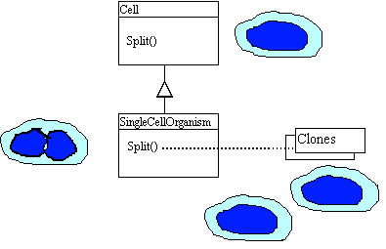
Intent
Motivation
Structure
Applicability
Implementation
Benefits &
Drawbacks
Usage
Motivation
Notes:
Osnove programskog jezika Java
09-2002
PSE SWS PSZ

Slide 4
Intent
Motivation
Structure
Applicability
Implementation
Benefits &
Drawbacks
Usage
Motivation
when method splitCell is called, then it is better to copy current state of the object Cell, then to create object, and then set attributes
Notes:
Osnove programskog jezika Java
09-2002
PSE SWS PSZ

Slide 5
Intent
Motivation
Structure
Applicability
Implementation
Benefits &
Drawbacks
Usage
Motivation
define abstract class Cell
public abstract class Cell implements Cloneable {
public abstract Cell splitCell() ...;
}
Notes:
Osnove programskog jezika Java
09-2002
PSE SWS PSZ

Slide 6
Intent
Motivation
Structure
Applicability
Implementation
Benefits &
Drawbacks
Usage
Motivation
SingleCellOrganizm inherite Cell and impl. metodu splitCell
public class SingleCellOrganizm extends Cell{
public Cell splitCell() throws CloneNotSupportedException {
return (Cell)this.clone();
}
...
}
Notes:
Osnove programskog jezika Java
09-2002
PSE SWS PSZ

Slide 7
Intent
Motivation
Structure
Applicability
Implementation
Benefits &
Drawbacks
Usage
Motivation
Client creates SingleCellOrganizm, then calls splitCell(), new object is created from existing one
public class Client {
private Cell cell;
public static void main(String[] args) {
Client client = new Client();
client.cell = new SingleCellOrganizm(1,2);
Cell cellSplited = client.cell.splitCell()
}
}
Notes:
Osnove programskog jezika Java
09-2002
PSE SWS PSZ

Slide 8
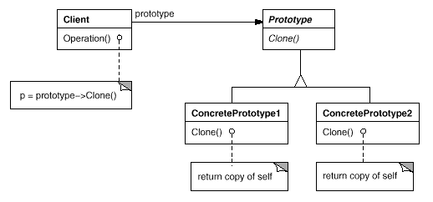
Intent
Motivation
Structure
Applicability
Implementation
Benefits &
Drawbacks
Usage
Structure
Notes:
Osnove programskog jezika Java
09-2002
PSE SWS PSZ

Slide 9
Intent
Motivation
Structure
Applicability
Implementation
Benefits &
Drawbacks
Usage
Structure
Prototype – declares an interface for cloning itself
ConcretePrototype – implements an operation for cloning itself
Client – creates a new object by asking a prototype to clone itself
Notes:
Osnove programskog jezika Java
09-2002
PSE SWS PSZ

Slide 10
Intent
Motivation
Structure
Applicability
Implementation
Benefits &
Drawbacks
Usage
Applicability
system should be independent of how its products are created, composed, and represented
when the classes to instantiate are specified at run-time
when instances of a class can have one of only a few different combinations of state
Notes:
Osnove programskog jezika Java
09-2002
PSE SWS PSZ

Slide 11
Intent
Motivation
Structure
Applicability
Implementation
Benefits &
Drawbacks
Usage
Implementation
public class Client {
private Prototype prototype;
public static void main(String[] args) {
Client c=new Client();
String sParam="A";
c.prototype=new ConcretePrototype2(sParam);
Prototype p2=c.prototype.cloneMe(); }
}
Notes:
Osnove programskog jezika Java
09-2002
PSE SWS PSZ

Slide 12
Intent
Motivation
Structure
Applicability
Implementation
Benefits &
Drawbacks
Usage
Implementation
public abstract class Prototype implements Cloneable {
public abstract Prototype cloneMe();
}
public class ConcretePrototype1 extends Prototype {
public Prototype cloneMe() {
return (Prototype) this.clone();
}
}
Notes:
Osnove programskog jezika Java
09-2002
PSE SWS PSZ

Slide 13
Intent
Structure
Applicability
Implementation
Benefits &
Drawbacks
Usage
Benefits & Drawbacks
copy of the usefull objects with current state
avoid complex constructors or complex init methods
Notes:
Osnove programskog jezika Java
09-2002
PSE SWS PSZ

Slide 14
Intent
Structure
Applicability
Implementation
Benefits &
Drawbacks
Usage
Usage
Copy constructor – one usage of the Prototype(deep or shalow)
String class, new object is created with call new String(“abc”);
clone() method, implements Clonable() interface so it is easy to have Prototype in Java
Notes:
Osnove programskog jezika Java
09-2002
PSE SWS PSZ

Slide 15
Intent
Structure
Applicability
Implementation
Benefits &
Drawbacks
Usage
End
Notes:
Osnove programskog jezika Java
09-2002
PSE SWS PSZ

