Slide 1
Notes:
Osnove programskog jezika Java
09-2002
PSE SWS PSZ

Slide 2
Intent
Motivation
Structure
Applicability
Implementation
Benefits &
Drawbacks
Usage
Intent
“Convert the interface of a class into another interface clients expect. Adapter lets classes work together that couldn't otherwise because of incompatible interfaces.”
Notes:
Osnove programskog jezika Java
09-2002
PSE SWS PSZ

Slide 3

Intent
Motivation
Structure
Applicability
Implementation
Benefits &
Drawbacks
Usage
Motivation
Notes:
Osnove programskog jezika Java
09-2002
PSE SWS PSZ

Slide 4
Intent
Motivation
Structure
Applicability
Implementation
Benefits &
Drawbacks
Usage
Motivation
we need “drawing editor” which draws diagrams using graphical elements (line, poligon, text, ...),
base abstraction is graphical object(Shape)
interface for graphical object is abstract class Shape
public abstract class Shape {
abstract public void draw();
}
Notes:
Osnove programskog jezika Java
09-2002
PSE SWS PSZ

Slide 5
Intent
Motivation
Structure
Applicability
Implementation
Benefits &
Drawbacks
Usage
Motivation
classes LineShape, PolygonShape & TextShape are subclasse of the class Shape
LineShape & PolygonShape – easy to implement
TextShape – not easy to implement (buffers, screen update, ...)
somebody already implements similar functionality TextView, but with different interfaces
lets adapt(Adapter) TextView to Shape interface
Notes:
Osnove programskog jezika Java
09-2002
PSE SWS PSZ

Slide 6
Intent
Motivation
Structure
Applicability
Implementation
Benefits &
Drawbacks
Usage
Motivation
public class LineShape extends Shape {
public void draw() {
System.out.println("LineShape draw");
}
}
public class PolygonShape extends Shape {
public void draw() {
System.out.println("PolygonShape draw");
}
}
Notes:
Osnove programskog jezika Java
09-2002
PSE SWS PSZ

Slide 7
Intent
Motivation
Structure
Applicability
Implementation
Benefits &
Drawbacks
Usage
Motivation
public class TextShape extends Shape{
private TextView textView = new TextView();
public void draw() {
textView.mydraw();
}
}
public class TextView {
public void mydraw(){
System.out.println("TextView->mydraw()");
}
}
Notes:
Osnove programskog jezika Java
09-2002
PSE SWS PSZ

Slide 8
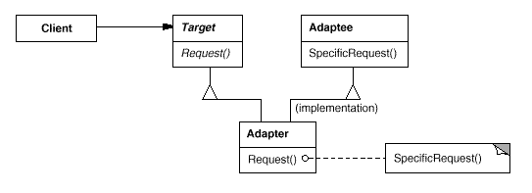
Intent
Motivation
Structure
Applicability
Implementation
Benefits &
Drawbacks
Usage
Structure – Class Adapter(Inheritance)
Notes:
Osnove programskog jezika Java
09-2002
PSE SWS PSZ

Slide 9
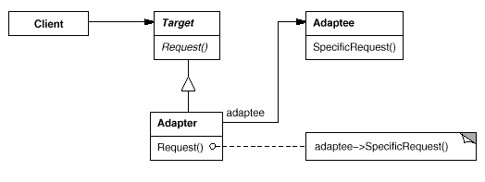
Intent
Motivation
Structure
Applicability
Implementation
Benefits &
Drawbacks
Usage
Structure – Object Adapter(delegation)
Notes:
Osnove programskog jezika Java
09-2002
PSE SWS PSZ

Slide 10
Intent
Motivation
Structure
Applicability
Implementation
Benefits &
Drawbacks
Usage
Participants
Target – defines domain-specific interface, used by Client
Client – use target interface
Adaptee – defines existing interface where adaption will be applied
Adapter – adapts interface Adaptee to Target
Notes:
Osnove programskog jezika Java
09-2002
PSE SWS PSZ

Slide 11
Intent
Motivation
Structure
Applicability
Implementation
Benefits &
Drawbacks
Usage
Applicability
use Adapter when you want to use existing class but, interfaces are not what you need
for incompatible interfaces
Notes:
Osnove programskog jezika Java
09-2002
PSE SWS PSZ

Slide 12
Intent
Motivation
Structure
Applicability
Implementation
Benefits &
Drawbacks
Usage
Implementation – Class Adapter
public interface Target {
String request();
}
public class Adaptee {
public String specificRequest()
{
return "Called specificRequest.";
}
}
Notes:
Osnove programskog jezika Java
09-2002
PSE SWS PSZ

Slide 13
Intent
Motivation
Structure
Applicability
Implementation
Benefits &
Drawbacks
Usage
Implementation – Class Adapter
public class Adapter extends Adaptee implements Target {
public String request() {
System.out.println("Called request.");
return specificRequest();
}
}
public class Client {
public static void main(String[] args) {
Target object= new Adapter();
System.out.println(object.request());
}
}
Notes:
Osnove programskog jezika Java
09-2002
PSE SWS PSZ

Slide 14
Intent
Structure
Applicability
Implementation
Benefits &
Drawbacks
Usage
Benefits & Drawbacks
interaction between incompatible objects
problem when method parameters are different then parameters needs to be adapted as well
Notes:
Osnove programskog jezika Java
09-2002
PSE SWS PSZ

Slide 15
Intent
Structure
Applicability
Implementation
Benefits &
Drawbacks
Usage
Usage
JavaBeans java.beans API use Adapter pattern
Notes:
Osnove programskog jezika Java
09-2002
PSE SWS PSZ

Slide 16
Intent
Structure
Applicability
Implementation
Benefits &
Drawbacks
Usage
End
Notes:
Osnove programskog jezika Java
09-2002
PSE SWS PSZ

