Slide 2
Intent
Motivation
Structure
Applicability
Implementation
Benefits &
Drawbacks
Usage
Intent
“Decouple an abstraction from its implementation so that the two can vary independently.”

Slide 3
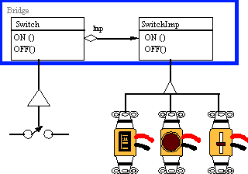
Intent
Motivation
Structure
Applicability
Implementation
Benefits &
Drawbacks
Usage
Motivation
A household switch controlling lights, ceiling fans, etc. is an example of the Bridge. The purpose of the switch is to turn a device on or off. The actual switch can be implemented as a pull chain, a simple two position switch, or a variety of dimmer switches.

Slide 4
Intent
Motivation
Structure
Applicability
Implementation
Benefits &
Drawbacks
Usage
Motivation
when an abstraction has more possible implementations we often use inheritence
subclass inherits abstract class and implements the interface
this is not flexible while subclass is “coupled” to abstract class

Slide 5
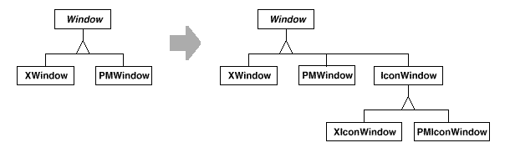
Intent
Motivation
Structure
Applicability
Implementation
Benefits &
Drawbacks
Usage
Motivation
imagine Window abstraction which must have implementation for XWindow & PMWindow
we want to extend implementation with IconWindow class
we have two new classes XIconWindow & PMIconWindow

Slide 6
Intent
Motivation
Structure
Applicability
Implementation
Benefits &
Drawbacks
Usage
Motivation
Bridge pattern separates Window abstraction & implementation in a two separate hiearchies
One for Window abstraction(Window, IconWindow),
One for “platform-specific” implementations

Slide 7
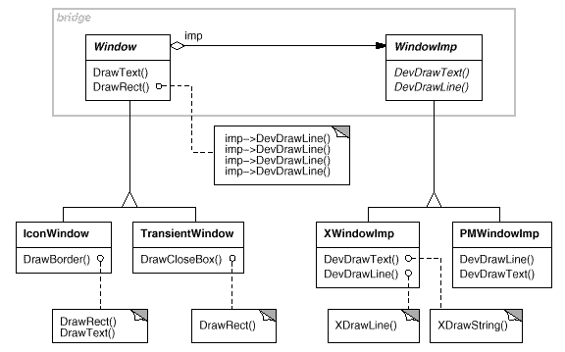
Intent
Motivation
Structure
Applicability
Implementation
Benefits &
Drawbacks
Usage
Motivation

Slide 8
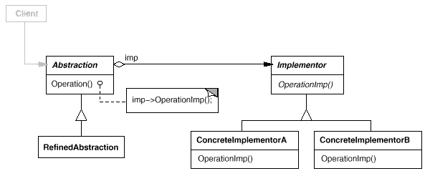
Intent
Motivation
Structure
Applicability
Implementation
Benefits &
Drawbacks
Usage
Structure

Slide 9
Intent
Motivation
Structure
Applicability
Implementation
Benefits &
Drawbacks
Usage
Participants
Abstraction – defines abstraction interface, maintains a reference to object of type Implementator
Refined Abstracion – extends the interface defined by Abstraction
Implementator – defines interface for implementation
ConcreteImplementator – implements Implementator interface

Slide 10
Intent
Motivation
Structure
Applicability
Implementation
Benefits &
Drawbacks
Usage
Applicability
avoid coupling between abstraction & implementation, particulary if we want to change implementation during run-time
abstraction and implemention can be easily extended
change in abstraction implementation does not influence on a client code

Slide 11
Intent
Motivation
Structure
Applicability
Implementation
Benefits &
Drawbacks
Usage
Implementation
public class Abstraction {
private Implementor implementor;
public void operation() {
System.out.println("Abstraction operation() called.");
implementor.operationImp();
}
}

Slide 12
Intent
Motivation
Structure
Applicability
Implementation
Benefits &
Drawbacks
Usage
Implementation
public class RefinedAbstraction extends Abstraction {
public void operation() {
System.out.println("RefinedAbstraction operation() called.");
this.getImplementor().operationImp();
}
}
public interface Implementor {
void operationImp();
}

Slide 13
Intent
Motivation
Structure
Applicability
Implementation
Benefits &
Drawbacks
Usage
Implementation
public class ConcreteImplementorA implements Implementor {
public void operationImp() {
System.out.println("ConcreteImplementorA operationImp() called.");
}
}
public class ConcreteImplementorB implements Implementor {
public void operationImp() {
System.out.println("ConcreteImplementorB operationImp() called.");
}
}

Slide 14
Intent
Structure
Applicability
Implementation
Benefits &
Drawbacks
Usage
Benefits & Drawbacks
separets implementation and interface
Abstraction & Implementator can be extended separetly
Hides implementation details from client

Slide 15
Intent
Structure
Applicability
Implementation
Benefits &
Drawbacks
Usage
End

