Slide 2
Intent
Motivation
Structure
Applicability
Implementation
Benefits &
Drawbacks
Usage
Intent
“Compose objects into tree structure to represent part-whole hierarchies. Composite lets clients treat induvidual objects and compositions of objects uniformly.”

Slide 3
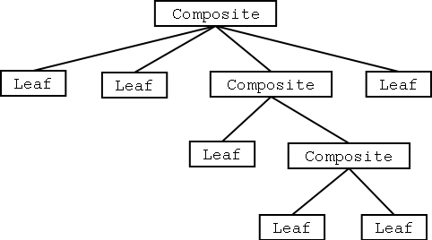
Intent
Motivation
Structure
Applicability
Implementation
Benefits &
Drawbacks
Usage
Motivation

Slide 4
Intent
Motivation
Structure
Applicability
Implementation
Benefits &
Drawbacks
Usage
Motivation
graphical applications groups simple graphical application into the group of the components
result – complex structure
define primitive graph elements Text i Lines
define class which will be container for primitive classes
problem: we can not use same methods on a same way

Slide 5
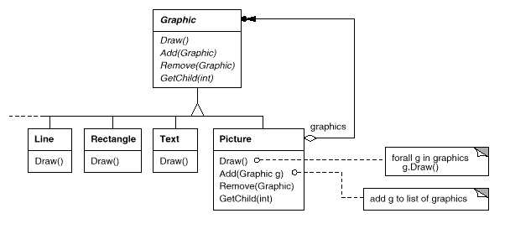
Intent
Motivation
Structure
Applicability
Implementation
Benefits &
Drawbacks
Usage
Motivation
Composite pattern defines recursive composition

Slide 6
Intent
Motivation
Structure
Applicability
Implementation
Benefits &
Drawbacks
Usage
Motivation
define abstract class which presents primitive type and container
e.g. class Graphic
define method draw()
define methods for access and manipulation with childs: add(), remove(), getChildren()
primitive subclasess Line, Rectangle & Text, implements draw() method

Slide 7
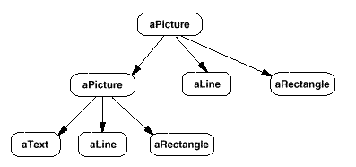
Intent
Motivation
Structure
Applicability
Implementation
Benefits &
Drawbacks
Usage
Motivation
subclass Picture is container (represents aggregation of the primitive graphical objects)
implements draw() method, and methods for manipulation with children

Slide 8
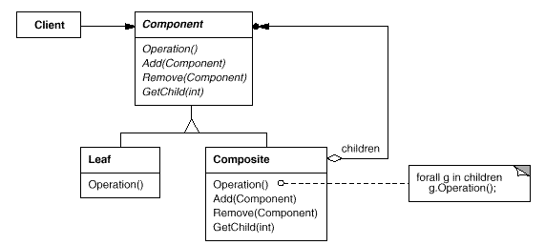
Intent
Motivation
Structure
Applicability
Implementation
Benefits &
Drawbacks
Usage
Structure

Slide 9
Intent
Motivation
Structure
Applicability
Implementation
Benefits &
Drawbacks
Usage
Participants
Component – declares the interface for objects in the composition, implements default behavior for the interface common to all classes, as appropriate , declares an interface for accessing and managing its child components
Leaf – represents leaf objects in the composition

Slide 10
Intent
Motivation
Structure
Applicability
Implementation
Benefits &
Drawbacks
Usage
Participants
Composite – defines behavior for components having children, stores child components, implements child-related operations in the Component interface
Client – use Composite interface

Slide 11
Intent
Motivation
Structure
Applicability
Implementation
Benefits &
Drawbacks
Usage
Applicability
“part-whole” hierarchies
client can ignore difference between primitive and composed objects

Slide 12
Intent
Motivation
Structure
Applicability
Implementation
Benefits &
Drawbacks
Usage
Implementation
public interface Component {
void operation();
}
public class Leaf implements Component {
public void operation() {
System.out.print("Leaf");
}
}

Slide 13
Intent
Motivation
Structure
Applicability
Implementation
Benefits &
Drawbacks
Usage
Implementation
public class Composite implements Component {
private ArrayList children=new ArrayList();
public boolean add(Component element) { ... }
public void operation() {...}
public void remove(Component c) {...}
public Component getChild(int i) {... }
}

Slide 14
Intent
Motivation
Structure
Applicability
Implementation
Benefits &
Drawbacks
Usage
Implementation
public class Composite implements Component {
private ArrayList children=new ArrayList();
public boolean add(Component element) { ... }
public void operation() {...}
public void remove(Component c) {...}
public Component getChild(int i) {... }
}

Slide 15
Intent
Structure
Applicability
Implementation
Benefits &
Drawbacks
Usage
Benefits & Drawbacks
simple client
simple to add new component
implementation using interfaces not god if class has attributes and some basic implementation, then we can use abstract classes
pattern is not god for testing

Slide 16
Intent
Structure
Applicability
Implementation
Benefits &
Drawbacks
Usage
Usage
SWING components are subclasses of the AWT Container class
each SWING component is container for any SWING component

Slide 17
Intent
Structure
Applicability
Implementation
Benefits &
Drawbacks
Usage
End

