Slide 2
Intent
Motivation
Structure
Applicability
Implementation
Benefits &
Drawbacks
Usage
Intent
“Provide a unified interface to a set of interfaces in a subsystem. Facade defines a higher-level interface that makes the subsystem easier to use.”

Slide 3
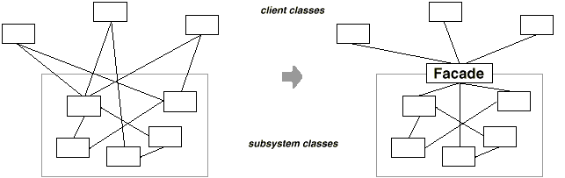
Intent
Motivation
Structure
Applicability
Implementation
Benefits &
Drawbacks
Usage
Motivation

Slide 4
Intent
Motivation
Structure
Applicability
Implementation
Benefits &
Drawbacks
Usage
Motivation
compiler has subclasess like Scaner, Parser, ProgramNode...
client which use compiler do not call subclass in order to compile
define uniform interface which presents compiler functionality
Compiler class represents a facade
facade hides “low-level” functionality from client

Slide 5
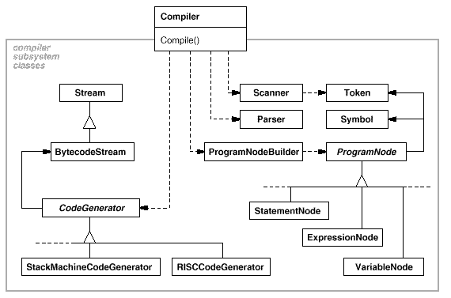
Intent
Motivation
Structure
Applicability
Implementation
Benefits &
Drawbacks
Usage
Motivation

Slide 6
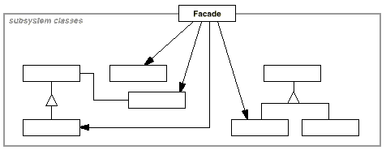
Intent
Motivation
Structure
Applicability
Implementation
Benefits &
Drawbacks
Usage
Structure

Slide 7
Intent
Motivation
Structure
Applicability
Implementation
Benefits &
Drawbacks
Usage
Participants
Facade – delegates client call to subclasses in system (Complier)
subsystem classes – implements functionalities of the subsystem, does not know about facade(Scanner, Parser, ...)

Slide 8
Intent
Motivation
Structure
Applicability
Implementation
Benefits &
Drawbacks
Usage
Applicability
simple interface towards complicated system
if we want to split subsystem to the layers, we introduce facade as a entry point for each layer

Slide 9
Intent
Motivation
Structure
Applicability
Implementation
Benefits &
Drawbacks
Usage
Implementation
/** "Façade" */
public class UserfriendlyDate
{
Date date = new Date();
public UserfriendlyDate(Date date) {
this.date = date;
}
public String toString() {
Format formatter = new SimpleDateFormat("yyyy-MMM-dd");
return formatter.format(date);
}
}

Slide 10
Intent
Motivation
Structure
Applicability
Implementation
Benefits &
Drawbacks
Usage
Implementation
/** "Client" */
public class FacadePattern
{
public static void main(String[] args)
{
Date date = new Date();
System.out.println(date);
UserfriendlyDate d = new UserfriendlyDate(date);
System.out.println("Date: "+d);
}
}

Slide 11
Intent
Structure
Applicability
Implementation
Benefits &
Drawbacks
Usage
Benefits & Drawbacks
simple client
simple add new component (client remains the same)

Slide 12
Intent
Structure
Applicability
Implementation
Benefits &
Drawbacks
Usage
Usage
java.lang.Class, part of the Reflection API
act as a facade for Reflection API
  getConstructors()
  getMethods()
  ...

Slide 13
Intent
Structure
Applicability
Implementation
Benefits &
Drawbacks
Usage
End

