Slide 2
Intent
Motivation
Structure
Applicability
Implementation
Benefits &
Drawbacks
Usage
Intent
“Attach additional responsibilities to an object dynamically. Decorators provide a flexible alternative to subclassing for extending functionality.”

Slide 3

Intent
Motivation
Structure
Applicability
Implementation
Benefits &
Drawbacks
Usage
Motivation

Slide 4
Intent
Motivation
Structure
Applicability
Implementation
Benefits &
Drawbacks
Usage
Motivation
we want to add new attribute to the object, not the class
if we want to add scrolling or borders to graphical application
one solution is to inherite graphical component
inheritence is not flexible, to many subslasses, client can not decide what to decorate and when

Slide 5
Intent
Motivation
Structure
Applicability
Implementation
Benefits &
Drawbacks
Usage
Motivation
in we enclose graphical component in object which can add new feature(scroll, border) we will have flexible solution
“enclosed” object is decorator

Slide 6
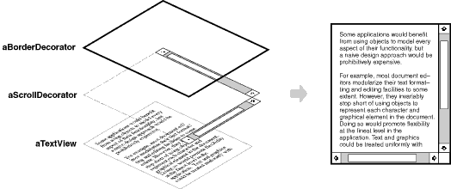
Intent
Motivation
Structure
Applicability
Implementation
Benefits &
Drawbacks
Usage
Motivation

Slide 7
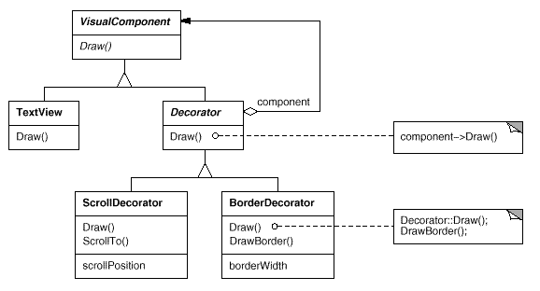
Intent
Motivation
Structure
Applicability
Implementation
Benefits &
Drawbacks
Usage
Motivation

Slide 8
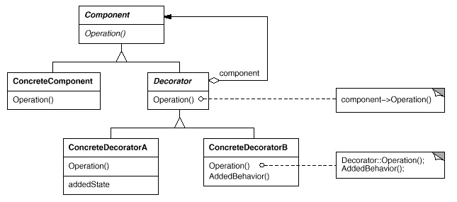
Intent
Motivation
Structure
Applicability
Implementation
Benefits &
Drawbacks
Usage
Structure

Slide 9
Intent
Motivation
Structure
Applicability
Implementation
Benefits &
Drawbacks
Usage
Participants
Component – define interface for new features which will be added dynamicaly
ConcreteComponent – define object where new features can be added
Decorator – keep reference to Component object
ConcreteDecorator – add features to component

Slide 10
Intent
Motivation
Structure
Applicability
Implementation
Benefits &
Drawbacks
Usage
Applicability
dynamicaly adds features to the object without infleunce on other objects
when inheritance is not practical
sometimes inheritence can led to a huge amount of the subclasses

Slide 11
Intent
Motivation
Structure
Applicability
Implementation
Benefits &
Drawbacks
Usage
Implementation
public interface Component {
public void operation();
}
public abstract class Decorator implements Component {
Component component;
public abstract void operation();
public void setComponent(Component component) {
this.component = component;
}
}

Slide 12
Intent
Motivation
Structure
Applicability
Implementation
Benefits &
Drawbacks
Usage
Implementation
public class ConcreteComponent implements Component {
public void operation() {...}
}
public class ConcreteDecoratorA extends Decorator {
private String state;
public void operation() {
...
component.operation();
}
public String getState() {... }
public void setState(String state) {...}
}

Slide 13
Intent
Motivation
Structure
Applicability
Implementation
Benefits &
Drawbacks
Usage
Implementation
public class ConcreteDecoratorB extends Decorator{
public void operation() {
addedBehaviour();
component.operation();
}
private void addedBehaviour(){...}
}

Slide 14
Intent
Motivation
Structure
Applicability
Implementation
Benefits &
Drawbacks
Usage
Implementation
public class Client {
..
ConcreteDecoratorA decA=new ConcreteDecoratorA();
ConcreteDecoratorB decB=new ConcreteDecoratorB();
ConcreteComponent com=new ConcreteComponent();
decB.setComponent(com);
decA.setComponent(decB);
decA.operation();
}

Slide 15
Intent
Structure
Applicability
Implementation
Benefits &
Drawbacks
Usage
Benefits & Drawbacks
simple change of the object behavior in “run-time”
in extreme cases Decorator produce huge amount of the small objects which complicates testing and debuging

Slide 16
Intent
Structure
Applicability
Implementation
Benefits &
Drawbacks
Usage
Usage
Collection Framework, java.util package
Collections classes use Decorator for extending of the functionality
  singleton - single element
  synhronized – synhronized collections
  unmodifiable – collecion which can not be changed

Slide 17
Intent
Structure
Applicability
Implementation
Benefits &
Drawbacks
Usage
End

