Slide 2
Intent
Motivation
Structure
Applicability
Implementation
Benefits &
Drawbacks
Usage
Intent
“Use sharing to support large numbers of fine-grained objects efficiently.”

Slide 3
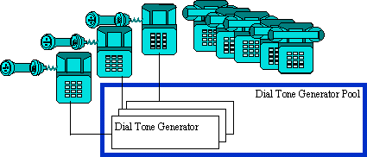
Intent
Motivation
Structure
Applicability
Implementation
Benefits &
Drawbacks
Usage
Motivation
The public switched telephone network is an example of a Flyweight. There are several resources such as dial tone generators, ringing generators, and digit receivers that must be shared between all subscribers.

Slide 4
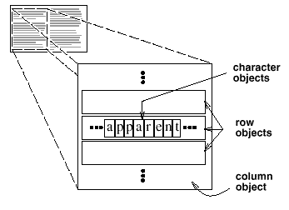
Intent
Motivation
Structure
Applicability
Implementation
Benefits &
Drawbacks
Usage
Motivation
OO editor editor use objects for presenting elements like table, row, column or character...

Slide 5
Intent
Motivation
Structure
Applicability
Implementation
Benefits &
Drawbacks
Usage
Motivation
huge amount of the object(e.g. chars) in memory
Flyweight can be used in different contexts
basic idea is to distinguish between intrinsic & extrinsic state
intrinsic state contains infos which are context independent, so we can share it
extrinsic state holds infos which are context dependent, so we can not share it

Slide 6
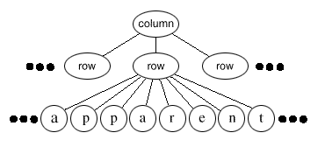
Intent
Motivation
Structure
Applicability
Implementation
Benefits &
Drawbacks
Usage
Motivation
intrinsic state – char cod
extrinsic state – column, row, ...

Slide 7
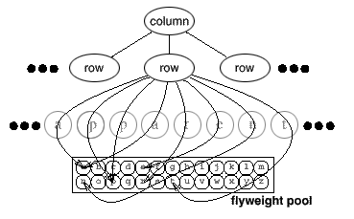
Intent
Motivation
Structure
Applicability
Implementation
Benefits &
Drawbacks
Usage
Motivation
chars can be instanced and can be putted in pool

Slide 8
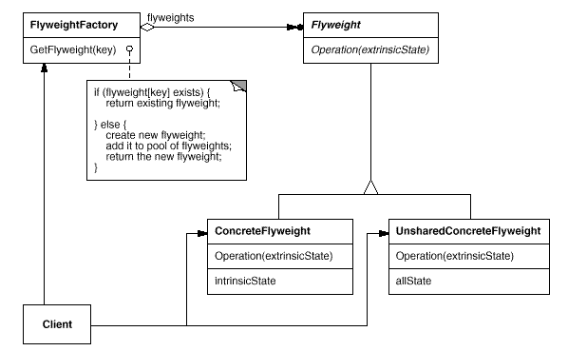
Intent
Motivation
Structure
Applicability
Implementation
Benefits &
Drawbacks
Usage
Structure

Slide 9
Intent
Motivation
Structure
Applicability
Implementation
Benefits &
Drawbacks
Usage
Participants
Flyweight – define interface through flyweight can recieve and act on extrinic state
ConcreteFlyweight – implements Flyweight, and add storage for intrisnic state (Character)
UnsharedConcreteFlyweight – define objects are not shared (Row, Column)

Slide 10
Intent
Motivation
Structure
Applicability
Implementation
Benefits &
Drawbacks
Usage
Participants
FlyweightFactory – creates and manages with the flyweight objects
Client – keep flyweight reference, stores extrinic state

Slide 11
Intent
Motivation
Structure
Applicability
Implementation
Benefits &
Drawbacks
Usage
Applicability
application use huge amount of objects
objects can be made extrinic
many groups of objects can be easily replaced with a few “shared” objects

Slide 12
Intent
Motivation
Structure
Applicability
Implementation
Benefits &
Drawbacks
Usage
Implementation
public interface Flyweight {
void operation(ExtrinsicState extrinsicState);
}
public class UnsharedConcreteFlyweight implements Flyweight {
private Object allState;
public void operation(ExtrinsicState extrinsicState) {...}
public Object getAllState() {...}
public void setAllState(Object allState) {...}
}

Slide 13
Intent
Motivation
Structure
Applicability
Implementation
Benefits &
Drawbacks
Usage
Implementation
public class FlyweightFactory {
private static Map flyweights=new HashMap();
static {flyweights.put(“1“...); ... }
public static Flyweight getFlyweight(Object key) {... }
private static class ConcreteFlyweight implements Flyweight {
private Object intrinsicObjAtribute;
private ConcreteFlyweight(Object intrinsicObjAtribute) {
...
this.intrinsicObjAtribute=intrinsicObjAtribute;
}
public void operation(ExtrinsicState extrinsicState) {...
}
}

Slide 14
Intent
Motivation
Structure
Applicability
Implementation
Benefits &
Drawbacks
Usage
Implementation
public class Client {
...
Flyweight flyweight1=FlyweightFactory.getFlyweight(“1");
Flyweight flyweight2=FlyweightFactory.getFlyweight(“2");
Flyweight flyweight3=FlyweightFactory.getFlyweight(“3");
Flyweight flyweight4=FlyweightFactory.getFlyweight(“4");
Flyweight flyweight5=new UnsharedConcreteFlyweight();
Flyweight flyweight6=new UnsharedConcreteFlyweight();
...
}

Slide 15
Intent
Structure
Applicability
Implementation
Benefits &
Drawbacks
Usage
Benefits & Drawbacks
decrese number of objects in memory or in storage (file, data base, ...)
if shared information can be calculated on-fly then we can save even more

Slide 16
Intent
Structure
Applicability
Implementation
Benefits &
Drawbacks
Usage
Usage
application which use huge number of the small objects

Slide 17
Intent
Structure
Applicability
Implementation
Benefits &
Drawbacks
Usage
End

