Slide 2
Intent
Motivation
Structure
Applicability
Implementation
Benefits &
Drawbacks
Usage
Intent
“Provide a surrogate or placeholder for another object to control access to it. ”

Slide 3
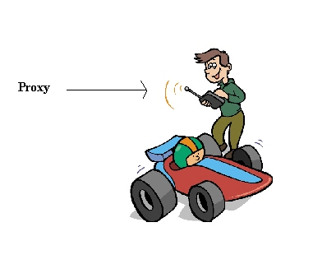
Intent
Motivation
Structure
Applicability
Implementation
Benefits &
Drawbacks
Usage
Motivation

Slide 4
Intent
Motivation
Structure
Applicability
Implementation
Benefits &
Drawbacks
Usage
Motivation
editor can have some “heavy” graphical elements which occupies a lot of memory (expensive objects)
e.g. images
opening the document must be quick, so we must avoid opening of “heavy” object on start while we can not see them at once anyway

Slide 5
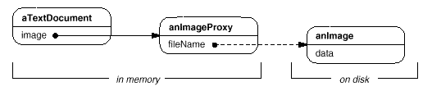
Intent
Motivation
Structure
Applicability
Implementation
Benefits &
Drawbacks
Usage
Motivation
“heavy” objects must be created on demand
we use another object which act as original (image proxy)

Slide 6
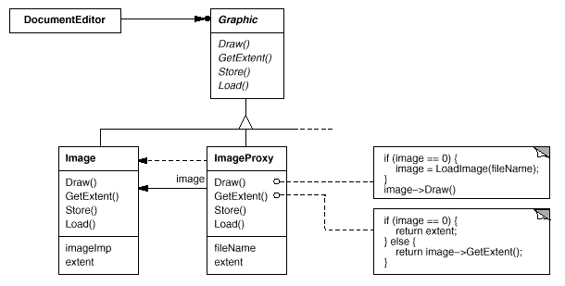
Intent
Motivation
Structure
Applicability
Implementation
Benefits &
Drawbacks
Usage
Motivation
image proxy draws picture when document realy needs that picture

Slide 7
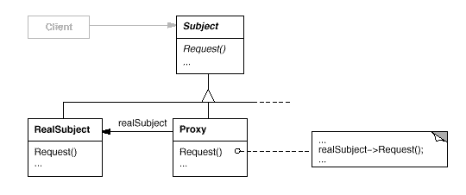
Intent
Motivation
Structure
Applicability
Implementation
Benefits &
Drawbacks
Usage
Structure

Slide 8
Intent
Motivation
Structure
Applicability
Implementation
Benefits &
Drawbacks
Usage
Participants
Proxy – keep reference on a real subject, define interface which represents Subject, so he can act as surogate, controll acces to real subject, can be responisble for creation and maintainence
Subject – define common interface for RealSubject i Proxy
RealSubject – real object which Proxy presents

Slide 9
Intent
Motivation
Structure
Applicability
Implementation
Benefits &
Drawbacks
Usage
Applicability
remote proxy represents object in different address space
virtual proxy creates “heavy” objects on demand
protection proxy controll access to the object
smart reference replacement for a smart pointer, can be used as a counter of the created objects etc.

Slide 10
Intent
Motivation
Structure
Applicability
Implementation
Benefits &
Drawbacks
Usage
Implementation
public interface Subject {
void request();
}
public class RealSubject implements Subject {
public void request() {... }
}

Slide 11
Intent
Motivation
Structure
Applicability
Implementation
Benefits &
Drawbacks
Usage
Implementation
public class Proxy implements Subject {
public Proxy(RealSubject realSubject) {
super();
this.realSubject = realSubject;
}
public void request() {
...
realSubject.request();
}
private RealSubject realSubject;
public RealSubject getRealSubject() {...}
public void setRealSubject(...) {... }
}

Slide 12
Intent
Motivation
Structure
Applicability
Implementation
Benefits &
Drawbacks
Usage
Implementation
public class Client {
public static void main(String[] args) {
Subject sub=new Proxy(new RealSubject());
sub.request();
}
}

Slide 13
Intent
Structure
Applicability
Implementation
Benefits &
Drawbacks
Usage
Benefits & Drawbacks
Remote Proxy – hide network from a client, client feels like he is working with local object, problems can occur if network fails
Virtual Proxy – creates real object on demand
Protection Proxy – access control

Slide 14
Intent
Structure
Applicability
Implementation
Benefits &
Drawbacks
Usage
Usage
RMI java.rmi package
RMI stub which comunicate with Server object is Proxy implemenation
Stub implements same interface as a remote object on server
benefit – client do not see network related actions(create connection, sesion, etc)

Slide 15
Intent
Structure
Applicability
Implementation
Benefits &
Drawbacks
Usage
End

