Slide 2
Intent
Motivation
Structure
Applicability
Implementation
Benefits &
Drawbacks
Usage
Intent
“Avoid coupling the sender of a request to its receiver by giving more than one object a chance to handle the request. Chain the receiving objects and pass the request along the chain until an object handles it. ”

Slide 3
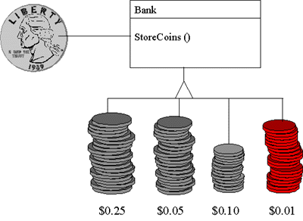
Intent
Motivation
Structure
Applicability
Implementation
Benefits &
Drawbacks
Usage
Motivation
Rather than having a separate slot for each coin denomination coupled with receptacle for the denomination, a single slot is used. When the coin is dropped, the coin is routed to the appropriate receptacle by the mechanical mechanisms within the bank.

Slide 4
Intent
Motivation
Structure
Applicability
Implementation
Benefits &
Drawbacks
Usage
Motivation
help in some graphical application
user can get info about help if he click on any graphical component
even if compent does not have help, help from upper component will be shown
object which shows help knows nothing about object which iniciate help
Solution: Chain of Responsability

Slide 5
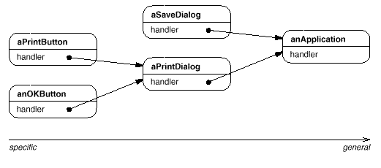
Intent
Motivation
Structure
Applicability
Implementation
Benefits &
Drawbacks
Usage
Motivation
firts object in chain gets request and process the request or forward the request to the next object in a chain

Slide 6
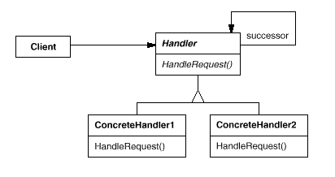
Intent
Motivation
Structure
Applicability
Implementation
Benefits &
Drawbacks
Usage
Structure

Slide 7
Intent
Motivation
Structure
Applicability
Implementation
Benefits &
Drawbacks
Usage
Participants
Handler – define interface for request handling
ConcreteHandler – handle the request, can access to the next object in a chain and forward the request if necesary
Client – initiate request towards ConcreteHandler-u

Slide 8
Intent
Motivation
Structure
Applicability
Implementation
Benefits &
Drawbacks
Usage
Applicability
when more objects can hanlde a request but we do not know which object will handle a request
send request without define the reciever
dynamicaly define group of the object which requsts will be handled

Slide 9
Intent
Motivation
Structure
Applicability
Implementation
Benefits &
Drawbacks
Usage
Implementation
public abstract class Handler {
private Handler sucessor;
public Handler getSucessor() {... }
public void setSucessor(...) {...}
public abstract void handleRequest();
}
public class ConcreteHandler1 extends Handler {
public void handleRequest() {
if(true) {
Handler sucessor=getSucessor();
if (sucessor!=null)
sucessor.handleRequest();
}
}
}

Slide 10
Intent
Motivation
Structure
Applicability
Implementation
Benefits &
Drawbacks
Usage
Implementation
public class ConcreteHandler2 extends Handler {
public void handleRequest() {... }
}
public class Client {
...
Handler hand1=new ConcreteHandler1();
Handler hand2=new ConcreteHandler2();
Handler hand3=new ConcreteHandler1();
hand1.setSucessor(hand2);
hand2.setSucessor(hand3);
hand1.handleRequest();
}

Slide 11
Intent
Structure
Applicability
Implementation
Benefits &
Drawbacks
Usage
Benefits & Drawbacks
simplify events handling
complicates developement, test and debug-ing

Slide 12
Intent
Structure
Applicability
Implementation
Benefits &
Drawbacks
Usage
Usage
AWTEventMulticaster

Slide 13
Intent
Structure
Applicability
Implementation
Benefits &
Drawbacks
Usage
End

