Slide 2
Intent
Motivation
Structure
Applicability
Implementation
Benefits &
Drawbacks
Usage
Intent
“Define the skeleton of an algorithm in an operation, deferring some steps to subclasses. Template Method lets subclasses redefine certain steps of an algorithm without changing the algorithm's structure.”

Slide 3
Intent
Motivation
Structure
Applicability
Implementation
Benefits &
Drawbacks
Usage
Non Software Example of the Template
home builders use the Template Method when developing a new subdivision
a typical subdivision consists of a limited number of floor plans, with different variations available for each floor plan.

Slide 4
Intent
Motivation
Structure
Applicability
Implementation
Benefits &
Drawbacks
Usage
Non Software Example of the Template
within a floor plan, the foundation, framing, plumbing, and wiring will be identical for each house
variation is introduced in the latter stages of construction to produce a wider variety of models

Slide 5
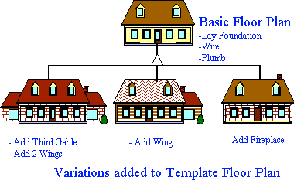
Intent
Motivation
Structure
Applicability
Implementation
Benefits &
Drawbacks
Usage
Non Software Example of the Template

Slide 6
Intent
Motivation
Structure
Applicability
Implementation
Benefits &
Drawbacks
Usage
Motivation
Consider an application framework that provides Application and Document classes
The Application class is responsible for opening existing documents stored in an external format
A Document object represents the information in a document once it's read from the file

Slide 7
Intent
Motivation
Structure
Applicability
Implementation
Benefits &
Drawbacks
Usage
Motivation
The abstract Application class defines the algorithm for opening and reading a document in its OpenDocument operation
OpenDocument defines steps for opening a document:
  it checks if the document can be opened
  creates the Document object
  reads the Document from a file
  ...

Slide 8
Intent
Motivation
Structure
Applicability
Implementation
Benefits &
Drawbacks
Usage
Motivation
We call OpenDocument a template method

Slide 9
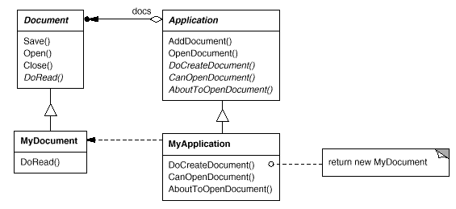
Intent
Motivation
Structure
Applicability
Implementation
Benefits &
Drawbacks
Usage
Motivation

Slide 10
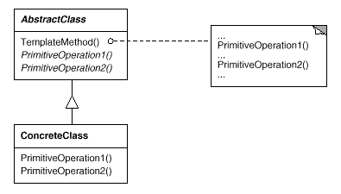
Intent
Motivation
Structure
Applicability
Implementation
Benefits &
Drawbacks
Usage
Structure

Slide 11
Intent
Motivation
Structure
Applicability
Implementation
Benefits &
Drawbacks
Usage
Participants
AbstractClass –
  defines abstract primitive operations that concrete subclasses define to implement steps of an algorithm.
  implements a template method defining the skeleton of an algorithm
ConcreteClass – implements the primitive operations to carry out subclass-specific steps of the algorithm

Slide 12
Intent
Motivation
Structure
Applicability
Implementation
Benefits &
Drawbacks
Usage
Applicability
to implement the invariant parts of an algorithm once
leave it up to subclasses to implement the behavior that can vary
avoid code duplication
want to control the point that subclassing is allowed

Slide 13
Intent
Motivation
Structure
Applicability
Implementation
Benefits &
Drawbacks
Usage
Implementation
abstract class AbstractClass {
public void templateMethod(){
primitiveOperation1();
primitiveOperation2();
}
public abstract void primitiveOperation1();
public abstract void primitiveOperation2();
}

Slide 14
Intent
Motivation
Structure
Applicability
Implementation
Benefits &
Drawbacks
Usage
Implementation
public class ConcreteClass extends AbstractClass{
public void primitiveOperation1() {
...
}
public void primitiveOperation2() {
...
}
}

Slide 15
Intent
Motivation
Structure
Applicability
Implementation
Benefits &
Drawbacks
Usage
Implementation
public class Client {
public static void main(String[] args) {
AbstractClass abstractClass =
new ConcreteClass();
abstractClass.templateMethod();
}
}

Slide 16
Intent
Structure
Applicability
Implementation
Benefits &
Drawbacks
Usage
Benefits & Drawbacks
code reuse
used to create framework for the class
difficult to understand program flow

Slide 17
Intent
Structure
Applicability
Implementation
Benefits &
Drawbacks
Usage
Usage
Arrays class uses it for sorting
java.util.Collections#sort()
JFrame uses update() as a template method
subclasses of the JFrame use paint(Graphics g) as their hook method

Slide 18
Intent
Structure
Applicability
Implementation
Benefits &
Drawbacks
Usage
End

