Slide 2
Intent
Motivation
Structure
Applicability
Implementation
Benefits &
Drawbacks
Usage
Intent
“Represent an operation to be performed on the elements of an object structure. Visitor lets you define a new operation without changing the classes of the elements on which it operates.”

Slide 3
Intent
Motivation
Structure
Applicability
Implementation
Benefits &
Drawbacks
Usage
Non Software Example of the Visitor
Visitor can be observed in the operation of a taxi company
when person calls a taxi company he or she becomes part of the company's list of customers

Slide 4
Intent
Motivation
Structure
Applicability
Implementation
Benefits &
Drawbacks
Usage
Non Software Example of the Visitor
the company then dispatches a cab to the customer (accepting a visitor)
upon entering the taxi, or Visitor, the customer is no longer in control of his or her own transportation, the taxi (driver) is

Slide 5
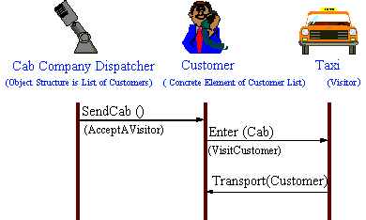
Intent
Motivation
Structure
Applicability
Implementation
Benefits &
Drawbacks
Usage
Non Software Example of the Visitor

Slide 6
Intent
Motivation
Structure
Applicability
Implementation
Benefits &
Drawbacks
Usage
Motivation
consider a compiler that represents programs as abstract syntax trees
it will need to perform operations like:
  type-checking
  code optimization
  flow analysis
  pretty-printing
  code instrumentation
  etc.

Slide 7
Intent
Motivation
Structure
Applicability
Implementation
Benefits &
Drawbacks
Usage
Motivation
most of these operations will need to treat nodes that represent assignment statements differently from nodes that represent variables or arithmetic expressions

Slide 8
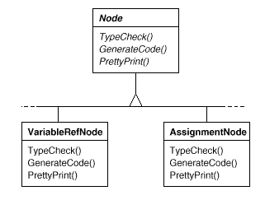
Intent
Motivation
Structure
Applicability
Implementation
Benefits &
Drawbacks
Usage
Motivation

Slide 9
Intent
Motivation
Structure
Applicability
Implementation
Benefits &
Drawbacks
Usage
Motivation
distributing all these operations across the various node classes leads to a system that's hard to understand, maintain, and change
it would be better if each new operation could be added separately, and the node classes were independent of the operations that apply to them

Slide 10
Intent
Motivation
Structure
Applicability
Implementation
Benefits &
Drawbacks
Usage
Motivation
if we package related operations from each class in a separate object, called a visitor, and pass it to elements of the abstract syntax tree as it's traversed
when an element "accepts" the visitor, it sends a request to the visitor that encodes the element's class

Slide 11
Intent
Motivation
Structure
Applicability
Implementation
Benefits &
Drawbacks
Usage
Motivation
it also includes the element as an argument
the visitor will then execute the operation for that element
the operation that used to be in the class of the element.

Slide 12
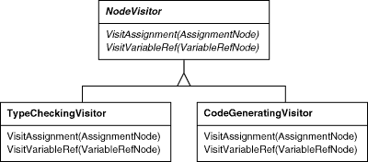
Intent
Motivation
Structure
Applicability
Implementation
Benefits &
Drawbacks
Usage
Motivation

Slide 13
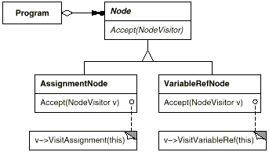
Intent
Motivation
Structure
Applicability
Implementation
Benefits &
Drawbacks
Usage
Motivation

Slide 14
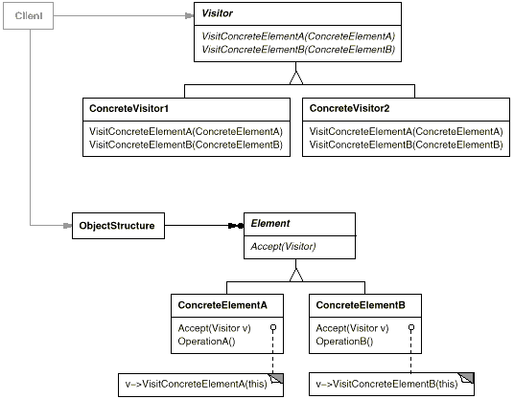
Intent
Motivation
Structure
Applicability
Implementation
Benefits &
Drawbacks
Usage
Structure

Slide 15
Intent
Motivation
Structure
Applicability
Implementation
Benefits &
Drawbacks
Usage
Participants
Visitor – declares a Visit operation for each class of ConcreteElement in the object structure
ConcreteVisitor – implements each operation declared by Visitor. Each operation implements a fragment of the algorithm defined for the corresponding class of object in the structure.
Element - defines an Accept operation that takes a visitor as an argument

Slide 16
Intent
Motivation
Structure
Applicability
Implementation
Benefits &
Drawbacks
Usage
Participants
ConcreteElement – implements an Accept operation that takes a visitor as an argument
ObjectStructure –
  can enumerate its elements
  may provide a high-level interface to allow the visitor to visit its elements.
  may either be a composite or a collection such as a list or a set

Slide 17
Intent
Motivation
Structure
Applicability
Implementation
Benefits &
Drawbacks
Usage
Applicability
object structure contains many classes of objects with differing interfaces
you want to perform operations on these objects that depend on their concrete classes

Slide 18
Intent
Motivation
Structure
Applicability
Implementation
Benefits &
Drawbacks
Usage
Applicability
object structure is shared by many applications, use Visitor to put operations in just those applications that need them
the classes defining the object structure rarely change, but you often want to define new operations over the structure

Slide 19
Intent
Motivation
Structure
Applicability
Implementation
Benefits &
Drawbacks
Usage
Implementation
public interface Visitor {
void visitConcreteElementA(ConcreteElementA e);
void visitConcreteElementB(ConcreteElementB e);
}

Slide 20
Intent
Motivation
Structure
Applicability
Implementation
Benefits &
Drawbacks
Usage
Implementation
public class ConcreteVisitor1 implements Visitor{
public void visitConcreteElementA(ConcreteElementA e) {
e.OperationA();
}
public void visitConcreteElementB(ConcreteElementB e) {
e.OperationB();
}
}

Slide 21
Intent
Motivation
Structure
Applicability
Implementation
Benefits &
Drawbacks
Usage
Implementation
public interface Element {
void Accept(Visitor v);
}
public class ConcreteElementA implements Element {
public void Accept(Visitor v) {
v.visitConcreteElementA(this);
}
public void OperationA(){
..
}
}

Slide 22
Intent
Motivation
Structure
Applicability
Implementation
Benefits &
Drawbacks
Usage
Implementation
public interface Element {
void Accept(Visitor v);
}
public class ConcreteElementA implements Element {
public void Accept(Visitor v) {
v.visitConcreteElementA(this);
}
public void OperationA(){
..
}
}

Slide 23
Intent
Motivation
Structure
Applicability
Implementation
Benefits &
Drawbacks
Usage
Implementation
public class ObjectStructure {
private ArrayList elements=new ArrayList();
...
public void acceptAll(Visitor v) {
foreach(int i=0;i<elements.size();i++) {
Element e=(Element) elements.get(i);
e.Accept(v);
}
}
}

Slide 24
Intent
Motivation
Structure
Applicability
Implementation
Benefits &
Drawbacks
Usage
Implementation
public class Client {
public static void main(String[] args) {
ObjectStructure structure = new ObjectStructure();
structure.addElement( new ConcreteElementA() );
...
ConcreteVisitor1 v1 = new ConcreteVisitor1();
structure.acceptAll( v1 );
}
}

Slide 25
Intent
Structure
Applicability
Implementation
Benefits &
Drawbacks
Usage
Benefits & Drawbacks
makes adding new operation easy
algorithm-specific data structures can be hidden in the visitor

Slide 26
Intent
Structure
Applicability
Implementation
Benefits &
Drawbacks
Usage
Benefits & Drawbacks
adding new ConcreteElement classes is hard
forces to provide public operations that access an element's internal state, which may compromise its encapsulation

Slide 27
Intent
Structure
Applicability
Implementation
Benefits &
Drawbacks
Usage
Usage
javax.lang.model.element.ElementVisitor
javax.lang.model.type.TypeVisitor

Slide 28
Intent
Structure
Applicability
Implementation
Benefits &
Drawbacks
Usage
End

