Slide 2
Intent
Motivation
Structure
Applicability
Implementation
Benefits &
Drawbacks
Usage
Intent
“Encapsulate a request as an object, thereby letting you parameterize clients with different requests, queue or log requests, and support undoable operations.”

Slide 3
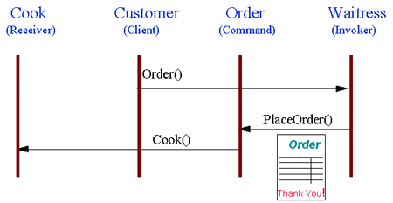
Intent
Motivation
Structure
Applicability
Implementation
Benefits &
Drawbacks
Usage
Motivation

Slide 4
Intent
Motivation
Structure
Applicability
Implementation
Benefits &
Drawbacks
Usage
Motivation
user select action in some graphical application
application catches the request and process the request
what in a case when user hits wrong action
how to return to the previus state
we need list of the actions and states
list will be very complex with a lot of redudancy

Slide 5
Intent
Motivation
Structure
Applicability
Implementation
Benefits &
Drawbacks
Usage
Motivation
we introduce Command object
holds inside action and data for specific commands
aplication calls execute method on Command object
aplication do not need to store different states

Slide 6
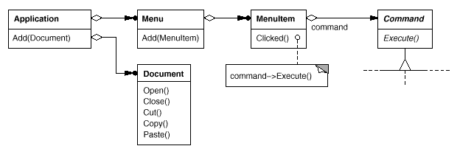
Intent
Motivation
Structure
Applicability
Implementation
Benefits &
Drawbacks
Usage
Motivation

Slide 7
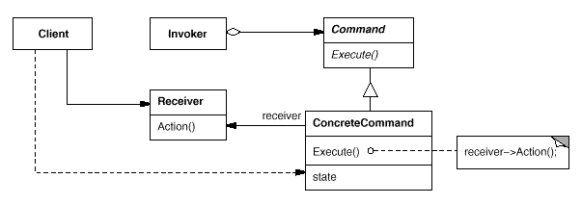
Intent
Motivation
Structure
Applicability
Implementation
Benefits &
Drawbacks
Usage
Structure

Slide 8
Intent
Motivation
Structure
Applicability
Implementation
Benefits &
Drawbacks
Usage
Participants
Command – declares an interface for executing an operation
ConcreteCommand – defines a binding between a Receiver object and an action
Client – creates a ConcreteCommand object and sets its receiver
Invoker – asks the command to carry out the request
Receiver – knows how to perform the operations associated with carrying out a request. Any class may serve as a Receiver

Slide 9
Intent
Motivation
Structure
Applicability
Implementation
Benefits &
Drawbacks
Usage
Applicability
undo, logging i/ili transactions
store and execute commands
separets request from the object where request will be applied

Slide 10
Intent
Motivation
Structure
Applicability
Implementation
Benefits &
Drawbacks
Usage
Implementation
public interface Command {
public void execute();
}
public class Invoker {
private Command com;
public void storeCommand(Command com){
this.com=com;
}
public void execute(){
com.execute();
}
}

Slide 11
Intent
Motivation
Structure
Applicability
Implementation
Benefits &
Drawbacks
Usage
Implementation
public class ConcreteCommand implements Command {
private Receiver rec;
public ConcreteCommand(Receiver rec) {
this.rec = rec;
}
public void execute() {
rec.action();
}
}
public class Receiver {
public void action(){... }
}

Slide 12
Intent
Motivation
Structure
Applicability
Implementation
Benefits &
Drawbacks
Usage
Implementation
public class Client {
private Receiver r;
private ConcreteCommand c;
public static void main(String[] args) {
Client client=new Client();
client.r = new Receiver();
client.c = new ConcreteCommand( client.r );
Invoker i = new Invoker();
i.storeCommand(client.c);
i.execute();
}
}

Slide 13
Intent
Structure
Applicability
Implementation
Benefits &
Drawbacks
Usage
Usage
multi level undo(stack)
transaactions(rollback)
progress bar
wizzards(next, back, finish)
GUI buttons & menu items(java.swingAction je command objekt)
Thread pools(addTask())
Macro(can be extended to script)

Slide 14
Intent
Structure
Applicability
Implementation
Benefits &
Drawbacks
Usage
End

