Slide 2
Intent
Motivation
Structure
Applicability
Implementation
Benefits &
Drawbacks
Usage
Intent
“Given a language, define a representation for its grammar along with an interpreter that uses the representation to interpret sentences in the language.”
define gramatic and interperter which interprets that gramatic

Slide 3
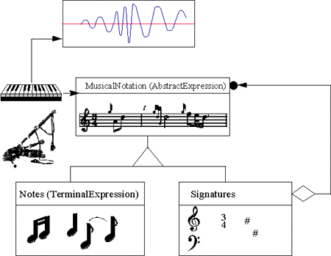
Intent
Motivation
Structure
Applicability
Implementation
Benefits &
Drawbacks
Usage
Motivation

Slide 4
Intent
Motivation
Structure
Applicability
Implementation
Benefits &
Drawbacks
Usage
Motivation
regular expressions are standar way how to search the string according to some expresion
instead of implementing complex algoritms, we can interpret it using regular expressions
Interpreter algoritam describes how to define gramatic for simple languages

Slide 5
Intent
Motivation
Structure
Applicability
Implementation
Benefits &
Drawbacks
Usage
Motivation
for a defined gramatic:
expression ::= literal | alternation | sequence | repetition | '(' expression ')' alternation ::= expression '|' expression
sequence ::= expression '&' expression
repetition ::= expression '*'
literal ::= 'a' | 'b' | 'c' | ... { 'a' | 'b' | 'c' | ... }*
one class presents the one gramatical rule
simbol s desne strane gramatičkog pravila je varijabla u klasi koja predstavlja gramatičko pravilo

Slide 6
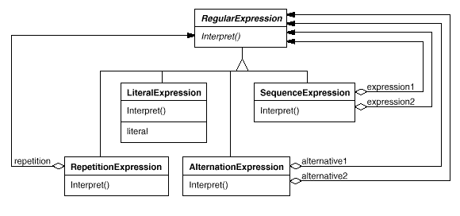
Intent
Motivation
Structure
Applicability
Implementation
Benefits &
Drawbacks
Usage
Motivation

Slide 7
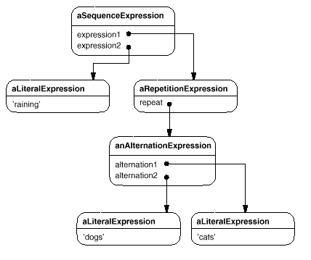
Intent
Motivation
Structure
Applicability
Implementation
Benefits &
Drawbacks
Usage
Motivation
raining & (dogs | cats) *

Slide 8
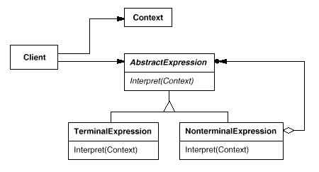
Intent
Motivation
Structure
Applicability
Implementation
Benefits &
Drawbacks
Usage
Structure

Slide 9
Intent
Motivation
Structure
Applicability
Implementation
Benefits &
Drawbacks
Usage
Participants
AbstractExpresion – definira abstraktnu Interpreter operaciju koja je zajednička za AST
TerminalExpresion – implementira Interpreter operaciju povezanu sa simbolom u gramatici(literal), instanca je potrebna za svaki simbol
NonterminalExpresion – po jedna klasa za svako gramatičko pravilo, održava varijable tipa AbstractExpresion(po jedno za svako pravilo)

Slide 10
Intent
Motivation
Structure
Applicability
Implementation
Benefits &
Drawbacks
Usage
Participants
Context – sadrži globalne informacije o Interpreteru
Client – kreira AST koji prezentira rečenicu definiranu u gramatici

Slide 11
Intent
Motivation
Structure
Applicability
Implementation
Benefits &
Drawbacks
Usage
Applicability
interpretacija jednostavnog jezika
brzina nije bitna

Slide 12
Intent
Motivation
Structure
Applicability
Implementation
Benefits &
Drawbacks
Usage
Implementation
public interface AbstractExpression {
public void interpret(Context ctx);
}
public class TerminalExpression implements AbstractExpression {
private Boolean exp;
public TerminalExpression(Boolean exp) {...}
public void interpret(Context ctx) {
ctx.addVariable(this,exp);
}
}

Slide 13
Intent
Motivation
Structure
Applicability
Implementation
Benefits &
Drawbacks
Usage
Implementation
public class NonTerminalExpression implements AbstractExpression {
public NonTerminalExpression(...) {...}
public void interpret(Context ctx) {...}
private AbstractExpression[] abstractExpressions ...;
}
public class Context {
private HashMap map = new HashMap();
public Object get(Object name){
return map.get(name);
}
public void addVariable(Object name, Object value){...}
}

Slide 14
Intent
Motivation
Structure
Applicability
Implementation
Benefits &
Drawbacks
Usage
Implementation
public class Client {
Context context = new Context();
AbstractExpression t1=new TerminalExpression(new Boolean(true));
AbstractExpression t2=new TerminalExpression(new Boolean(false));
AbstractExpression nt1=new NonTerminalExpression(t1,t2);
nt1.interpret(context);
...
}

Slide 15
Intent
Structure
Applicability
Implementation
Benefits &
Drawbacks
Usage
Benefits & Drawbacks
brzo se pilagodi promjenama u gramatici
nepraktičan za velike gramatike(veliki broj novih klasa)

Slide 16
Intent
Structure
Applicability
Implementation
Benefits &
Drawbacks
Usage
Usage
SQL ili jezici za upite na bazu podataka
jezici za opis komunikacijskih protokola

Slide 17
Intent
Structure
Applicability
Implementation
Benefits &
Drawbacks
Usage
Vježba
pronađi primjer jednostavog Interpreter patterna
te ga implementiraj

Slide 18
Intent
Structure
Applicability
Implementation
Benefits &
Drawbacks
Usage
Kraj

