Slide 2
Intent
Motivation
Structure
Applicability
Implementation
Benefits &
Drawbacks
Usage
Intent
“Provide a way to access the elements of an aggregate object sequentially without exposing its underlying representation.”

Slide 3

Intent
Motivation
Structure
Applicability
Implementation
Benefits &
Drawbacks
Usage
Motivation

Slide 4
Intent
Motivation
Structure
Applicability
Implementation
Benefits &
Drawbacks
Usage
Motivation
collection must have possibility to acces each element of the collection without expressing internal structure of each element
we want to “walk” through collection
Iterator pattern
Iterator class defines interface for access to the collection elements
Iterator holds information abut current element

Slide 5
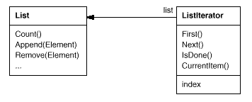
Intent
Motivation
Structure
Applicability
Implementation
Benefits &
Drawbacks
Usage
Motivation
realization between List & ListIterator classes:

Slide 6
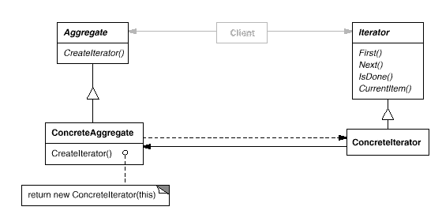
Intent
Motivation
Structure
Applicability
Implementation
Benefits &
Drawbacks
Usage
Structure

Slide 7
Intent
Motivation
Structure
Applicability
Implementation
Benefits &
Drawbacks
Usage
Participants
Iterator – defines an interface for accessing and traversing elements
ConcreteIterator – implements the Iterator interface, keeps track of the current position in the traversal of the aggregate
Aggregate – defines an interface for creating an Iterator object
ConcreteAgregate – implements the Iterator creation interface to return an instance of the proper ConcreteIterator

Slide 8
Intent
Motivation
Structure
Applicability
Implementation
Benefits &
Drawbacks
Usage
Applicability
to access an aggregate object's contents without exposing its internal representation
to support multiple traversals of aggregate objects
to provide a uniform interface for traversing different aggregate structures (that is, to support polymorphic iteration)

Slide 9
Intent
Motivation
Structure
Applicability
Implementation
Benefits &
Drawbacks
Usage
Implementation
public interface Aggregate {
MyIterator createIterator();
}
public class ConcreteAggregate implements Aggregate {
public MyIterator createIterator() {
return new MyConcreteIterator(this);
}
}

Slide 10
Intent
Motivation
Structure
Applicability
Implementation
Benefits &
Drawbacks
Usage
Implementation
public interface Iterator {
Object first();
Object next();
boolean isDone();
Object currentItem();
}
public class ConcreteIterator implements Iterator {
private ConcreteAggregate agg;
public ConcreteIterator(ConcreteAggregate agg) {
this.agg = agg;
}
public Object first() {... }
public Object next() {... }
public boolean isDone() {... }
public Object currentItem() {... }
}

Slide 11
Intent
Structure
Applicability
Implementation
Benefits &
Drawbacks
Usage
Benefits & Drawbacks
simplify collections
varius traverse options
more navigation points in collection

Slide 12
Intent
Structure
Applicability
Implementation
Benefits &
Drawbacks
Usage
Usage
Collection Framework, package java.util
Collection interface define method Iterator
List interface define listIterator method
Iterator interface, navigation in one direction(forward)
ListIterator interface navigation in both directions(forward & back)

Slide 13
Intent
Structure
Applicability
Implementation
Benefits &
Drawbacks
Usage
End

