Slide 2
Intent
Motivation
Structure
Applicability
Implementation
Benefits &
Drawbacks
Usage
Intent
“Define an object that encapsulates how a set of objects interact. Mediator promotes loose coupling by keeping objects from referring to each other explicitly, and it lets you vary their interaction independently.”

Slide 3
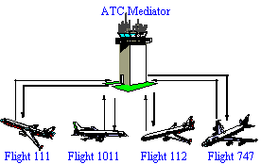
Intent
Motivation
Structure
Applicability
Implementation
Benefits &
Drawbacks
Usage
Motivation

Slide 4
Intent
Motivation
Structure
Applicability
Implementation
Benefits &
Drawbacks
Usage
Motivation
dialog box for an GUI application
dialog box has a lot graphical elements (buttons, menus, listboxes, entry fields)
graphical elements are dependent
e.g. Selecting an element in listbox, loads one entry field

Slide 5
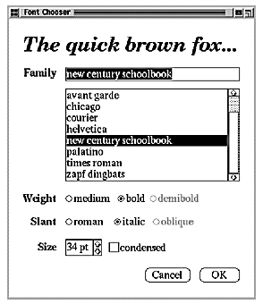
Intent
Motivation
Structure
Applicability
Implementation
Benefits &
Drawbacks
Usage
Motivation

Slide 6
Intent
Motivation
Structure
Applicability
Implementation
Benefits &
Drawbacks
Usage
Motivation
Mediator separates common behavior in an independent object
Mediator controlls interaction between objects

Slide 7
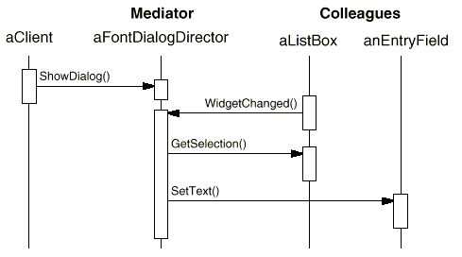
Intent
Motivation
Structure
Applicability
Implementation
Benefits &
Drawbacks
Usage
Motivation

Slide 8
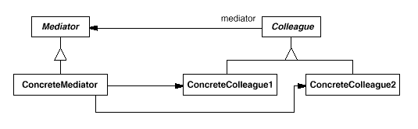
Intent
Motivation
Structure
Applicability
Implementation
Benefits &
Drawbacks
Usage
Structure

Slide 9
Intent
Motivation
Structure
Applicability
Implementation
Benefits &
Drawbacks
Usage
Participants
Mediator – defines an interface for communicating with Colleague objects
ConcreteMediator – implements cooperative behavior by coordinating Colleague objects Colleague classes – each Colleague class knows its Mediator object, each colleague communicates with its mediator whenever it would have otherwise communicated with another colleague

Slide 10
Intent
Motivation
Structure
Applicability
Implementation
Benefits &
Drawbacks
Usage
Applicability
a set of objects communicate in well-defined but complex ways
reusing an object is difficult because it refers to and communicates with many other objects
a behavior that's distributed between several classes should be customizable without a lot of subclassing

Slide 11
Intent
Motivation
Structure
Applicability
Implementation
Benefits &
Drawbacks
Usage
Implementation
public interface Mediator {
public void colleagueChanged(Colleague c);
}
public class ConcreteMediator implements Mediator {
private ConcreteColleague1 concreteColleague1;
private ConcreteColleague2 concreteColleague2;
public void colleagueChanged(Colleague c) {
if(c==concreteColleague1){... }
else if (c==concreteColleague2) {... }
else { // we can have N colleagues
}
}
}

Slide 12
Intent
Motivation
Structure
Applicability
Implementation
Benefits &
Drawbacks
Usage
Implementation
public abstract class Colleague {
private Mediator mediator;
public Colleague(Mediator mediator) {
super();
this.mediator = mediator;
}
public Mediator getMediator() {...}
public void setMediator(...) {...}
}
public class ConcreteColleague1 extends Colleague {
...
public void methodA() {
this.getMediator().colleagueChanged(this);
}
}

Slide 13
Intent
Motivation
Structure
Applicability
Implementation
Benefits &
Drawbacks
Usage
Implementation
public class Client {
...
ConcreteMediator m=new ConcreteMediator();
ConcreteColleague1 col1=new ConcreteColleague1(m);
ConcreteColleague2 col2=new ConcreteColleague2(m);
m.setConcreteColleague1(col1);
m.setConcreteColleague2(col2);
col1.methodA();
}

Slide 14
Intent
Structure
Applicability
Implementation
Benefits &
Drawbacks
Usage
Benefits & Drawbacks
simplier components
components are generic
testing and debuging is complicated
hard to maintain

Slide 15
Intent
Structure
Applicability
Implementation
Benefits &
Drawbacks
Usage
Usage
messaging systems, brokers

Slide 16
Intent
Structure
Applicability
Implementation
Benefits &
Drawbacks
Usage
End

