Slide 2
Intent
Motivation
Structure
Applicability
Implementation
Benefits &
Drawbacks
Usage
Intent
“Without violating encapsulation, capture and externalize an object's internal state so that the object can be restored to this state later.”

Slide 3
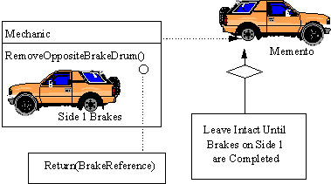
Intent
Motivation
Structure
Applicability
Implementation
Benefits &
Drawbacks
Usage
Motivation

Slide 4
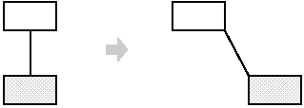
Intent
Motivation
Structure
Applicability
Implementation
Benefits &
Drawbacks
Usage
Motivation
GUI application draws objects and connection between them
user move rectangle
how to ensure undo operation

Slide 5
Intent
Motivation
Structure
Applicability
Implementation
Benefits &
Drawbacks
Usage
Motivation
memento stores internal state of the object
undo returns object in previus state

Slide 6
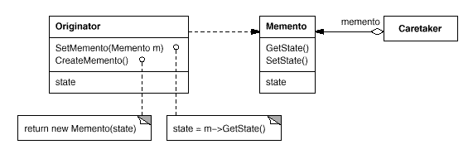
Intent
Motivation
Structure
Applicability
Implementation
Benefits &
Drawbacks
Usage
Structure

Slide 7
Intent
Motivation
Structure
Applicability
Implementation
Benefits &
Drawbacks
Usage
Participants
Memento – stores internal state of the Originator object , protects against access by objects other than the originator
Originator – creates a memento containing a snapshot of its current internal state, uses the memento to restore its internal state
Caretaker – is responsible for the memento's safekeeping

Slide 8
Intent
Motivation
Structure
Applicability
Implementation
Benefits &
Drawbacks
Usage
Applicability
a snapshot of (some portion of) an object's state must be saved so that it can be restored to that state later
a direct interface to obtaining the state would expose implementation details and break the object's encapsulation

Slide 9
Intent
Motivation
Structure
Applicability
Implementation
Benefits &
Drawbacks
Usage
Implementation
public class Originator {
private StringBuffer state = new StringBuffer();
public void addToState(String s) {... }
public void setMemento(Memento m) {... }
public Memento createMemento() {...}
public StringBuffer getState() {...}
}
public class Memento {
private StringBuffer mementoState;
public Memento(StringBuffer state) {...}
public StringBuffer getState(){...}
}

Slide 10
Intent
Motivation
Structure
Applicability
Implementation
Benefits &
Drawbacks
Usage
Implementation
public class Caretaker {
private Memento memento;
public Memento getMemento() {...}
public void setMemento(Memento memento) {...}
}

Slide 11
Intent
Motivation
Structure
Applicability
Implementation
Benefits &
Drawbacks
Usage
Implementation
public class Client {
...
Originator o=new Originator();
o.addToState(" first ");
o.addToState(" second ");
Caretaker c=new Caretaker();
c.setMemento(o.createMemento());
o.addToState(" third ");
// undo
o.setMemento(c.getMemento());
}

Slide 12
Intent
Structure
Applicability
Implementation
Benefits &
Drawbacks
Usage
Benefits & Drawbacks
ensure encapsulation
if Originator is a big object, we must store a lot of states, so Memento may not be god solution

Slide 13
Intent
Structure
Applicability
Implementation
Benefits &
Drawbacks
Usage
Usage
classical examples:
  pseudorandom number generator
  finite state machine

Slide 14
Intent
Structure
Applicability
Implementation
Benefits &
Drawbacks
Usage
End

