Slide 2
Intent
Motivation
Structure
Applicability
Implementation
Benefits &
Drawbacks
Usage
Intent
“Define a one-to-many dependency between objects so that when one object changes state, all its dependents are notified and updated automatically.”

Slide 3
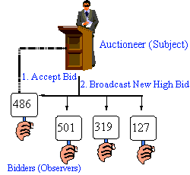
Intent
Motivation
Structure
Applicability
Implementation
Benefits &
Drawbacks
Usage
Motivation

Slide 4
Intent
Motivation
Structure
Applicability
Implementation
Benefits &
Drawbacks
Usage
Motivation
GUI aplication often separates graphical presentation and data model
same data model is shown on graph and in table

Slide 5
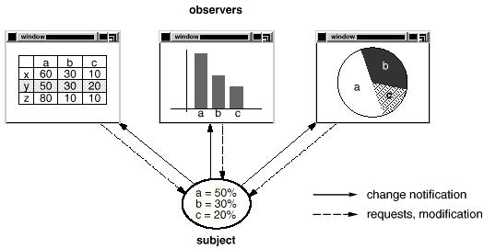
Intent
Motivation
Structure
Applicability
Implementation
Benefits &
Drawbacks
Usage
Motivation

Slide 6
Intent
Motivation
Structure
Applicability
Implementation
Benefits &
Drawbacks
Usage
Motivation
Observer pattern offers a solution
two key objects are subject and observer
subjects applies themself to the observers
changes in the subject are notified to all observers

Slide 7
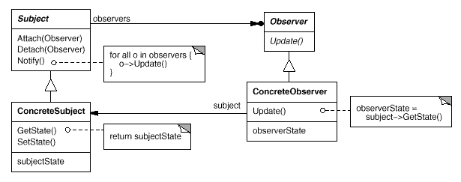
Intent
Motivation
Structure
Applicability
Implementation
Benefits &
Drawbacks
Usage
Structure

Slide 8
Intent
Motivation
Structure
Applicability
Implementation
Benefits &
Drawbacks
Usage
Participants
Subject – knows its observers. Any number of Observer objects may observe a subject
Observer – defines an updating interface for objects that should be notified of changes in a subject
ConcreteSubject – stores state of interest to ConcreteObserver objects, sends a notification to its observers when its state changes
ConcreteObserver – maintains a reference to a ConcreteSubject object, stores state that should stay consistent with the subject's, implements the Observer updating interface to keep its state consistent with the subject's

Slide 9
Intent
Motivation
Structure
Applicability
Implementation
Benefits &
Drawbacks
Usage
Applicability
When an abstraction has two aspects, one dependent on the other. Encapsulating these aspects in separate objects lets you vary and reuse them independently
When a change to one object requires changing others, and you don't know how many objects need to be changed
When an object should be able to notify other objects without making assumptions about who these objects are

Slide 10
Intent
Motivation
Structure
Applicability
Implementation
Benefits &
Drawbacks
Usage
Implementation
public interface Observer {
public void update();
}
public class ConcreteObserver implements Observer {
private String name;
private int observerState;
private ConcreteSubject subject;
public ConcreteObserver(ConcreteSubject subject,
String name) {...}
public void update() {
observerState=subject.getState();
}
}

Slide 11
Intent
Motivation
Structure
Applicability
Implementation
Benefits &
Drawbacks
Usage
Implementation
public abstract class Subject {
private Collection observers=new ArrayList();
public void attach( Observer observer ) {... }
public void detach( Observer observer ) {...}
public void notifyObservers() {
Iterator i=observers.iterator();
Observer currObserver;
while( i.hasNext()){
currObserver=(Observer) i.next();
currObserver.update();
}
}
}

Slide 12
Intent
Motivation
Structure
Applicability
Implementation
Benefits &
Drawbacks
Usage
Implementation
public class ConcreteSubject extends Subject {
private int subjectState;
public int getState() {
return subjectState;
}
public void setState(int subjectState) {
this.subjectState = subjectState;
this.notifyObservers();
}
}

Slide 13
Intent
Motivation
Structure
Applicability
Implementation
Benefits &
Drawbacks
Usage
Implementation
public class Client {
public static void main(String[] args) {
ConcreteSubject s = new ConcreteSubject();
s.attach( new ConcreteObserver( s, “A" ) );
s.attach( new ConcreteObserver( s, “B" ) );
s.attach( new ConcreteObserver( s, “C" ) );
// Change subject and notify observers
s.setState(1);
s.setState(2);
}
}

Slide 14
Intent
Structure
Applicability
Implementation
Benefits &
Drawbacks
Usage
Benefits & Drawbacks
easy testing
easy to add new observer
potential problems with “messaging” strategy:
  generic – to many(unnesecary) mesagges to the observers
  specific – complex code

Slide 15
Intent
Structure
Applicability
Implementation
Benefits &
Drawbacks
Usage
Usage
Event handling, java.awt.event, javax.swing.event, java.util

Slide 16
Intent
Structure
Applicability
Implementation
Benefits &
Drawbacks
Usage
End

