Slide 2
Intent
Motivation
Structure
Applicability
Implementation
Benefits &
Drawbacks
Usage
Intent
“Allow an object to alter its behavior when its internal state changes. The object will appear to change its class.”

Slide 3
Intent
Motivation
Structure
Applicability
Implementation
Benefits &
Drawbacks
Usage
Non Software Example of State
vending machines have states based on:
  inventory
  amount of currency deposited
  the ability to make change
  the item selected, etc.

Slide 4
Intent
Motivation
Structure
Applicability
Implementation
Benefits &
Drawbacks
Usage
Non Software Example of State
when currency is deposited and a selection is made, a vending machine will
  deliver a product
  deliver no product due to insufficient currency on deposit
  deliver no product due to inventory depletion

Slide 5
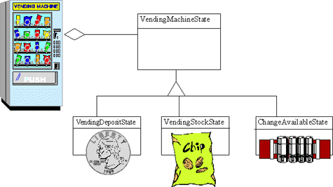
Intent
Motivation
Structure
Applicability
Implementation
Benefits &
Drawbacks
Usage
Non Software Example of State

Slide 6
Intent
Motivation
Structure
Applicability
Implementation
Benefits &
Drawbacks
Usage
Motivation
TCPConnection represents a network connection
TCPConnection object can be in different states
  Established
  Listening
  Closed

Slide 7
Intent
Motivation
Structure
Applicability
Implementation
Benefits &
Drawbacks
Usage
Motivation
TCPConnection responds differently depending on its current state
e.g. Open request depends of the curent state(e.g. Open/Closed)
The State pattern describes how TCPConnection can exhibit different behavior in each state

Slide 8
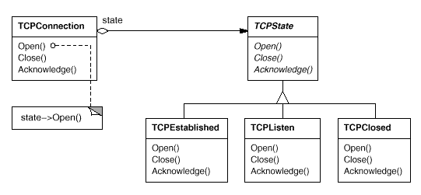
Intent
Motivation
Structure
Applicability
Implementation
Benefits &
Drawbacks
Usage
Motivation

Slide 9
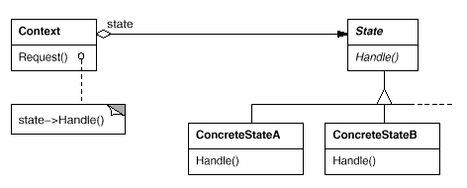
Intent
Motivation
Structure
Applicability
Implementation
Benefits &
Drawbacks
Usage
Structure

Slide 10
Intent
Motivation
Structure
Applicability
Implementation
Benefits &
Drawbacks
Usage
Participants
Context – defines the interface of interest to clients, maintains an instance of a ConcreteState subclass that defines the current state
State – defines an interface for encapsulating the behavior associated with a particular state of the Context
ConcreteState subclasses – each subclass implements a behavior associated with a state of the Context

Slide 11
Intent
Motivation
Structure
Applicability
Implementation
Benefits &
Drawbacks
Usage
Applicability
An object's behavior depends on its state, and it must change its behavior at run-time depending on that state
Operations have large, multipart conditional statements that depend on the object's state
The State pattern puts each branch of the conditional in a separate class

Slide 12
Intent
Motivation
Structure
Applicability
Implementation
Benefits &
Drawbacks
Usage
Implementation
public interface State {
public void handle();
}
public class ConcreteStateA implements State{
public void handle() {
...
}
}

Slide 13
Intent
Motivation
Structure
Applicability
Implementation
Benefits &
Drawbacks
Usage
Implementation
public class Context {
private State state;
public State getState() {
return state;
}
public void setState(State state) {
this.state = state;
}
public void request(){
state.handle();
}
}

Slide 14
Intent
Motivation
Structure
Applicability
Implementation
Benefits &
Drawbacks
Usage
Implementation
public class Client {
public static void main(String[] args) {
Context ctx=new Context();
State stateA=new ConcreteStateA();
State stateB=new ConcreteStateB();
ctx.setState(stateA);
ctx.request();
ctx.setState(stateB);
ctx.request();
}
}

Slide 15
Intent
Structure
Applicability
Implementation
Benefits &
Drawbacks
Usage
Benefits & Drawbacks
encapsulate and simplify state processing
decrese amount of code duplication
responsibility portioned out into encapsulated and cohesive unites
can potentialy have to many small classes
can complicate when used in trivial cases

Slide 16
Intent
Structure
Applicability
Implementation
Benefits &
Drawbacks
Usage
Usage
This allows you easily change an object’s behavior at runtime based on internal state.
-javax.faces.lifecycle.LifeCycle#execute()

Slide 17
Intent
Structure
Applicability
Implementation
Benefits &
Drawbacks
Usage
End

