Slide 2
Intent
Motivation
Structure
Applicability
Implementation
Benefits &
Drawbacks
Usage
Intent
“Define a family of algorithms, encapsulate each one, and make them interchangeable.
Strategy lets the algorithm vary independently from clients that use it.”

Slide 3
Intent
Motivation
Structure
Applicability
Implementation
Benefits &
Drawbacks
Usage
Non Software Example of Strategy
modes of transportation to an airport is an example of a Strategy
several options exist, such as:
  driving one's own car
  taking a taxi
  etc.

Slide 4
Intent
Motivation
Structure
Applicability
Implementation
Benefits &
Drawbacks
Usage
Non Software Example of Strategy
for some airports, subways and helicopters are also available
any of these modes of transportation will get a traveler to the airport
the traveler must chose the Strategy based on tradeoffs between cost, convenience, and time

Slide 5
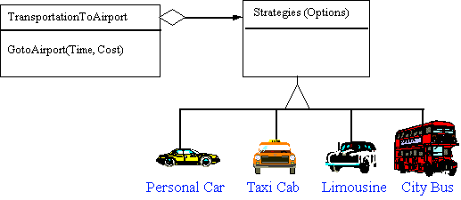
Intent
Motivation
Structure
Applicability
Implementation
Benefits &
Drawbacks
Usage
Non Software Example of Strategy

Slide 6
Intent
Motivation
Structure
Applicability
Implementation
Benefits &
Drawbacks
Usage
Motivation
many algorithms exist for breaking a stream of text into lines
hard-wiring all such algorithms into the classes isn't desirable for several reasons:
  clients becomes complex if we include linebreaking code
  different algorithms nedded at different times
  we don't want multiple algorithms if we don't use them all
  difficult to add new algorithms

Slide 7
Intent
Motivation
Structure
Applicability
Implementation
Benefits &
Drawbacks
Usage
Motivation
we can avoid these problems by defining classes that encapsulate different linebreaking algorithms
an algorithm that's encapsulated in this way is called a strategy.

Slide 8
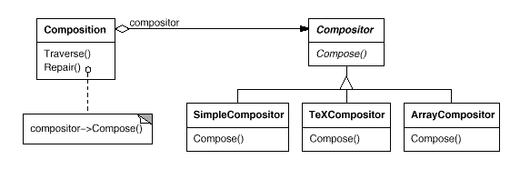
Intent
Motivation
Structure
Applicability
Implementation
Benefits &
Drawbacks
Usage
Motivation

Slide 9
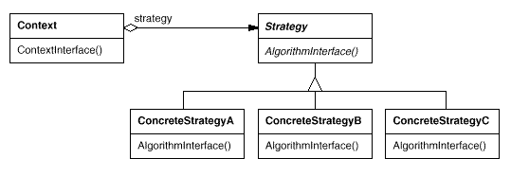
Intent
Motivation
Structure
Applicability
Implementation
Benefits &
Drawbacks
Usage
Structure

Slide 10
Intent
Motivation
Structure
Applicability
Implementation
Benefits &
Drawbacks
Usage
Participants
Strategy – declares an interface common to all supported algorithms. Context uses this interface to call the algorithm defined by a ConcreteStrategy
ConcreteStrategy – implements the algorithm using the Strategy interface

Slide 11
Intent
Motivation
Structure
Applicability
Implementation
Benefits &
Drawbacks
Usage
Participants
Context –
  is configured with a ConcreteStrategy object
  maintains a reference to a Strategy object
  may define an interface that lets Strategy access its data

Slide 12
Intent
Motivation
Structure
Applicability
Implementation
Benefits &
Drawbacks
Usage
Applicability
you need different variants of an algorithm
many related classes differ only in their behavior
an algorithm uses data that clients shouldn't know about. Use the Strategy pattern to avoid exposing complex, algorithm-specific data structures.
a class defines many behaviors, and these appear as multiple conditional statements in its operations

Slide 13
Intent
Motivation
Structure
Applicability
Implementation
Benefits &
Drawbacks
Usage
Implementation
public interface Strategy {
public void algorithmInterface();
}
public class ConcreteStrategyA implements Strategy{
public void algorithmInterface() {
System.out.println(...);
}
}

Slide 14
Intent
Motivation
Structure
Applicability
Implementation
Benefits &
Drawbacks
Usage
Implementation
public class Context {
private Strategy strategy;
public Strategy getStrategy() {
return strategy;
}
public void setStrategy(Strategy strategy) {
this.strategy = strategy;
}
public void contextInterface(){
strategy.algorithmInterface();
}
}

Slide 15
Intent
Motivation
Structure
Applicability
Implementation
Benefits &
Drawbacks
Usage
Implementation
public class Client {
public static void main(String[] args) {
Context ctx=new Context();
ctx.setStrategy(new ConcreteStrategyA());
ctx.contextInterface();
ctx.setStrategy(new ConcreteStrategyB());
ctx.contextInterface();
ctx.setStrategy(new ConcreteStrategyC());
ctx.contextInterface();
}
}

Slide 16
Intent
Structure
Applicability
Implementation
Benefits &
Drawbacks
Usage
Benefits & Drawbacks
separate algorithms into classes that can be plugged in runtime
decouple algorithm logic from usage
eliminate conditional statements
choice of implementation
increased number of object(shared strategy together with Flyweight)
all algorithms must use same interface

Slide 17
Intent
Structure
Applicability
Implementation
Benefits &
Drawbacks
Usage
Usage
Swing Border
Swing LayoutManagers

Slide 18
Intent
Structure
Applicability
Implementation
Benefits &
Drawbacks
Usage
End

