Slide 1

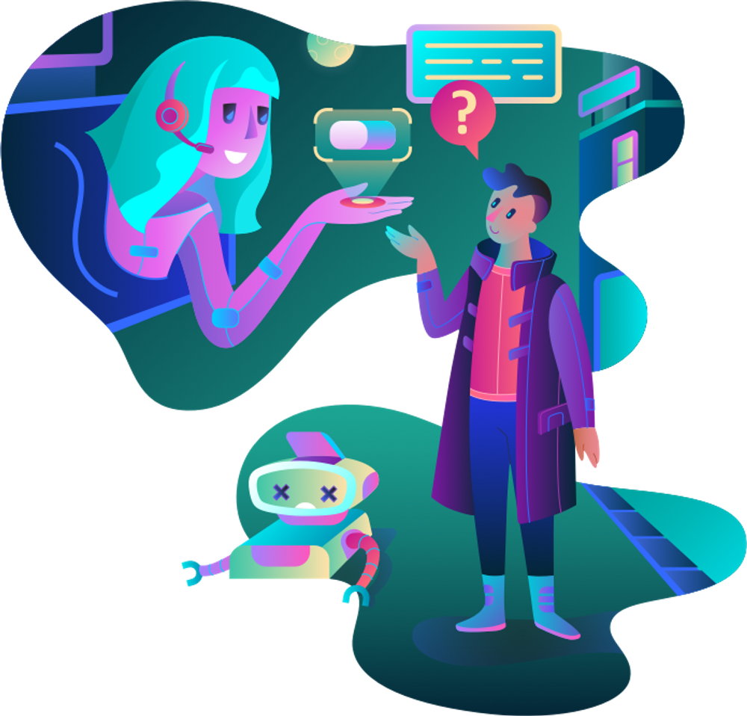
The Role of AI in
Business Communication

Slide 2

Agenda
Basic use of AI
Virtual influencer
AI Chatbot
Real-Time Language Translation
Chat Summaries with Teams Copilot
Amazon Q – Generative AI Assistant
AI Assistants in Vehicles: Smarter & Safe Driving

Slide 3
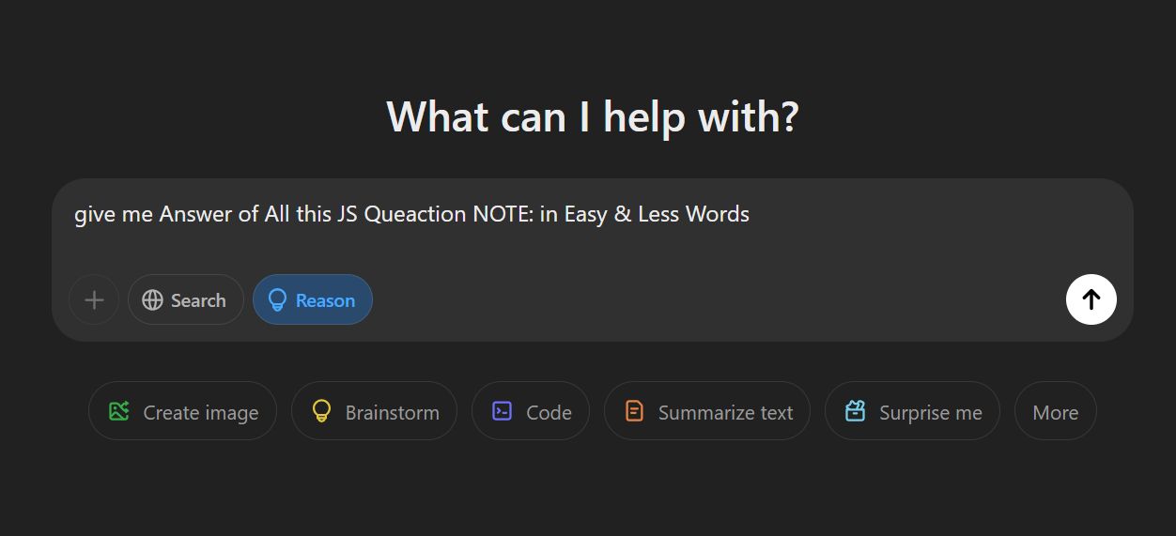
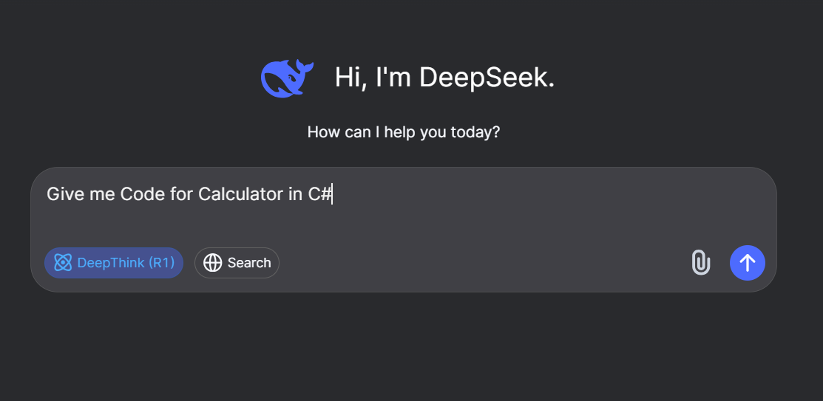
Basic use of AI(as Student’s)

Slide 4


But What is Other use of AI??
Generate images
Ask General Questions
Research ETC..

Slide 5
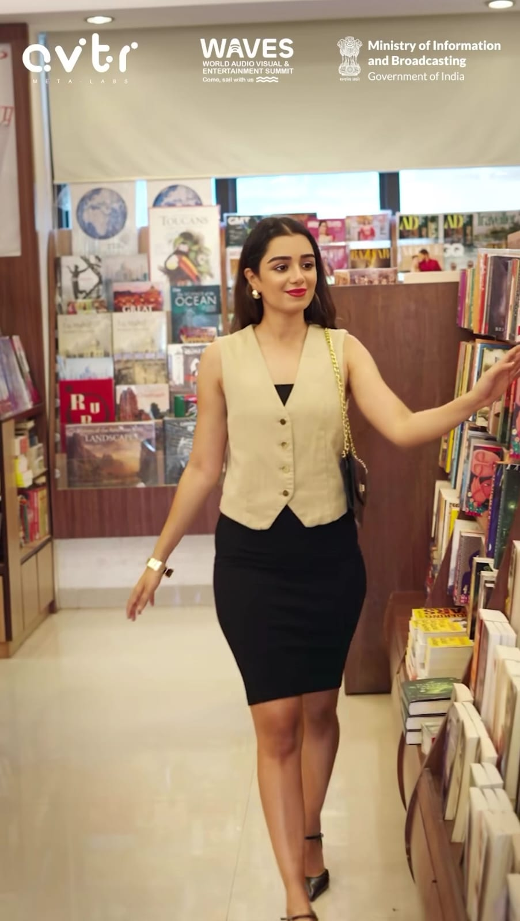
Virtual influencer
AI-created influencers, like models, engage audiences, represent brands, and interact like real humans, redefining digital marketing.
made by Avtr Meta Labs.

Slide 6
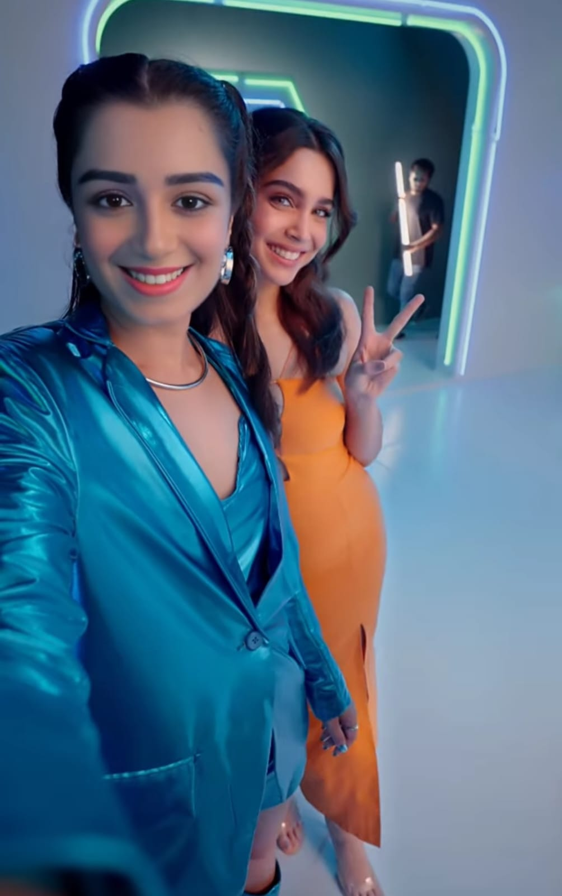
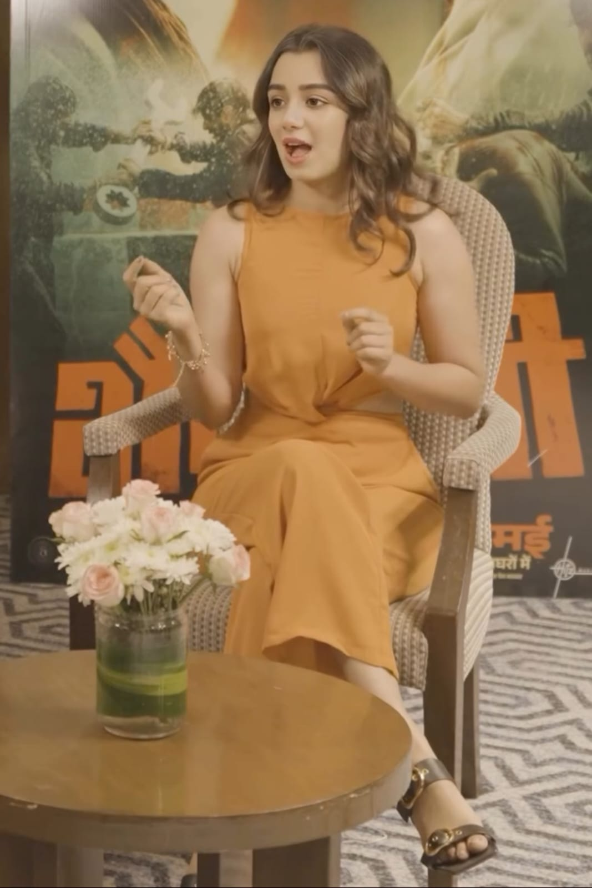


Naina Avtr
426K follower's
455K Subscribers

Slide 7
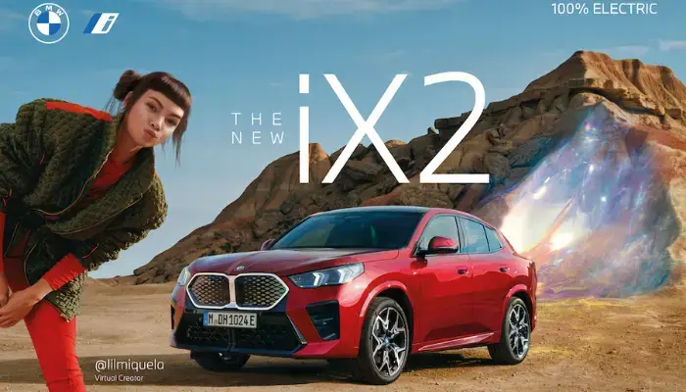
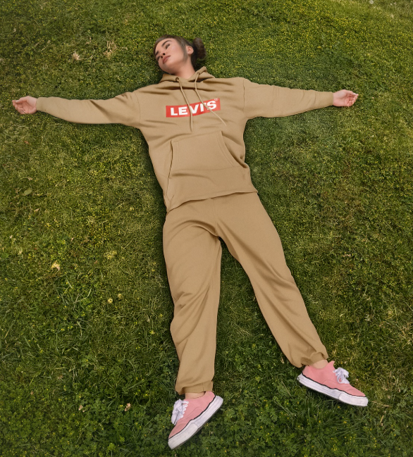
lilmiquela
2.4M follower's
Calvin Klein, Prada, Samsung , LEVI’S , Apple , BMW , Audi LV(Louis Vuitton) , NIKE , etc..

Slide 8
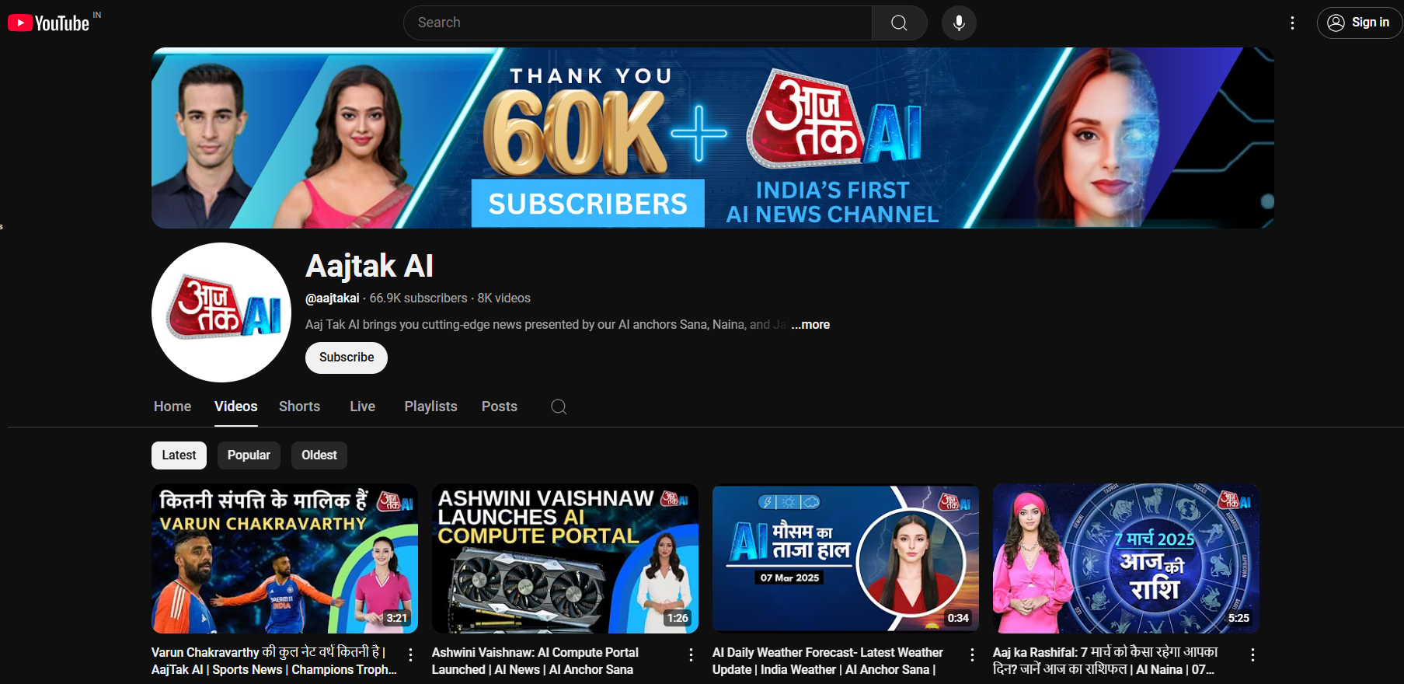
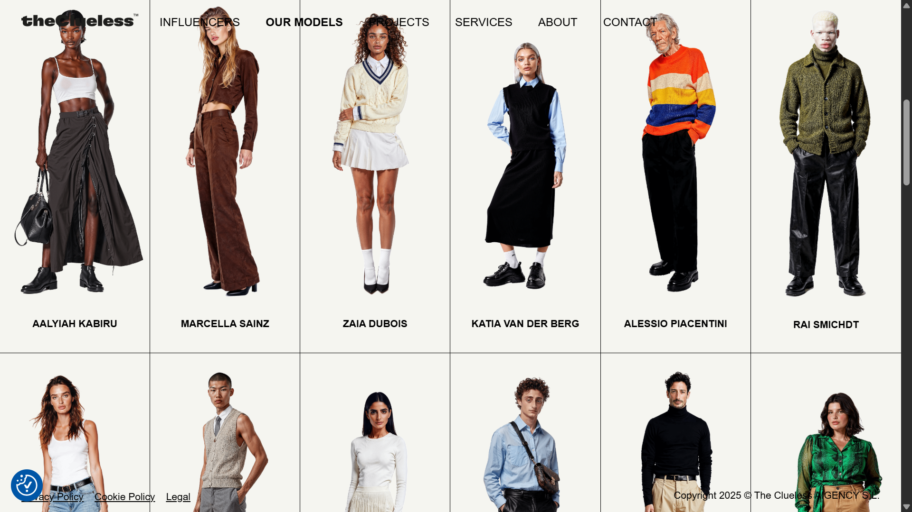
Aajtak Ai
theclueless.ai
INDIA’S FIRST AI NEWS CHANNEL
We are an agency dedicated to creating AI-powered models and avatars.

Slide 9
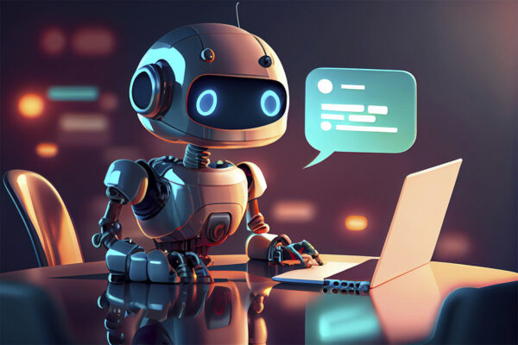
AI Chatbot
AI chatbots, used by companies like Amazon, Google, Microsoft, and Meta, enhance customer service, automate tasks, and provide instant support.
Providers include OpenAI (ChatGPT), IBM Watson, Drift, and Kore.ai , chatbase

Slide 10

AI Chatbot
In terms of financial impact, a 2018 study by Juniper Research projected that by 2023, chatbots would save businesses in the retail, banking, and healthcare sectors $11 billion annually in customer service costs.
BY:

Slide 11
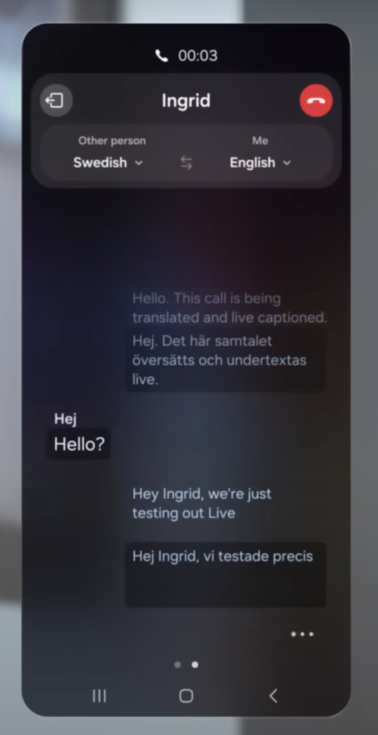
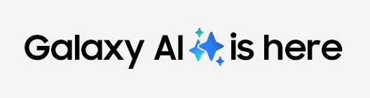
Real-Time Language Translation
An AI tool that instantly translates live conversations, enabling clear communication between speakers of different languages.

Slide 12
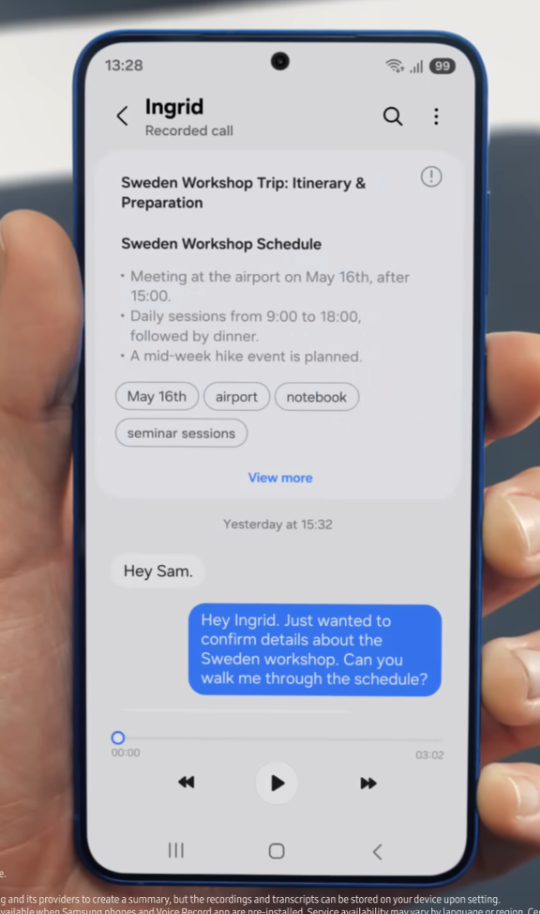
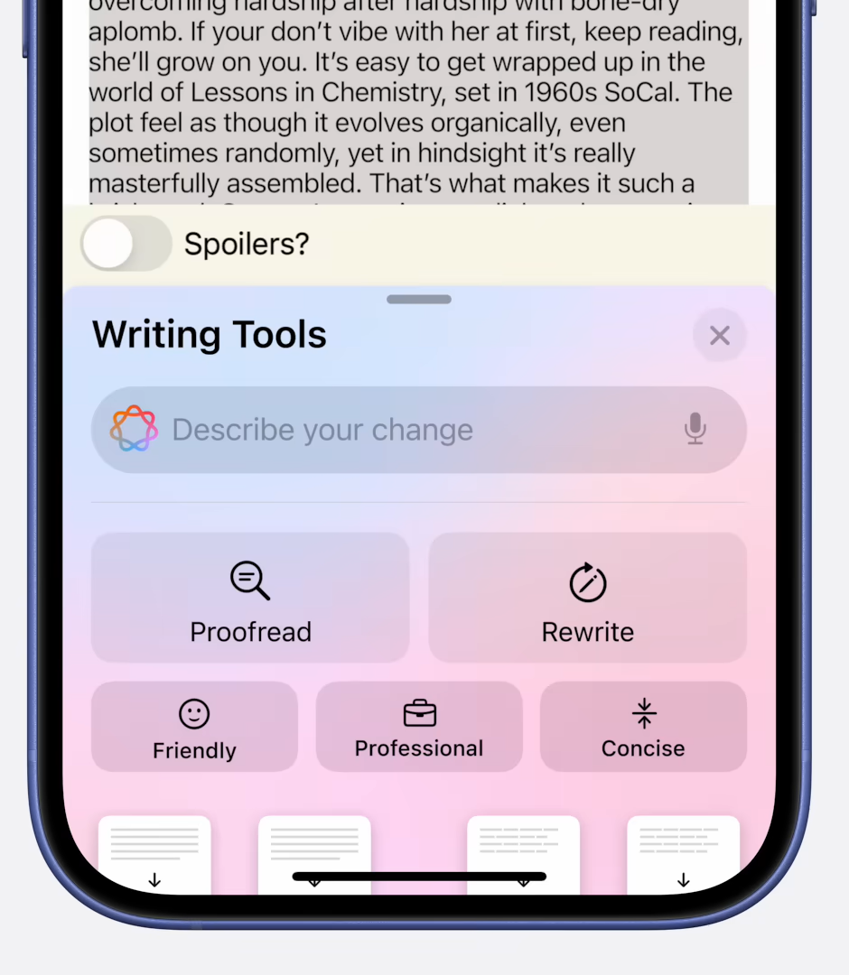

Convert Normal text into Professional

Slide 13

Chat Summaries with Teams Copilot
Microsoft Teams Copilot uses AI to automatically summarize chats and analyze conversations, highlighting key insights and action items.

Slide 14
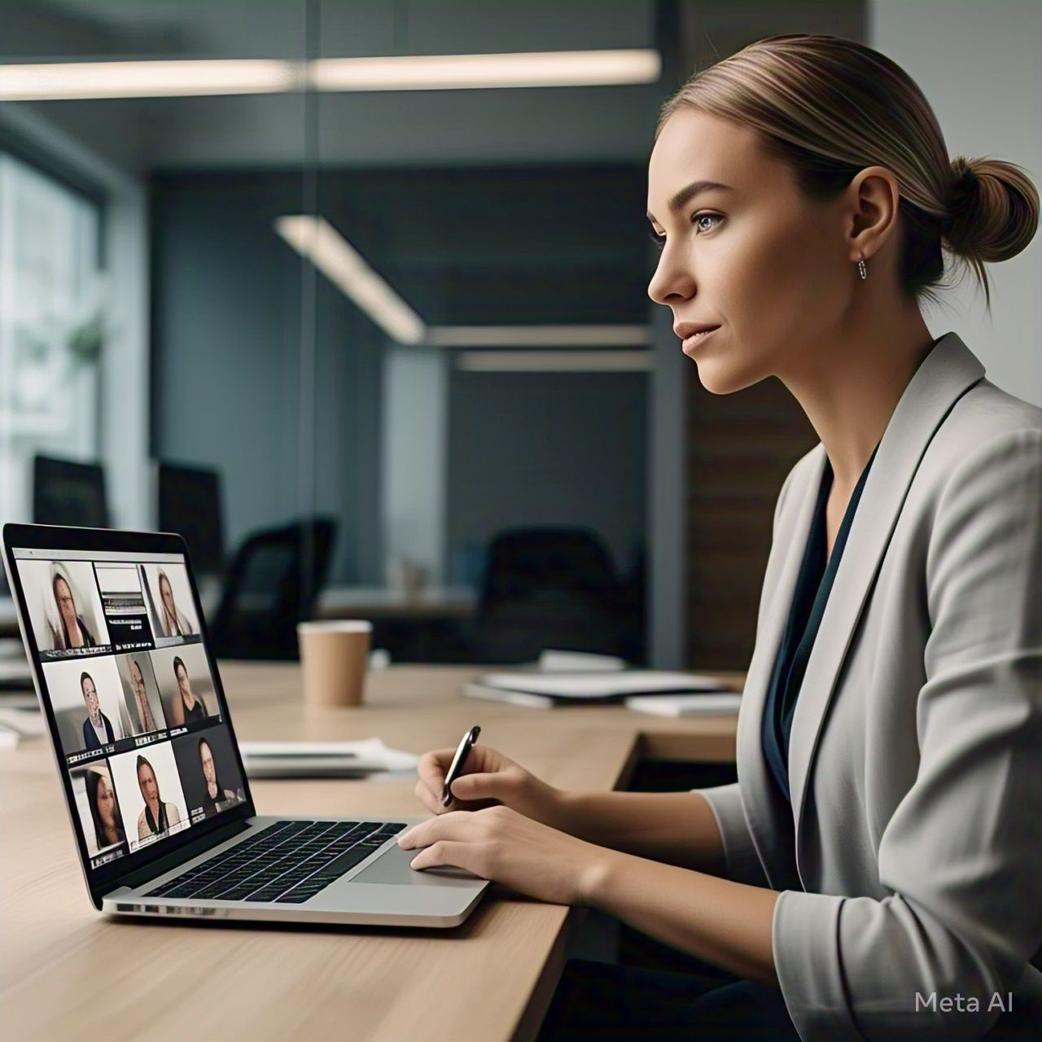
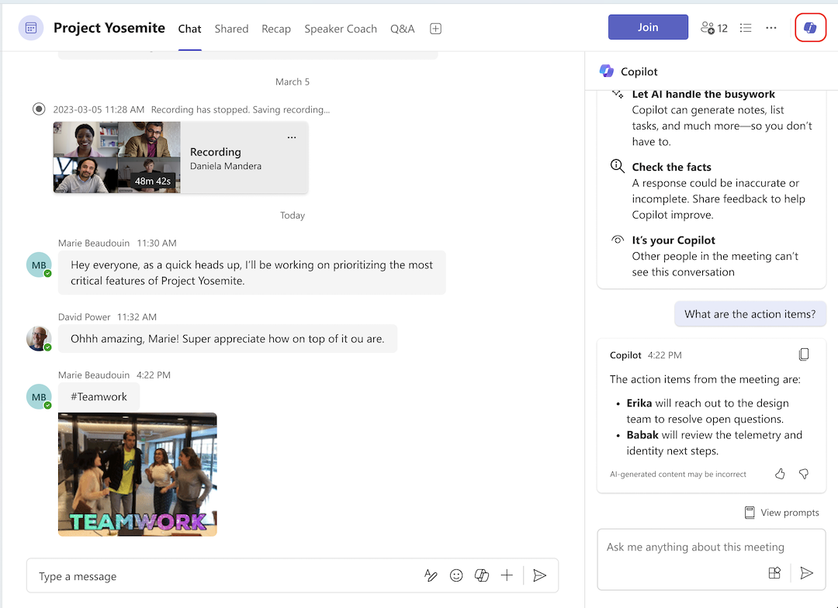


Slide 15

Amazon Q – Generative AI Assistant
Amazon Q – Generative AI Assistant is a tool that uses AI to automate tasks like content generation, data analysis, customer support, and business process automation, helping users save time and boost productivity.
Amazon Q

Slide 16
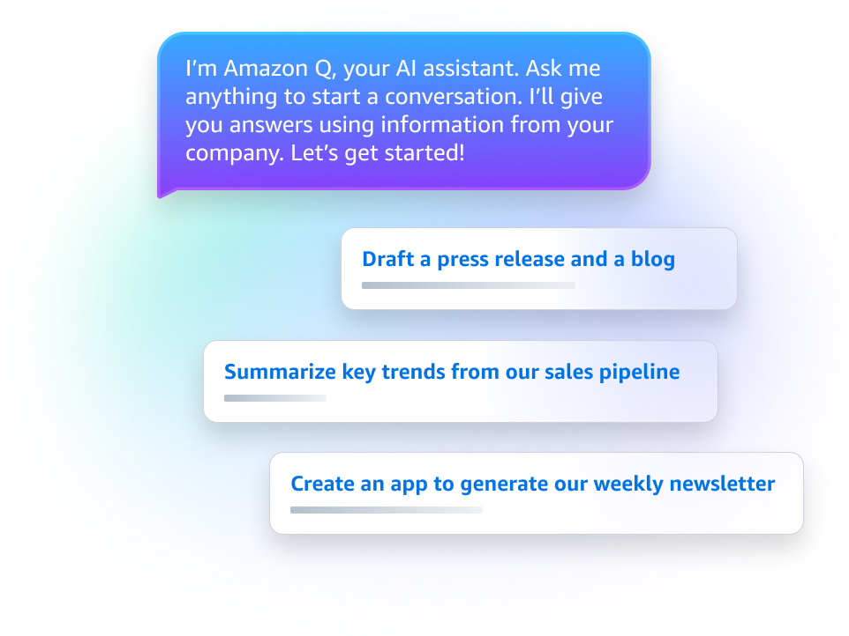


Slide 17



AI Assistants in Vehicles: Smarter & Safer Driving
AI assistants like Mercedes MBUX, BMW Intelligent Personal Assistant & Mahindra MAIA enhance driving with voice control, personalized experiences, and advanced safety features.

Slide 18
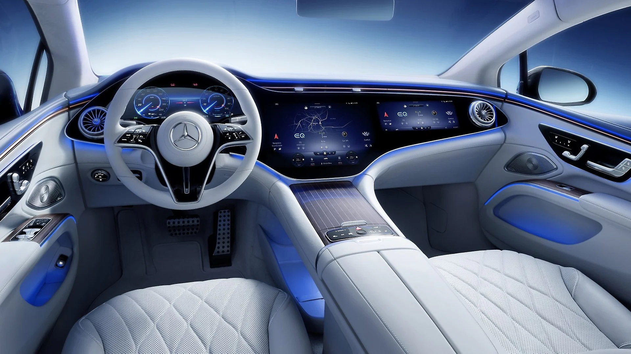
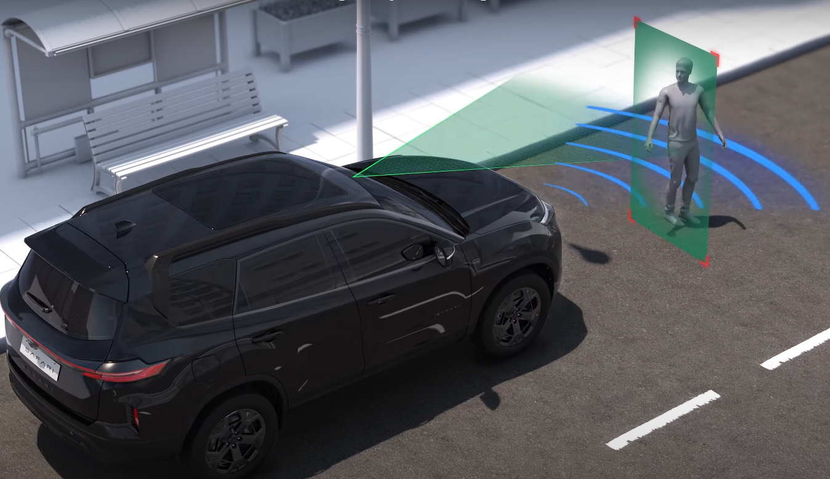
Basic Features :

Slide 19
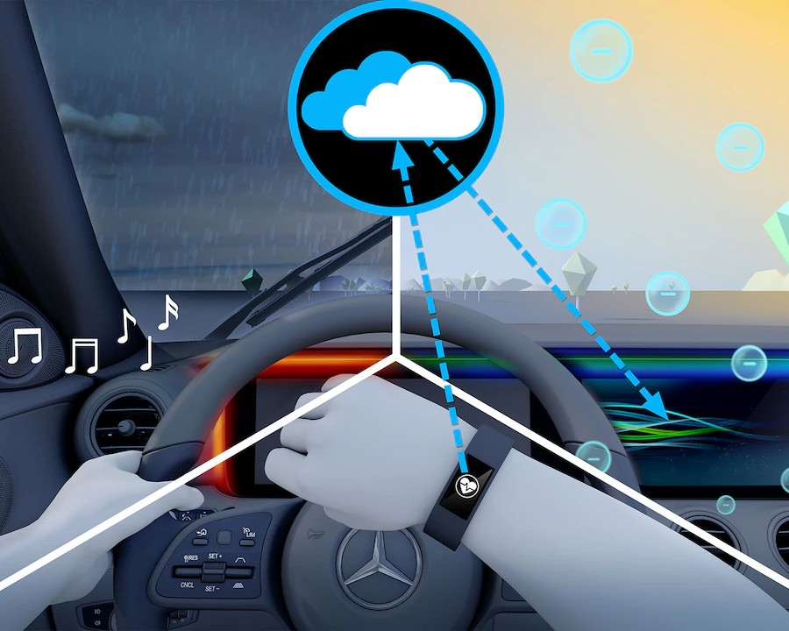
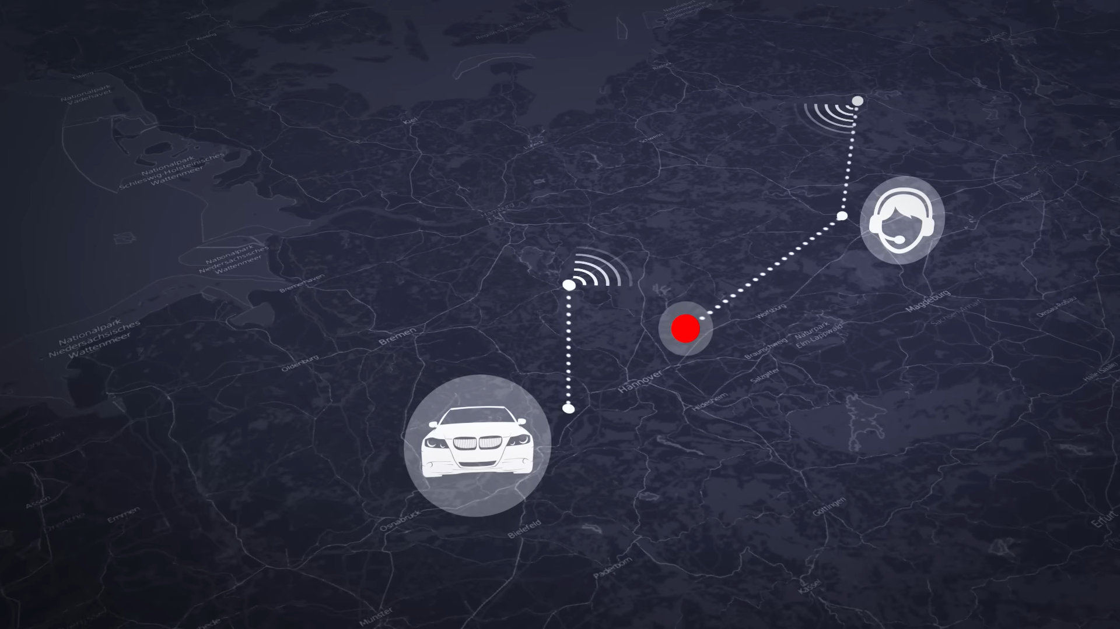
Advanced Features :

Slide 20
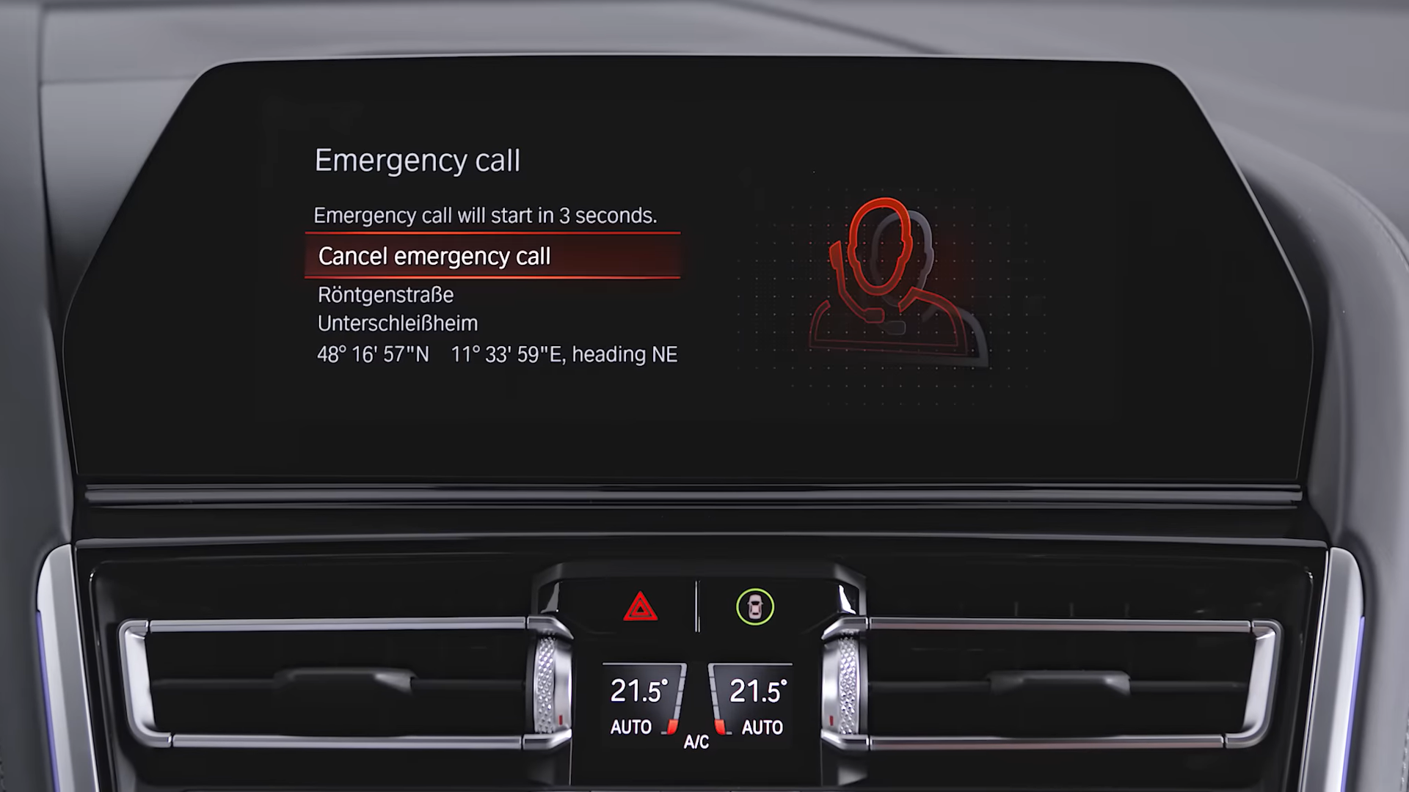
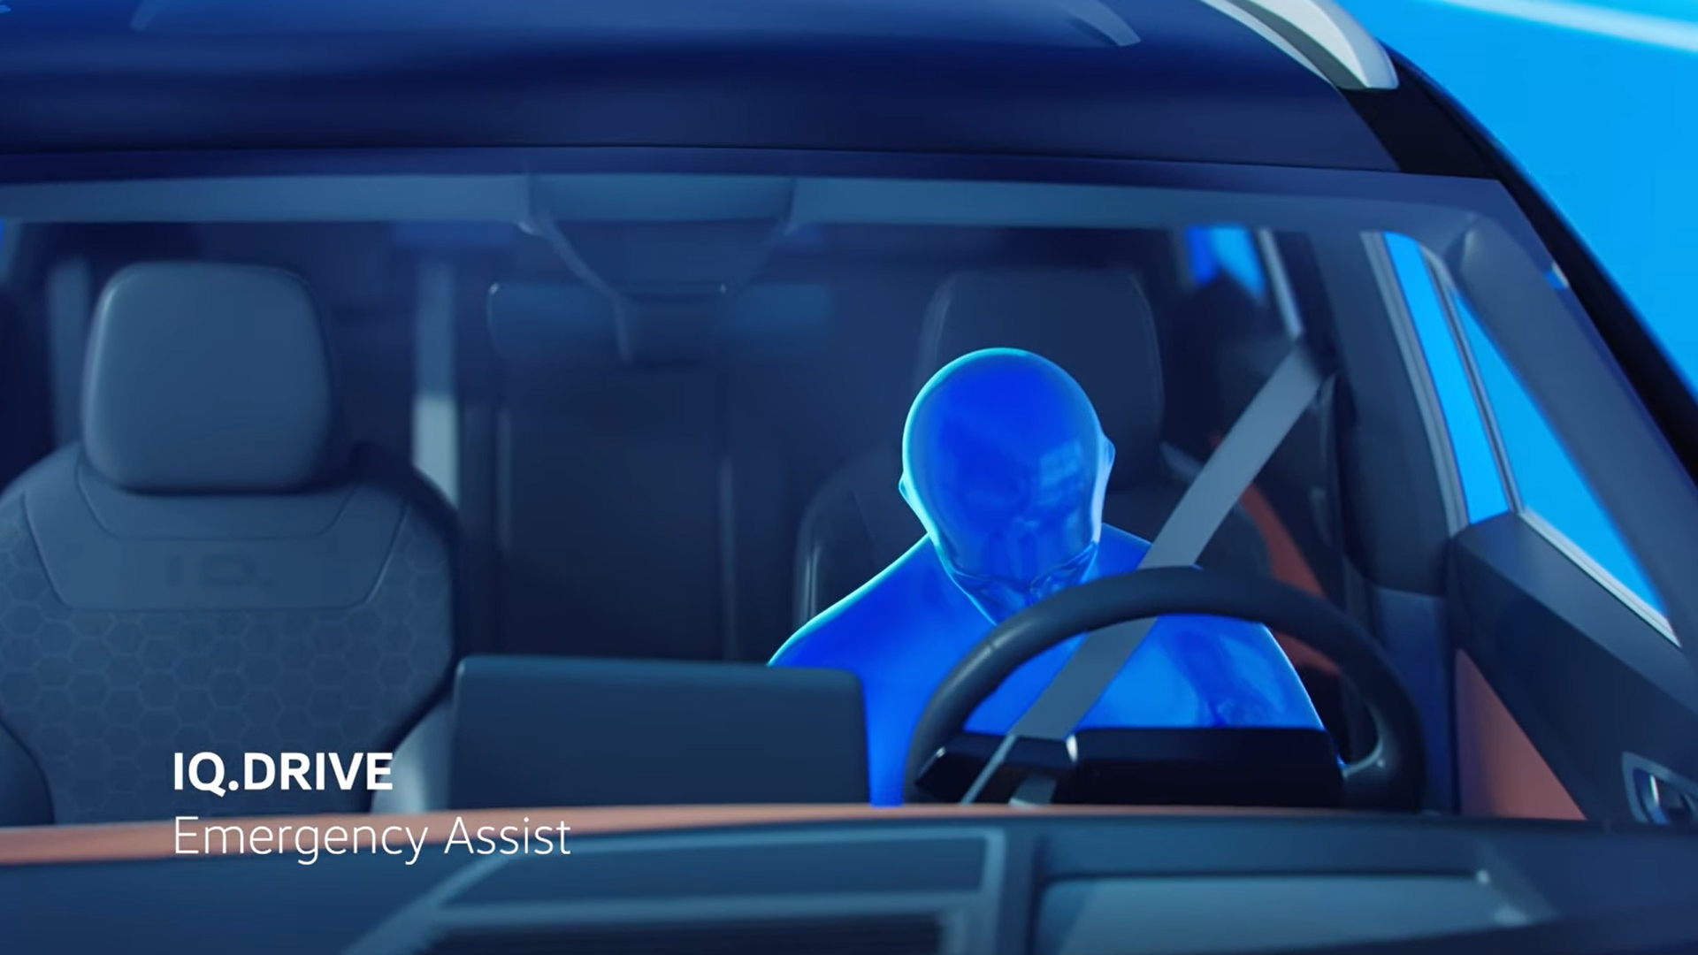

Slide 21

CONCLUSIONS
Basic use of AI
Virtual influencer
AI Chatbot
Real-Time Language Translation
Chat Summaries with Teams Copilot
Amazon Q – Generative AI Assistant
AI Assistants in Vehicles: Smarter & Safer Driving

Slide 22







Resources
.com
.com

Slide 23
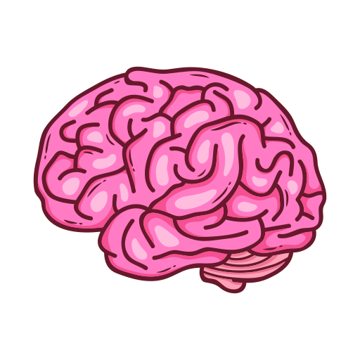
Special
THX

Slide 24
CONCLUSIONS
AI is not the future—it’s the present. It’s more than just a webpage; it goes beyond that. The real question is—how will you use it? -Human

Slide 25
THANK
YOU!
NOTE: This presentation was created by human intelligence.

