Slide 1
GPTCast: A Weather Language Model for Precipitation Nowcasting
- By Vaibhav Gaikwad

Slide 2
Introduction
What is “Nowcasting?”
A process of forecasting weather conditions in the very short term, typically within the next few hours, using current observations and data. It focuses on providing detailed, immediate weather predictions, especially for rapidly changing weather events like precipitation, storms, or fog.
Importance
Nowcasting provides real-time weather updates, crucial for managing severe weather events and ensuring public safety in aviation, transportation, and emergency responses.

Slide 3
Current Methods in Nowcasting
Extrapolation Techniques - These methods predict future weather conditions by extending the movement and changes of current weather patterns.
Process: Use radar and satellite data to track precipitation and cloud movements.
Strengths:
Quick and computationally inexpensive.
Effective for short-term forecasts (up to 1-2 hours).
Limitations:
Accuracy decreases rapidly with time.
Struggles with predicting the initiation or dissipation of weather events.

Slide 4
Current Methods in Nowcasting
Numerical Weather Prediction (NWP) Models - Use mathematical models of the atmosphere to simulate weather conditions.
Process:
Solve complex equations governing atmospheric dynamics.
Require substantial computational power and data assimilation.
Strengths:
Can provide detailed forecasts for longer periods (up to several days).
Incorporate a wide range of atmospheric processes.
Limitations:
Computationally intensive and time-consuming.
Limited spatial resolution may miss small-scale, localized events.

Slide 5
Challenges Faced
High-Intensity, Localized Precipitation Events:
Nature: These events can develop and dissipate quickly, often in small areas.
Impact: Can cause flash floods, landslides, and severe weather conditions.
Difficulty in Prediction:
Traditional methods may lack the resolution or speed to capture these events accurately.
Require high-resolution data and rapid processing to predict effectively.

Slide 6
GPTCast Model Architecture
The GPTCast model consists of two main components:
Spatial Tokenizer: This component compresses and discretizes radar images into a finite set of tokens using a Quantized Variational Autoencoder (VQGAN). It employs a novel reconstruction loss called Magnitude Weighted Absolute Error (MWAE) to focus on high rainfall rates and improve the reconstruction of precipitation patterns.
Spatiotemporal Forecaster: This is a modified GPT-2 model trained on sequences of tokens representing spatiotemporal contexts of precipitation data. It learns the evolutionary dynamics of precipitation and outputs probabilities over the codebook for the next expected token.

Slide 7
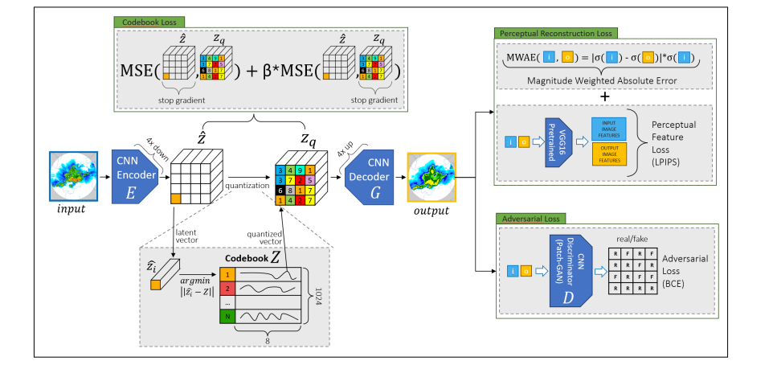
The Spatial Tokenizer Architecture
The three loss terms are enclosed in boxes with green borders. The blue square [i] is the input image, the yellow square [o] is the reconstructed autoencoder output.

Slide 8

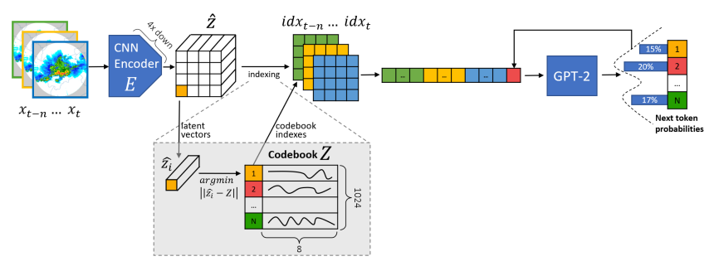
The Spatiotemporal Forecaster Architecture
During the training of the forecaster the tokenizer encoder (E) weights are frozen.

Slide 9
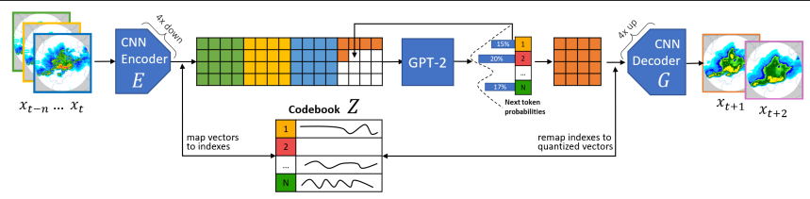
The GPTCast architecture during inference
The trained tokenizer and forecaster are combined (Tokenizer encoder (E) -> Forecaster -> Tokenizer decoder (G)) to generate forecasts. In the standard unconditional setting, the next token is chosen by applying a multinomial draw over the codebook probabilities to generate different ensemble members.

Slide 10
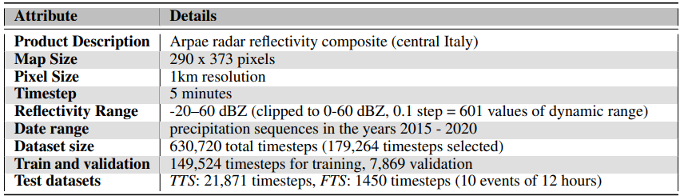
Summary of Dataset Characteristics

Slide 11
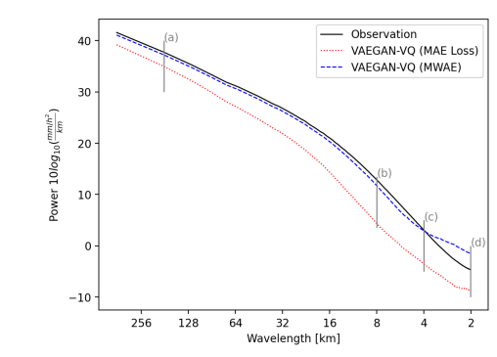
Average Energy spectra reconstruction performance
Comparison of radially averaged power spectral density reconstruction performance by adopting the MWAE loss function compared to MAE.

Slide 12
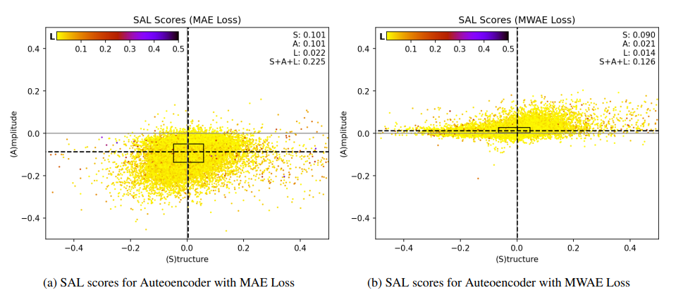
SAL scores for Autoencoder with MAE and MWAE Loss

Slide 13
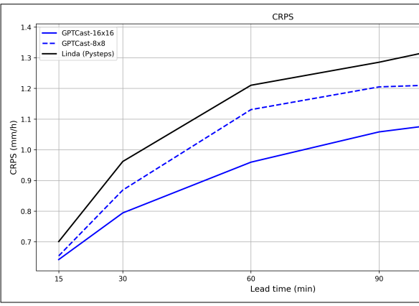
CRPS (continuous ranked probability score) comparison of GPTCast and LINDA over the FTS (lower is better) at different lead times

Slide 14
Conclusion
GPTCast represents a significant advancement in precipitation nowcasting by adapting LLM architectures to weather forecasting. Its novel approach to tokenization and the use of a specialized reconstruction loss enable it to generate reliable and realistic forecasts, making it a valuable tool for operational meteorological services.
This comprehensive approach demonstrates the potential of adapting language models to the domain of weather forecasting, particularly for short-term precipitation predictions.

