Slide 1
ImageBind-LLM: Multi-modality Instruction Tuning
- By Vaibhav Gaikwad

Slide 2
INTRODUCTION
The paper discusses recent progress in making large language models (LLMs) like ChatGPT and GPT-4 more versatile and interactive. These models can understand and follow instructions involving text and images. However, they are closed-source, meaning their internal workings and code are not publicly available. This has inspired other projects to create open-source alternatives.
PROBLEM –
While current methods work well for text and image instructions, developing a model that can handle multiple types of instructions (text, image, audio, 3D point clouds, and video) is still challenging.

Slide 3
SOLUTION : Imagebind-llm
What is ImageBind-LLM?
ImageBind-LLM is a new way to train large language models (LLMs) to understand and respond to different types of inputs like images, audio, 3D shapes, and videos.
Why is It Important?
It allows the LLM to handle different types of data, not just text and images.
The model can follow instructions and generate responses based on diverse inputs (like videos or audio).
This makes the model more versatile and useful in various applications.

Slide 4
How Does It Work?
Training:
Normally, LLMs are trained with text, and sometimes with images.
ImageBind-LLM uses a special network to connect the LLM (called LLaMA) with an image processing tool (ImageBind).
It transforms image features and combines them with words in the LLM, helping it learn from both text and images at the same time.
This process consists of
Embedding Space Alignment
Joint Embedding

Slide 5
How does it work?
Inference (Using the Trained Model):
When you give the model an input (like an image, sound, or video), it processes these inputs using ImageBind.
A "visual cache" helps the model use stored image features to better understand and respond to the inputs without needing extra training.
This process consists of:
Multi-Modality Inputs
Visual Cache Model

Slide 6
Key Characteristics of ImageBind-LLM
a) Multi-Modality Instructions:
Unlike models that only handle text and image instructions, ImageBind-LLM can process instructions across various formats: text, images, audio, 3D point clouds, and video.
It achieves this by using embedding-space arithmetic encoded by ImageBind and Point-Bind.
b) Tuning Efficiency:
During training, the image encoder from ImageBind is frozen (i.e., its weights are not updated).Only part of the LLaMA model is fine-tuned using efficient techniques like LoRA (Low-Rank Adaptation) and bias-norm tuning. The additional bind network and zero-initialized gating factors are the only parts that are newly trained.

Slide 7
Key Characteristics of ImageBind-LLM
c) Attention-Free Zero-Initialized Injection:
Instead of using complex attention layers to add new instruction cues, this model directly adds multi-modality conditions to all word tokens in LLaMA. A learnable gating mechanism is used for progressively injecting this knowledge, making the process simpler and more effective.
d) Cross-Modality Cache Retrieval:
To address the differences between training (with images) and inference (with multiple modalities), a visual cache model is used. This model, built from ImageBind-extracted image features, enhances embeddings by retrieving similar visual features, aiding in generating better responses across modalities.

Slide 8
Comparison to Other Models
PandaGPT also aims for multi-modality instruction-following using ImageBind but doesn’t support 3D point clouds and uses the stronger Vicuna LLM.
ImageBind-LLM, based on LLaMA, introduces unique methods like attention-free zero-initialized injection and cross-modality cache retrieval, improving multi-modality reasoning.

Slide 9
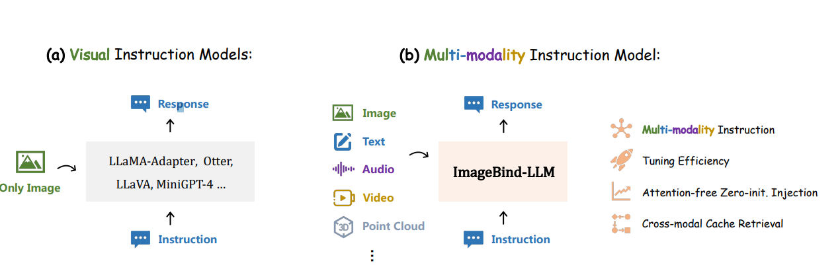
Visual instruction models vs imageBind llm

Slide 10
breakdown of the method
1) Vision-Language Pre-training
Objective: To fine-tune LLaMA to generate language responses based on images encoded by ImageBind, which inherently allows the model to understand instructions from various other modalities.
Process:
Data Utilization: Use large-scale image-caption datasets to train the model.
Two-Stage Training Pipeline:
First Stage: Train on image-caption data to develop the ability to generate responses based on image conditions.
Second Stage: Use instruction-following data to maintain the model's capability to generate coherent long sentences.

Slide 11
breakdown of the method
Implementation:
Frozen Image Encoder: Use the frozen image encoder from ImageBind to extract global visual features.
Bind Network: Transform these visual features using a learnable bind network.
Feature Addition: Add the transformed visual feature to each word token in LLaMA across all transformer layers.
Zero-Initialized Injection: Apply an attention-free, zero-initialized mechanism to inject visual knowledge, allowing LLaMA to generate captions based on the visual input.

Slide 12
breakdown of the method
2) Multi-Modality Instruction Tuning
Objective: To fine-tune the model using multi-modality data to handle instructions involving text, images, audio, video, and 3D point clouds.
Process:
Leverage visual instruction data to enhance the model's ability to follow diverse instructions across various modalities.

Slide 13
breakdown of the method
3) Cross-Modality Cache Retrieval
Objective: To enhance inference by using a cache model to bridge the gap between training on images and inference on multiple modalities.
Process:
Visual Cache Model: Construct a cache model with millions of ImageBind-extracted image features.
Embedding Enhancement: During inference, the model retrieves similar visual features to improve multi-modality embeddings, ensuring higher-quality language responses to multi-modality instructions.

Slide 14
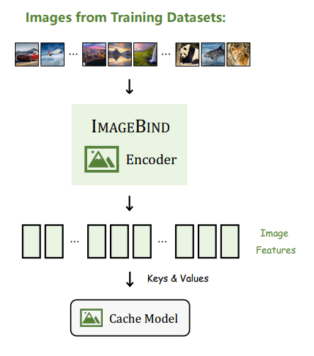
Visual cache model

Slide 15
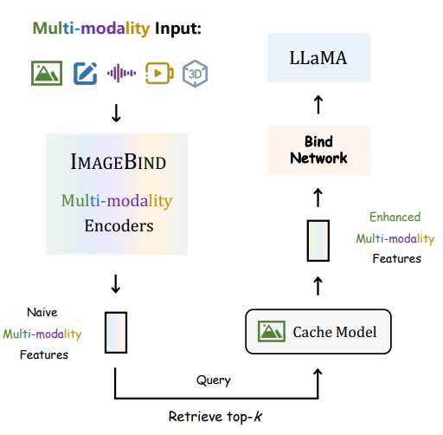
Embedding Enhancement

Slide 16
Advanced Applications
1) Bilingual Instruction Tuning
Objective: Extend ImageBind-LLM to support bilingual instruction-following, such as English and Chinese.
Implementation:
Replace the base LLM from LLaMA to a bilingual LLM (e.g., ChineseLLaMA).
Add 52K Chinese instruction data from GPT4LLM for joint instruction tuning.
Despite the lack of direct Chinese visual instruction data during initial vision-language training, ImageBind-LLM learns to align Chinese, English, and multi-modality inputs effectively.

Slide 17
Advanced Applications
2) Any-to-Any Generation
Objective: Enable ImageBind-LLM to generate multi-modality outputs (e.g., text, image, audio, point clouds) in response to multi-modality inputs.
Implementation:
Extend ImageBind with CLIP-conditioned generative models:
Stable Diffusion for image generation.
Make-An-Audio for audio generation.
CLIP-Forge for point cloud generation.
Utilize cache-enhanced generation to reduce modality discrepancy, similar to cache-enhanced inference.
Outcome:
Create an instruction model capable of any-to-any generation, producing both textual and image responses from multi-modality inputs.

Slide 18
Advanced Applications
3) Integration with Object Detection
Objective: Enhance ImageBind-LLM's ability to associate textual responses with specific regional objects within an image for tasks like visual reasoning and grounding.
Implementation:
Connect ImageBind-LLM with object detectors.
Use traditional noun parsers or ChatGPT to extract nouns from generated responses.
Input the parsed nouns and images into object detectors to obtain detailed object detection results.
Outcome:
Provide detailed, fine-grained visual responses by linking text with specific objects in images.

Slide 19
Advanced Applications
4) ImageBind-LLM as a Chatbot
Objective: Transform ImageBind-LLM from a single-turn instruction model to a multi-turn chatbot.
Implementation:
Train ImageBind-LLM on multi-turn conversation data:
Language conversation data from ShareGPT.
Visual conversation data from LLaVA.
Outcome:
Enable ImageBind-LLM to handle multi-turn conversations, making it capable of answering open-ended questions across multiple modalities.

Slide 20
Advanced Applications
5) ImageBind-LLM for API Control
Objective: Empower ImageBind-LLM to control various APIs for multi-modality tool usage.
Implementation:
Train ImageBind-LLM on a tool-related instruction dataset from GPT4Tools.
Use the proposed training paradigm to enhance the model's ability to call different APIs.
Outcome:
Demonstrate proficiency in API control, allowing ImageBind-LLM to accomplish a wide range of tasks using diverse tools, thereby highlighting its potential as a versatile visual assistant.

Slide 21
Training details
Image-Text Pair Data:
Datasets: COCO [53], CC3M [41], CC12M [42], SBU [54], LAION-2B [40], COYO [55], MMC4 [56]
Data Selection: Extracted 20M high-quality image-text pairs from MMC4-Core based on CLIP alignment score. For LAION-2B, extracted 100M high-quality image-text pairs using CLIP alignment scores.
Total Data: Combined, the datasets result in 940M image-text pairs. Despite being noisier compared to BLIP [57], our empirical observations show strong image understanding and factual ability in ImageBind-LLM when pre-trained with this dataset. Future work includes exploring advanced data cleaning and deduplication techniques.

Slide 22
Quantitative Evaluation on Traditional Tasks
Conducted quantitative evaluations of ImageBind-LLM on 27 datasets using a zero-shot approach. The quantitative evaluation encompassed five specific tasks:
1) Optical Character Recognition (OCR)
2) Key Information Extraction (KIE)
3) Image Captioning
4) Visual Question Answering (VQA)
5) Knowledge-Grounded Image Description (KGID)

Slide 23
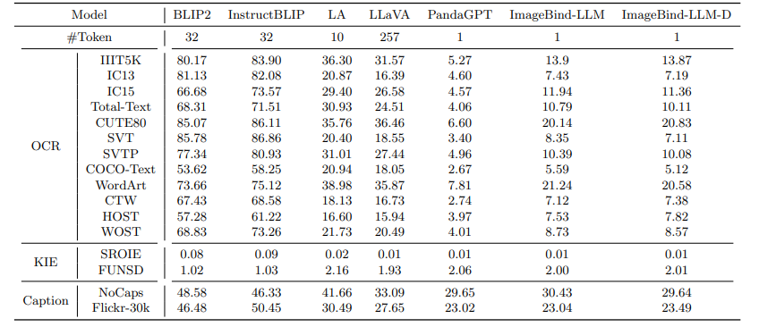
ZERO-shot performance on ocr, kie and image captioning tasks.s
OCR Tasks –
Evaluated on 12 representative OCR datasets which has diverse collection of images. Prompt used –
“What is written in the image”
KIE Tasks –
Evaluated on 2 KIE benchmarks which includes wide range of receipts, forms, etc. Prompt used –
“What is the name of the company that issued this invoice?”

Slide 24
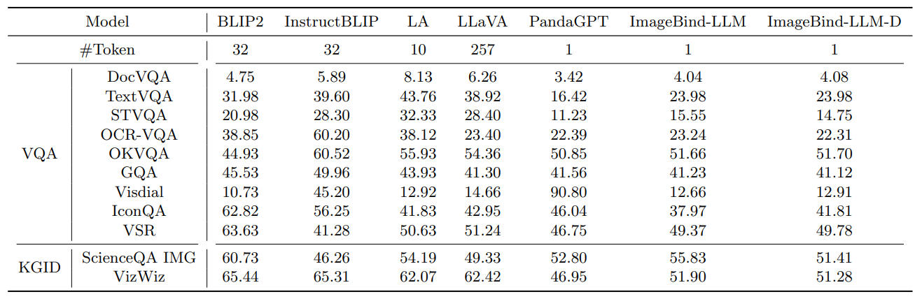
Zero-shot performance on vqa and kgid
VQA Tasks –
Employed 9 benchmarks in VQA task which has collection of question-image pairs that cover a wide range of topics. IT requires models not only to comprehend the visual content but also to understand and reason about the questions presented.
KGID Tasks –
It aims to assess the model’s ability to produce descriptive and precise image captions by incorporating external knowledge. 2 benchmarks used.

Slide 25
Overall analysis
The tables demonstrate the exceptional zero-shot performance of ImageBind-LLM across various tasks. For OCR, Image Captioning, and KGID, ImageBind-LLM performs competitively with other VLMs and outperforms PandaGPT, highlighting its effective modality alignment. It also shows strong performance on KIE and VQA datasets.
Overall, these results underscore the impressive zero-shot capabilities of ImageBind-LLM in various vision and language tasks and its potential as a versatile solution for real-world applications.

Slide 26
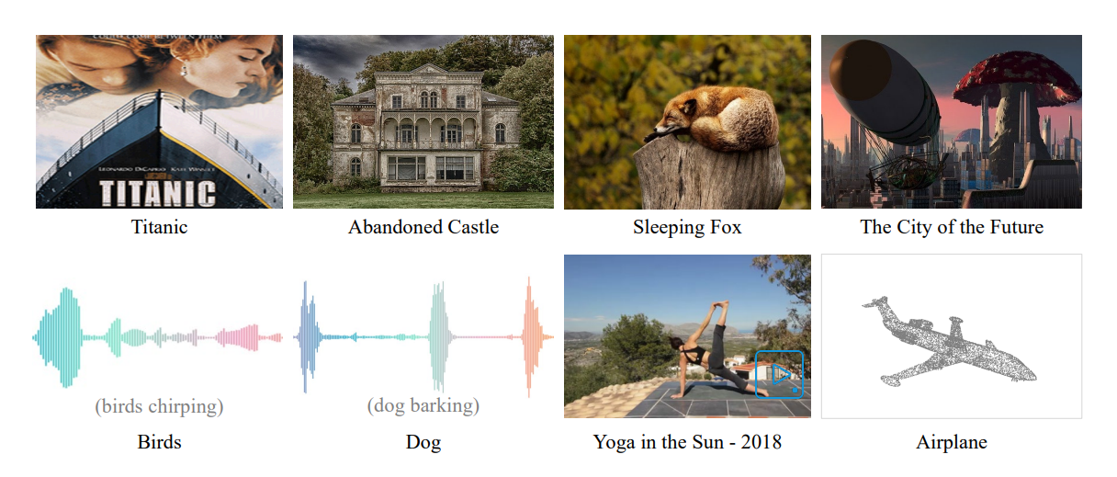
AN example of training data with captions

Slide 27
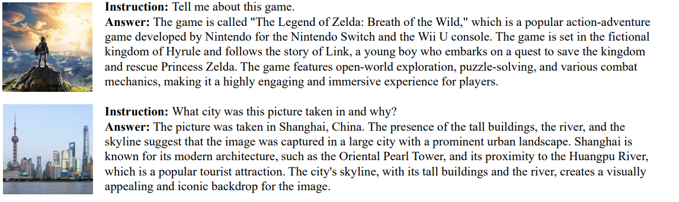
Image as an input

Slide 28
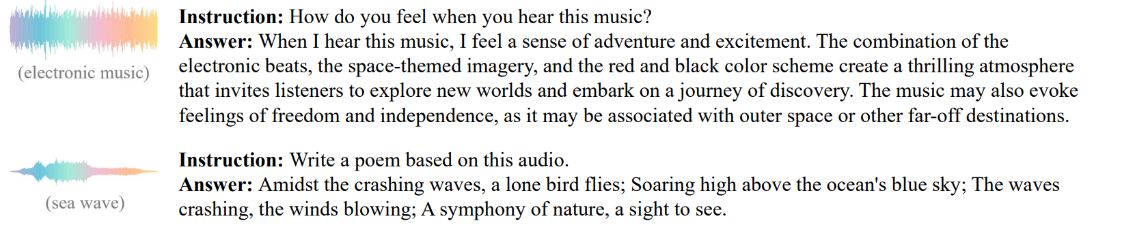
Audio as an input

Slide 29
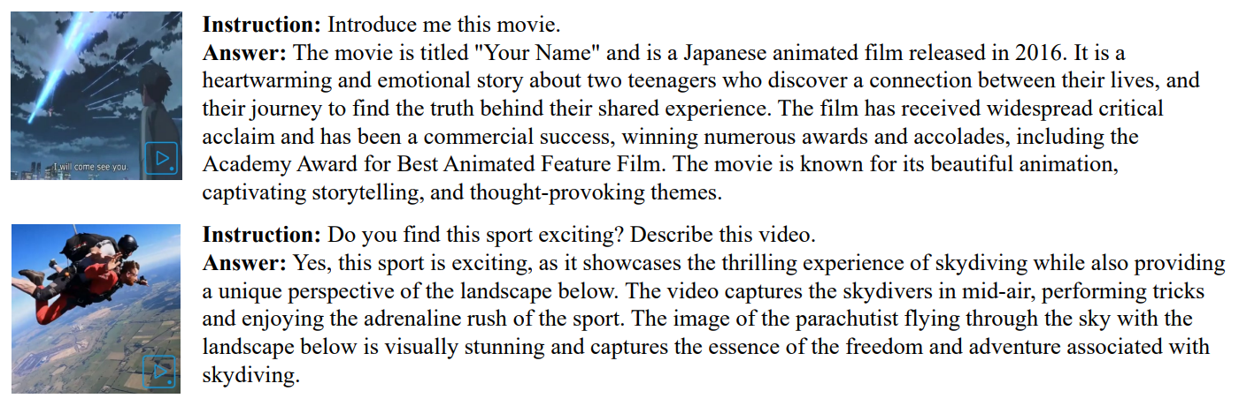
Video as an input

Slide 30
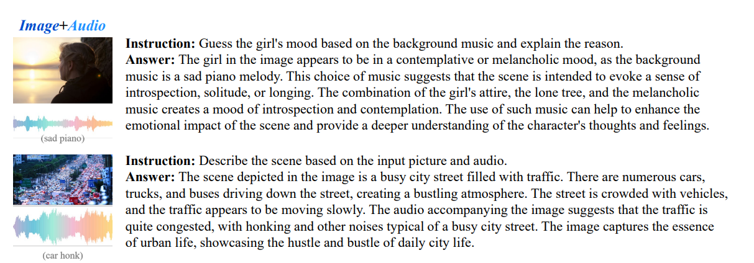
Multiple inputs

Slide 31
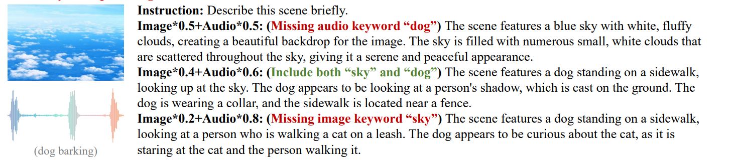
Failure case - hallucination

Slide 32
Failure cases
Although ImageBind-LLM can handle multi-modality inputs effectively, it is not without flaws. It struggles with hallucination issues in descriptive instructions. For instance, it sometimes describes objects not present in the image.
Two possible reasons for this are:
Limited Visual Tokens: ImageBind-LLM injects only one global visual token into the LLMs, significantly fewer than other models (e.g., 10 for LLaMA-Adapter, 32 for MiniGPT4, and 256 for LLaVA). Consequently, the LLM may not receive sufficient visual information in the self-attention layers.
Data Quality: The quality of instruction tuning data is insufficient. For example, visual instruction data from LLaVA is generated by vision experts and GPT-4 but lacks human verification and corrections. To address this, a human-verified high-quality dataset will be created in the future.

Slide 33
Conclusion
ImageBind is a novel approach that transforms large language models (LLMs) into multi-modality instruction models using ImageBind. By aligning ImageBind’s visual encoder with an LLM via a bind network, ImageBind-LLM integrates image, audio, 3D point clouds, and video inputs seamlessly. This enables it to handle diverse multimodal tasks without additional training.
Evaluation across 27 traditional vision-language datasets hows that ImageBind-LLM achieves competitive performance comparable to recent multimodal LLMs.
Future directions include enhancing ImageBind-LLM by increasing multi-modality tokens and integrating additional modalities to further extend its versatility.

Slide 34
THANK you!

