Slide 1

TravelPlanner: A Benchmark for Real-World Planning with Language Agents
- By Vaibhav Gaikwad

Slide 2
INTRODUCTION TO THE PROBLEM
Planning is a crucial aspect of human intelligence, involving the use of various tools, information collection, and decision-making. Traditional AI has struggled with this in complex, real-world settings. Recent advances in large language models (LLMs) have shown potential, but their capability in intricate planning tasks remains uncertain.
PURPOSE OF TRAVELPLANNER
TravelPlanner aims to fill this gap by providing a benchmark for evaluating AI agents' planning abilities in travel scenarios, which are inherently complex and require handling multiple constraints like budget, time, preferences, and commonsense knowledge.

Slide 3
KEY COMPONENTS OF TRAVELPLANNER
1) Sandbox Environment: TravelPlanner provides a rich sandbox with around four million data entries related to travel (flights, accommodations, restaurants, attractions, etc.).
2) Tools for Information Collection: Six tools are available to the agents to gather information:
CitySearch
AttractionSearch
FlightSearch
DistanceMatrix
RestaurantSearch
AccommodationSearch
3) Planning Intents and Reference Plans: The benchmark includes 1,225 meticulously curated planning intents (queries) and their reference plans to evaluate the performance of the agents.

Slide 4
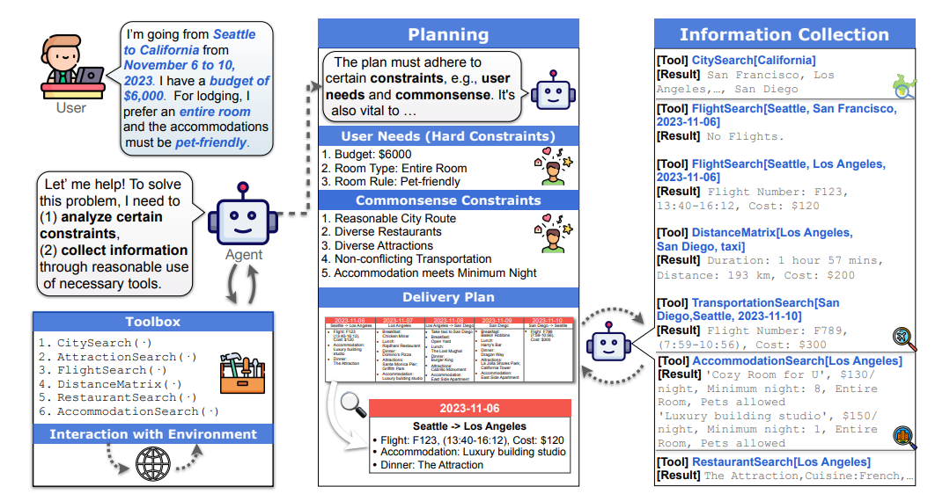
AN OVERVIEW

Slide 5
Evaluation Criteria
Agents are evaluated based on their ability to:
Collect Information: Use the provided tools effectively to gather relevant data.
Stay on Task: Adhere to the given constraints (budget, preferences, etc.) while planning.
Handle Multiple Constraints: Manage various explicit (e.g., budget, pet-friendly accommodations) and implicit (e.g., reasonable travel routes) constraints.

Slide 6
CONSTRAINTS
1) Environment Constraints:
The real-world is dynamic, necessitating agents to be adaptable. For instance, flights to a particular destination may be unavailable at certain times (e.g., no flights from Seattle to San Francisco in previous Figure ), possibly because tickets are sold out. In such cases, the agent must dynamically seek an alternative, like changing the destination of the flight or the way of transportation. To tackle this, environment constraints within TravelPlanner is introduced.

Slide 7
CONSTRAINTS
2) Commonsense Constraints:
Agents, functioning in real-world and serving humans, should consider commonsense when designing plans. For instance, repeatedly visiting the same attraction is not typical. To evaluate agents’ understanding and utilization of commonsense during planning, the commonsense constraint in TravelPlanner is included.

Slide 8
CONSTRAINTS
3) Hard Constraints:
A crucial ability for agents is to effectively satisfy personalized user needs. To evaluate this, TravelPlanner incorporates various user needs, such as budget constraints. These user needs are termed hard constraints. The hard constraint measures the agent’s generalization ability with regard to different user needs. This is categorized into three difficulty levels:
Easy (budget constraint for single person)
Medium (cuisine type, room type and preference)
Hard (transportation preference)

Slide 9
EVALUATION
The LLM models which were used are Mixtral-7, Gemini Pro, GPT-3.5 Turbo, GPT-4 Turbo.
The two modes which are used are Two-stage mode and Sole-planning mode (direct strategy).

Slide 10
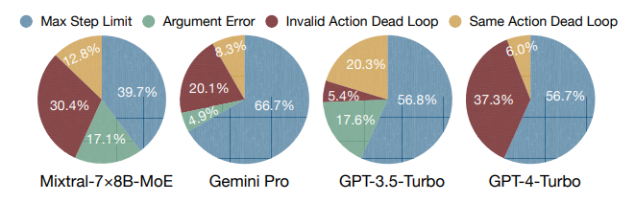
Tool-use error distribution on test set

Slide 11
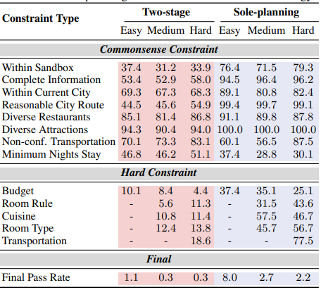
Constraint pass rate of GPT-4-Turbo on test set
The "Sole-planning" approach generally performs better than the "Two-stage" approach across both commonsense and hard constraints.
Both approaches struggle with harder tasks, particularly with hard constraints.
There is a significant drop in performance as task difficulty increases for both planning strategies.

Slide 12
Key Observations and Issues
1) Inability to Rectify Persistent Errors:
Issue: Agents fail to complete plans due to repeated errors, often related to incorrect date inputs.
Impact: These repeated errors cause agents to stop planning, highlighting their inability to self-correct initial mistakes.

Slide 13
Key Observations and Issues
2) Production of Hallucinatory Answers Due to Information Confusion:
Issue: Agents produce incorrect (hallucinatory) answers by confusing pieces of information.
Impact: This results in plans that do not align with the sandbox data, suggesting that agents get confused when dealing with large amounts of information, a problem referred to as “Lost in the Middle”.

Slide 14
Key Observations and Issues
3) Struggle to Align Actions with Reasoning:
Issue: Agents have difficulty matching their actions to their analytical reasoning.
Impact: This discrepancy between thought and action significantly reduces the agents' effectiveness in delivering accurate plans.

Slide 15
CONCLUSION
TravelPlanner serves as a benchmark to push the boundaries of what AI can achieve in real-world planning scenarios, providing a structured way to evaluate and improve the capabilities of language agents.
Despite the current limitations, the fact that AI agents can even attempt such complex tasks is seen as a significant step forward. TravelPlanner offers a meaningful testbed for developing more advanced planning capabilities in future AI agents.
The paper highlights the need for more sophisticated planning strategies and better integration of commonsense reasoning and constraint management in language agents.

Slide 16
THANK YOU!

