Slide 1
Innovative Projects- Raspberry-pi Using Python (CSE1003)
Phase –II Review Presentation
TITLE OF THE PROJECT
AUTOMATIC VENDING MACHINE FOR RECYCLEABLE WATER WASTE USING RASPBERRY PI
Submitted to the Presidency University, Bengaluru in partial fulfillment of the requirements for the Innovative Project- Raspberry-pi using Python
ByIPR-141
Under the supervision of
Dr.Saritha K
Associate Professor
Department of Computer Science and Engineering
November , 2022
Name | Roll Number
MONICA V | 20211CSG0067
VAIBHAV V | 20211CAI0108
SHREYAS R N | 20211CST0118
AISHWARYA S | 20211ECE0281
BHARATH H D | 20211EEE0019

Slide 2
Project Brief Summery
Our model basically works as a reverse vending machine , the main feature of our model is that it is a smart machine for Plastic disposal i.e , it accepts plastic cans for recycling and in return dispenses drinking water
In our daily life we get to see many plastic bottles in landfills , floating on rivers and on sidewalks . It is approximated that 46000 pieces of plastic trash are floating on the ocean per square mile.Each bottle can take up to one thousand years to decompose , leaking dangerous and harmful chemicals during the process . So our main aim is to collect all these plastic and provide something to the society.
This model uses a IR sensor to ensure that the input is plastic like PET bottles . Once the garbage enters the bin, data will be sent to raspberry pi through IR sensor. If the input bottle satisfies the conditions, a signal will be sent to the aqua pump and dispenses the water.

Slide 3

Challenges Faced in Project
To work raspberry pi we have to download raspberry pi imager and OS software to a SD card which is quite long process.
Installation of software to the raspberry pi takes a more time so we got time delayed in software part.
We had to make sure that we could complete the project with certain limitations such as user friendly and unique

Slide 4
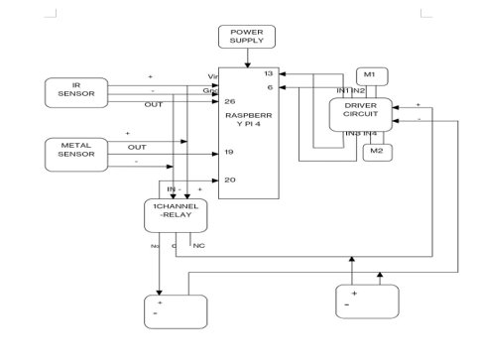
Circuit/Block Diagram

Slide 5
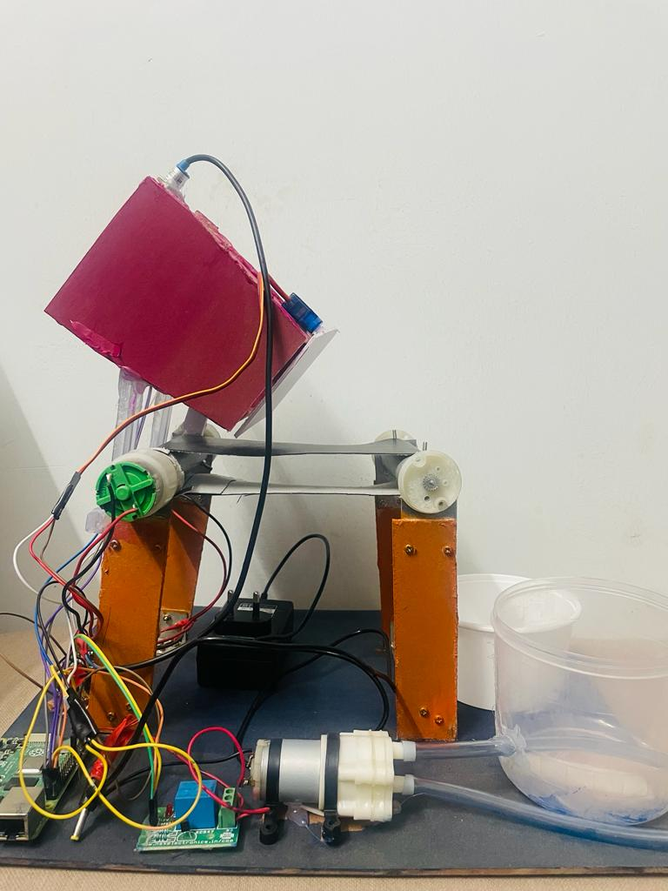
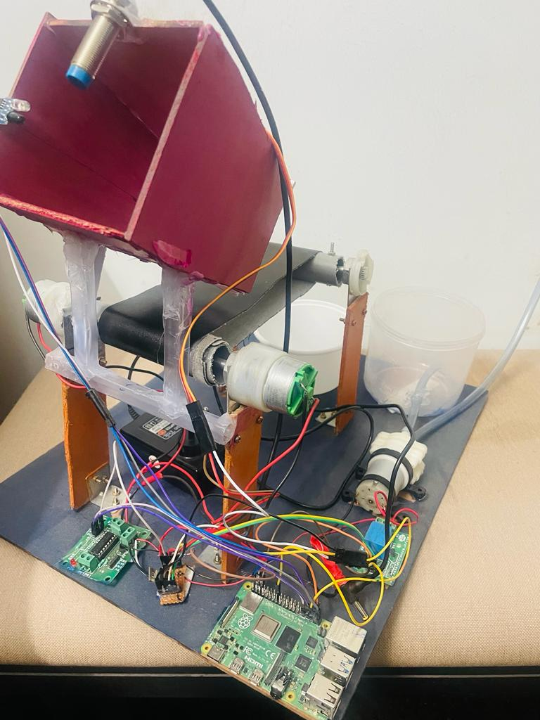
Results and Discussions
In this prototype of Reverse Vending Machine for Recycling Plastic Bottles is successfully generated and the depositor gets drinking water. IR sensor was used for the detection of plastic bottles. Inlet of machine opens only when the machine detects plastic bottle else it remains closed. Once the depositor completes depositing the bottles he/she receives drinking water accordingly. . When the machine is filled with plastic bottles ,they can be sent to the recycling center for recycling

Slide 6
Q&A

Slide 7
Thank you !!

