Slide 1
Inheritance in C++

Slide 2
The capability of a class to derive properties and characteristics from another class is called Inheritance.
Inheritance is one of the most important feature of Object Oriented Programming.
Sub Class: The class that inherits properties from another class is called Sub class or Derived Class.
Super Class:The class whose properties are inherited by sub class is called Base Class or Super class.

Slide 3

Why and when to use inheritance?
Consider a group of vehicles. You need to create classes for Bus, Car and Truck. The methods fuelAmount(), capacity(), applyBrakes() will be same for all of the three classes. If we create these classes avoiding inheritance then we have to write all of these functions in each of the three classes as shown in below figure:
You can clearly see that above process results in duplication of same code 3 times. This increases the chances of error and data redundancy. To avoid this type of situation, inheritance is used. If we create a class Vehicle and write these three functions in it and inherit the rest of the classes from the vehicle class, then we can simply avoid the duplication of data and increase re-usability. Look at the below diagram in which the three classes are inherited from vehicle class:

Slide 4
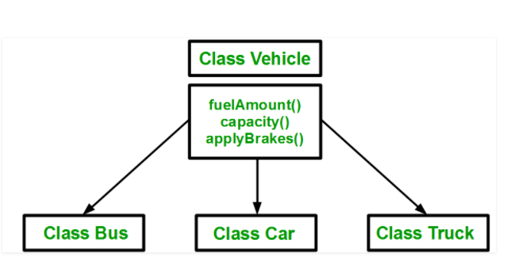
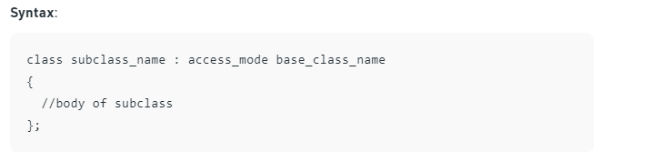

Slide 5
#include <bits/stdc++.h>
using namespace std;
//Base class
class Parent
{
public:
int id_p;
};
class Child : public Parent
{
public:
int id_c;
};
int main()
{
Child obj1;
obj1.id_c = 7;
obj1.id_p = 91;
cout << "Child id is " << obj1.id_c << endl;
cout << "Parent id is " << obj1.id_p << endl;
return 0;
}

Slide 6
In the above program the ‘Child’ class is publicly inherited from the ‘Parent’ class so the public data members of the class ‘Parent’ will also be inherited by the class ‘Child’.
Modes of Inheritance
Public mode: If we derive a sub class from a public base class. Then the public member of the base class will become public in the derived class and protected members of the base class will become protected in derived class.
Protected mode: If we derive a sub class from a Protected base class. Then both public member and protected members of the base class will become protected in derived class.
Private mode: If we derive a sub class from a Private base class. Then both public member and protected members of the base class will become Private in derived class.
Note : The private members in the base class cannot be directly accessed in the derived class, while protected members can be directly accessed. For example, Classes B, C and D all contain the variables x, y and z in below example. It is just question of access.

Slide 7
class A
{
public:
int x;
protected:
int y;
private:
int z;
};
class B : public A
{
// x is public
// y is protected
// z is not accessible from B
};
class C : protected A
{
// x is protected
// y is protected
// z is not accessible from C
};
class D : private A // 'private' is default for classes
{
// x is private
// y is private
// z is not accessible from D
};

Slide 8
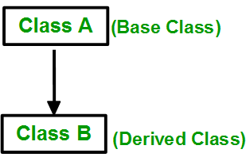
Types of Inheritance in C++
1. Single Inheritance: In single inheritance, a class is allowed to inherit from only one class. i.e. one sub class is inherited by one base class only.
class Vehicle {
public:
Vehicle()
{
cout << "This is a Vehicle" << endl;
}
};
// sub class derived from a single base classes
class Car: public Vehicle{
};
int main()
{
// creating object of sub class will
// invoke the constructor of base classes
Car obj;
return 0;
}

Slide 9

2. Multiple Inheritance: Multiple Inheritance is a feature of C++ where a class can inherit from more than one classes. i.e one sub class is inherited from more than one base classes.

Slide 10
class Vehicle {
public:
Vehicle()
{
cout << "This is a Vehicle" << endl;
}
};
// second base class
class FourWheeler {
public:
FourWheeler()
{
cout << "This is a 4 wheeler Vehicle" << endl;
}
};
// sub class derived from two base classes
class Car: public Vehicle, public FourWheeler {
};
// main function
int main()
{
// creating object of sub class will
// invoke the constructor of base classes
Car obj;
return 0;
}

Slide 11
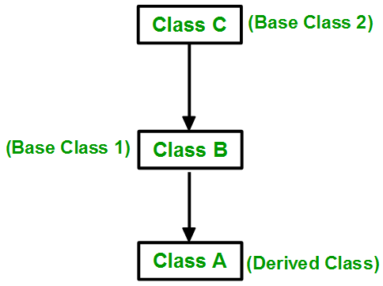
3. Multilevel Inheritance: In this type of inheritance, a derived class is created from another derived class.
class Vehicle
{
public:
Vehicle()
{
cout << "This is a Vehicle" << endl;
}
};
class fourWheeler: public Vehicle
{ public:
fourWheeler()
{
cout<<"Objects with 4 wheels are vehicles"<<endl;
}
};
class Car: public fourWheeler{
public:
Car()
{
cout<<"Car has 4 Wheels"<<endl;
}
};
int main()
{
Car obj;
return 0;
}

Slide 12
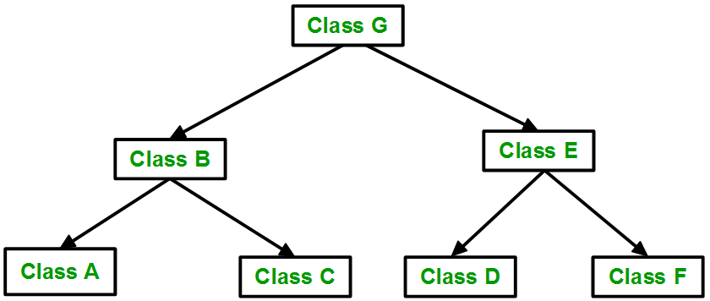
4. Hierarchical Inheritance: In this type of inheritance, more than one sub class is inherited from a single base class. i.e. more than one derived class is created from a single base class.
class Vehicle
{
public:
Vehicle()
{
cout << "This is a Vehicle" << endl;
}
};
class Car: public Vehicle
{
};
// second sub class
class Bus: public Vehicle
{
};
int main()
{
Car obj1;
Bus obj2;
return 0;
}

