Slide 1
OOP
Priti Patel
Department of Computer Applications

Slide 2
Topics
Inheritance

Slide 3
Inheritance
It is a concept of Object-Oriented Programming.
Inheritance is a mechanism that allows us to inherit all the properties from another class.
The class from which the properties and functionalities are utilized is called the parent class (also called as Base Class).
The class which uses the properties from another class is called as Child Class (also known as Derived class).
Inheritance is also called an Is-A Relation.
Let’s say you have a base class Animal and you derive from it to create a Horse class. The inheritance relationship states that a Horse is an Animal.

Slide 4
Inheritance
Code reusability- we do not have to write the same code again and again, we can just inherit the properties we need in a child class.
It represents a real world relationship between parent class and child class.
It is transitive in nature. If a child class inherits properties from a parent class, then all other sub-classes of the child class will also inherit the properties of the parent class.

Slide 5
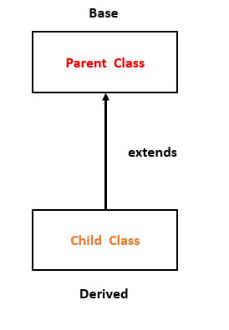
Inheritance

Slide 6
Inheritance
Syntax :
# Parent class
class Parent :
# Constructor
# Variables of Parent class
# Methods
...
# Child class inheriting Parent class
class Child(Parent) :
# constructor of child class
# variables of child class
# methods of child class
...

Slide 7
Inheritance
There are five types of inheritances:
Single Inheritance
Multiple Inheritance
Multilevel Inheritance
Hierarchical Inheritance
Hybrid Inheritance

Slide 8
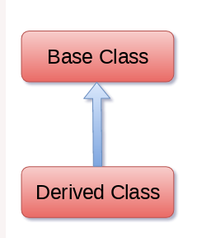
Single Inheritance

Slide 9
Single Inheritance
Example :
class Parent:
def func1(self):
print("this is function one")
class Child(Parent):
def func2(self):
print(" this is function 2 ")
ob = Child()
ob.func1()
ob.func2()

Slide 10
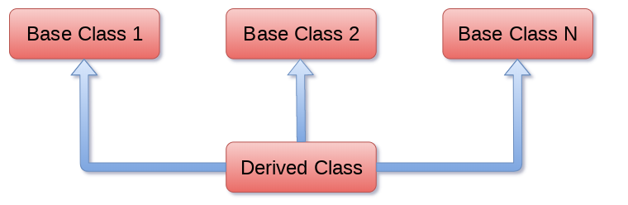
Multiple Inheritance

Slide 11
Multiple Inheritance
class Parent:
def func1(self):
print("this is function 1")
class Parent2:
def func2(self):
print("this is function 2")
class Child(Parent , Parent2):
def func3(self):
print("this is function 3")
ob = Child()
ob.func1()
ob.func2()
ob.func3()

Slide 12
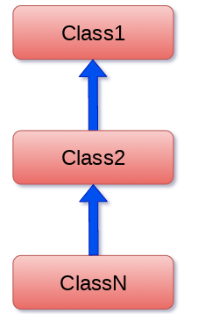
Multilevel Inheritance

Slide 13
Multilevel Inheritance
class Parent:
def func1(self):
print("this is function 1")
class Child(Parent):
def func2(self):
print("this is function 2")
class Child2(Child):
def func3("this is function 3")
ob = Child2()
ob.func1()
ob.func2()
ob.func3()

Slide 14
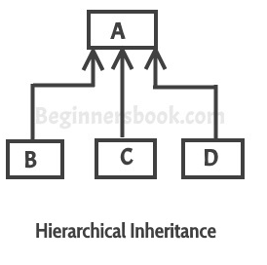
Hierarchical Inheritance

Slide 15
Hierarchical Inheritance
class Parent:
def func1(self):
print("this is function 1")
class Child(Parent):
def func2(self):
print("this is function 2")
class Child2(Parent):
def func3(self):
print("this is function 3")
ob = Child()
ob1 = Child2()
ob.func1()
ob.func2()

Slide 16
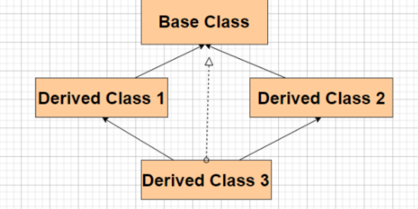
Hybrid Inheritance

Slide 17
Hybrid Inheritance
class Parent:
def func1(self):
print("this is function one")
class Child(Parent):
def func2(self):
print("this is function 2")
class Child1(Parent):
def func3(self):
print(" this is function 3"):
class Child3(Parent , Child1):
def func4(self):
print(" this is function 4")
ob = Child3()
ob.func1()

Slide 18
Method Overriding
Method overriding is an ability of any object-oriented programming language that allows a subclass or child class to provide a specific implementation of a method that is already provided by one of its super-classes or parent classes.
When a method in a subclass has the same name, same parameters or signature and same return type(or sub-type) as a method in its super-class, then the method in the subclass is said to override the method in the super-class.

Slide 19
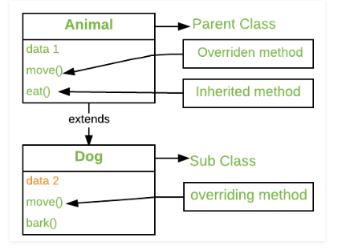
Method Overriding

Slide 20
Method Overriding
The version of a method that is executed will be determined by the object that is used to invoke it.
If an object of a parent class is used to invoke the method, then the version in the parent class will be executed, but if an object of the subclass is used to invoke the method, then the version in the child class will be executed

Slide 21
Method Overriding
class Parent:
def func1(self):
print("this is parent function")
class Child(Parent):
def func1(self):
super().func1()
print("this is child function")
ob = Child()
ob.func1()

Slide 22
Composition
It is one of the fundamental concepts of Object-Oriented Programming.
In this concept, we will describe a class that references to one or more objects of other classes as an Instance variable.
Here, by using the class name or by creating the object we can access the members of one class inside another class.
This type of relationship is known as Has-A Relation.

Slide 23
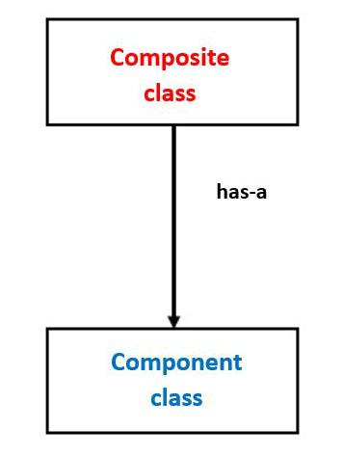
Composition

Slide 24
Composition
Syntax :
class A :
# variables of class A
# methods of class A
...
...
class B :
# by using "obj" we can access member's of class A.
obj = A()
# variables of class B
# methods of class B
...
...

Slide 25
Composition vs Inheritance
Inheritance is used where a class wants to derive the nature of parent class and then modify or extend the functionality of it.
Inheritance will extend the functionality with extra features allows overriding of methods, but in the case of Composition, we can only use that class we can not modify or extend the functionality of it.
It will not provide extra features.
Thus, when one needs to use the class as it without any modification, the composition is recommended and when one needs to change the behavior of the method in another class, then inheritance is recommended.

Slide 26
super() Method
super() is a built-in method which is useful to call the super class constructors,variables and methods from the child class.
From child class we are not allowed to access parent class instance variables by using super(),Compulsory we should use self only. [Example 3 of Super_Example.doc file]
But we can access parent class static variables by using super(). [Example 3 of Super_Example.doc file]
From child class constructor and instance method, we can access parent class instance method,static method and class method by using super() . [Example 4 of Super_Example.doc file]

Slide 27
super() Method
From child class, class method we cannot access parent class instance methods by using super() directly(but indirectly possible). But we can access parent class static and class methods. . [Example 5 of Super_Example.doc file]
In child class static method we are not allowed to use super() generally (But in special way we can use) . . [Example 6 of Super_Example.doc file]

Slide 28
Abstract Classes
Abstract classes are classes that contain one or more abstract methods.
An abstract method is a method that is declared, but contains no implementation.
Abstract classes cannot be instantiated, and require subclasses to provide implementations for the abstract methods.
When we want to provide a common interface for different implementations of a component, we use an abstract class.
By default, Python does not provide abstract classes. Python comes with a module that provides the base for defining Abstract Base classes(ABC) and that module name is ABC

Slide 29
Abstract Classes
In python we can declare abstract method by using @abstractmethod decorator as follows.
@abstractmethod
def m1(self):
pass
@abstractmethod decorator present in abc module. Hence compulsory we should import abc module,otherwise we will get error.
Child classes are responsible to provide implemention for parent class abstract methods.
Every abstract class in Python should be derived from ABC class which is present in abc module.

Slide 30
Abstract Classes
abstract class with abstract method instantiation is not possible"
Parent class abstract methods should be implemented in the child classes. otherwise we cannot instantiate child class.If we are not creating child class object then we won't get any error.
If we are extending abstract class and does not override its abstract method then child class is also abstract and instantiation is not possible.
Abstract class can contain both abstract and non-abstract methods also

Slide 31
Interface
In general if an abstract class contains only abstract methods such type of abstract class is considered as interface. [Interface_Example.doc ]

Slide 32
Public, Protected and Private Attributes
By default every attribute is public. We can access from anywhere either within the class or from outside of the class.
syntax:
name = ‘priti’
Protected attributes can be accessed within the class anywhere but from outside of the class only in child classes. We can specify an attribute as protected by prefexing with _ symbol.
syntax:
_variablename=value
_name = ‘priti’

Slide 33
Public, Protected and Private Attributes
private attributes can be accessed only within the class.i.e from outside of the class we cannot access.
We can declare a variable as private explicitly by prefexing with 2 underscore symbols.
syntax:
__variablename=value
__name=“priti”

