Slide 1
ARTIFICIAL INTELLIGENCE
Presented By
Dr. KSHITIJ TRIPATHI
Assistant Professor
B.Sc. (Maths), M.Sc, MCA, C-DAC
PhD( Data Science+Artificial Intelligence+Machine Learning)
UGC SLET (COMPUTER SCIENCE)

Slide 2
LOGIC & KNOWLEDGE BY MACHINE
VISION
SPEECH
HEAR
PROCESS CPU -IT HAS BRAIN
PROGRAM
WITHOUT DATA PROGRAM HAS NO MEANING
IN SUMMARY IT IS ALL ABOUT DATA AND ALGORITHMS
KEY ROLE IS PLAYED BY MATHEMATICS

Slide 3
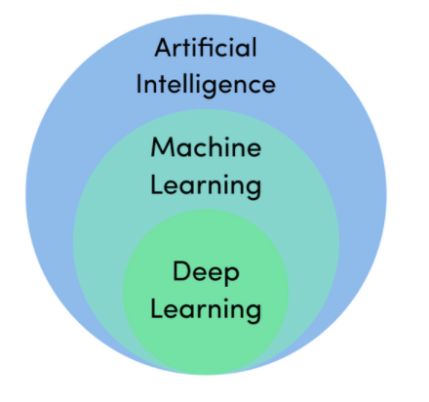
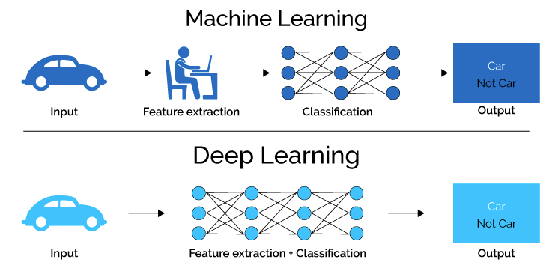

Slide 4
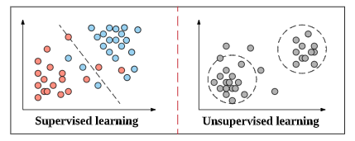

Slide 5
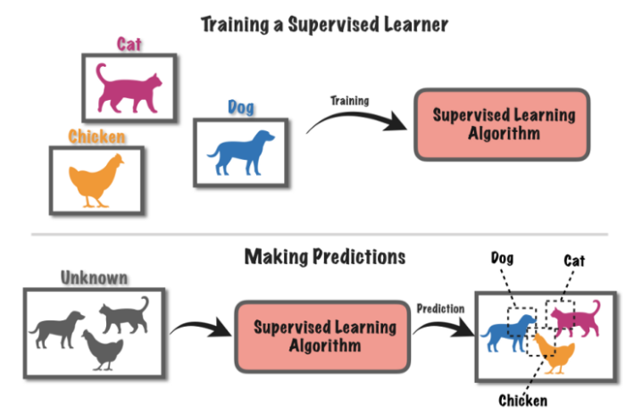

Slide 6
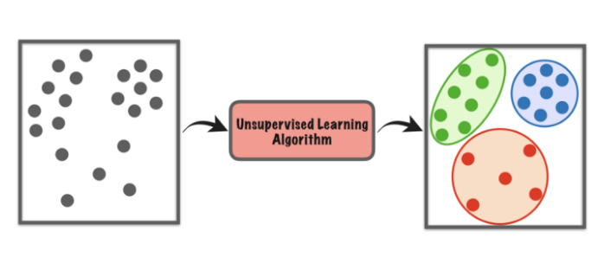

Slide 7
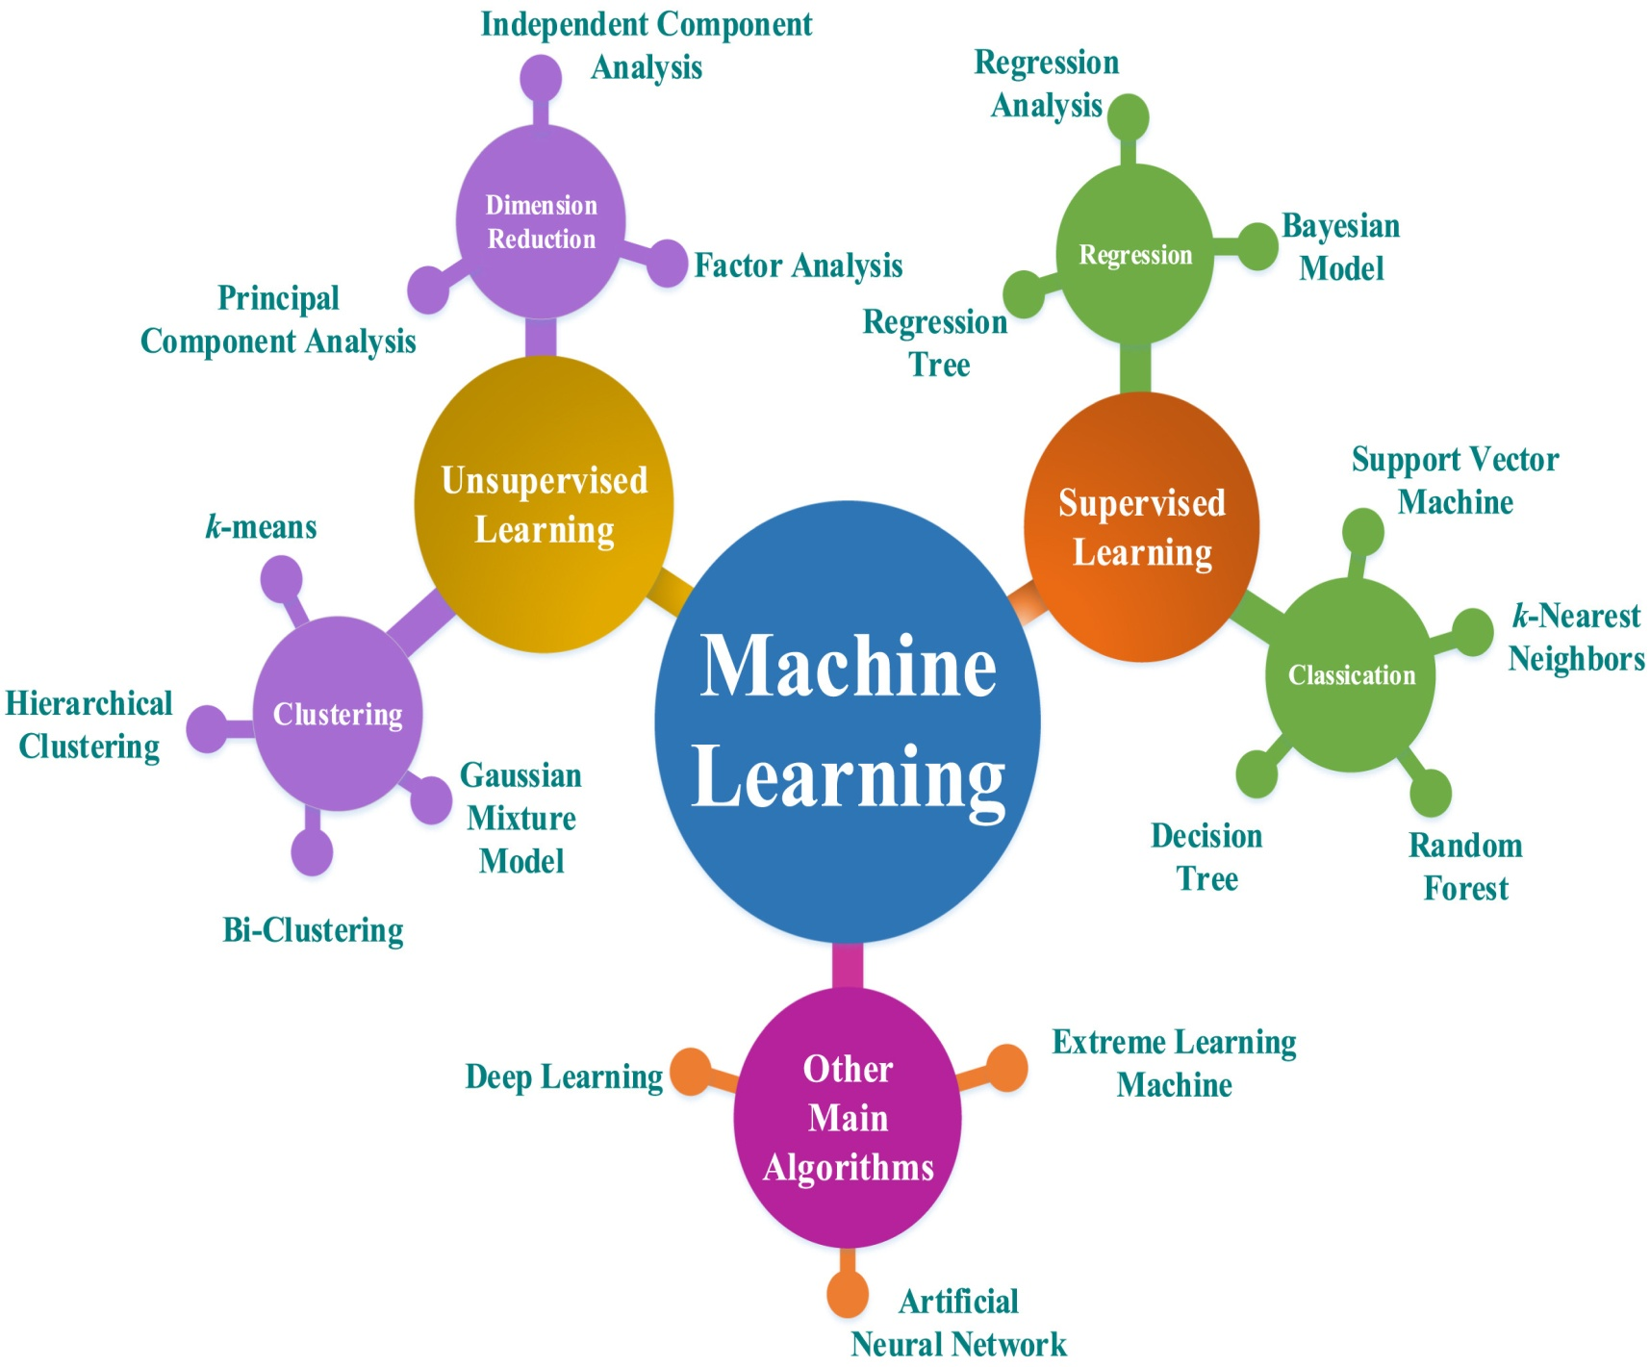

Slide 8
ADVANTAGES OF MACHINE LEARNING
WHOLE PROCESS IS AUTOMATED
PROCESS SMALL AND LARGE DATA ADEQUATELY
HANDLES A VARIETY OF DATA
IDENTIFY THE DATA PATTERNS (SUPERVISED AND UNSUPERVISED)
RELIABLE AND EFFICIENT
DISADVANTAGES OF MACHINE LEARNING
LACK OF EXPLAINABILITY
HIGH CHANCES OF ERROR
DATA BIAS
COMPLEXITY
MAKING THE WRONG ASSUMPTIONS
INACCURATE PREDICTIONS

Slide 9
HEURISTIC APPROACH
In problem solving tasks related to data mining those approaches are called heuristic which do not have explicit procedures to solve the specific problem rather we have to employ implicit techniques which may be a combination of novel mathematical and other scientific concepts that may be a part of computational algorithms. It is observed that there is no direct method available which decides the configuration of ANN for specific problem and dataset like number of hidden layers, number of neurons in these hidden layers, transfer function employed and other parameters which best fits the specific problem. Further cross-validation approach is based on partitioning of data in to multiple folds but there is no explicit reason available to decide number of folds for specific problem. In the experiments performed in this thesis we use hit and trial methods induced from the literature available from the various ANN resources.

Slide 10
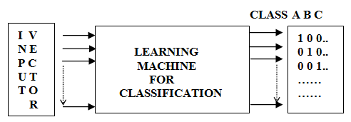
DATA CLASSIFICATION

Slide 11
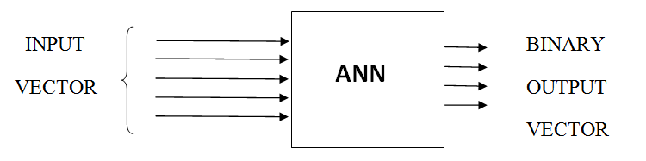
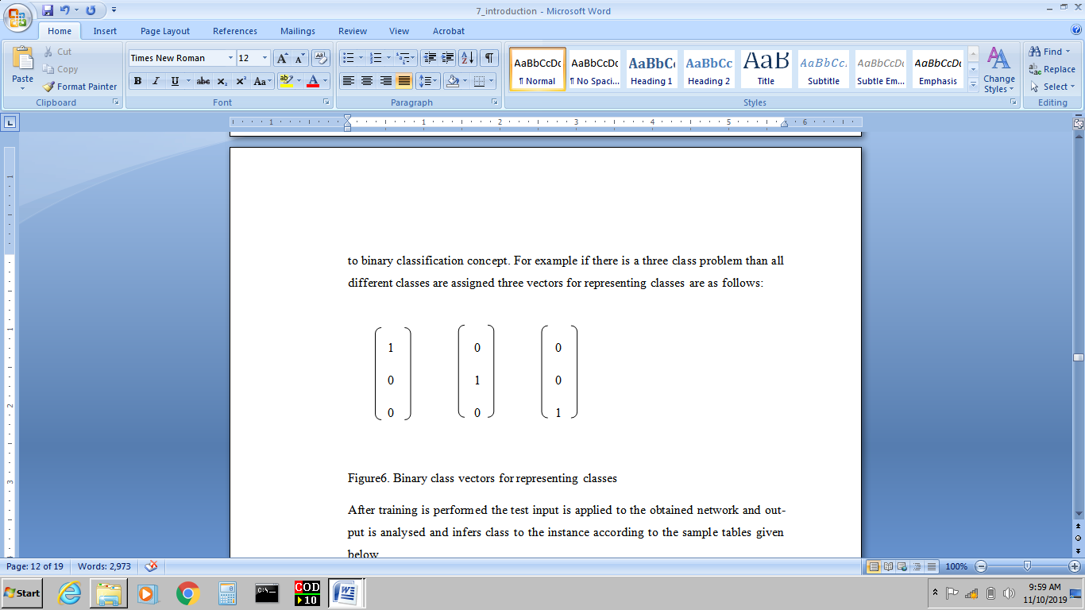
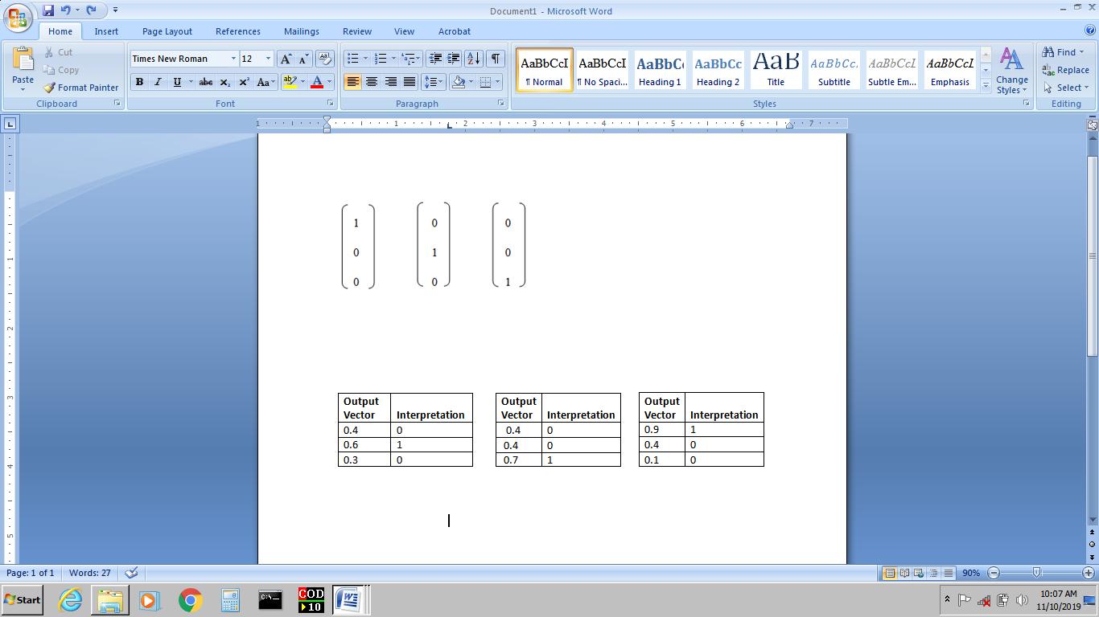

Slide 13
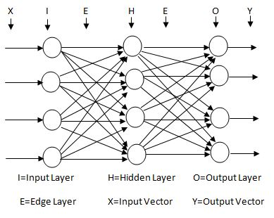
ARCHITECTURE OF ARTIFICIAL NEURAL NETWORK

Slide 14
THANK YOU

