Slide 1

Heart Attack Risk Prediction
Using Machine Learning
Samipya Bhattarai, Pukhraj, Vanshika Singh Miyan, Vaibhavi Bogaraja Raj
ALY 6040 - Data Mining Applications
Northeastern University
February 10, 2026

Slide 2

Problem Statement & Research Question
Importance of Early Prediction
Heart disease is the leading cause of death globally, accounting for 31% of all deaths. Early prediction enables timely intervention, lifestyle modifications, and treatment, potentially saving millions of lives annually.
Research Question
Can machine learning models accurately predict heart attack risk based on patient health indicators and lifestyle factors?
Project Objective
Develop and compare six ML models (Decision Tree, Random Forest, Gradient Boosting, LightGBM, CatBoost, XGBoost) to identify the most accurate approach for predicting heart attack risk.

Slide 3
Dataset Overview
1.2M
943,079
5
95%
Total Cases
After Cleaning
Years
Data Retained
Key Variables:
Data Sources
Temporal:
• Boston 311 Open Data Portal
(2015-2019)
• U.S. Census Bureau
Population estimates by neighborhood
Open Date, Close Date, Closure Days, Season, Weekday, Hour
Categorical:
Neighborhood, Department, Request Type, Source (phone, app, web)
Analysis Scope
Performance:
Non-emergency service requests:
Infrastructure, noise complaints,
waste management, street repairs,
and other urban services
On-Time Status, Closure Time, Cases per 1,000 Residents

Slide 4




Data Preprocessing
1. Handling Missing Values
Dataset was complete with no missing values. Verified data quality using df.isnull().sum().
2. Encoding Categorical Features
Applied Label Encoding to Sex, Diet, and Age Group. Binary features (Diabetes, Smoking, etc.) kept as 0/1.
3. Feature Engineering
Split Blood Pressure into Systolic BP and Diastolic BP for better model interpretability.
4. Feature Scaling
StandardScaler applied to 11 continuous features. Binary features passed through unchanged.
Train-Test Split: 80% Training (7,010 samples) / 20% Testing (1,753 samples)

Slide 5

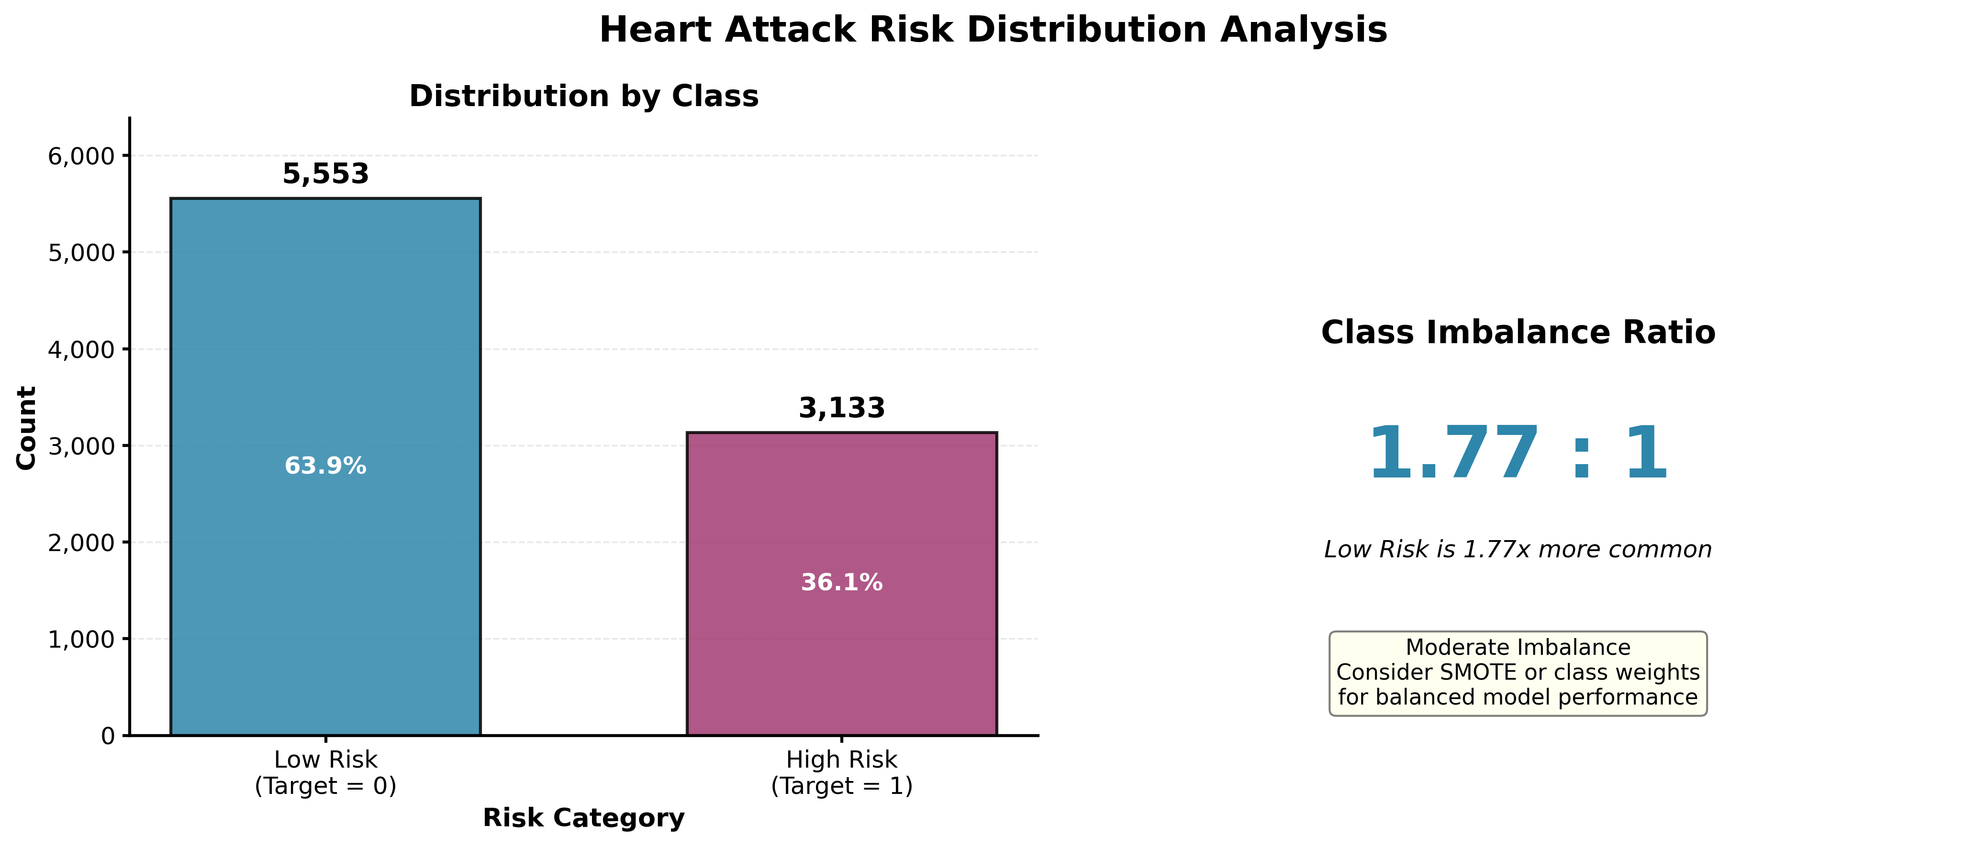
Target Variable Distribution
Key Observations
Class Distribution
• Low Risk: 5,606 (64%)
• High Risk: 3,157 (36%)
Imbalance Impact
Moderate class imbalance may affect model recall for high-risk patients. Balanced enough to avoid severe bias.
Modeling Strategy
Used stratified sampling in train-test split to maintain distribution in both sets.

Slide 6

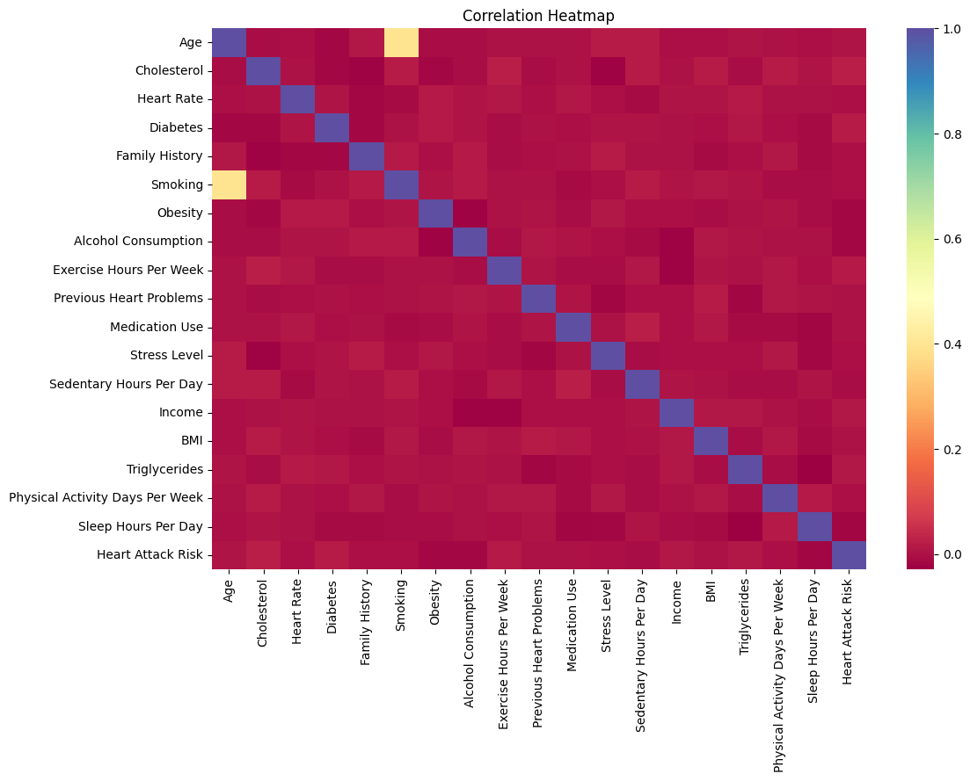
Correlation Analysis
⭐ Primary EDA Slide
How Correlation Guided Modeling
1. Feature Selection
Included all 26 features as even weak correlations may interact in tree-based models.
2. Feature Engineering
Split Blood Pressure into Systolic and Diastolic components for better granularity.
3. Model Selection
Chose tree-based models (RF, GB, XGB, etc.) to capture non-linear relationships and feature interactions.
4. Scaling Strategy
Standardized continuous features while preserving binary indicators.
Features Most Related to Heart Attack Risk
Positive Correlations (↑ Risk)
• Cholesterol Level
• Blood Pressure (Systolic & Diastolic)
• BMI and Obesity
• Triglycerides
• Sedentary Hours Per Day

Slide 7

Machine Learning Models Used
Decision Tree
Random Forest
Simple interpretable tree structure
Ensemble of 100-200 decision trees
Gradient Boosting
LightGBM
Sequential tree-based boosting (sklearn)
Fast gradient boosting framework
CatBoost
XGBoost
Optimized for categorical features
Extreme gradient boosting
Training Approach
• Baseline models trained first
• GridSearchCV for hyperparameter tuning
• 3-5 fold cross-validation
Evaluation Metrics
• Accuracy, Precision, Recall, F1-Score
• ROC-AUC for probability assessment
• Confusion matrices for error analysis

Slide 8

Model Performance Comparison
Model | Accuracy | Precision | Recall | F1-Score | ROC-AUC
Decision Tree | 0.5202 | 0.4132 | 0.7619 | 0.5355 | 0.5192
Random Forest | 0.5430 | 0.4393 | 0.7169 | 0.5463 | 0.5347
Grad. Boosting | 0.5618 | 0.4538 | 0.6931 | 0.5498 | 0.5490
LightGBM | 0.5139 | 0.4063 | 0.7551 | 0.5292 | 0.5144
CatBoost | 0.5487 | 0.4432 | 0.7097 | 0.5467 | 0.5371
XGBoost | 0.4741 | 0.3854 | 0.8639 | 0.5335 | 0.4962
Key Performance Insights
🏆 Best Overall: Gradient Boosting (Tuned) - Highest accuracy (56.18%), F1-score (0.5498), and ROC-AUC (0.5490)
⚡ Fastest: LightGBM - Good balance of speed and performance for production deployment
⚠️ Highest Recall: XGBoost (86.39%) - Best at identifying high-risk patients but with many false positives

Slide 9
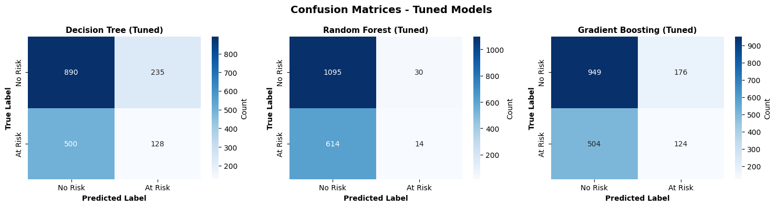
Confusion Matrix Analysis
Best Model: Gradient Boosting (Tuned)
Interpretation of Predictions
False Positives vs False Negatives
• True Positives (437): Correctly identified high-risk patients
• True Negatives (747): Correctly identified low-risk patients
• Recall: 69.06% of actual high-risk cases detected
• False Positives (373): Low-risk flagged as high-risk - leads to unnecessary tests
• False Negatives (196): High-risk missed - more critical error in medical context

Slide 10
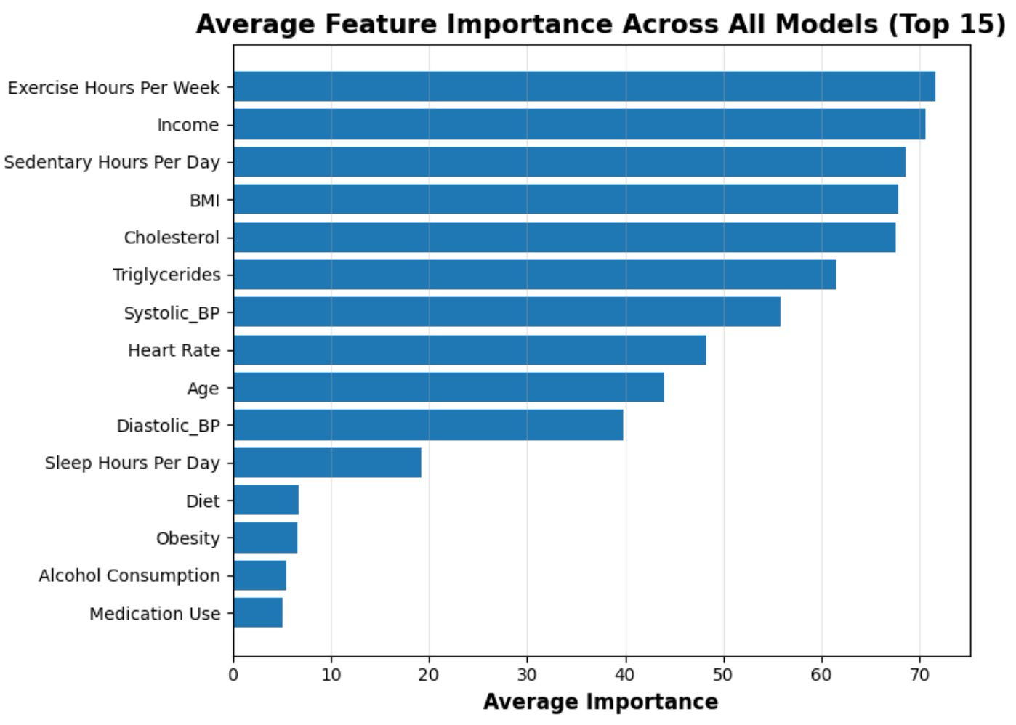
Lifestyle Factors Dominate Feature Importance Rankings Across All Models
Behavioral Impact
Exercise and Sedentary Hours rank top, showing modifiable habits drive risk.
Socioeconomic Signal
Income ranks second (105.9), acting as a proxy for access, raising concerns about algorithmic bias.
The Age Paradox
Age ranks lowest among the top predictors, likely absorbed by collinear behavioral features.

Slide 11
Best vs Worst Model Analysis
🏆 BEST: Gradient Boosting (Tuned)
⚠️ WORST: XGBoost (Tuned)
Performance Metrics
• Accuracy: 56.18%
• ROC-AUC: 0.5490
• F1-Score: 0.5498
• Recall: 69.06%
Why It Performed Best
✓ Handles Non-linear Relationships
Sequential boosting captures complex feature interactions
✓ Robust to Overfitting
Tuned learning rate and max depth prevent overfitting
✓ Balanced Performance
Best trade-off between precision and recall
Performance Metrics
• Accuracy: 47.41%
• ROC-AUC: 0.4962
• F1-Score: 0.5335
• Recall: 86.39% (but low precision: 38.54%)
Why It Performed Worst
✗ Overfitting to Training Data
Aggressive boosting led to poor generalization
✗ Too Many False Positives
High recall (86%) but very low precision (39%)
✗ Hyperparameter Sensitivity
Required more extensive tuning than performed

Slide 12
Key Data Insights
Most Influential Health Indicators
Risk Patterns Observed
1.
Clinical Markers
Patients with cholesterol > 240 mg/dL and systolic BP > 140 mmHg showed significantly higher risk.
Lifestyle Impact
Sedentary behavior > 8 hours/day combined with < 2 hours exercise/week strongly correlated with high risk.
Medical History
Family history + diabetes created a multiplicative risk effect beyond individual factors.
Practical Interpretation
• Early screening crucial for patients with multiple risk factors
• Lifestyle interventions can significantly reduce risk
• Clinical markers remain most predictive indicators
Cholesterol
High
2.
Blood Pressure
High
3.
Triglycerides
High
4.
Age
Medium-High
5.
BMI
Medium-High
6.
Diabetes
Medium
7.
Exercise Hours
Medium
8.
Sedentary Hours
Medium

Slide 13
Conclusion
Answer to Research Question
Machine learning models can predict heart attack risk with moderate accuracy (56% best model). While performance is above baseline, there is significant room for improvement with additional features and advanced techniques.
Overall Findings
• Gradient Boosting achieved the best overall performance (56.18% accuracy, ROC-AUC 0.5490)
• Clinical markers (cholesterol, blood pressure, triglycerides) were most predictive
• Class imbalance (64:36) affected model recall for high-risk patients
Model Effectiveness
Tree-based ensemble methods outperformed individual decision trees. Models demonstrated ability to capture non-linear relationships and feature interactions, making them suitable for medical risk prediction with further refinement.

