Slide 1
Task-4
Sales_interactive_Dashboard

Slide 2
Summary
The dashboard delivers a panoramic picture of the metrics of business performance, catering to stakeholders analyzing trends in sales, profitability, and product/category performance across the horizon. It relies on the utilization of filters and KPI visualization for fact-based decision-making.

Slide 3
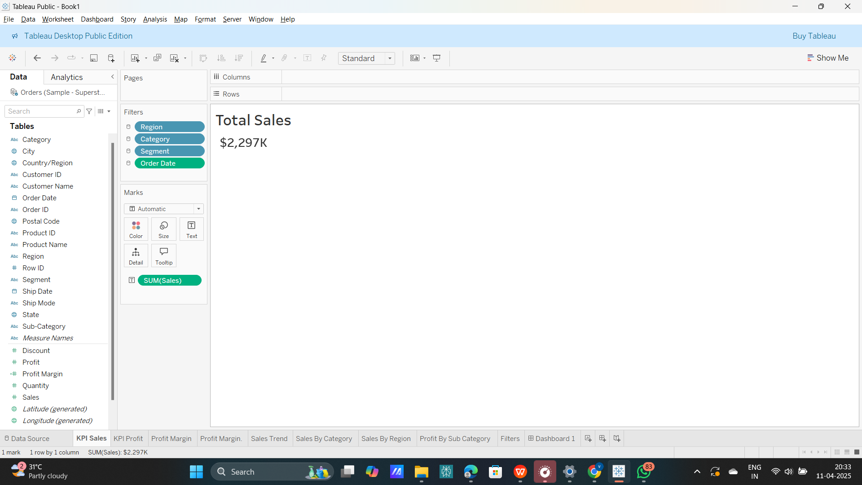
KPIs (Key Performance Indicators) Total Sales
Definition: Accumulated sale of products from the selected duration.
Value Shown: $2,297K
Reason: Sums up total money making through the revenues. Key analysis figure when doing growth assessments on the finance front.

Slide 4
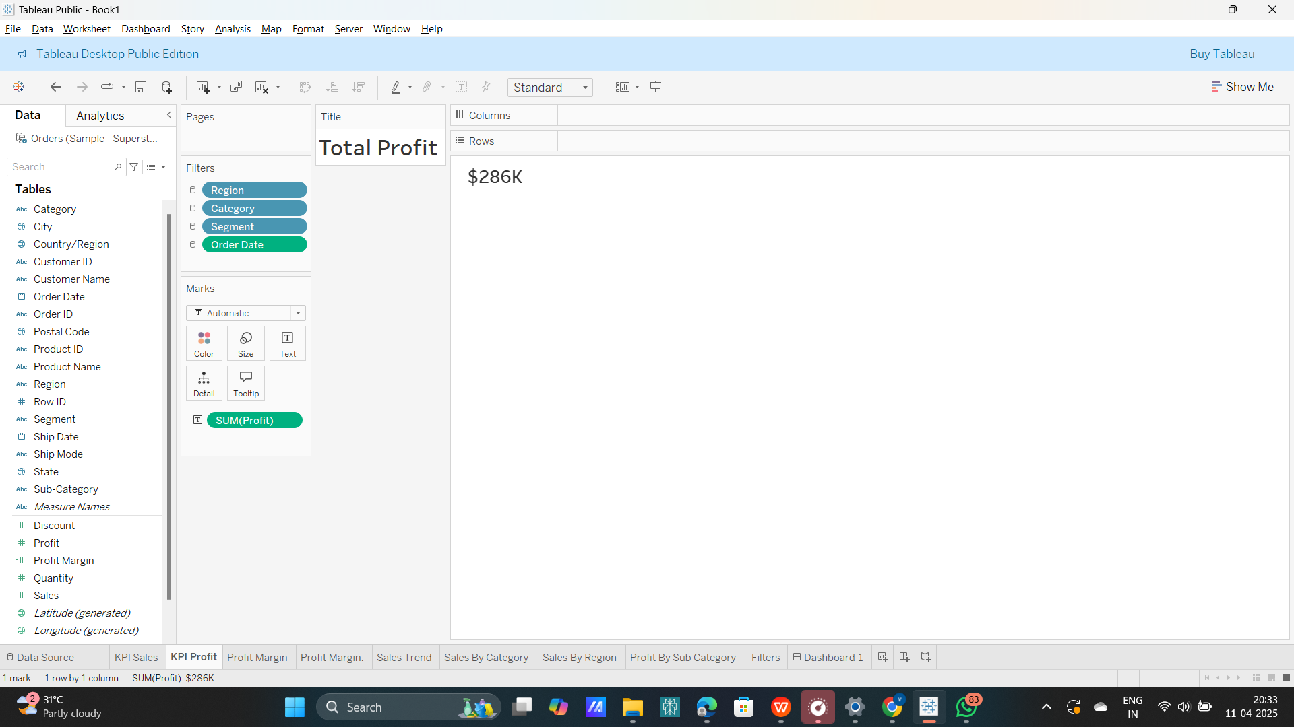
Total Profit
Definition: Total revenue - total cost.
Value Displayed: $286K
Purpose: Measures profitability of the business. Assists in evaluating cost efficiency.

Slide 5

Profit Margin
Definition: (Profit ÷ Sales) × 100
Value Displayed: 12.5%
Purpose: Shows how much profit is generated per dollar of sales. Helpful for margin optimization.

Slide 6
Interactive Filters (Slicers)
Region, Segment, Category, Order Date
Function: Filter the entire dashboard according to user choices.
User Benefit: Enables stakeholders to drill down and conduct focused analysis, i.e., on "Technology" sales in the "West" region for 2020.

Slide 7
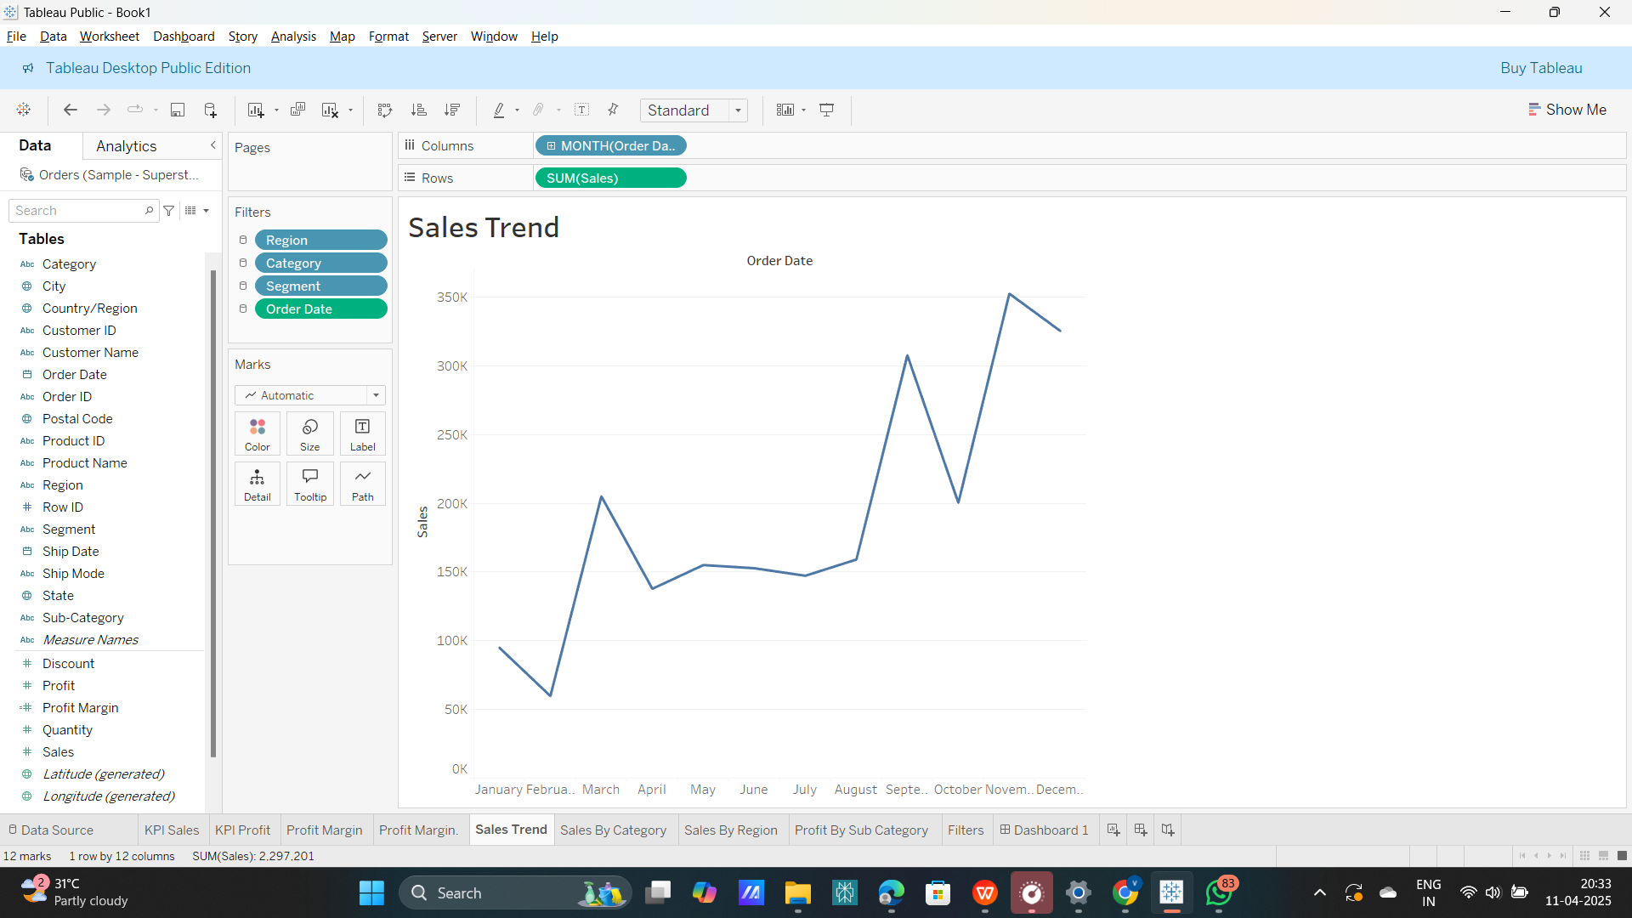
Sales Trend (Line Chart)
Measure: Monthly Sales
Dimension: Order Date (Monthly)
Purpose: Depicts seasonal trends and fluctuations in sales.
Use Case: Stakeholders can identify peak months or slump periods to fine-tune marketing/supply chain initiatives.

Slide 8
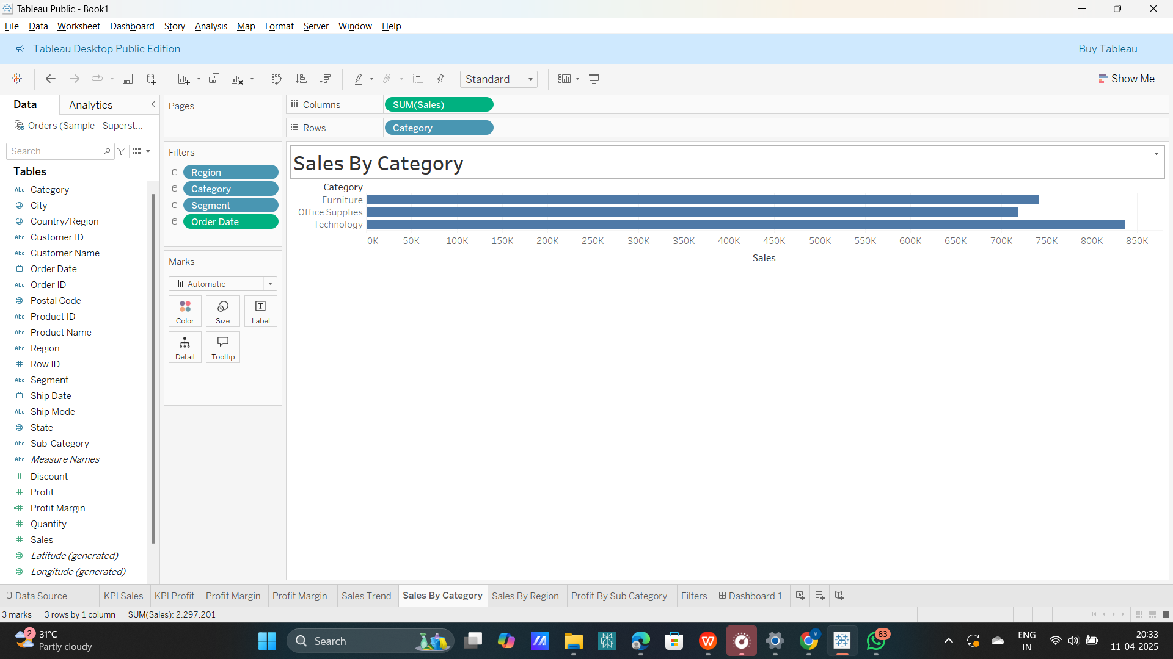
Sales by Category (Bar Chart)
Measure: Sales
Dimension: Product Category (Furniture, Office Supplies, Technology)
Purpose: Indicates which product sub-category generates most sales.
Insight: Assists in determining inventory priority or promotion campaigns for underperforming sub-categories.

Slide 9
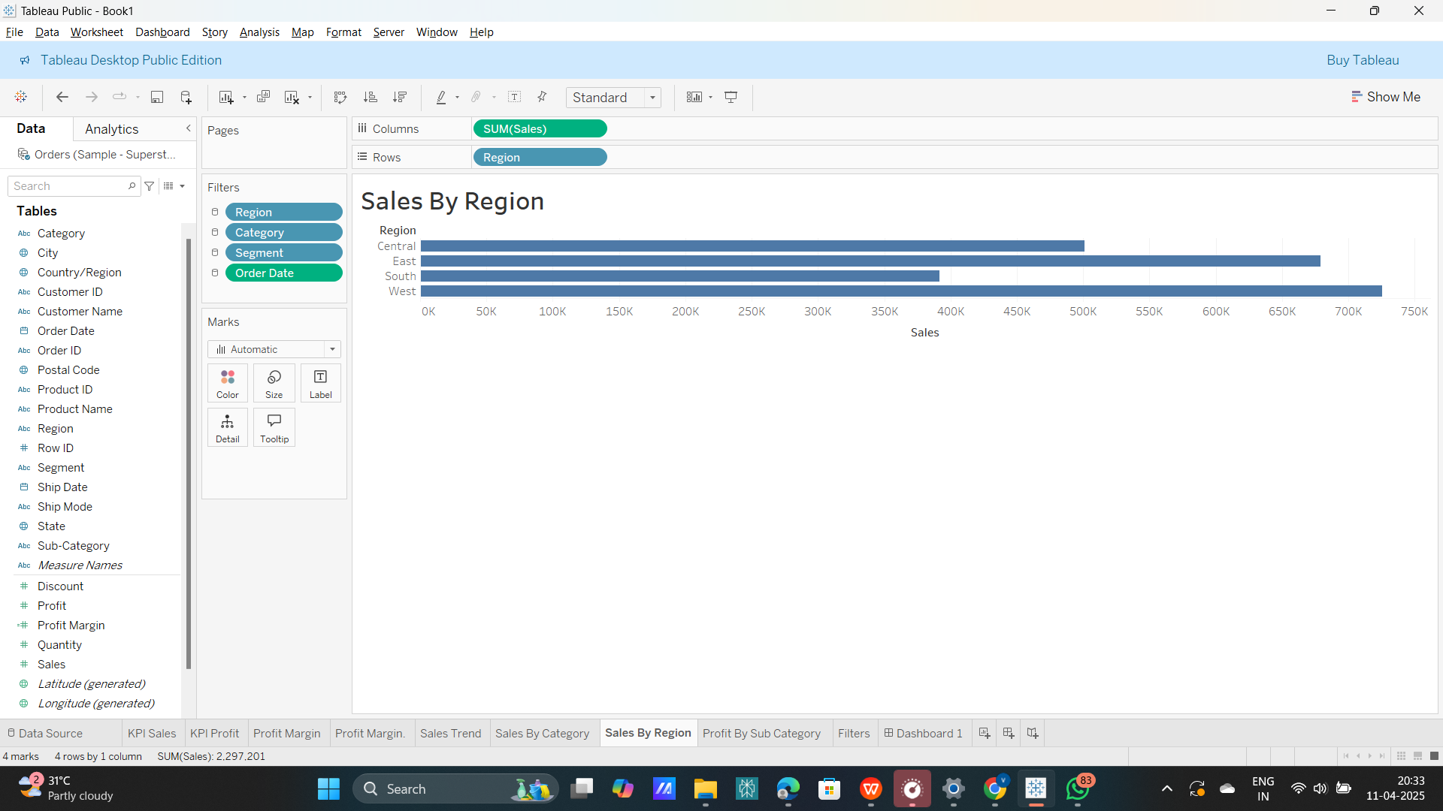
Sales by Region (Bar Chart)
Measure: Sales
Dimension: Region (East, West, Central, South)
Purpose: Indicates geographic distribution of sales.
Use Case: Business can align sales teams, distribute resources, or execute localized marketing campaigns.

Slide 10
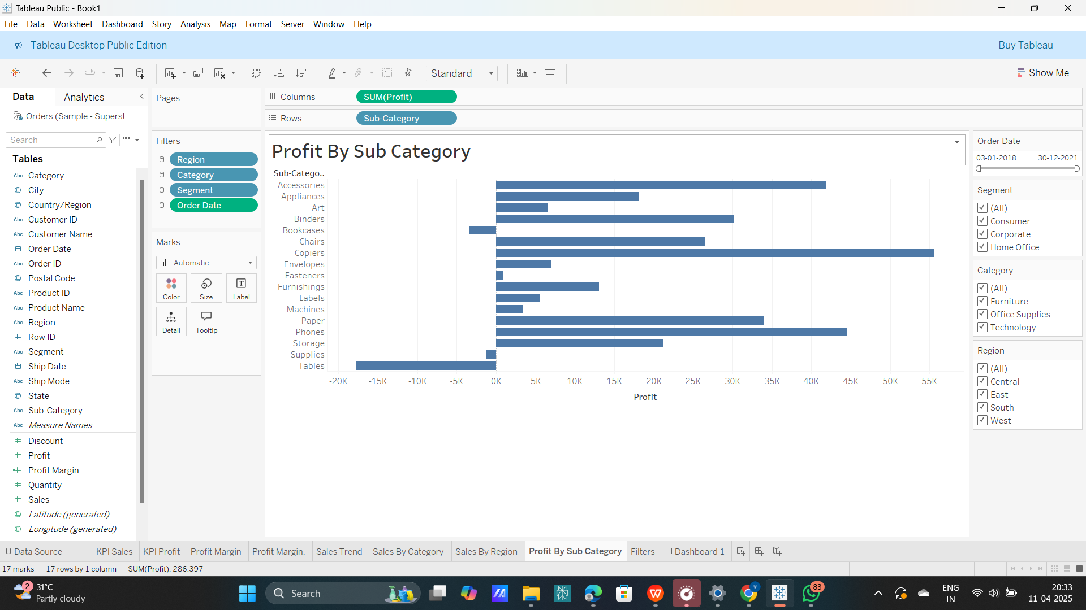
Profit by Sub-Category (Horizontal Bar Chart)
Measure: Profit
Dimension: Product Sub-Category (e.g., Chairs, Binders, Appliances)
Purpose: Assists in identifying highly profitable or loss-making sub-categories.
Insight: For instance, negative profit in "Tables" may indicate cost control or review of pricing strategy.

Slide 11
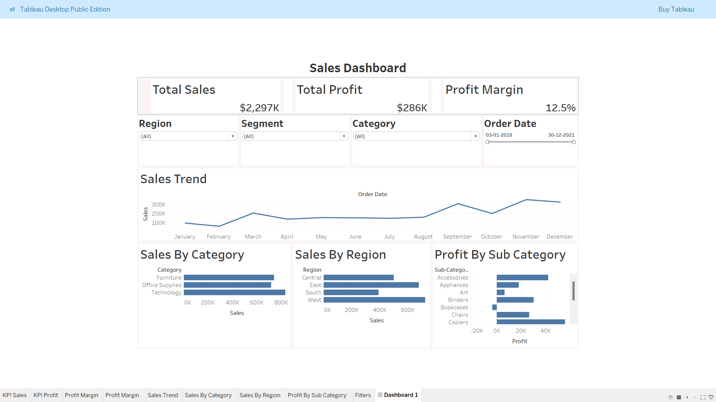
FINAL DASHBOARD

Slide 12
Final Dashboard summary
This sales dashboard provides a clear and interactive overview of business performance using key metrics and visualizations. It showcases Total Sales, Total Profit, and Profit Margin as KPIs to track overall financial health. The dashboard includes filters for Region, Segment, Category, and Order Date to allow users to customize views. A Sales Trend line chart illustrates monthly sales fluctuations, helping to identify seasonality. Bar charts display Sales by Category and Region, highlighting top-performing areas and products. Additionally, a Profit by Sub-Category chart reveals the most and least profitable product groups. Together, these elements support strategic, data-driven decisions.

Slide 13
Thank You

