Slide 1

Deep Learning-Based Glaucoma Detection Using Convolutional Neural Networks on Retinal images.
Guided by:
Dr. Gauri Morankar
Presented by :
Sejal Kediya (44)
Shravani Dhanvada (45)
Sakshi Melag (47)
Vaibhavi Baware (61)

Slide 2
INTRODUCTION
Glaucoma is a group of eye diseases that can cause vision loss and blindness by damaging a nerve in the back of your eye called the optic nerve
One of the main causes of vision loss worldwide is glaucoma. Early detection is essential for successful intervention.
Traditional glaucoma detection techniques are time-consuming, difficult, and expensive. A potential, cost effective answer is provided by neural network models.
The Digital Fundus Image (DFI) is one of the most common and popular ways to diagnose glaucoma. DFI has become the best modality for thorough glaucoma screening because to how simple it is to acquire them in a non-invasive way that is appropriate for screening on a big scale.
The assessment system to be employed comprises a variety of performance criteria, including the Confusion Matrix, Accuracy,F1-score, Precision, and ROC- AUC curve.

Slide 3
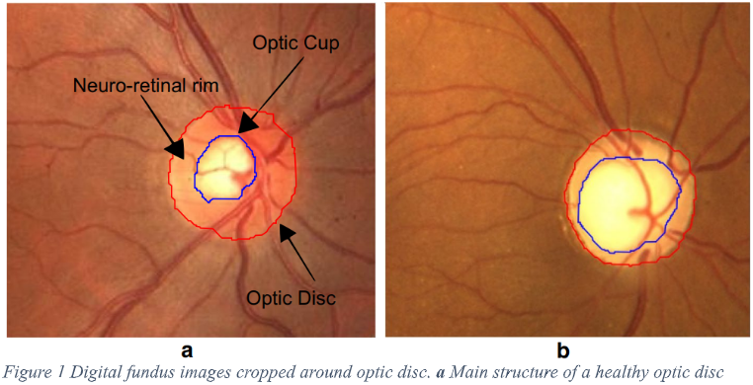
.
(a)Main structure of a healthy optic disc (b)Glaucoma affected disc

Slide 4
PROBLEM STATEMENT
The aim of research work is diagnosis of glaucoma with the help of interpretation of retinal fundus images.
It is planned to development a computerized detection system using machine learning
and deep learning techniques in the form of a web application & handheld camera for the assistance of health practitioners.
The proposed method will result in automatic screening of glaucoma diagnosis and classifies an input image as glaucomatous or healthy.

Slide 5
LITERATURE REVIEW
PAPER | METHODOLOGY | DATASET | PERFORMANCE (ACCURACY)
Islam et al. [1] 2022 | Deep Learning(EfficientNet-b3, MobileNet) | Bangladesh eye Hospital-collected fundus pictures | EfficientNet-b3: 96.5% MobileNet v2: 91.3%
Yu et al. [2] | U-Net for segmentation, SVM for classification | RIGA to DRISHTI-GS and RIM-ONE | Average training accuracy 93% and test accuracy value of 80.77%
Muthmainah et al. [3] 2018 | support vector machine (SVM), k-nearest neighbor (k-NN), linear discriminant analysis (LDA), and Naive Bayes | Public dataset of High Resolution Fundus (HRF) | K-NN: 93.9% SVM: 80% Naïve Bayes: 86.7%
Afolabi et al. [4] 2021 | U-Net lite | DRIONS, DRISHTI-GS, RIM-ONE | Accuracy: 88.6% AUC-ROC of 93.6 %

Slide 6
NEW TECHNOLOGIES FOR GLAUCOMA DETECTION
Ensemble & Two-Stage Models
Combine a segmentation model (e.g., U-Net) to localize optic disc/cup, followed by a classifier (e.g., ViT, EfficientNet).
Helps improve interpretability and focus.
Hybrid or Attention-based Models
CoAtNet: Combines convolution and attention for better spatial modeling—excellent for retinal features.
Helps model automatically emphasize key clinical features without explicit annotation.
Self-Supervised Learning (SSL)
SimCLR, MoCo, BYOL: Use unlabelled fundus images to pretrain your model, then fine-tune.
SIMCLR (Simple Contrastive Learning of Representations) learns representations by comparing augmented views of the same image.
Pretraining with SSL on large, unlabelled retinal datasets helps the model learn general retinal anatomy (vessels, disc shape, color gradients).

Slide 7
PROJECT PHASES
Phase 1- Model Selection and Training
Evaluate and compare multiple pretrained models for glaucoma detection using retinal fundus images.
Train the selected model using fundus images..
Phase 2- UI Development
Design of User Interface (Frontend).
Integration with Model Inference Backend
Phase 3- Web App Development
Smartphone + Lens Attachment Setup
Capture the fundus images which will then be fed to the web application for testing.
Phase 4- Clinical Testing
Conduct controlled testing of the system on real patients in a clinical or community setting, comparing results with ophthalmologist diagnosis to evaluate effectiveness.

Slide 8
METHODOLOGY
Methodology comprises of following steps that will assist in Glaucoma Detection through Machine learning and deep learning techniques:
1. Acquire Ophthalmology Dataset – Collect raw data related to eye health and visual function.
Collaboration with ophthalmologist - Dr. Abhijeet Deshpande
Spandan Diagnostics, Ramdaspeth.
2. Data Preprocessing :
Reduce noise.
Data augmentation and Resizing of Fundus images.
3. Analyze Visual Function Data – Extract relevant features such as visual sharpness, contrast sensitivity, and retinal segmentation.
4. Apply CNN for Prediction – Train and test Convolutional Neural Network (CNN) models including VGG16, Resnet-50, DenseNet and Inception-V3 to classify fundus images as Glaucomatous and Healthy. 5. Analyze Results & Predict Diagnosis – Evaluate CNN performance, interpret predictions, and derive diagnostic insights. 6. Web application development - A user-friendly web interface will be designed to allow users to upload retinal images from a Hand Held Retinal Camera and receive instant feedback.

Slide 9
DATASETS
DATASET | TOTAL IMAGES | COLLECTED | GLAUCOMA IMAGES | NORMAL IMAGES | RESOLUTION
DRISHTI-GS1 | 101 | KAGGLE | 70 | 31 | 2896 x 1944 PNG
ORIGA-R | 650 | KAGGLE | 168 | 482 | 3072 x 2048 JPEG
ACRIMA | 705 | KAGGLE | 396 | 309 | 178x178 to 1420 x 1420 JPEG.
PRIVATE DATASET | 60 | FROM DR. ABHIJEET DESHPANDE | 60 | - | 549x550 PNG

Slide 10
PRE-PROCESSING
Data preprocessing included crucial steps such as:
Resizing:
Standardized all images to 224×224 pixels for consistency in deep learning models.
Ensures uniform input dimensions for efficient model training.
Data Augmentation:
Data augmentation is a process which helps to increase the diversity of data for training a model without gathering new data
Applied Data Augmentation Techniques:
Rotation: Randomly rotates images to improve robustness.
Shifting: Moves images vertically & horizontally to simulate different viewpoints.
Brightness Adjustment: Simulates different lighting conditions.
Gaussian Blur: Adds slight blurring for better generalization.

Slide 11
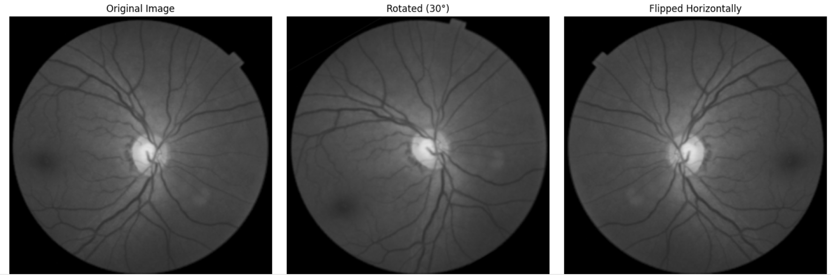
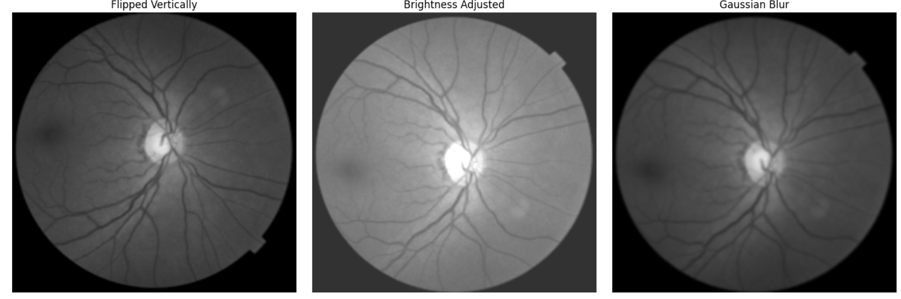
Visualization:

Slide 12
MODELS
Vgg16 (Visual Geometry Group 16)
VGG16 is a 16-layer CNN (13 convolutional+3 fully connected) with a simple 3×3 conv design. It's effective for image classification and transfer learning but lacks skip connections and is computationally heavy.
Resnet-50 (Residual Network 50-layer)
ResNet-50 is a 50-layer CNN with skip connections (residuals) to avoid vanishing gradients. It uses bottleneck blocks (1×1, 3×3, 1×1 conv) for efficiency and high accuracy. Widely used in object detection, face recognition, and medical imaging due to its strong feature extraction capabilities.
DenseNet (Densely Connected Convolutional Network)
DenseNet connects each layer to all subsequent layers, promoting feature reuse and better gradient flow. It improves efficiency, reduces parameters, and excels in tasks like medical imaging by capturing fine details.
InceptionV3
InceptionV3 is an efficient CNN for image classification, using factorized (3×3) and asymmetric (3×1, 1×3) convolutions to reduce cost. Auxiliary classifiers aid training, and multi-scale layers capture both fine and large features—ideal for tasks like medical imaging.

Slide 13
Result
Model | Accuracy | Precision | Recall | F1-score
VGG16 | 92.41% | 82.97% | 0.82 | 82.29%
Resnet50 | 68.99% | 78.66% | 0.68 | 64.98%
DenseNet | 93.75% | 75.9% | 0.92 | 83.6%
InceptionV3 | 96.8% | 71.97% | 0.94 | 83.1%
InceptionV3 has the highest recall (1.0) and highest accuracy (96.8%), making it the best model in terms of correctly
identifying all positive glaucoma cases—critical for medical diagnosis.
InceptionV3 is the most sensitive model, with good recall, making it ideal for avoiding missed diagnoses.
DenseNet offers the best balance between high recall and respectable precision, with the highest F1-score overall.
VGG16 performs consistently well across all metrics and is reliable for both balanced detection and practical deployment.
ResNet50 underperforms relative to the others, particularly in recall and F1-score, indicating the need for further optimization.

Slide 14
Confusion Matrix
Model | TP | FP | FN | TN | AUC score
VGG16 | 98 | 12 | 2 | 68 | 0.98
Resnet-50 | 64 | 20 | 36 | 60 | 0.82
DenseNet | 78 | 2 | 6 | 79 | 0.85
InceptionV3 | 75 | 0 | 4 | 80 | 0.89
According to the metrics, the Model Inception obtained a significant actual and predicted for class 0 with a count of 80. This suggests that it successfully recognised 80 patients as glaucoma positive cases. 75 of these instances involve matches between class 1 predictions and actual data. Similar to this, all other deep learning models also performed admirably, with fewer than 1 or 2 percent of labels being incorrect.
VGG16 has the highest AUC (0.98) and extremely low false negatives, making it highly reliable for both screening and clinical diagnosis.
ResNet-50 shows weak performance due to high false negatives (36), which compromises its usefulness for glaucoma detection without further tuning.
DenseNet is the only model with 6 false negatives, delivering perfect sensitivity and minimal false positives.
InceptionV3 is the most precise with no false positives, though it has a slightly higher false negative count than VGG16.

Slide 15
Step wise implementation of the entire system
Step 1: Capture and save the retinal fundus image using the smartphone setup with the lens.
Step 2: Upload the captured image in the web application.
Step 3: Image is sent to the backend and preprocessing is applied. The image is then fed to the trained deep learning model.
Step 4: Model classifies the image as 'Glaucoma' or 'Normal'.
Step 5: Display the result on the UI.

Slide 16
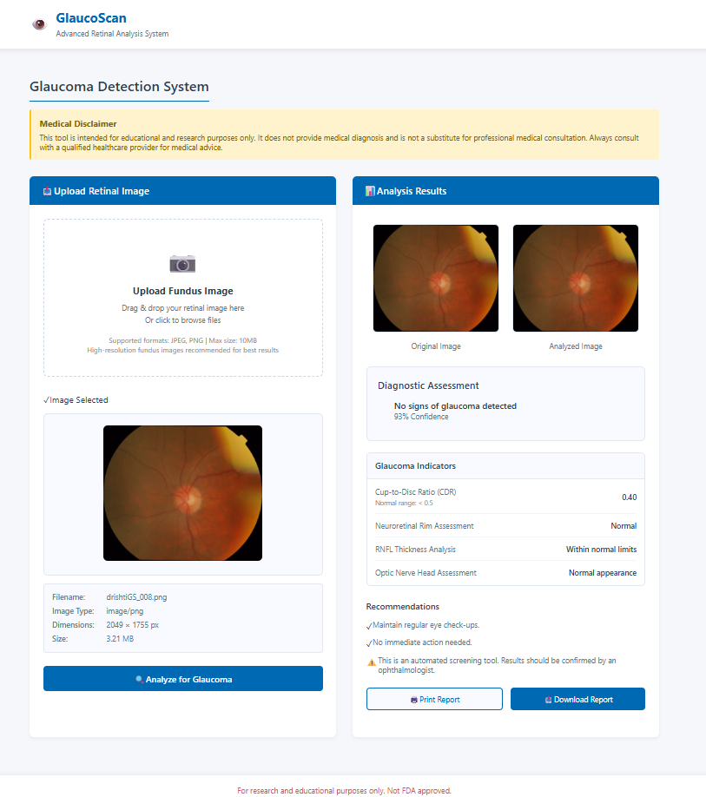
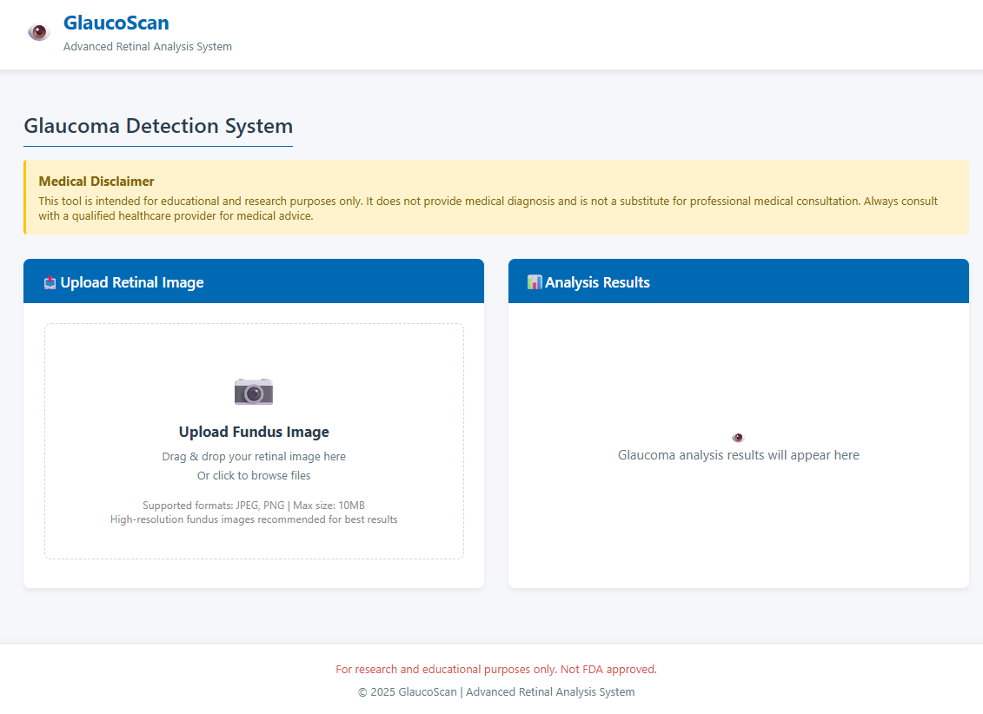
UI DESIGN
.

Slide 17
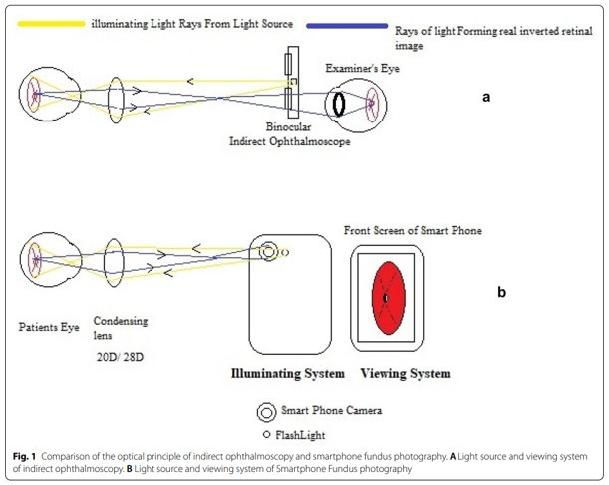
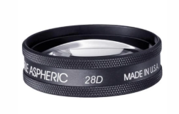
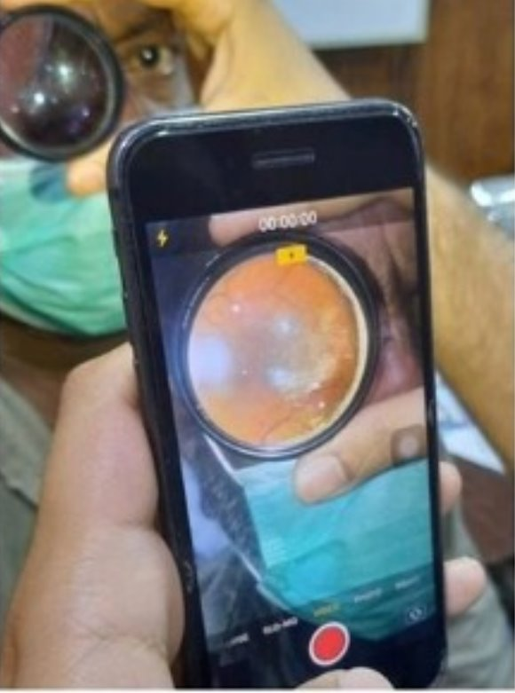
Hand-held fundus camera

Slide 18
The project successfully demonstrates the potential of deep learning, particularly Convolutional Neural Networks (CNNs), in the early detection of glaucoma using retinal fundus images. By leveraging pre-trained models and effective preprocessing techniques, the system improves diagnostic accuracy, reduces analysis time, and enhances accessibility.
FUTURE COURSE OF ACTION
Dataset Expansion: Collect and integrate more diverse datasets, including real-world images from different populations, to improve generalization.
Multiclass Classification: Extend the model’s capabilities to detect and differentiate between multiple subtypes of glaucoma
(e.g., primary open-angle, angle-closure, secondary glaucoma)
Model Optimization: Enhance accuracy by experimenting with advanced deep learning architectures, transfer learning, and
hyperparameter tuning.
Real-World Validation: Conduct clinical trials to validate model performance against standard diagnostic methods.
Web & Mobile Deployment: Fully implement and optimize the web-based system and mobile integration for real-time diagnosis.
Regulatory Compliance & Approval: Ensure compliance with medical regulations and obtain necessary certifications for real-world deployment.
Multi-Disease Detection: Incorporate detection of additional retinal diseases such as diabetic retinopathy, hypertensive retinopathy.
GitHub link : https://github.com/shravnid/G1-FINAL-PROJECT#

Slide 19
CONCLUSION
This project demonstrates the effectiveness of deep learning models, particularly CNNs, in detecting glaucoma from retinal fundus images.
Among the evaluated models, InceptionV3 showed the highest accuracy and recall, while DenseNet achieved perfect sensitivity with minimal false positives.
VGG16 also performed reliably across all metrics, whereas ResNet-50 needs further tuning.
A user-friendly interface and web application were developed to support real-time diagnosis using handheld fundus cameras.
Advanced approaches such as ensemble models, attention mechanisms, and self-supervised learning offer promising future directions.
Overall, this work lays a solid foundation for automated, accessible glaucoma screening, with potential to enhance early detection and assist in real-world clinical workflows.

Slide 20
REFERENCE PAPERS :
[1] M. T. Islam, S. T. Mashfu, A. Faisal, S. C. Siam, I. T. Naheen, and R. Khan, "Deep Learning-Based Glaucoma Detection With Cropped Optic Cup and Disc and Blood Vessel Segmentation," IEEE Access, vol. 10,Dec. 2021, https://ieeexplore.ieee.org/document/9664528
[2] Shuang Yu, Di Xiao, Shaun Frost, Yogesan Kanagasingam, Robust optic disc and cup segmentation with deep learning for glaucoma detection, Computerized Medical Imaging and Graphics 2019, https://doi.org/10.1016/j.compmedimag.2019.02.005
[3] Maria Ulfa Muthmainah, Hanung Adi Nugroho, Bondhan Winduratna, “Analysis of retinal fundus images for classification of glaucoma,” 2018 IEEE Biomedical Innovations and Applications Conference (BIOMIC), 2018. Available: https://sci-hub.se/http://dx.doi.org/10.1109/BIOMIC.2018.8610605
[4] O. J. Afolabi, G. P. Mabuza-Hocquet, F. V. Nelwamondo and B. S. Paul, "The Use of U-Net Lite and Extreme Gradient Boost (XGB) for Glaucoma Detection," in IEEE Access, vol. 9, pp. 47411-47424, 2021, doi: https://doi.org/10.1109/ACCESS.2021.3068204
[5] Omar Bernabé; Elena Acevedo; Antonio Acevedo; Ricardo Carreño; Sandra Gómez, “Classification of eye diseases in fundus images,” 2021 International Conference on Computing, Communication and Green Engineering (CCGE), 2021. Available: https://ieeexplore.ieee.org/abstract/document/9474508
[6] Rajendra Acharya U , Kannathal N , E. Y. K. Ng , Lim Choo Min , Jasjit S. Suri, “Computer-based classification of eye diseases,” Proceedings of the 28th Annual International Conference of the IEEE Engineering in Medicine and Biology Society (EMBS), pp. 3022–3025, 2006. Available: https://sci-hub.se/https://doi.org/10.1109/IEMBS.2006.260211

Slide 21
THANK YOU

