Slide 1


WELCOME
This Photo by Unknown Author is licensed under CC BY-SA-NC

Slide 2
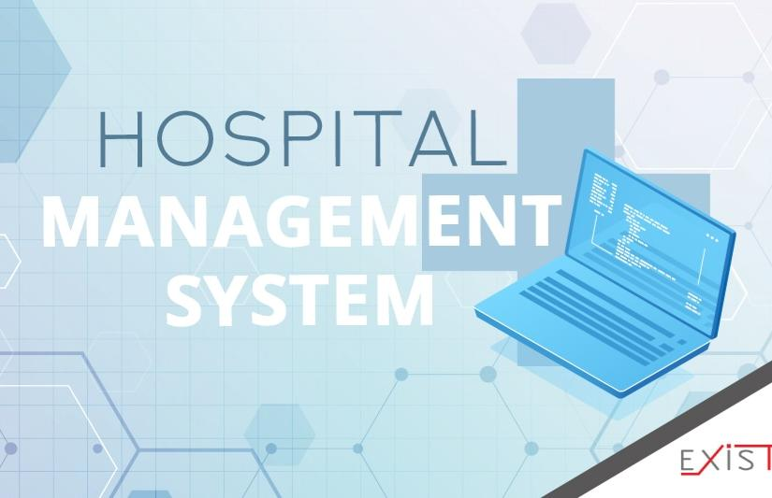
Hospital Management System
S.E.S POLYTHECHNIC SOLAPUR
Computer Technology industrial Traning Presentation
On
Hospital Management System
**********************************************************
Team Members:-
1)Vaibhavi dyavarkonda 2)Nandini Gajul
3)Shruti Balla 4)Suhas Raichurkar
5)Rohit Dapure 6)Sanjana Pardeshi

Slide 3
Introduction
1)Hospital Management System is a Project which aims in developing a computerized system to maintain all the information of hospital entities. 2)Admin modules are managing Patients,Manage Doctors& manage appointments. 3)Patient modules are find doctors &applied for appointment ,view appointment.
4)Doctor Modules are view our appointments,write,billing,&View Patient details.
5)Overall this project of ours is being developed to help the hospital administration,maintain the Hospital.
6) Management in the best way possible &also reduce the human efforts.

Slide 4

1)To manage the hospital administrate work.It helps to patients to find doctors details and take appointment online from anywhere. 2)This project also helps doctors work such as keep information of patient and appointment bookings &helps in giving prescripritions to patients.

Slide 5
NEED OF THE SYSTEM
1)There is always a need a system that will Perform Online Serching
of doctor&apply for appointment.
2)This system will reduce the manual operation required to maintain all the records. And also generates the various reports for analysis.

Slide 6
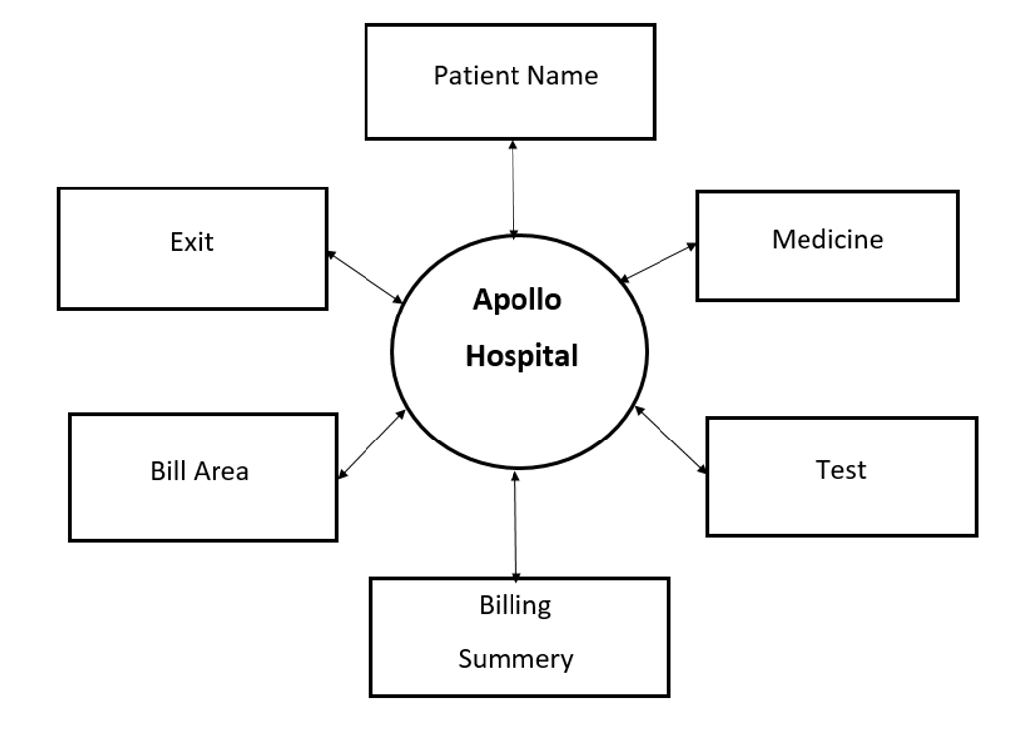

Slide 7
Objective
1)The main objective of this project is to manage the records of patients,doctors& appointments
2)Reduce the paper work &the provide the 24*7 accessible website with User-friendly GUI to
manage records
3)Our objective is by using the website patient can serch &view doctor Profiles &also apply for appointment.
4) This website project is also become useful for doctors for viewing patients details & write
prescriptions to Patient.

Slide 8
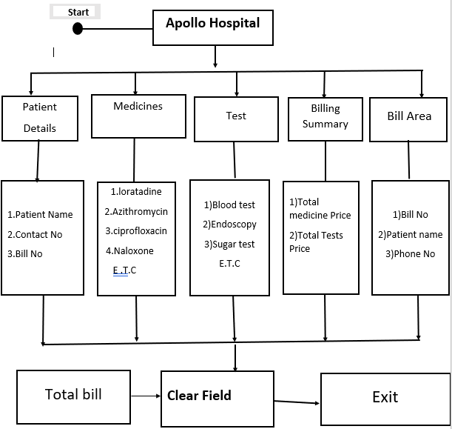

Slide 9
Admin Module:-
1)patient Details
2) Medicine
3)Tests
4) Bill Summary

Slide 10
Conclusion
The project entitled Hospital Management System. Is developed using GUI ,python language,& squlite database in back to computerize the process of Online doctor Serching & appointments management. This Project covers only basic features reqired.

Slide 11
~THANK YOU! *

