Slide 1

Walmart Store Sales
Business Forecasting
Group 9
Vaibhavi Mukadam, Aditya Pai, Cameron Clark

Slide 2
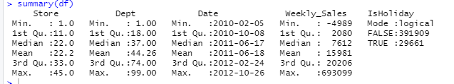
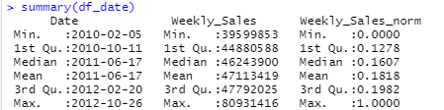
Data Description
Walmart is a renowned retail corporation that operates a chain of hypermarkets.
Walmart has provided a data combining of 45 stores including store information and weekly sales of year 2010, 2011 and 2012.
We aggregated the data to get consistent interval of time within the dataset.
Notes:
Some departments did not have sales for particular weeks, so we aggregated to get consistent intervals

Slide 3
Holidays
Super Bowl: ~ 2nd Week of February
Labor Day: ~ 2nd Week of September
Thanksgiving/Black Friday: ~4th week of November
Christmas: ~ 4th Week of December
Notes:
Holidays:
Super Bowl: ~ 2nd Week of Feb
12-Feb-10, 11-Feb-11, 10-Feb-12, 8-Feb-13
Labor Day: ~ 2nd Week of September
10-Sep-10, 9-Sep-11, 7-Sep-12, 6-Sep-13
Thanksgiving: ~4th week of November
26-Nov-10, 25-Nov-11, 23-Nov-12, 29-Nov-13
Christmas: Last week of December
31-Dec-10, 30-Dec-11, 28-Dec-12, 27-Dec-13
Note : remove the actual date

Slide 4
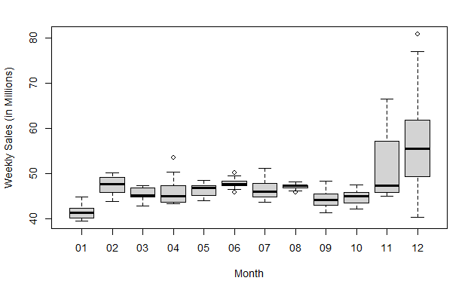
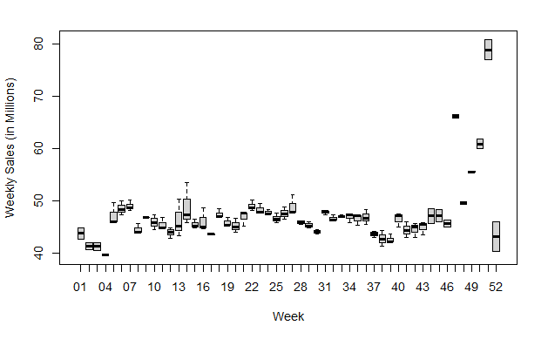
Data in Millions Aggregated

Slide 5
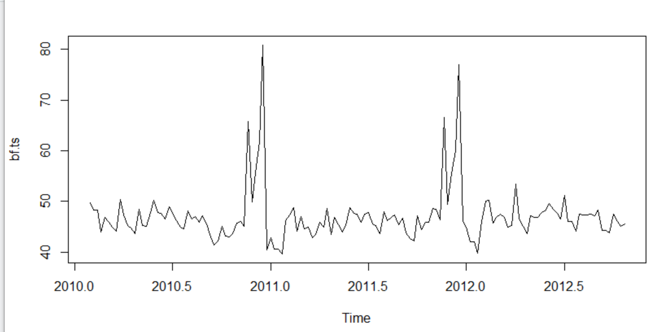
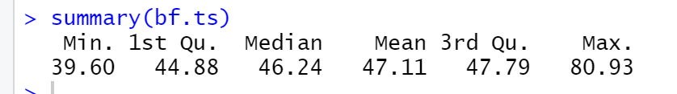
Time Series -
Weekly sales are in Millions
There is a spike late in the year
The data shows seasonality at the end of each year
There is dip in the initial months of the year

Slide 6
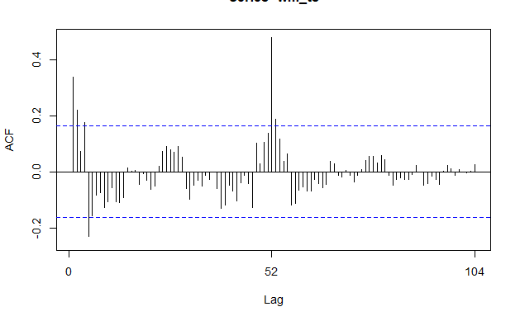
Autocorrelation
Autocorrelation represents the degree of similarity between a given time series and a lagged version of itself over successive time intervals.
Notes:
Due to the seasonal pattern in the graph, the peak is at around the 52 week mark and when data are seasonal, the autocorrelations will be larger for the seasonal lags (at multiples of the seasonal frequency) than for other lags.
Negative seasonality could be due to the drop observed in Initial weeks that is in month of January
•Is our data Random
•Does our data have a trend
•Is there seasonality?

Slide 7
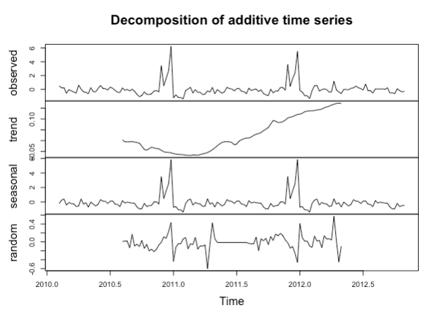
Decomposition
Notes:
•An attempt or procedure to identify the component factors that influence each of the values in a series
The additive decomposition is the most appropriate if the magnitude of the seasonal fluctuations, or the variation around the trend-cycle, does not vary with the level of the time series.
•Can be used for long and short term forecasting
•Identify each component of a TS and forecast each one separately
•Display underlying growth or decline of a TS
•Adjust series by eliminating one or more of its component

Slide 8

Accuracy Measure: MAPE
Mean absolute percentage error :
Actual data is non zero, that is, the aggregated data which we are analysing does not have zero as a value in Weekly Sales.
MAPE puts a heavier penalty on negative errors than on positive errors.
We cannot use MAE and RMSE as it depends upon the scale and also it is difficult to make comparison for a different time interval.
Notes:
Mean absolute percentage error:
The percentage error is given by p t = 100 e t / y t . Percentage errors have the advantage of being unit-free. Measures based on percentage errors have the disadvantage of being infinite or undefined if y t = 0 for any t in the period of interest, and having extreme values if any y t is close to zero.
When ME is positive, the model is under forecasting and MAPE is used for an under forecasted data.
Therefore we use MAPE, it gives the percent deviation from the actual result.
Overforescasting => bad mape
A positive value of forecast error signifies that the model has underestimated the actual value of the period. A negative value of forecast error signifies that the model has overestimated the actual value of the period.

Slide 9
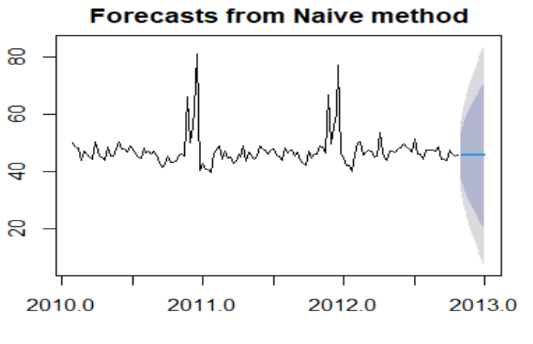
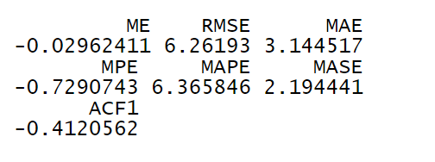
Naive Forecast

Slide 10
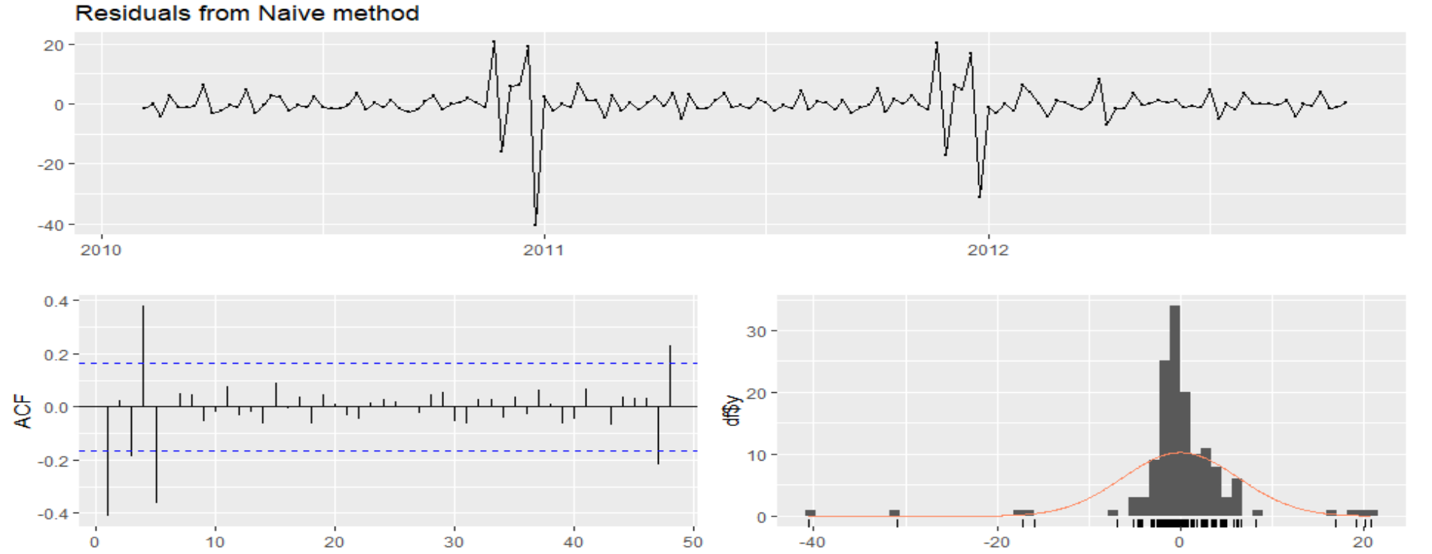
Naive : Residual analysis

Slide 11
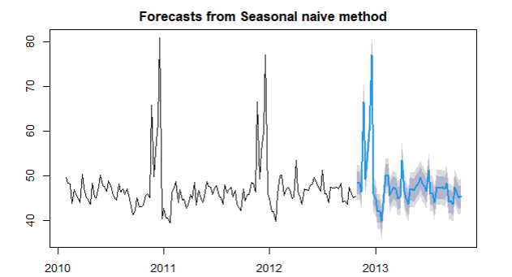
Seasonal Naive Forecast
Notes:
3.017517

Slide 12
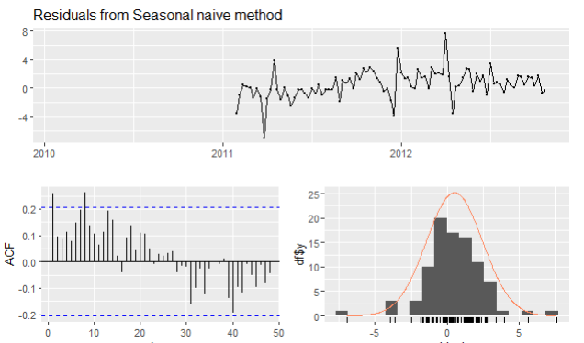
Snaive: Residual Analysis

Slide 13
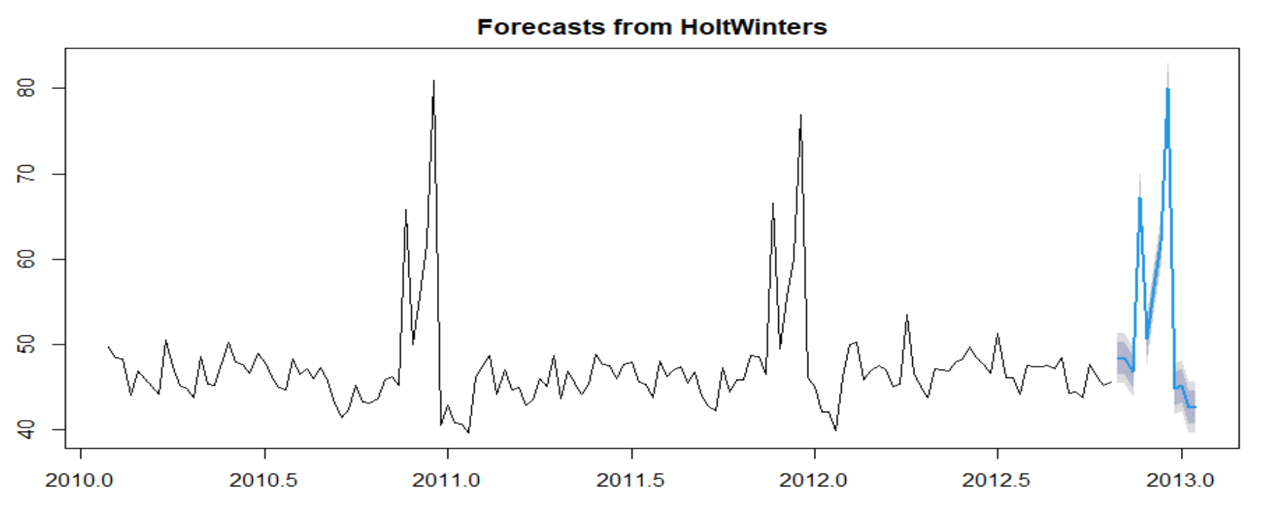
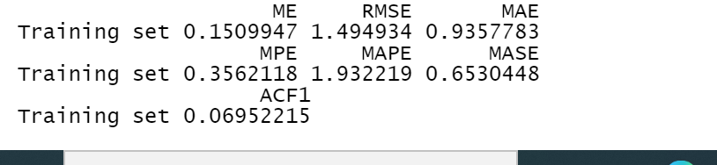
Holts Winter Forecasting Model
Smoothing parameters:
alpha: 0.06058175
beta : 0.008479722
gamma: 0.557241

Slide 14
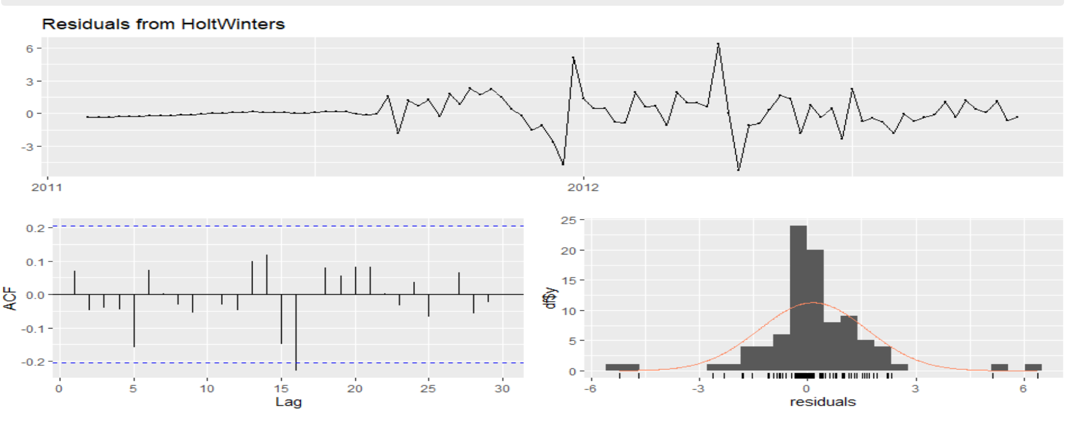
Holts Winter: Residual Analysis

Slide 15
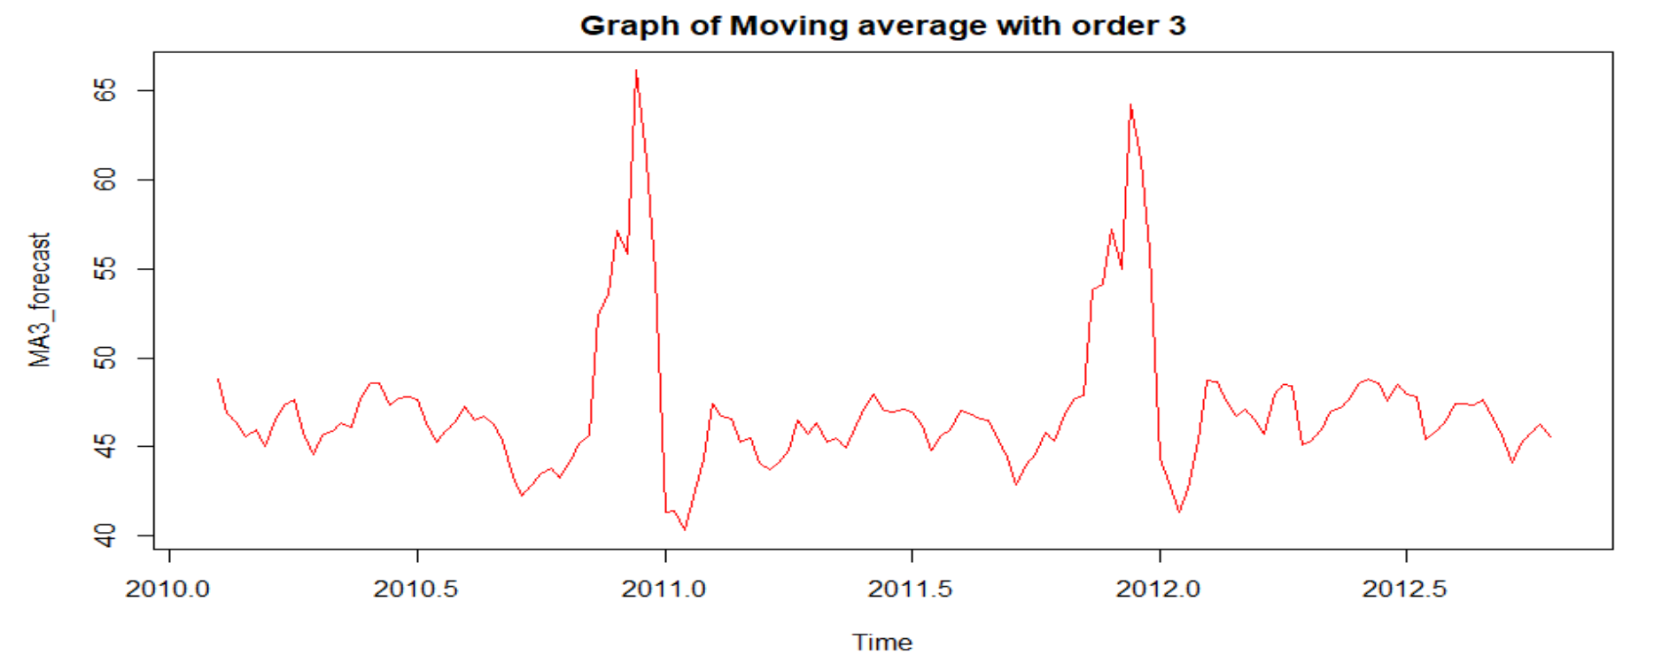
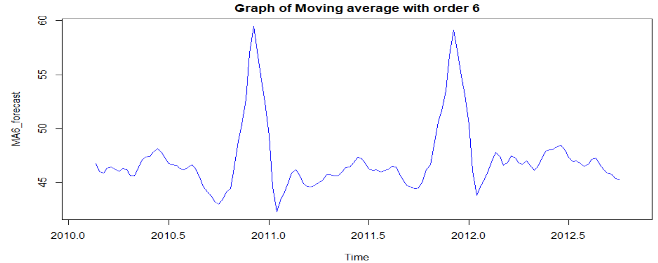
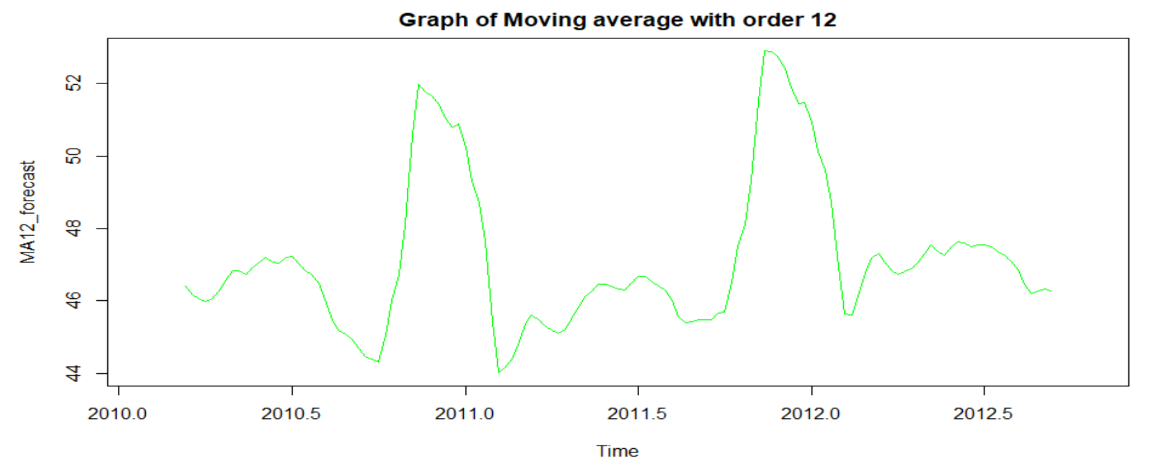
Moving Averages Forecast

Slide 16
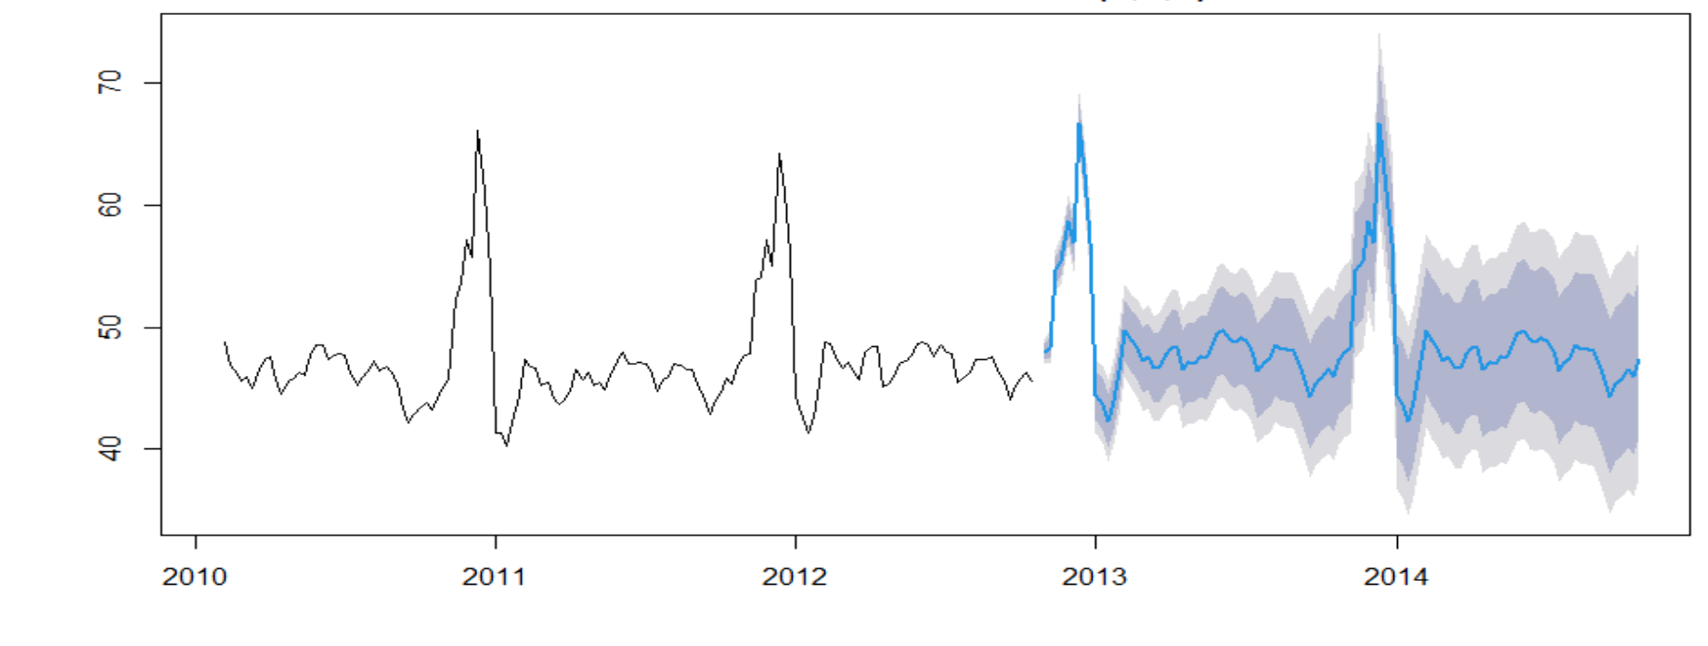
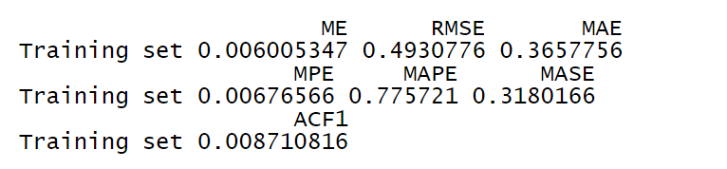
Moving average order = 3

Slide 17
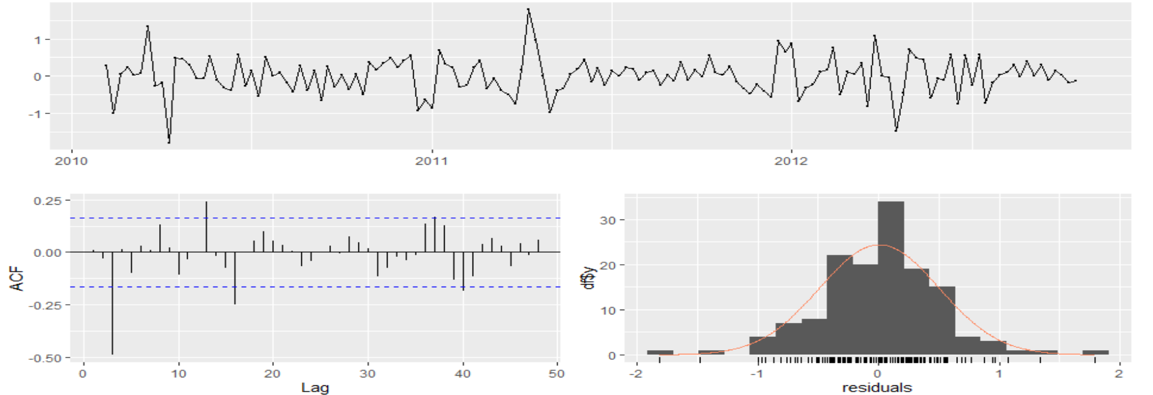
Moving Average: Residual Analysis

Slide 18
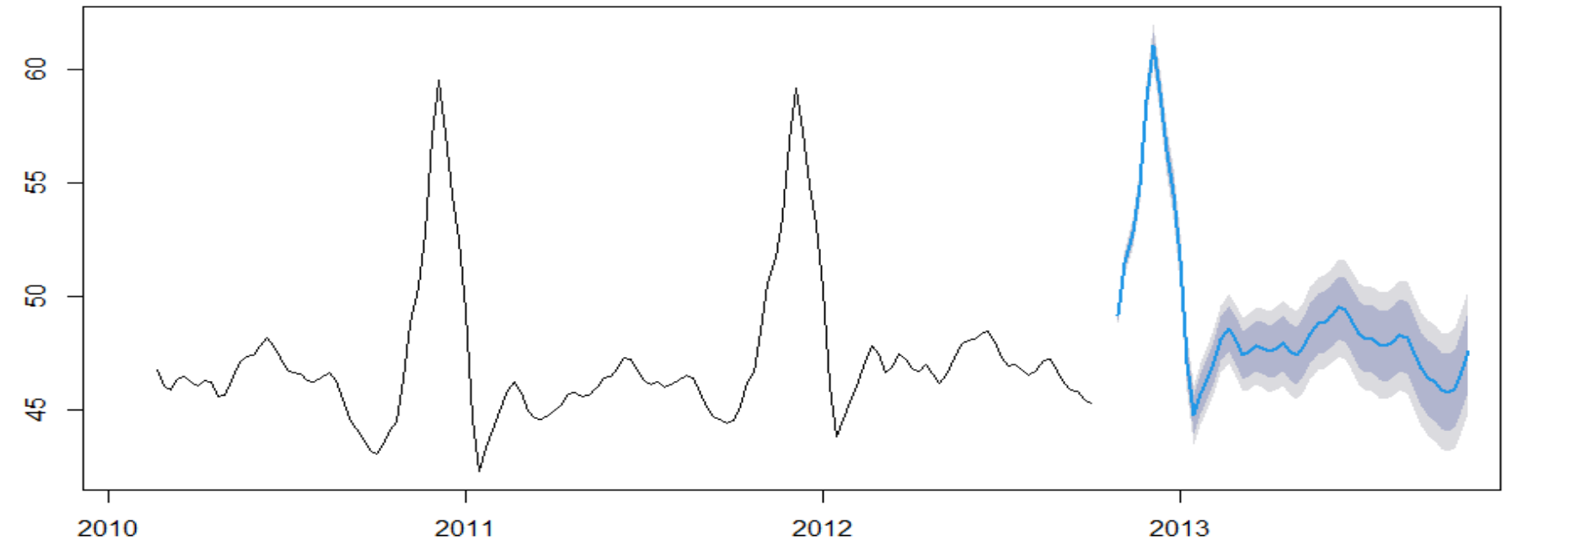
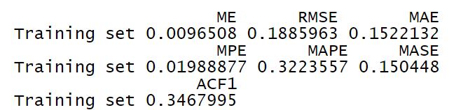
Moving average order = 6

Slide 19
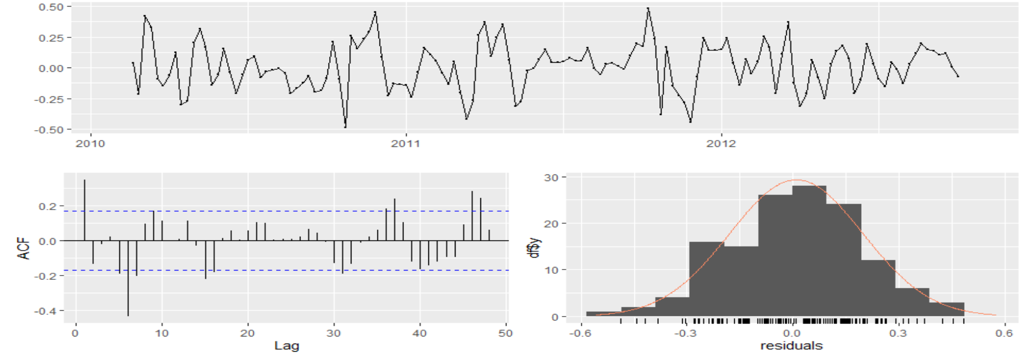
Moving Average: Residual Analysis

Slide 20
Accuracy Measures
Forecasting Models | Accuracy (MAPE) | ACF
Naive Model | 6.365 | 0.412
Seasonal Naive Model | 3.0175 | 0.258
Moving Average (O=3) | 0.775721 | 0.008710
Moving Average (O=6) | 0.3223557 | 0.3467995
Holts Winter Forecasting | 1.9322 | 0.069522
STL + ETS | 1.6242 | 0.0067
Arima Model | 1.72022 | 0.0067

Slide 21
Insights
Walmart may need to hire more people to work during high periods of sales
Walmart may want to capitalise on the holidays other than end of the year. Have more effective sales during February and September other than Thanksgiving and Christmas.
Using the model consistently, it can hire part time worker if they see growth in the business 1 month prior.

Slide 22
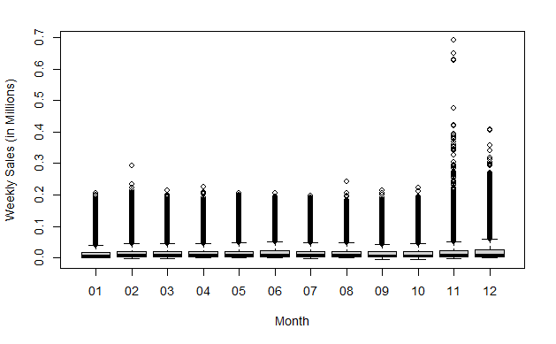
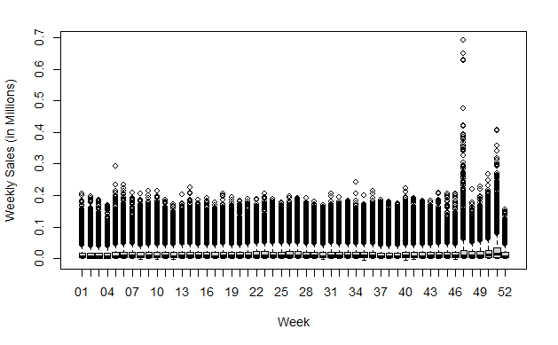
Data in Millions

Slide 23
Moving average order = 3

Slide 24
Patterns in the data
Walmart week pattern for the year
First week of every month except november and december have more sales
Customers show pattern in buying, there is more sales on weekends than weekdays, first week of every month has more sales, there are few months which can be capitalised majorly using these patterns.

Slide 25
February and August
In the month of february we can see a spike in the graph, notable events are 14th february Valentine’s day and Super bowl in the same week, here we have two weeks to target, the first week, and mainly the second week. Departments such as beauty, clothing, jewellery, shoes, bag and accessories can be very lucrative and should be targeted.
August has an unusual spike, as there are no holidays or notable events around that month. After some research we found that around the first-second week of august most of schools and colleges reopen. Departments such as stationery, clothing, electronics can be targeted.

Slide 26
October end - December end
These months are very unpredictable, it cannot be said surely on how high the sales for these months might go. These are the most important months of the year, and so the main things have to be seriously taken care of. Firstly, the work force has to be increased according to the needs. The inventory has to be closely monitored as products go out of stock quickly in these months. Starting from halloween in october end, thanksgiving in third week of november, black friday in the same week. Christmas and New year in the end of december to complete the holiday season. All departments should be equally monitored.

Slide 27
Targeted Departments
The products in these departments should be displayed more, as people have spending patterns,the more the products on display the more will be the sales.
The staff should be trained for specific work in these departments, as these departments will increase the sales.
Rollback offers that walmart offers and claims to be lowest in the market can be put on products in the untargeted departments, so that even those departments make more sales.
Stores located in colder areas have better chance of selling winter goods, so they should be targeted in the months of October, November and December.

Slide 28
Thank you
Questions?

