Slide 1

Walmart Store Sales
Business Forecasting
Group 9
Vaibhavi Mukadam, Aditya Pai, Cameron Clark

Slide 2
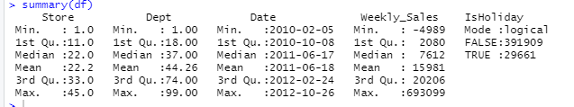
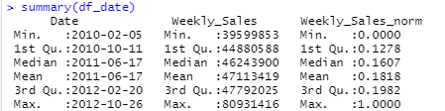
Data Description
Walmart is a renowned retail corporation that operates a chain of hypermarkets.
Walmart has provided a data combining of 45 stores including store information and weekly sales of year 2010, 2011 and 2012.
We aggregated the data to get consistent interval of time within the dataset.
Notes:
Some departments did not have sales for particular weeks, so we aggregated to get consistent intervals

Slide 3
Holidays
Super Bowl: ~ 2nd Week of February
Labor Day: ~ 2nd Week of September
Thanksgiving/Black Friday: ~4th week of November
Christmas: ~ 4th Week of December
Notes:
Holidays:
Super Bowl: ~ 2nd Week of Feb
12-Feb-10, 11-Feb-11, 10-Feb-12, 8-Feb-13
Labor Day: ~ 2nd Week of September
10-Sep-10, 9-Sep-11, 7-Sep-12, 6-Sep-13
Thanksgiving: ~4th week of November
26-Nov-10, 25-Nov-11, 23-Nov-12, 29-Nov-13
Christmas: Last week of December
31-Dec-10, 30-Dec-11, 28-Dec-12, 27-Dec-13
Note : remove the actual date

Slide 4
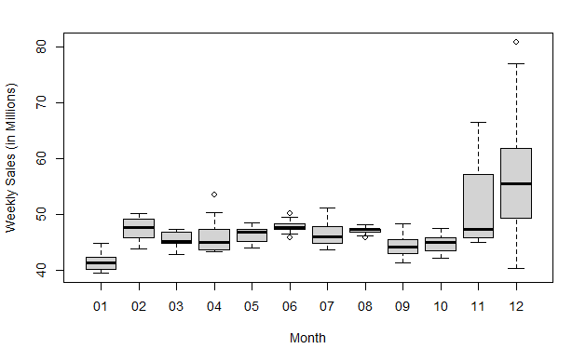
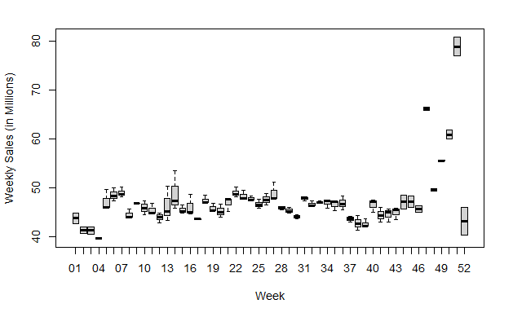
Data in Millions Aggregated

Slide 5
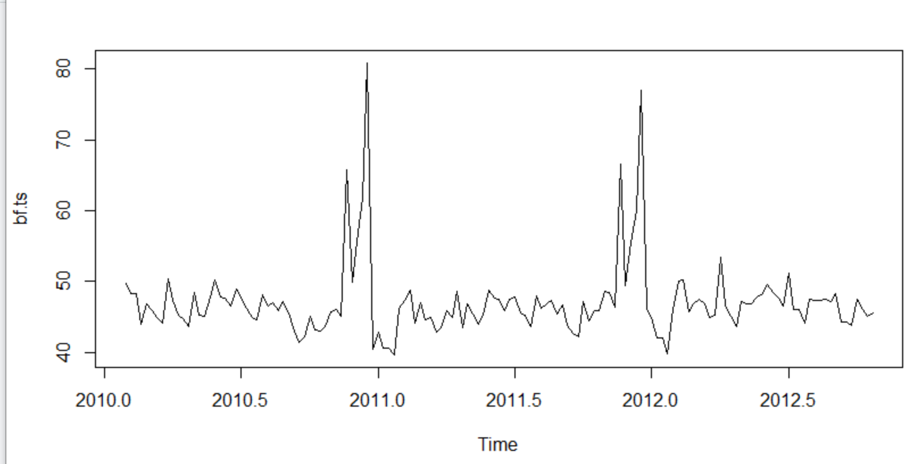
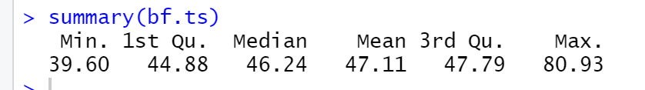
Time Series -
Weekly sales are in Millions
There is a spike late in the year
The data shows seasonality at the end of each year
There is dip in the initial months of the year

Slide 6
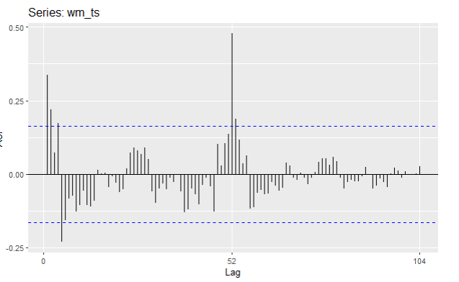
Autocorrelation
Autocorrelation represents the degree of similarity between a given time series and a lagged version of itself over successive time intervals.
Autocorrelation of the time series -
We can see there is a strong negative correlation from the 5th lag. We should expect this given the seasonality of the time series.
There is a strong correlation with the observation a year (52 weeks) prior, this is expected.
Notes:
Due to the seasonal pattern in the graph, the peak is at around the 52 week mark and when data are seasonal, the autocorrelations will be larger for the seasonal lags (at multiples of the seasonal frequency) than for other lags.
Negative seasonality could be due to the drop observed in Initial weeks that is in month of January
•Is our data Random
•Does our data have a trend
•Is there seasonality?

Slide 7
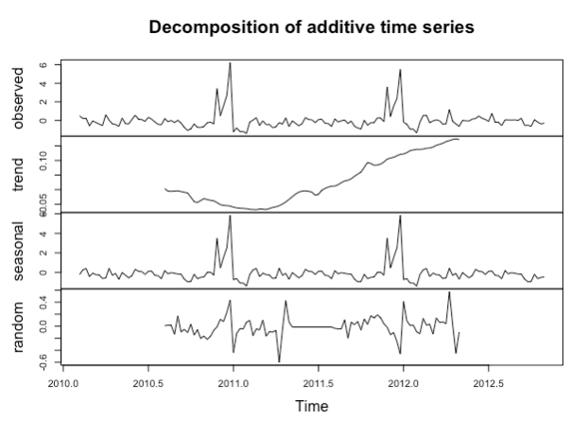
Decomposition
Autocorrelation represents the degree of similarity between a given time series and a lagged version of itself over successive time intervals.
Autocorrelation of the time series -
We can see there is a strong negative correlation from the 5th lag. We should expect this given the seasonality of the time series.
There is a strong correlation with the observation a year (52 weeks) prior, this is expected.
Notes:
•An attempt or procedure to identify the component factors that influence each of the values in a series
The additive decomposition is the most appropriate if the magnitude of the seasonal fluctuations, or the variation around the trend-cycle, does not vary with the level of the time series.
•Can be used for long and short term forecasting
•Identify each component of a TS and forecast each one separately
•Display underlying growth or decline of a TS
•Adjust series by eliminating one or more of its component

Slide 8

Accuracy Measure: MAPE
Mean absolute percentage error :
Actual data is non zero, that is, the aggregated data which we are analysing does not have zero as a value in Weekly Sales.
MAPE puts a heavier penalty on negative errors than on positive errors.
We cannot use MAE and RMSE as it depends upon the scale and also it is difficult to make comparison for a different time interval.
Notes:
Mean absolute percentage error:
The percentage error is given by p t = 100 e t / y t . Percentage errors have the advantage of being unit-free. Measures based on percentage errors have the disadvantage of being infinite or undefined if y t = 0 for any t in the period of interest, and having extreme values if any y t is close to zero.
When ME is positive, the model is under forecasting and MAPE is used for an under forecasted data.
Therefore we use MAPE, it gives the percent deviation from the actual result.
Overforescasting => bad mape
A positive value of forecast error signifies that the model has underestimated the actual value of the period. A negative value of forecast error signifies that the model has overestimated the actual value of the period.

Slide 9
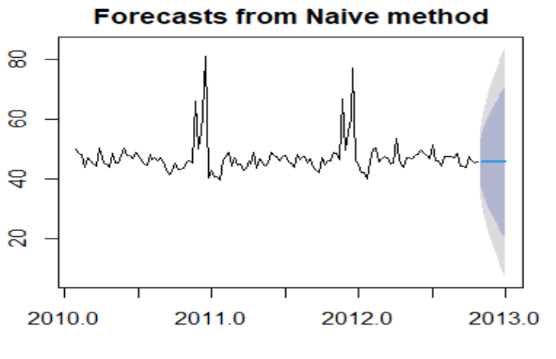
Naive Forecast
A naive model predicts the last value when forecasting.
Here, is the year forecast with naive.
Forecast: 45.54412

Slide 10
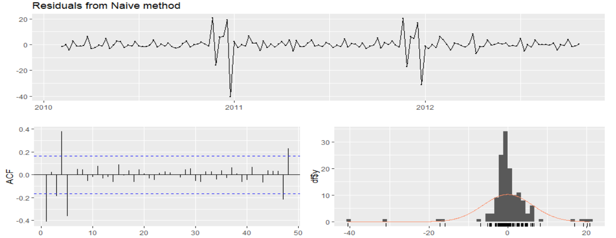
Naive : Residual analysis

Slide 11
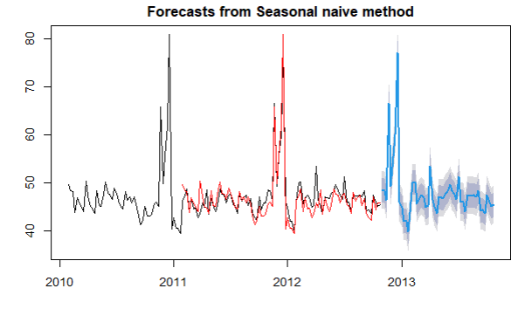
Seasonal Naive Forecast
A seasonal naive model predicts the last value of the same season (same week last year) when forecasting.
Here, is the year forecast with snaive with the fitted values after 52
1st Forecast: 48.65554
6th Forecast: 55.56115
10th Forecast: 44.9554
Notes:
3.017517

Slide 12
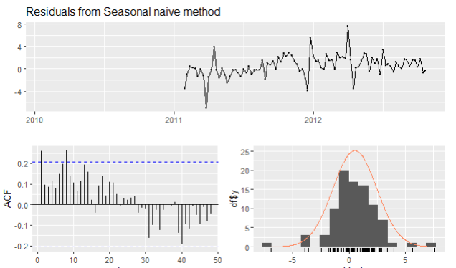
Snaive: Residual Analysis

Slide 13
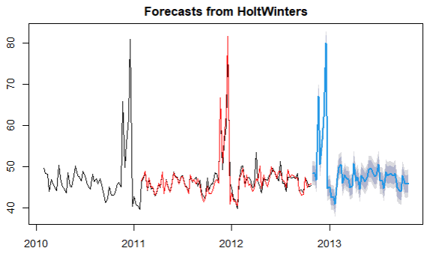
Holts Winter Forecasting Model
Forecast :
1st Forecast: 48.32820
6th Forecast: 56.65287
10th Forecast: 45.10548
Smoothing parameters:
alpha: 0.06058175
beta : 0.008479722
gamma: 0.557241

Slide 14
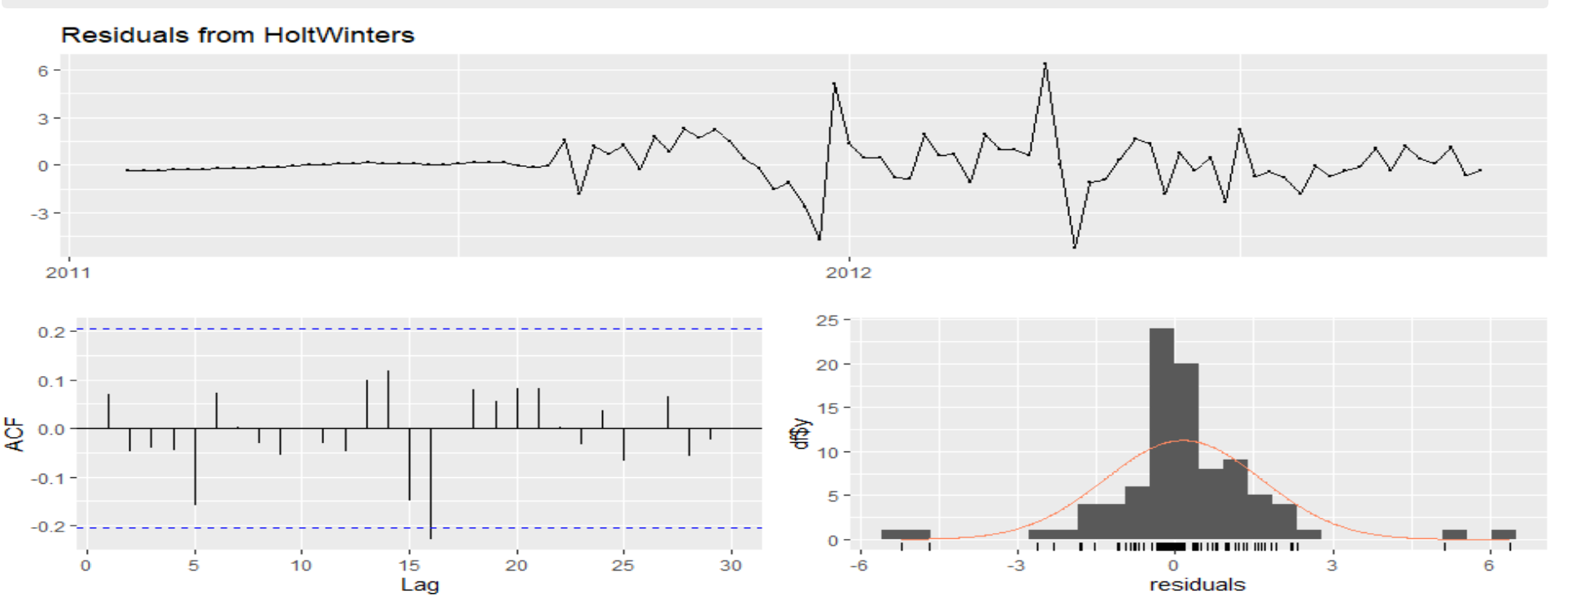
Holts Winter: Residual Analysis

Slide 15
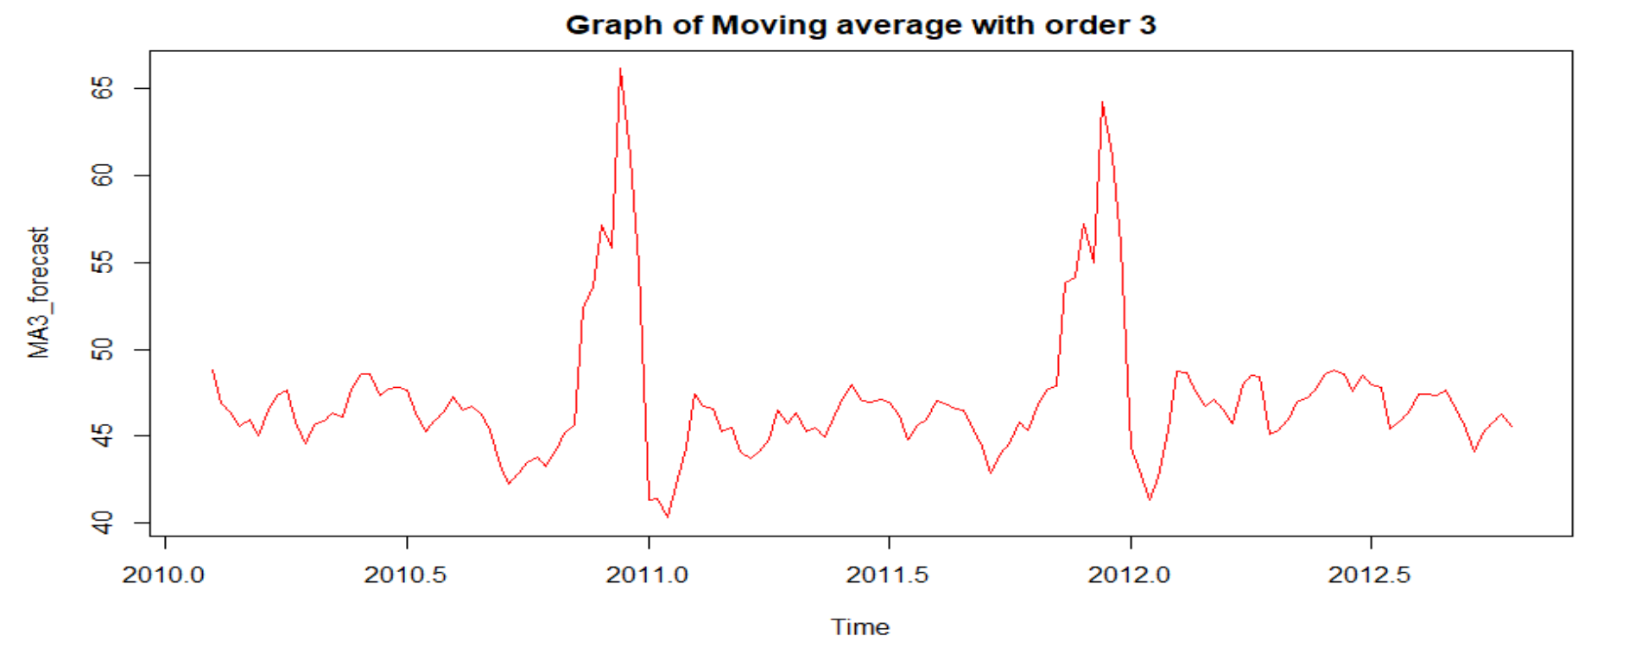
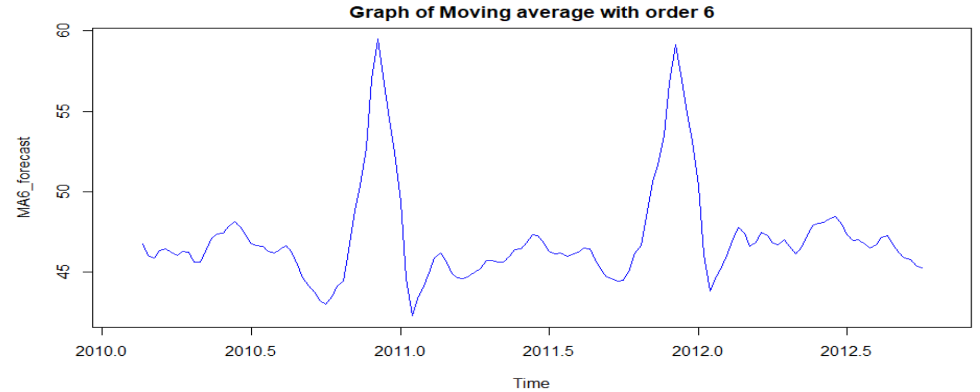
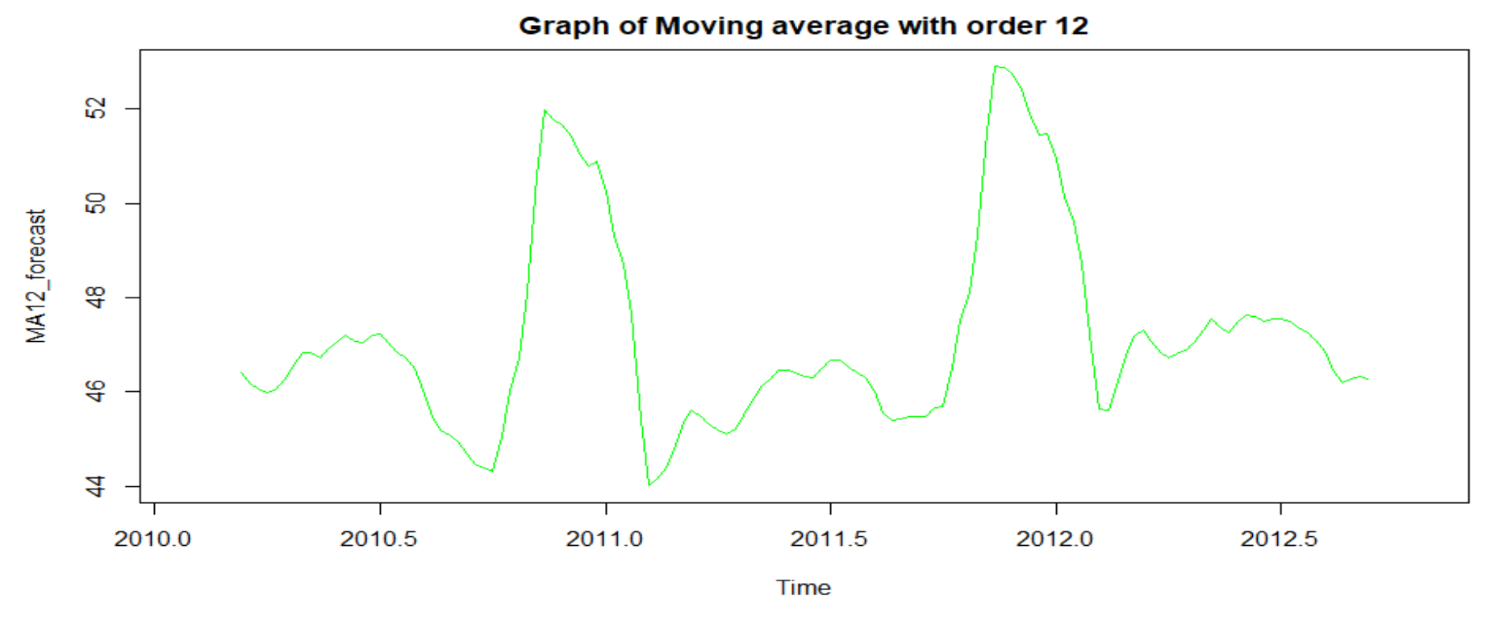
Moving Averages Forecast

Slide 16
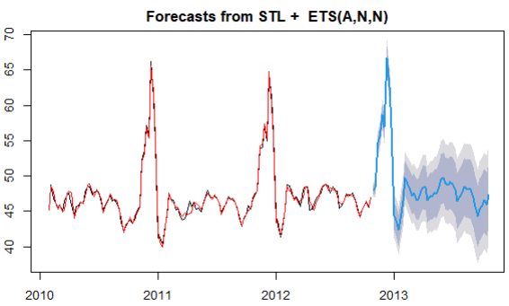
Moving average order = 3

Slide 17
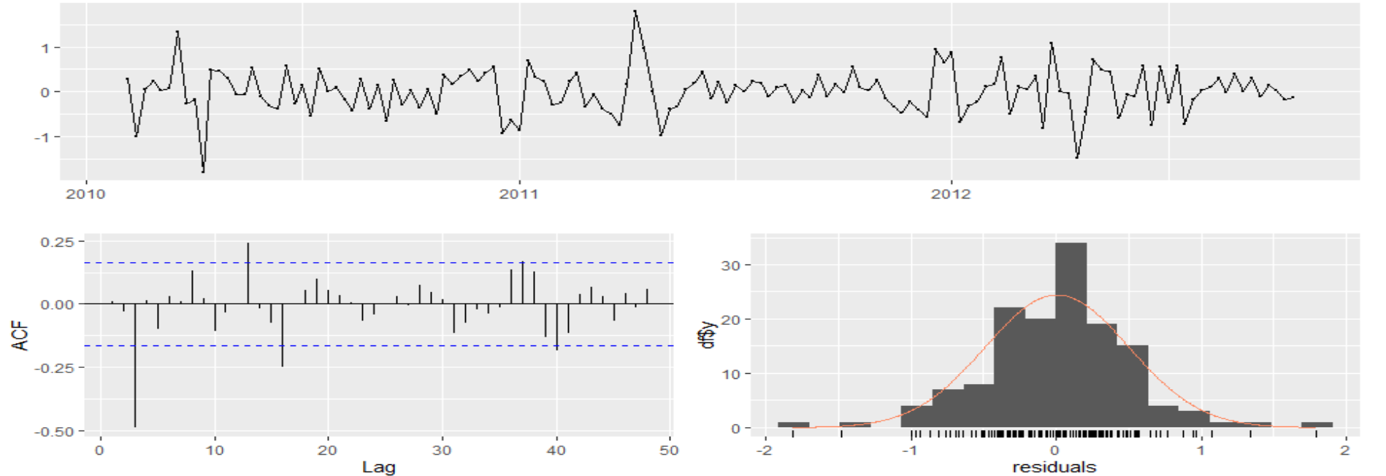
Moving Average: Residual Analysis

Slide 18
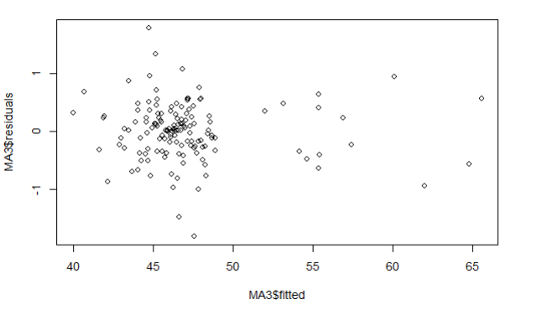
Order 3: Residual vs fitted

Slide 19
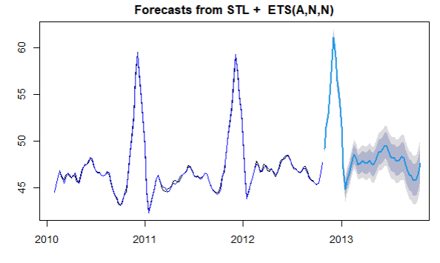
Moving average order = 6

Slide 20
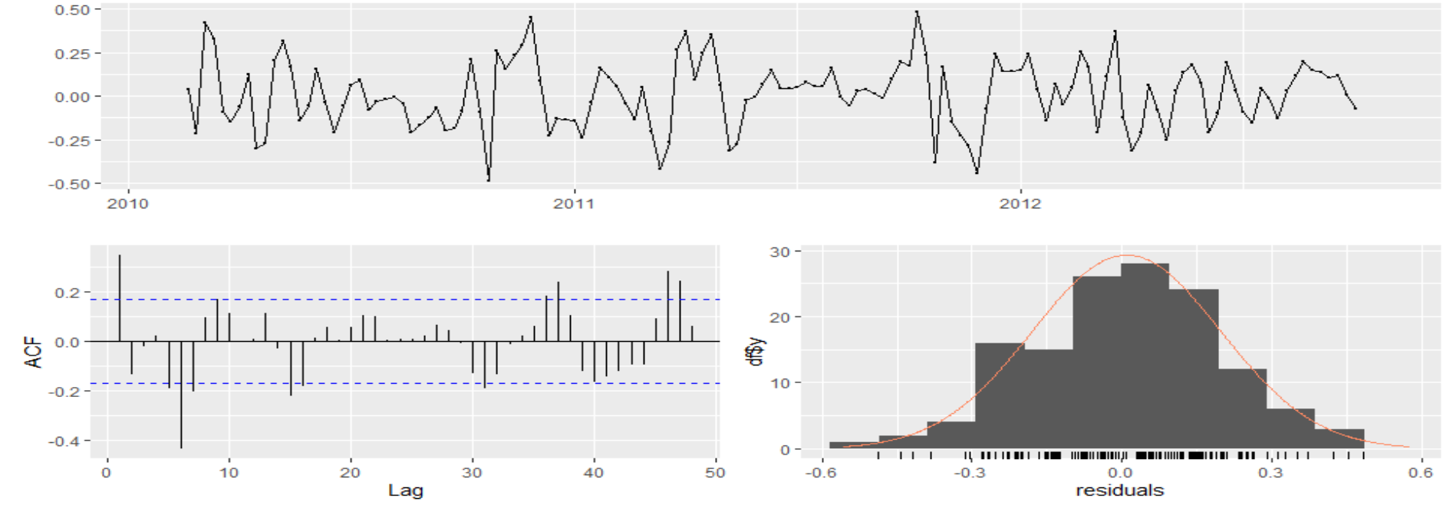
Moving Average: Residual Analysis

Slide 21
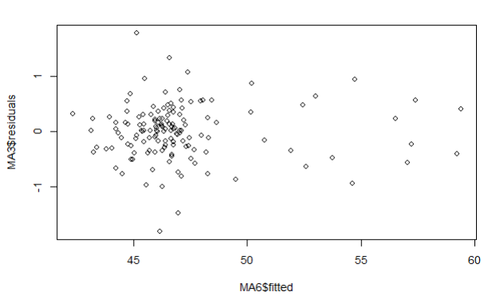
Order 6: Residual vs fitted

Slide 22
Accuracy Measures
Forecasting Models | Accuracy (MAPE) | ACF
Naive Model | 6.365 | 0.412
Seasonal Naive Model | 3.0175 | 0.258
Moving Average (O=3) | 0.775721 | 0.008710
Moving Average (O=6) | 0.3223557 | 0.3467995
Holts Winter Forecasting | 1.9322 | 0.069522
STL + ETS | 1.6242 | 0.0067
Arima Model | 1.72022 | 0.0067

Slide 23
Insights
Walmart may need to hire more people to work during high periods of sales
Walmart may want to capitalise on the holidays other than end of the year. Have more effective sales during February and September other than Thanksgiving and Christmas.
Using the model consistently, it can hire part time worker if they see growth in the business 1 month prior.

Slide 24
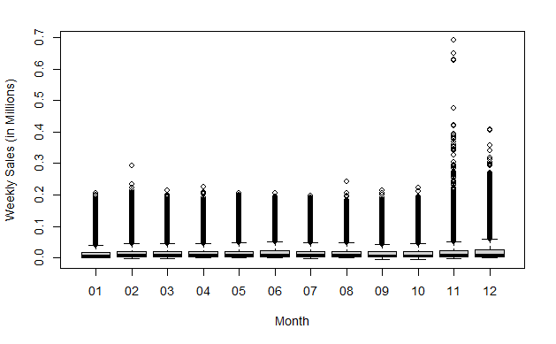
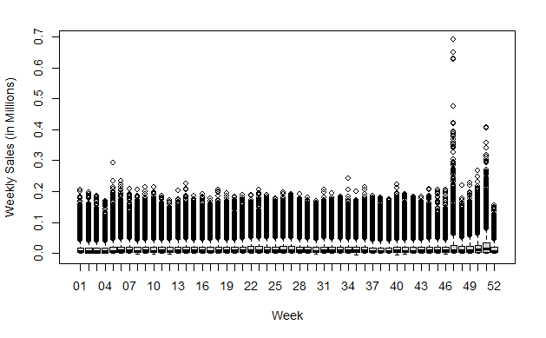
Data in Millions

Slide 25
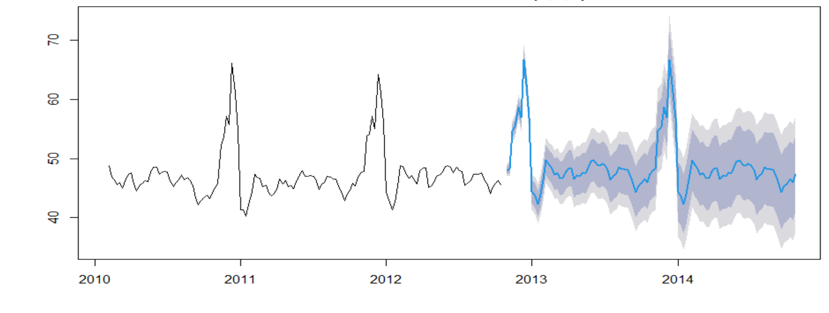
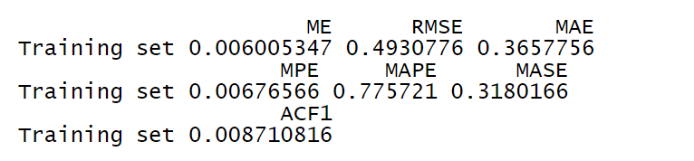
Moving average order = 3

Slide 26
Patterns in the data
Walmart week pattern for the year
First week of every month except november and december have more sales
Customers show pattern in buying, there is more sales on weekends than weekdays, first week of every month has more sales, there are few months which can be capitalised majorly using these patterns.

Slide 27
February and August
In the month of february we can see a spike in the graph, notable events are 14th february Valentine’s day and Super bowl in the same week, here we have two weeks to target, the first week, and mainly the second week. Departments such as beauty, clothing, jewellery, shoes, bag and accessories can be very lucrative and should be targeted.
August has an unusual spike, as there are no holidays or notable events around that month. After some research we found that around the first-second week of august most of schools and colleges reopen. Departments such as stationery, clothing, electronics can be targeted.

Slide 28
October end - December end
These months are very unpredictable, it cannot be said surely on how high the sales for these months might go. These are the most important months of the year, and so the main things have to be seriously taken care of. Firstly, the work force has to be increased according to the needs. The inventory has to be closely monitored as products go out of stock quickly in these months. Starting from halloween in october end, thanksgiving in third week of november, black friday in the same week. Christmas and New year in the end of december to complete the holiday season. All departments should be equally monitored.

Slide 29
Targeted Departments
The products in these departments should be displayed more, as people have spending patterns,the more the products on display the more will be the sales.
The staff should be trained for specific work in these departments, as these departments will increase the sales.
Rollback offers that walmart offers and claims to be lowest in the market can be put on products in the untargeted departments, so that even those departments make more sales.
Stores located in colder areas have better chance of selling winter goods, so they should be targeted in the months of October, November and December.

Slide 30
Thank you
Questions?

