Slide 1
Who works with whom in Bollywood?
Markov Clustering on a co-star network
IIS4140 Social Network Analysis · Manipal University Jaipur
Notes:
Introduce the question: can an algorithm discover the friend groups of Hindi cinema purely from who appears in films together? We use Markov Clustering, a topic from lectures 26-27 of the course.

Slide 2
Can we find Bollywood's friend groups?
Link two actors when they share a film, then let Markov Clustering find the communities. No labels, and no preset number of groups.
2,305
512
10,777
films scraped from Wikipedia, 2000 to 2024
actors with at least 5 films (the nodes)
co-star edges, weighted by Jaccard overlap
Source: Wikipedia, List of Hindi films of each year (CC BY-SA)
Notes:
Data: scraped Wikipedia's list of Hindi films for 2000 to 2024, 2,305 films and 2,060 actors in total. We keep the 512 actors with at least 5 films to drop one-off cameos. Edge weight is the Jaccard overlap of films, which matters later.

Slide 3
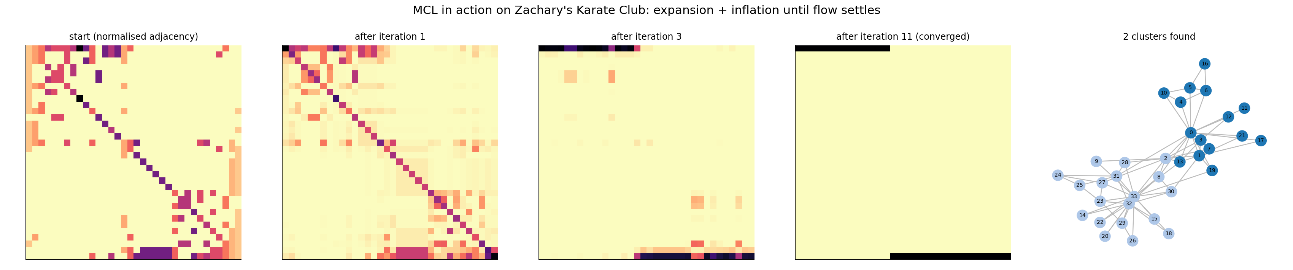
How MCL finds groups with random walks
Check on Zachary's Karate Club: our from-scratch implementation recovers the 2 known factions.
1 Expansion
2 Inflation
3 Repeat
Square the matrix. Flow spreads along longer walks.
Raise entries to power r. Strong flow grows, weak flow dies.
Until nothing changes. Attractor rows define the clusters.
Notes:
Core idea: a random walk stays inside a dense group for a long time and rarely crosses the sparse links between groups. Expansion lets the flow spread; inflation sharpens it. Repeat until the matrix stops changing. The Karate Club panels show the flow collapsing onto two attractor rows, which is the 2-faction split.

Slide 4
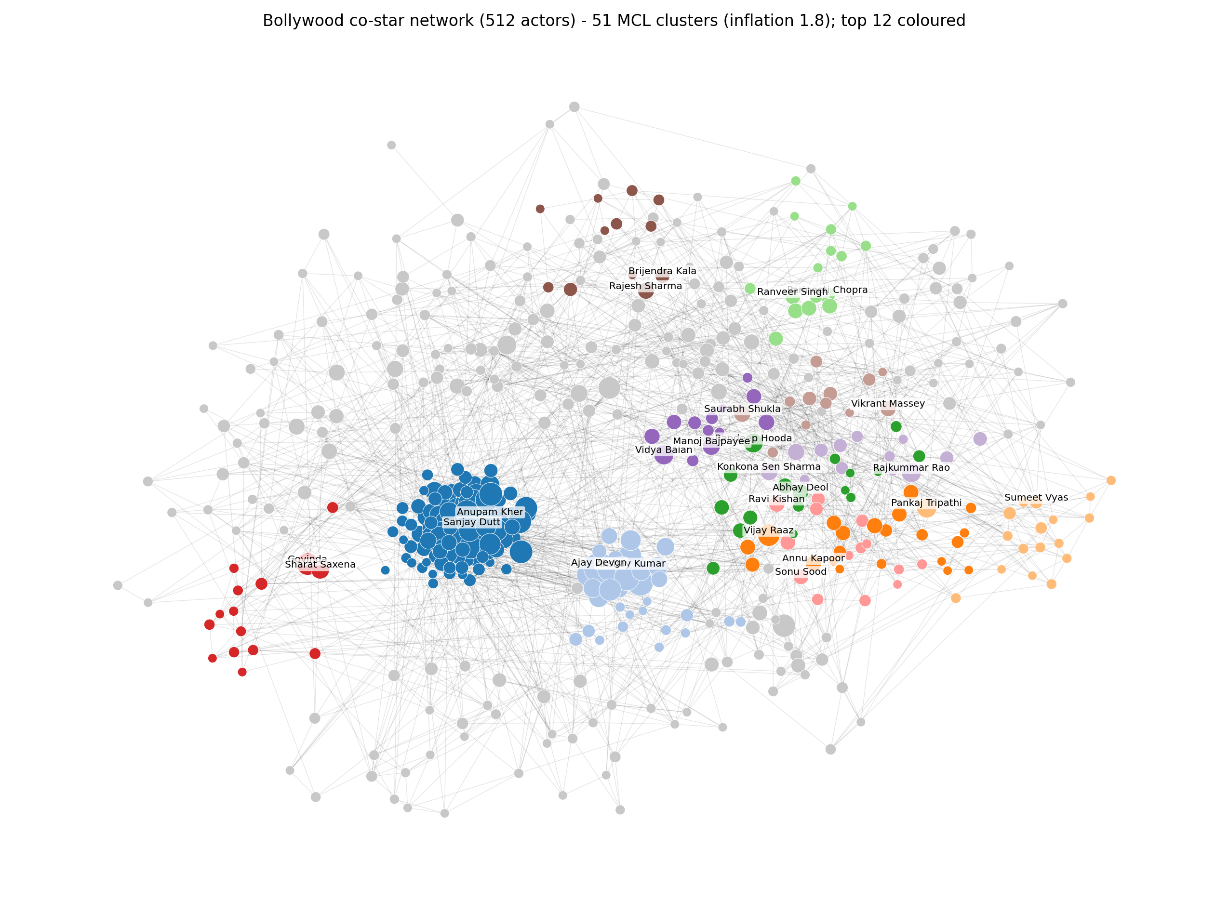
MCL splits the network into 51 groups
51
clusters found without choosing k
18
iterations to converge, 0.08 s
L to R
older casts on the left, recent casts on the right
Notes:
The layout pulls each cluster together. Without being given any dates, the clusters separate by era: older ensemble casts on the left, recent casts on the right. Only the 12 largest clusters are coloured.

Slide 5
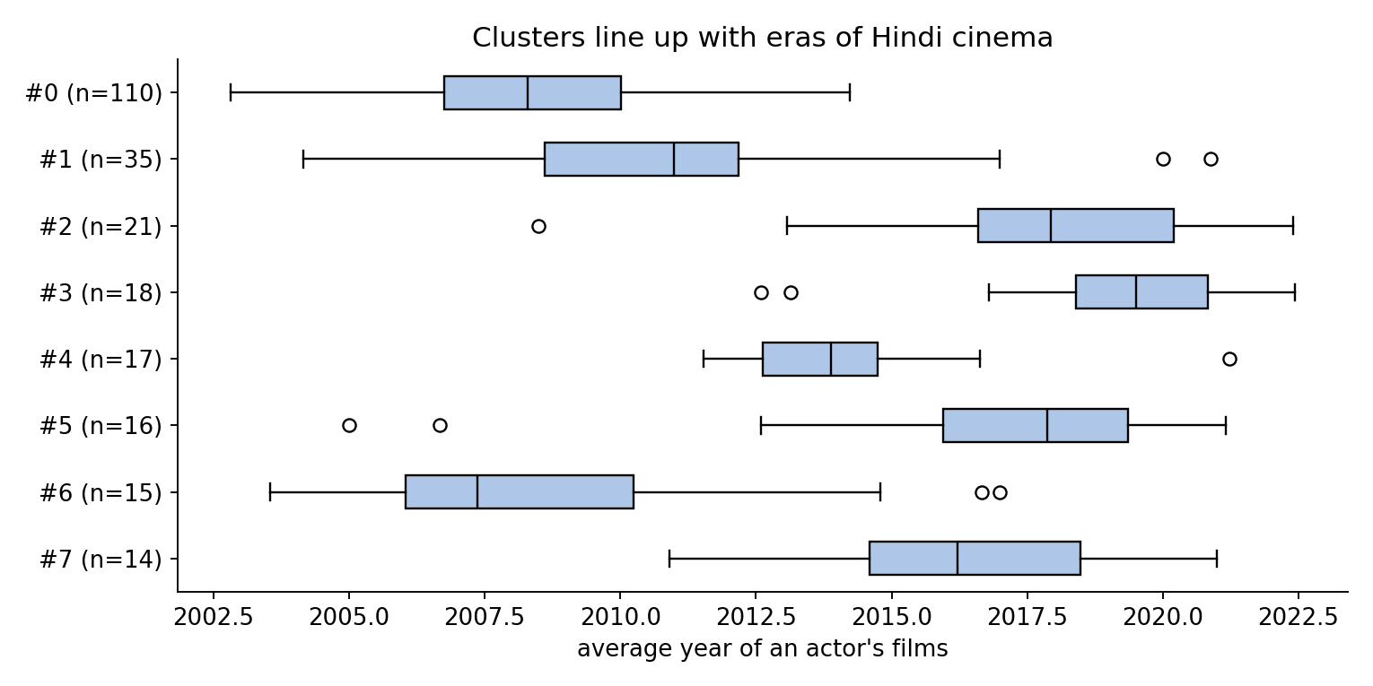
Clusters line up with eras and styles
Cluster reading | Avg year | Key actors
Ensemble veterans (n=110) | 2008 | Sunil Shetty, Paresh Rawal, Sanjay Dutt
Comedy-action stars (n=35) | 2011 | Akshay Kumar, Ajay Devgn, Johnny Lever
OTT and indie wave (n=18) | 2019 | Pankaj Tripathi, Gulshan Devaiah, Sumeet Vyas
Young stars (n=16) | 2016 | Ranveer Singh, Alia Bhatt, Arjun Kapoor
90s-style veterans (n=15) | 2009 | Govinda, Kader Khan, Sharat Saxena
Indie actors (n=11) | 2015 | Radhika Apte, Richa Chadha, Nawazuddin Siddiqui
MCL was never given years, yet clusters separate by era.
Cluster labels are my interpretation of each cluster's top actors.
Notes:
Walk through two or three rows. The labels are my interpretation of the top actors in each cluster, not algorithm output. The key point: MCL had no time information, but average film year differs strongly across clusters (about 2005 to 2021 across all 51).

Slide 6
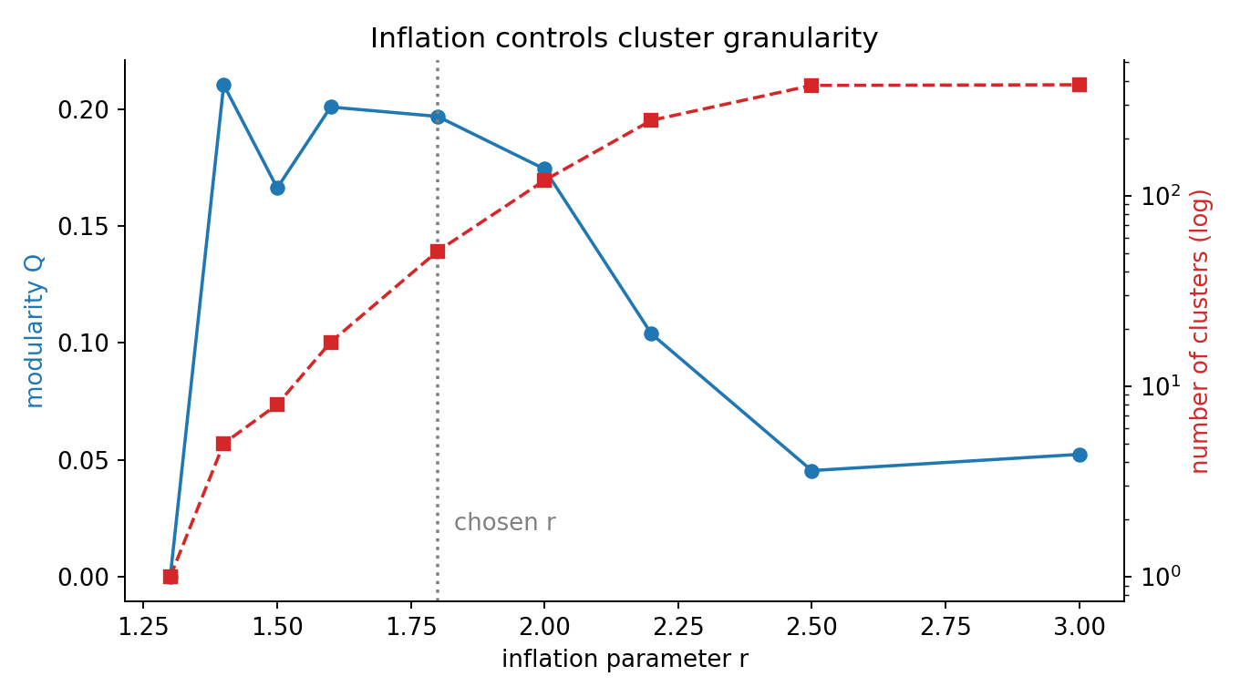
Inflation r controls the cluster size
r up to 1.3
one big blob
r = 1.4
5 clusters
r = 1.8
51 clusters (chosen)
r 2.5 or more
mostly singletons
Notes:
Inflation is the main knob. Low r gives one blob, high r shatters the graph. Modularity is best between about 1.4 and 1.8. I chose 1.8 because the clusters are balanced and interpretable. There is no ground truth, so this is a judgement call.

Slide 7
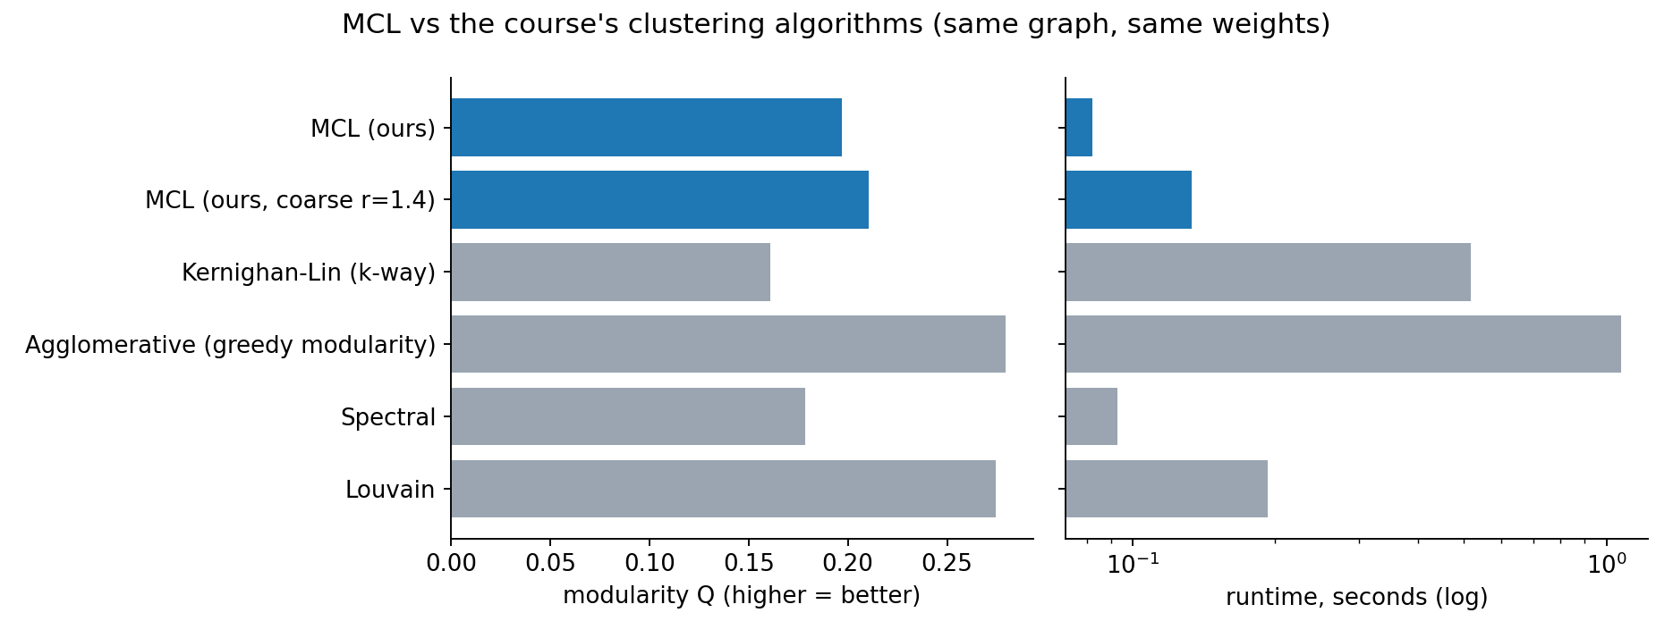
MCL vs the course's algorithms
MCL beats Kernighan-Lin and spectral at equal cluster count and is fast. Louvain scores higher because it optimises modularity directly, but MCL needs no preset k.
Notes:
All methods run on the same graph and weights. Kernighan-Lin and spectral were given k=51 to match MCL. Louvain and greedy agglomerative reach higher modularity (0.27 to 0.28) because they optimise it. MCL's selling point is the flow-based approach and no need to choose k up front. Modularity falls with many small clusters, so the 51-cluster rows are not directly comparable with the 6-cluster rows.

Slide 8
Lessons and limits
1
Edge weights matter most
2
Clusters are hard
Raw counts put 503 of 512 actors in one blob. Jaccard weights gave 51 clusters.
Real actors move between circles, but MCL assigns each actor to one.
3
The data is partial
4
r is a judgement call
Wikipedia lists top-billed Hindi casts only, 2000 to 2024.
No ground truth, so r was chosen by modularity and readability.
Notes:
The biggest lesson: MCL is very sensitive to edge weights. Without Jaccard normalisation, prolific hub actors dominate the random walk. Also be upfront about limits: partial Wikipedia data, hard clusters, and a tuned inflation parameter. Future work: overlapping variants and using clusters for link prediction.

Slide 9
Questions?
Code, data and report: bollywood-mcl/
Notes:
Likely questions. Why not Louvain? It scores higher modularity, but MCL is the course topic and needs no preset k. How was r picked? A sweep from 1.3 to 3.0, by modularity and readability. Why Jaccard? Hub actors with 70+ films otherwise dominate the walk.

