Slide 1
The Role of QA in the Software Development Life Cycle

Slide 2
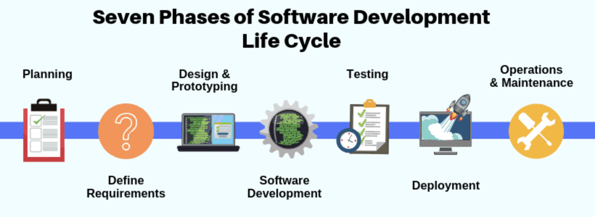
Software Development Life Cycle
The primary purpose of QA is to ensure that the software meets planned functionality, bug-free, and it will be working flawlessly under different circumstances.​

Slide 3
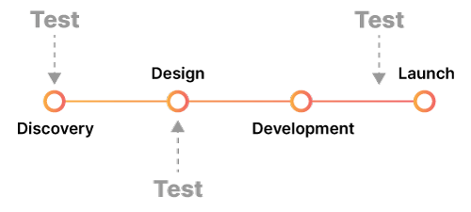
Test Early, Test Often
Testing performed at the early stages of development significantly decreases the cost of bugs.
Testing allows checking how your software works in different environments which eventually can help to increase user satisfaction.

Slide 4
The Role of QA in Planning
QA is responsible for making sure that the project meets all quality requirements, such as scope, budget, timeline, and compliance with standards.
Review user requirements and analyse them to determine if they fit within the scope of the project.
Creating test plans and preparing documents outlining processes and quality assurance specifications.

Slide 5
The Role of QA in Design
At this stage of the process, developers create application prototype. Also, developers design the architecture of software.
Testing of a schematic prototype at the first stage of design
Testers can offer some recommendations on prototype improvements. As a result, there’s a possibility to increase the usability of software.

Slide 6
The Role of QA in Development
Code Reviews - Evaluating coding techniques and ensuring that code meets industry standards.
Component/Integration Testing - The QA creates a list of test cases describing the steps to be performed and expected results.
Review unit test

Slide 7
The Role of QA in Testing As a tester, testing is the most important phase of the Software Development Lifecycle.
Writing test cases
Test Automation
Filing bugs and testing Bug Fixes
Regression Testing
Preparing bug reports
Preparing testing status
Prioritizing client-supported browsers and devices.

Slide 8
The Role of QA in Deployment
Verifying all required components of the product have been deployed properly and accurately.
Troubleshooting any issues or bugs, identified during testing or after deployment.
Performing regression tests to ensure no unintended changes were made during the deployment process.
Ensuring all tests have been successfully completed.

Slide 9
The Role of QA in Maintenance
Verifying software updates to confirm they are working properly
Identifying potential problems with updates
Following up with customers to ensure they are satisfied with changes and updates
By investing in QA during maintenance, companies can be sure their products remain reliable and bug-free for customers for the long haul!

Slide 10
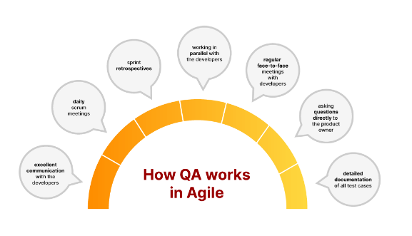
Conclusion
Test Early, Test Often
Participate in Core Agile Meetings and Ceremonies.
Identify Edge Cases Early.
Ensure the Acceptance Criteria are Clear
Verify Functionalities
Test Automation

Slide 11
Handling Scope Change in Agile
A scope change can occur due to
Business Requirements Change during Task Execution.
The Product Owner’s Priorities Change.
The Requirement Is No Longer Valid for the Product

Slide 12
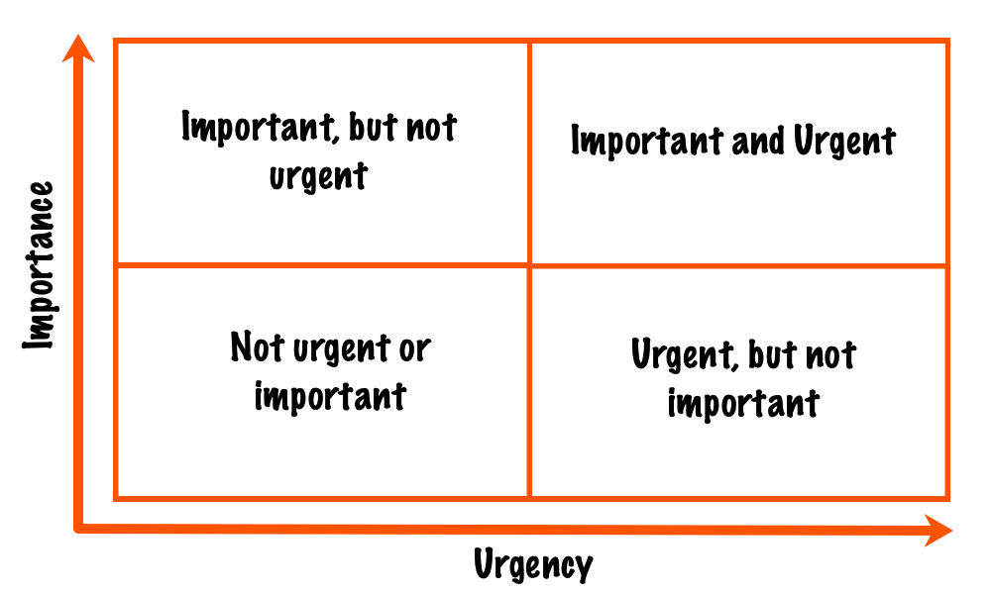
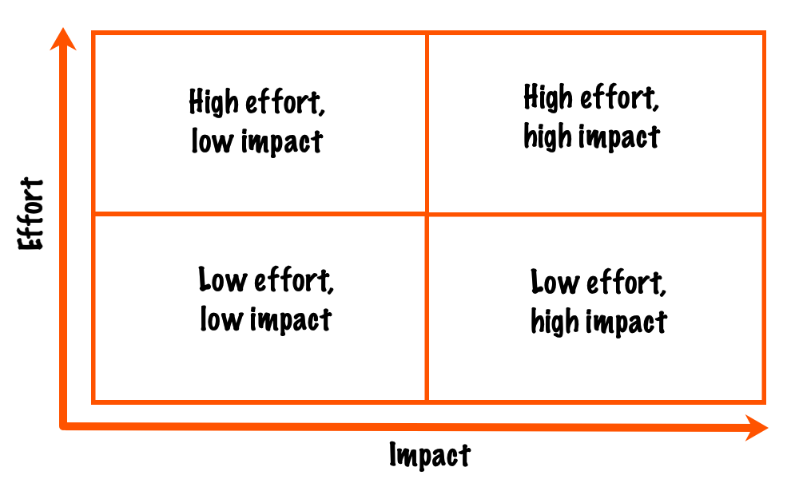
Never disrupt the current sprint
Priority Matrix
Urgency
Impact
Severity

