Slide 1
BookMyShow
Overview and Implementation

Slide 2
Problem Statment
XYZ wants to build an online movie ticket booking platform that caters to both B2B (theatre partners) and B2C (end customers) clients.
Key goals it wants accomplished as part of its solution:
Enable theatre partners to onboard their theatres over this platform and get access to a bigger customer base while going digital.
Enable end customers to browse the platform to get access to movies across different cities, languages, and genres, as well as book tickets in advance with a seamless experience.

Slide 3
Technologies Used
Java
Spring Framework
Database - Mysql
Editor - Intellij
Preferred cloud technologies - AWS

Slide 4
Implementation
Application is developed in Spring Boot 2.0.0 with Java 8 on Spring Tool Suite IDE. Database used is MySQL 5.7.17.
You can book movie tickets using the application.
Mandatory entities to book a ticket are - user, movie, theater with seats, shows of configured movies in configured theater with seats.
Logging is done on console as well as file. Log file can be accessed at D:/bms/bookmyshow.log.
Exception Handling is done using BMSException class.
Unit test cases are present for User Operations - User Registration and User Get. Cases for exceptions are also handled.

Slide 5
Assumptions
For the simplicity of system, I have made following assumptions while implementing the solution -
Single User Model - One user will use at once. No locking implemented for seat selection.
Single Screen Theaters - No multiple screen handling for a theater has been done. However an option is given for future scope.
10 seats for each show are configured - 5 for CLASSIC and 5 for PREMIUM. Seat numbers are kept fixed in all theaters.
No Payment flow used.

Slide 6
Setup the Application
Create a database bookmyshow using the sql file bookmyshow.sql provided in src/main/resources.
Open src/main/resources/application.properties and change spring.datasource.username and spring.datasource.password properties as per your MySQL installation.
Type mvn spring-boot:run from the root directory of the project to run the application.
Datapopulator class has also been provided to populate the data.

Slide 7
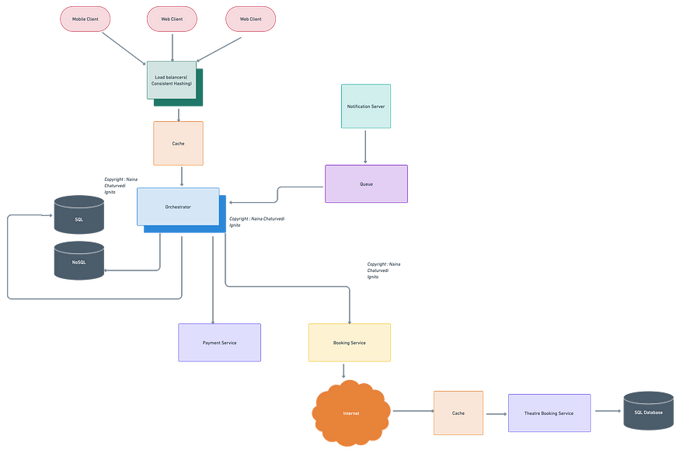
Architecture

Slide 8
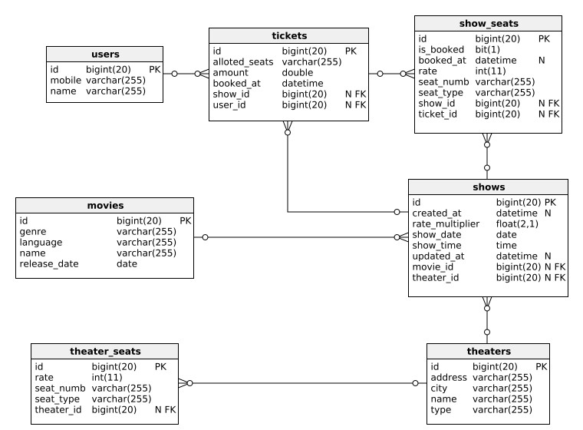
DB Model

Slide 9
Concurrency
How to handle concurrency; such that no two users are able to book the same seat?
We can use transactions in SQL databases to avoid any clashes. For example, if we are using SQL server we can utilize Transaction Isolation Levels to lock the rows before we update them. Note: within a transaction, if we read rows we get a write-lock on them so that they can’t be updated by anyone else. Here is the sample code:
SET TRANSACTION ISOLATION LEVEL SERIALIZABLE; BEGIN TRANSACTION; -- Suppose we intend to reserve three seats (IDs: 54, 55, 56) for ShowID=99 Select * From ShowSeat where ShowID=99 && ShowSeatID in (54, 55, 56) && isReserved=0 -- if the number of rows returned by the above statement is NOT three, we can return failure to the user. update ShowSeat table... update Booking table ... COMMIT TRANSACTION;

