Slide 1

Deploy an Application Using Flux

Slide 2
Table of Contents:-
Introduction to Flux Deployment
Understanding Flux
Preparing for Deployment
Setting Up Flux
Deploying Applications with Flux

Slide 3
Introduction to Flux Deployment
Overview of Flux
Flux is an open-source continuous delivery and GitOps automation tool for Kubernetes. It operates by ensuring that the state of your Kubernetes cluster matches the configuration defined in your Git repository. This GitOps approach enables declarative and automated management of Kubernetes resources, promoting consistency, reliability, and scalability in application deployments.
Flux continuously monitors your Git repository for changes and automatically applies updates to your Kubernetes cluster, allowing for seamless and efficient deployment workflows. It supports features such as automated rollouts, rollback capabilities, and integration with popular CI/CD tools, making it a powerful tool for modern cloud-native development and operations.
Importance of Deployment
Deployments impact various aspects of software development and operations, including:
Time-to-Market: Efficient deployment processes enable faster delivery of features and updates to end-users.
Reliability: Proper deployment practices minimize the risk of errors, failures, and service disruptions,.
Scalability: Automated deployment pipelines facilitate the scaling of applications and infrastructure resources in response to changing demand.
Security: Secure deployment practices, such as immutable infrastructure and automated vulnerability scanning.

Slide 4
Understanding Flux
What is Flux?
Flux is an open-source continuous delivery and GitOps tool designed specifically for Kubernetes. It acts as an operator that ensures the desired state of your Kubernetes cluster matches the configuration stored in a Git repository.
Key Concepts and Components
1. GitOps Workflow:
Flux employs the GitOps workflow, where all changes to the Kubernetes cluster are driven by Git commits.
Developers push changes to a Git repository, which triggers Flux to reconcile the state of the cluster with the desired state defined in the repository.

Slide 5

Preparing for Deployment
Infrastructure Requirements
1. Kubernetes Cluster:
Ensure you have a Kubernetes cluster provisioned and properly configured.
Choose a Kubernetes distribution or manage your cluster using tools like Kubernetes on AWS (EKS), Google Kubernetes Engine (GKE), or self-managed Kubernetes (e.g., kops, kubeadm).
2. Storage:
Consider storage requirements for persistent data storage within your cluster.
Provision storage solutions such as PersistentVolumeClaims (PVCs), cloud storage (e.g., AWS EBS, Google Cloud Persistent Disks), or distributed storage systems.
3. Networking:
Ensure proper networking configurations to allow communication between Kubernetes nodes and external services.

Slide 6

Setting Up Flux
Installation Process
1. Prerequisites:
Ensure you have access to your Kubernetes cluster and have the necessary permissions to install resources.
Verify that you have a Git repository set up to store your cluster configuration.
2. Installation Flux.
Part 1 – Install Flux
We will now install Flux.
1. Run this command to install Flux:
$ curl -s https://fluxcd.io/install.sh | sudo bash
We will now configure Flux. This does mainly two things:
Installs various components inside Kubernetes. This is how the Flux system actually runs.
Create a GitHub repo where all Flux configuration files are stored.

Slide 7

Part 2 – Bootstrap Flux
The bootstrapping process does mainly two things:
Creates a GitHub repo that stores Flux’s own configuration YAML files.
Installs various components like services and pods within K8s that run the Flux code.
1. Open the text file with your saved GitHub PAT and copy the token.
2. Export these two shell variables. This is how Flux finds out your GitHub credentials:
$ export GITHUB_TOKEN=<PAT> $ export GITHUB_USER=<YOUR GITHUB USER ID> [Replace <PAT> with your GitHub personal access token and <YOUR GITHUB USER ID> with your GitHub user]
3. Run this command to make sure all prerequisites are met:
$ flux check –pre

Slide 8
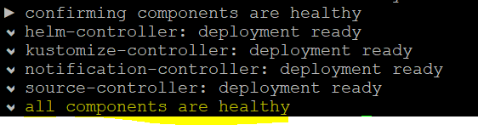
4. Run this command to configure Flux. Be patient, this command can take about 5 minutes to complete:
$ flux bootstrap github \ --owner=$GITHUB_USER \ --repository=flux-documents \ --branch=main \ --path=./clusters/my-cluster \ --personal If all goes well, you should see all components as healthy.

Slide 9
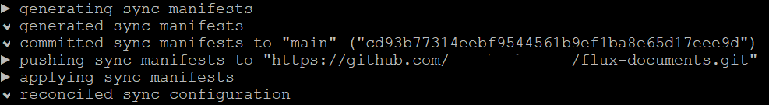
Part 3 – Review Flux GitHub Repo
The bootstrapping process has created a repo for us. Flux has pushed yaml files that are needed to install its own components. Let’s review them.
1. From the bootstrap output copy the URL to the repo. An example is shown below:

Slide 10
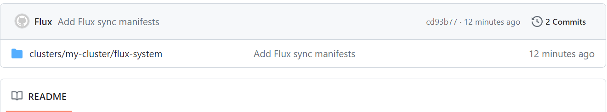
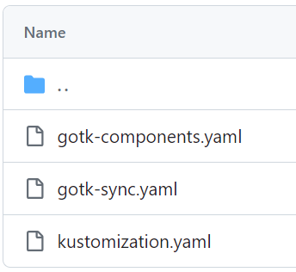
2. Clone the repo:
$ cd ~/ $ git clone https://github.com/vaibhavkalel1/flux-documents.git [You will be requested to provide credentials, enter your user name and as password you need to enter your PAT] Example:
Open GitHub and then go to the home page. 3. You should see under Recent Repositories the flux-documents repository. Click on it to open it or open the Repositories page. 4. Click clusters/my-cluster/flux-system folder.
These files install a few components in K8s. Let’s review these components.

Slide 11
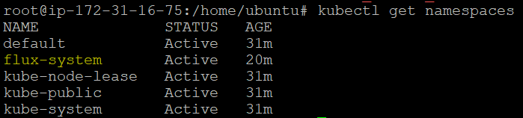
Run this command to note that a new namespace called flux-system was added: $ kubectl get namespaces You should see:

Slide 12
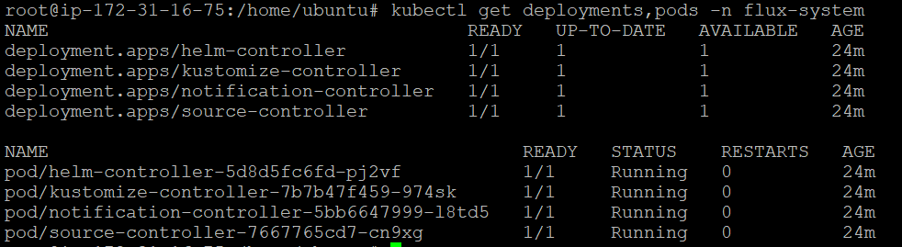
Run this command to view the new deployments and pods added by Flux. Flux itself executes using them: $ kubectl get deployments,pods -n flux-system
You should see:

Slide 13
Part 4 – Prepare the Application for Flux Based Deployment
We will now add the yaml file that defines the deployment and service for our demo app. We will then tell Flux to monitor these files and look for any updates. Flux will detect any changes to these files and automatically apply them to K8s. The process of defining what deployment, service etc. you need for an application is called customization.
1. In the folder where you have cloned weather-demo-webapp, create a subfolder called flux-config: $ cd ~/weather-demo-webapp $ mkdir flux-config $ cd flux-config

Slide 14
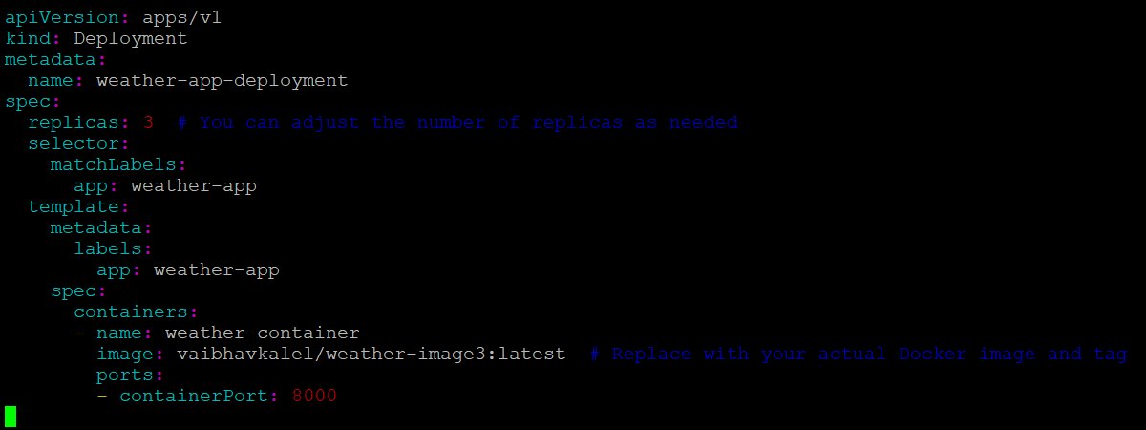
2. Copy the deployment.yaml file used earlier to this new folder.
$ vi deployment.yaml

Slide 15
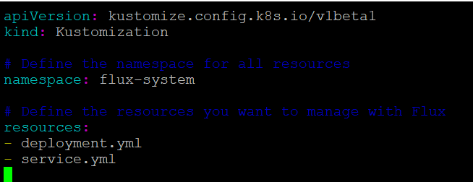
Now we need to tell Flux which files it should pull and apply to K8s.
3. In the flux-config folder, create a file called kustomization.yaml. Note: The file must be called kustomization.yaml. $ vi kustomization.yaml
Enter the following lines to that file: apiVersion: kustomize.config.k8s.io/v1beta1 kind: Kustomization resources:
– deployment.yaml
-service.yaml
4. Save changes and close the file.

Slide 16
6. Commit and push these files. Don’t forget to use your GitHub PAT for the password when asking for user and password:
$ git add . $ git commit -m"Flux kustomization config files" $ git push [You will be requested to provide credentials, enter your user name and as password you need to enter your PAT]

Slide 17
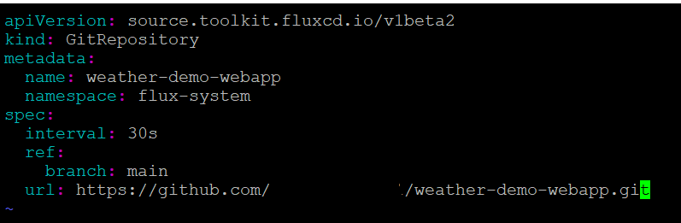
Part 5 – Configure Flux for Our Application
We will now tell where our application’s “kustomization” files are located.
1. In the flux-documents repo, go inside the clusters/my-cluster folder:
$ cd ~/flux-documents/clusters/my-cluster
2. In that folder create a file for our application called gitops-demo.yaml:
$ vi gitops-demo.yaml
3. In the gitops-demo.yaml file we will tell Flux the location of our application’s GitHub repo. Add these lines to that file. Here, <YOUR GITHUB USER ID> should be replaced with your own user ID:
4. Save and close the file.

Slide 18
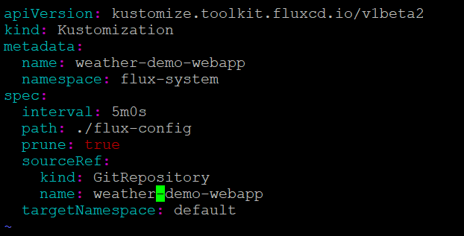
We will now tell Flux where the kustomization files are located within the above repo. Flux can then begin to constantly monitor any changes made to these files and apply them to K8s.
5. In the flux-documents/clusters/my-cluster folder, create a file called gitops-demo-kustomization.yaml:
$ vi gitops-demo-kustomization.yaml
6. Add these lines to that file.
7. Save and close the file.

Slide 19
Part 6 – Deploy the Application
To deploy the application we need to push the YAML files created in the previous part. Once we do that, Flux will know about the Git repo of our web application and pull the deployment files from there. 1. Commit and push the YAML files that are in the application’s repo. Don’t forget to use your GitHub PAT for the password when asking for user and password:
$ cd ~/flux-documents $ git add . $ git commit -m"Add gitops-demo app info" $ git push
2. It takes a few minutes for Flux to poll GitHub and detect the changes we just made. We can watch for the synchronization process by running this command:
$ flux get kustomizations –watch
After a few minutes you should see the success message: “Applied revision: main/###”

Slide 20
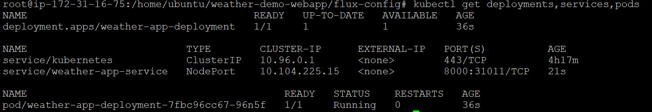
3. Exit the flux command by hitting Control+C.
4. Run this command to verify that our application’s deployment, service and pod are all running successfully. The status of the pod being the most crucial since that is where our application is physically running:
$ kubectl get deployments,services,pods You should see something similar than this, pay attention to the pod:

Slide 21
Part 7 – Test the Application
1. Run this command to find out the endpoint URL of the application:
$ minikube service --url gitops-demo
You should see the URL. The URL may be different for you!

