Slide 1
🏠
HOUSE PREDICTION
MODEL
Machine Learning Project | Indian Real Estate Market | Streamlit Deployment
🇮🇳 Mumbai · Delhi NCR · Bangalore · Pune · Hyderabad · Chennai · Kolkata · Ahmedabad · Jaipur · Lucknow
Presented by: [VAIBHAV KESHARWANI | [Institution :- UCER] | 2026

Slide 2
Problem Statement
📊
⏱️
💰
Market Complexity
Time-Consuming
Financial Risk
Indian property prices vary drastically across cities, localities, and amenities, making manual valuation inconsistent.
Traditional appraisals take days. Buyers, sellers, and brokers need instant, data-driven price estimates.
Mispriced properties cause real losses for home-buyers, sellers, builders, and home-loan lenders.
💡 Solution: Build an ML model to predict Indian house prices accurately and instantly from property details.

Slide 3
Project Objectives
Collect and preprocess a 1,200-record Indian housing dataset across 10 major cities.
Perform comprehensive EDA to uncover city-wise and locality-wise pricing patterns.
01
02
Engineer new features (Amenity Score, Total Rooms, Is New) for better accuracy.
Train and compare three regression models: Linear Regression, Random Forest, Gradient Boosting.
03
04
Evaluate models using MAE, RMSE, R² Score and select the best deployable model.
Deploy the model as a live, interactive web application using Streamlit.
05
06

Slide 4
Dataset Description
1,200
12
10
₹8L–₹4.2Cr
Records
Features
Indian Cities
Price Range
Feature | Type | Description
City | Categorical | Mumbai, Delhi NCR, Bangalore, Pune, Hyderabad, etc. (10 cities)
Locality_Type | Categorical | Prime/CBD, Premium Residential, Mid-tier, Developing Suburb, Outskirts
Area_sqft | Numerical | Built-up area in square feet (400–3500)
BHK | Integer | Number of bedrooms (1–5 BHK)
Age_years | Integer | Property age in years (0–40)
Floor_No, Parking | Integer | Floor number and car parking slots
Furnishing | Categorical | Unfurnished, Semi-Furnished, Fully-Furnished
Price_INR | Numerical | Target: Sale price in Indian Rupees (₹)

Slide 5
ML Lifecycle Methodology
P1
P2
P3
P4
Problem
Understanding
Data
Collection
Data
Preprocessing
EDA
P5
P6
P7
P8
Feature
Engineering
Model
Building
Model
Evaluation
Deployment

Slide 6
Data Preprocessing
🔍 Missing Value Detection
✓ Filled using median/mode imputation
Age_years: 45 nulls (3.75%) | Bathrooms: 30 nulls (2.5%)
📋 Duplicate Removal
✓ 0 duplicates found — dataset clean
Scanned 1,200 rows for exact duplicates
📦 Outlier Treatment
✓ Removed 34 extreme price outliers
IQR method: Q1 − 1.5×IQR to Q3 + 1.5×IQR on Price_INR
🏷️ Categorical Encoding
✓ Label Encoded into integer codes
City, Locality_Type, Furnishing — string categories
⚖️ Feature Scaling
✓ StandardScaler (zero mean, unit variance)
Features span vastly different ranges and units

Slide 7
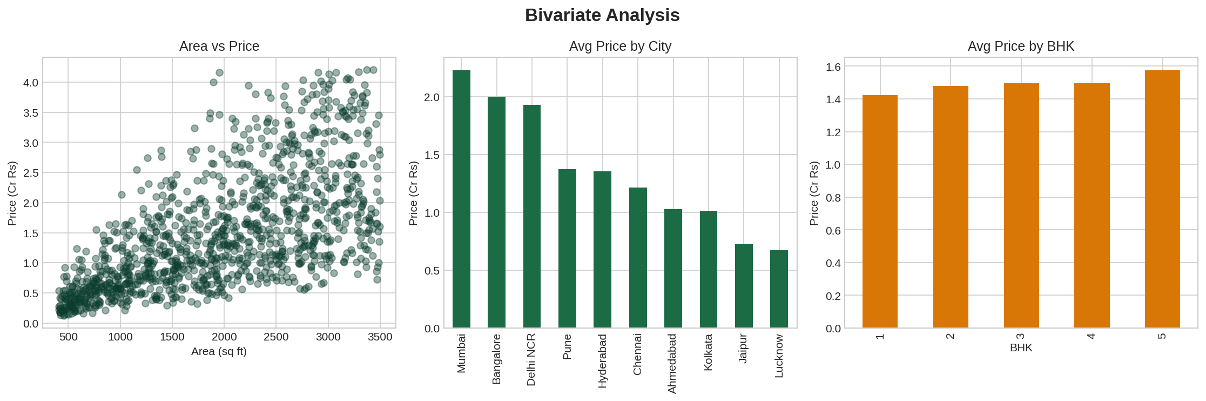
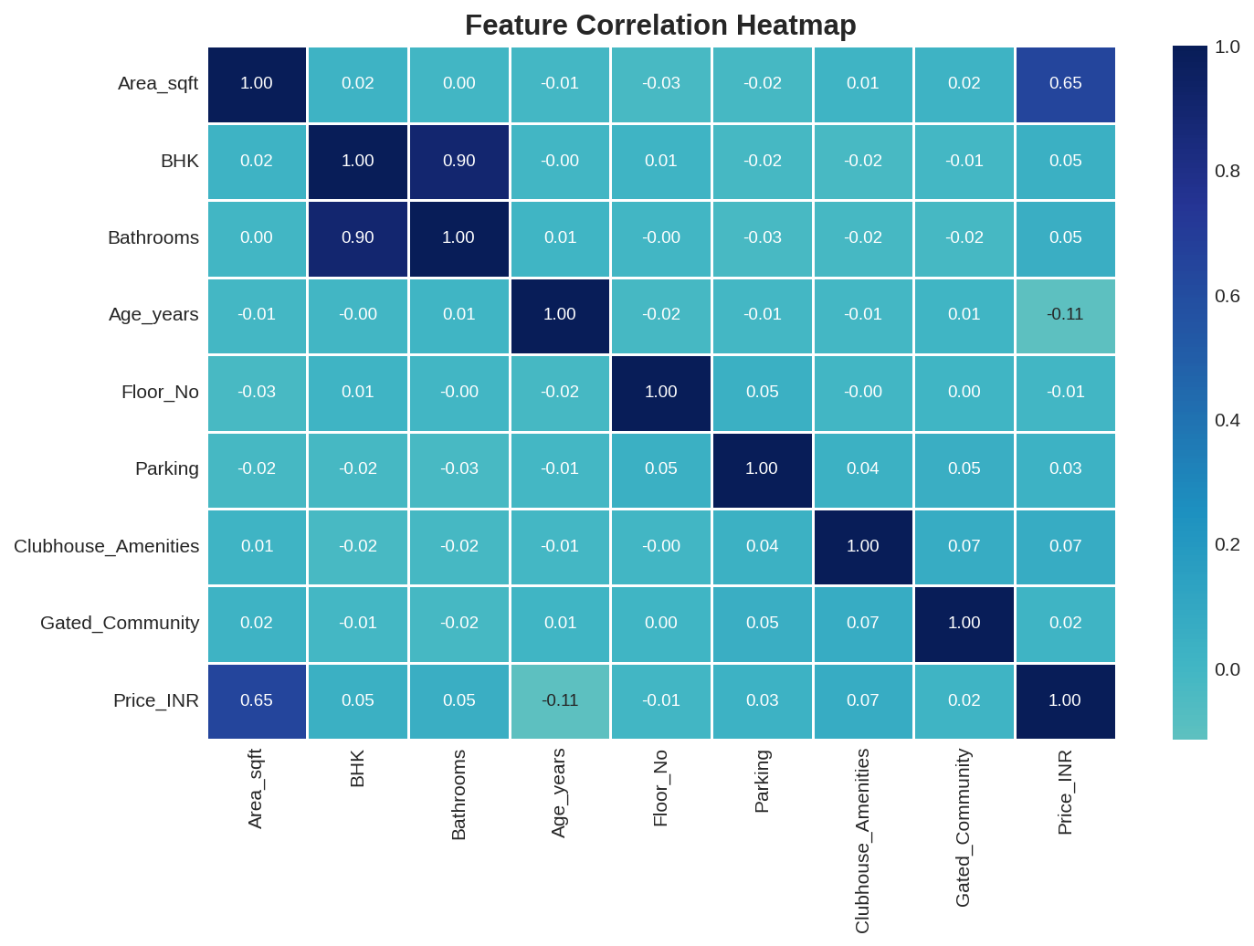
Exploratory Data Analysis (EDA)
Key Insight: Mumbai commands the highest average price; Area_sqft shows the strongest correlation (r = 0.65) with price.

Slide 8
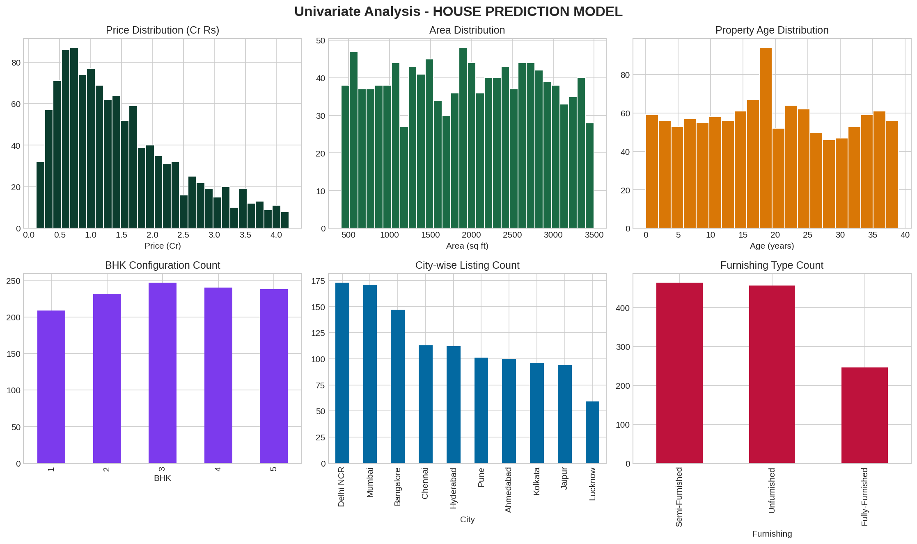
EDA — Distribution & Outlier Analysis

Slide 9
Machine Learning Models
⭐ DEPLOYED MODEL
📉 Linear Regression
🌳 Random Forest
🚀 Gradient Boosting
R² = 0.48
R² = 0.867
R² = 0.934
✓ Pros:
✓ Pros:
✓ Pros:
• Simple & interpretable
• Handles non-linearity
• Highest accuracy
• Fast training
• Robust to outliers
• Captures complex patterns
• Good baseline
• Portable .pkl format
• Built-in regularization
✗ Cons:
✗ Cons:
✗ Cons:
• Assumes linearity
• Slightly lower than GBM
• Needs tuning
• Underfits complex patterns
• Less interpretable
• Version-sensitive serialization

Slide 10
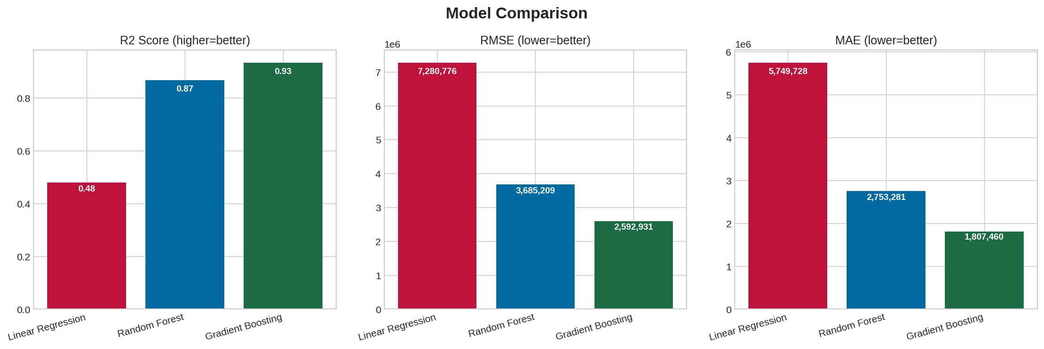
Results & Performance Metrics
Model | MAE (₹) | RMSE (₹) | R² Score | CV R²
Linear Regression | 57,49,728 | 72,80,776 | 0.4796 | 0.4666
Random Forest ⭐ | 27,53,281 | 36,85,209 | 0.8667 | 0.8798
Gradient Boosting | 18,07,460 | 25,92,931 | 0.9340 | 0.9329

Slide 11
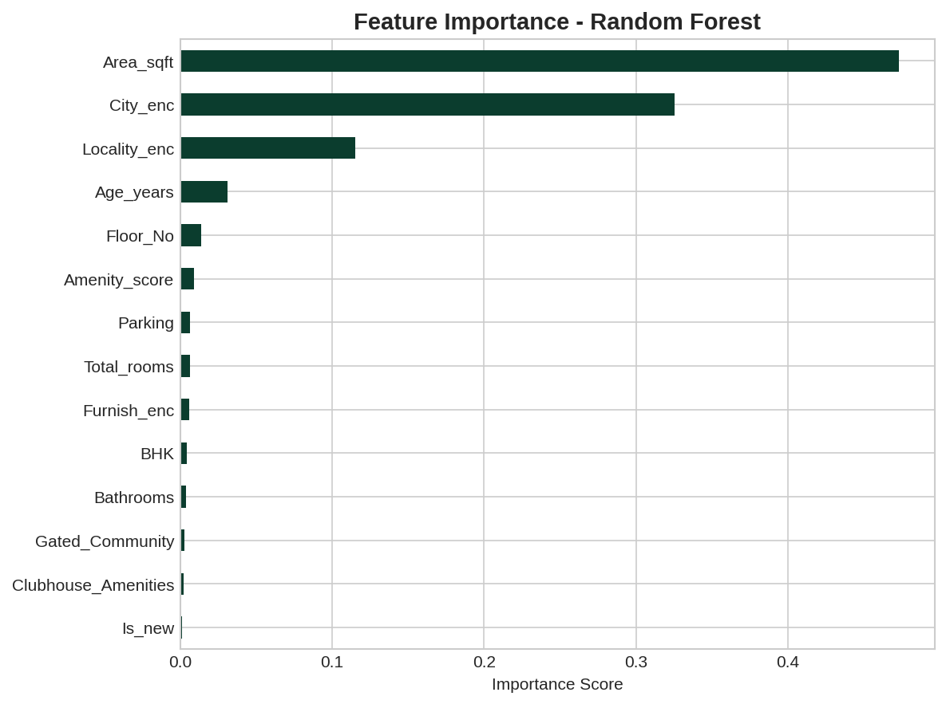
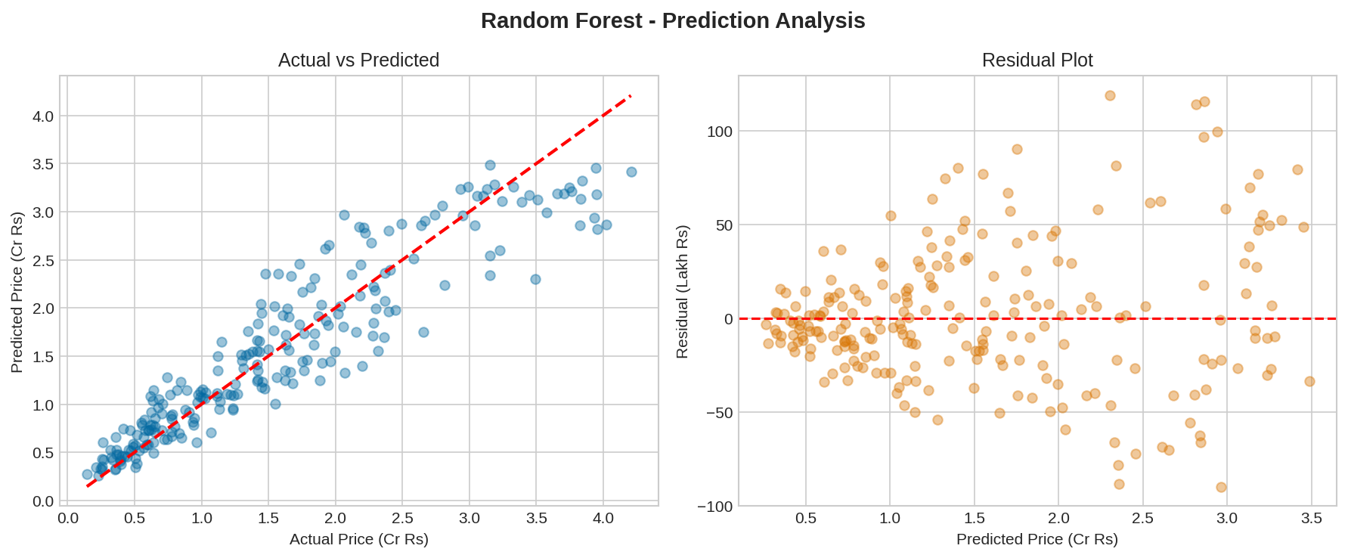
Feature Importance & Prediction Quality
Area_sqft and City dominate price prediction, consistent with real Indian real-estate intuition.

Slide 12
Application Demo — Streamlit App
🔒 localhost:8501 — HOUSE PREDICTION MODEL
🏠 HOUSE PREDICTION MODEL — Real-time property valuation
City
BHK
Area (sqft)
Floor
Furnishing
Mumbai
3
1,450
9
Semi
🔮 Predict Price
Estimated Market Value
₹ 1.84 Cr
₹ 1,84,32,150
Model: Random Forest | R² Score: 0.867
Run: python -m streamlit run Streamlit_App/app.py

Slide 13
Conclusion
✅
Successfully Built
Complete ML pipeline from raw Indian housing data to a deployed web application, covering all 8 lifecycle phases.
🎯
Strong Accuracy
Random Forest (deployed) achieved R² = 0.867; Gradient Boosting reached R² = 0.934 in evaluation.
🔬
Insights Uncovered
City tier, locality type, and area are the strongest drivers of Indian residential property prices.
🌐
Deployed
Interactive Streamlit app lets users enter property specs across 10 Indian cities and get instant ₹ valuations.

Slide 14
Future Scope
Where this project can grow next
🗺️ Real RERA/Listing Data
🤖 Deep Learning
📡 Live Market Feed
Integrate live data from 99acres, MagicBricks, or RERA portals for authentic pricing.
Try neural networks to capture complex non-linear pricing patterns.
Connect to real-time property APIs for up-to-date predictions.
📸 Image Analysis
☁️ Cloud Deployment
📊 MLOps Pipeline
Use CNNs to analyze property photos for visual quality scoring.
Deploy on AWS/GCP/Azure with Docker for scalable serving.
Automated retraining and model monitoring on fresh data.

