Slide 1
Customer Centric Data & SQL in R

Slide 2
Data Form For Analysis
The data used for the preceding projects was arranged as
One record for each zip code
One record for each prospect
This is the form needed for analysis
Allows one to study how those who purchased differ from those who did not
Or study segments (clusters) of zip codes

Slide 3
Is This How Data is Stored?
The data necessary for analysis is almost never stored this way
For example
Customer names & address are stored in one table
Their orders are stored in another table
Detailed info about the orders may be stored in another table
Why?—Discussion Point
So building a data set in the proper form for analyzing your customers is one of the first steps of any analysis project

Slide 4
Example Data
Much of this lecture material will be based on the Northwind example database
Formerly Shipped with MS Access
Fictitious wholesale company that sells beverages, seafood, produce, etc.
Copy of database files is available on Blackboard
Within MS Access use Database Tools, Relationships to see the basic relationships between the tables (next slide)

Slide 5
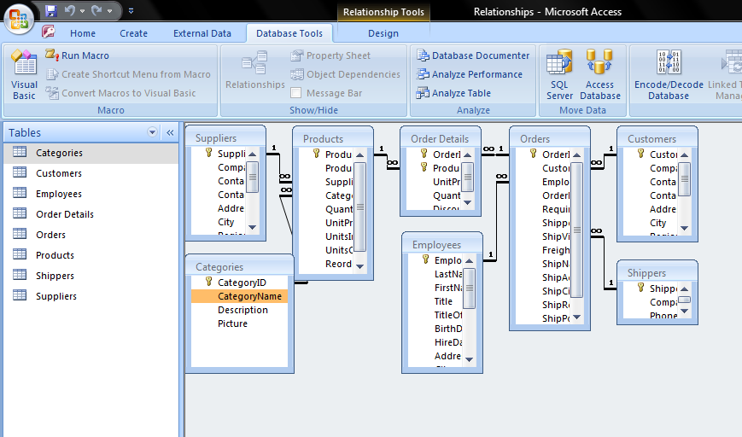
Northwind Relationship Diagram
Note the one-to-many relationships demonstrated on the matching keys

Slide 6
How Get Data Into Form?
There are a number of potential ways to get distributed data into proper form for analysis
One of the strengths of SAS and R are their tools for processing data– so one could use SAS or R data processing to build customer centric view
Many times, however, the data will be stored in data base software, so the only way to process it is to use SQL
We will do both

Slide 7
Connect to Database
If you want to practice these steps then download Northwind.rda from Week 11 folder on Blackboard
Load the data to R either by double-clicking on the file on your hard drive or using the load command
Load(“path/Northwind.rda”)
Remember that quotes pasted from PowerPoint won’t work
You will need to load the orders table separately

Slide 8
sqldf
Fortunately, one can run full SQL from within R using the sqldf library
install.packages('sqldf', repos='https://cloud.r-project.org', dependencies=TRUE)
Library(sqldf)
As the name implies this library allows you to perform sql commands on R data frames
For example, to retrieve the full record for all customers whose name begins with P
FNPSQL<-sqldf("
SELECT *
FROM `Customers`
WHERE FirstName Like 'P%'
")

Slide 9
Sqldf Details
Notice the (“ and “) enclose the query
FNPSQL<-sqldf("
SELECT *
FROM `Customers`
WHERE FirstName Like 'P%'
")
If those not present, then not work

Slide 10
A Few Additional Details
In the where statement
WHERE FirstName Like 'P%’
The P% enforces that the string must begin with P
Very generally, this is the use of what is called regular expressions for string matching

Slide 11
Regular Expressions
These are very powerful tools for matching string and pulling records that match certain criteria
People who are really good with regular expressions love them
But they are rather complicated, so I hate them

Slide 12
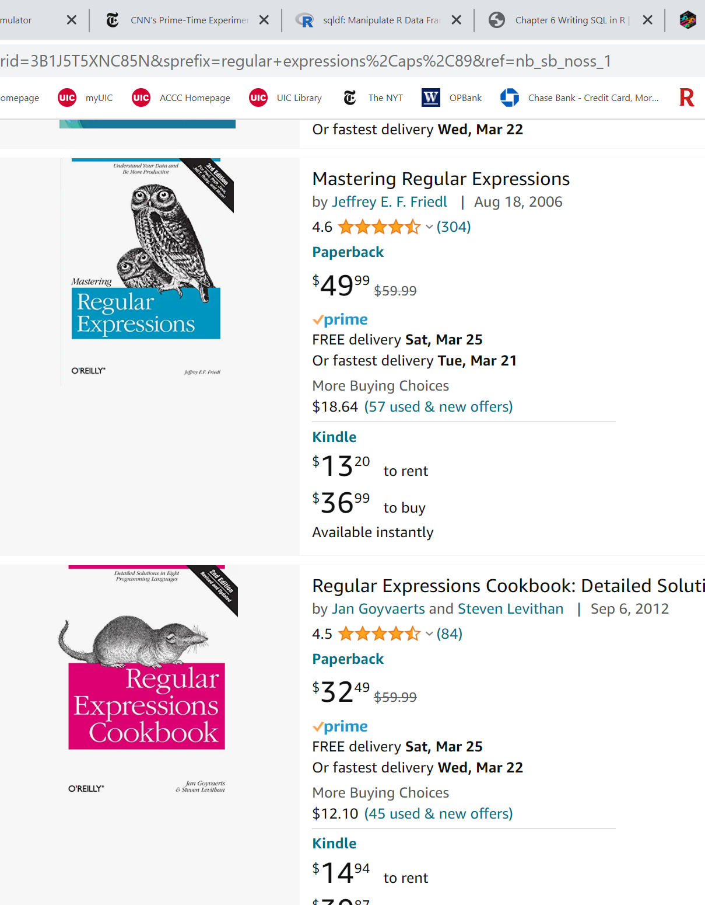
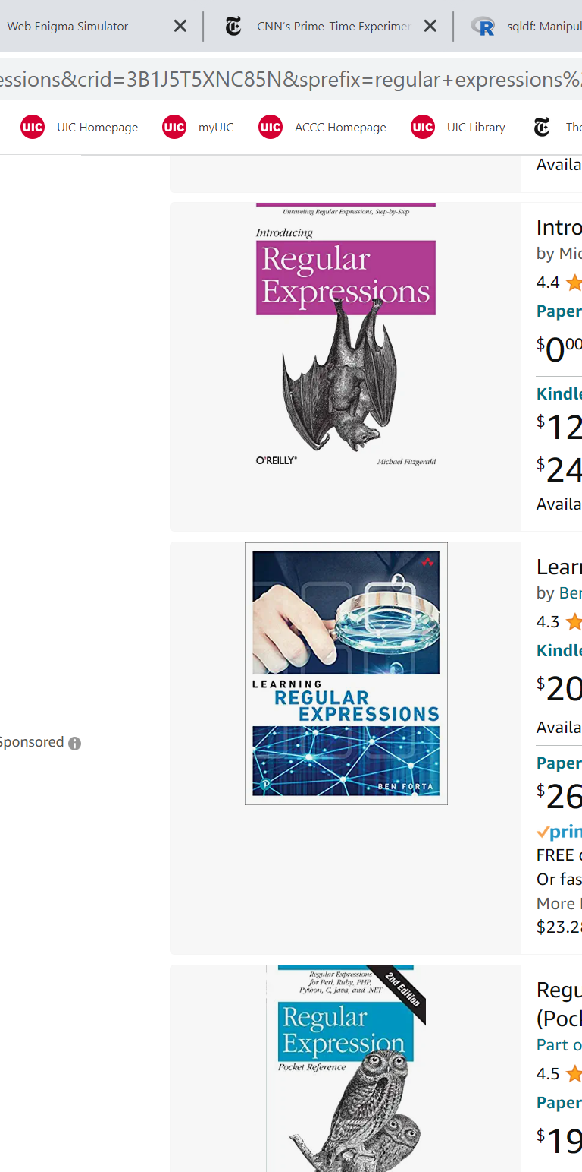
Whole Books On Regular Expressions

Slide 13
Duplicating SQL Programming
I have mentioned before that the dplyr library is very powerful for data cleaning
Sometimes may be much easier to do something in dplyr vs. SQL
But if the data is in a structured database then must use SQL
You can write your R or dplyr code and then get it translated into SQL using show_query

Slide 14
Show Query Example
> q2 <- Cust_tbl %>% select(everything()) %>%
+ filter(starts_with(FirstName, "P")) %>%
+ show_query(q2)
<SQL>
SELECT *
FROM `Customers`
WHERE (starts_with(`FirstName`, 'P'))

Slide 15
Show_query Is A Little Innaccurate
I took the sql from the previous slide and put it into sqldf and got…
> FNPSQL<-sqldf("
+ SELECT *
+ FROM `Customers`
+ WHERE (starts_with(`FirstName`, 'P'))
+ ")
Error: no such function: starts_with
So the SQL that is produced is generic
No guarantee that the syntax will be available in sqldf

Slide 16
Sqldf Not The Only Library
There are several libraries that you can use to execute sql in R. Others include
RMySQL
RSQLite
RPostgreSQL
Roracle
They have different strengths and weaknesses and slight differences in some syntax

Slide 17
R F M
Frequently a company will be interested in the following metrics about their customers
Recency: how long ago did the customer last order?
Frequency: how many times did a customer order?
Monetary Value: how many dollars were spent by the customer?
Referred to as RFM analysis
These three metrics will frequently be good predictors of a customer’s future order activity

Slide 18
Frequency– Introduction
Go back to Access and look at the Orders table
Each order has a customer id
If you simply wanted to pull the customer id and the order id then the syntax would be
CustomerAndOrder<-sqldf("
select
OrderID
,CustomerID
from Orders
")
Can use carriage returns to keep the operations organized (select vs. from)
This will become more important as the SQL become more complicated
Also note commas between items in the list

Slide 19
Order By
If you want the records to come out in a certain order then you can end the query with an order by statement
CustomerAndOrder<-sqldf("
select
OrderID
,CustomerID
from Orders
order by CustomerID
")
> head(CustomerAndOrder)
OrderID CustomerID
1 71 Company A
2 44 Company A
3 57 Company AA
4 30 Company AA
5 72 Company BB
6 65 Company BB

Slide 20
Functions & Group By (Discuss)
OrderFreq<-sqldf("
select
CustomerID
,count(CustomerID) as freq
from Orders
group by CustomerID
order by CustomerID
")
A group by statement is largely
required if you have any sort
of function [such as count]

Slide 21
Base R Equivalent for Counts
data.frame(table(Orders$CustomerID))
Use data.frame to make output readable. Without it get
> table(Orders$CustomerID)
Company A Company AA Company BB Company C Company CC Company D
2 2 4 3 4 5
Company F Company G Company H Company I Company J Company K
6 2 6 2 4 2
Company L Company Y Company Z
2 2 2
Base R much easier and quicker in this case

Slide 22
Recency
Need to get latest order date
Can then subtract it from ‘today’ or the last day of the year or some other appropriate date
What function do you suspect you would use in order to get the latest date?

Slide 23
Recency
OrderRecency<-sqldf("
select
CustomerID
,max(OrderDate) as LatestDate
from Orders
group by CustomerID
order by CustomerID
")

Slide 24
Recency from R (dplyr)
dplyrRecency<-Orders %>% group_by(CustomerID)%>%
summarise(LatestDate=max(OrderDate,na.rm=TRUE))
# A tibble: 15 × 2
CustomerID LatestDate
<chr> <chr>
1 Company A 5/24/2006
2 Company AA 4/22/2006
3 Company BB 6/7/2006
4 Company C 4/25/2006
5 Company CC 6/5/2006
6 Company D 4/7/2006
…
Blech! A tibble. Use data.frame wrapper to avoid

Slide 25
SQL for Monetary Value
Monetary<-sqldf("
select
CustomerID
,sum(OrderTotal) as TotalSpend
from Orders
group by CustomerID
order by CustomerID
")
Monetary
CustomerID TotalSpend
1 Company A 0
2 Company AA 0
3 Company BB 0
4 Company C 0
5 Company CC 0
6 Company D 0
7 Company F 0
8 Company G 0
9 Company H 0
10 Company I 0
Company J 0
…
Uh-Oh!!

Slide 26
Format For OrderTotal
> str(Orders)
'data.frame': 48 obs. of 9 variables:
$ OrderID : int 81 80 79 78 77 76 75 74 73 72 ...
$ OrderDate : chr "4/25/2006" "4/25/2006" "6/23/2006" "6/5/2006" ...
$ Employee.ID : chr "Andrew Cencini" "Andrew Cencini" "Andrew Cencini" "Nancy Freehafer" ...
$ Status : chr "New" "New" "Closed" "Closed" ...
$ CustomerID : chr "Company C" "Company D" "Company F" "Company CC" ...
$ Shipped.Date: chr "" "" "6/23/2006" "6/5/2006" ...
$ Shipping.Fee: chr "$0.00" "$0.00" "$0.00" "$200.00" ...
$ Taxes : chr "$0.00" "$0.00" "$0.00" "$0.00" ...
$ OrderTotal : chr "$0.00" "$380.00" "$2,490.00" "$1,760.00" ...
OrderTotal came into R as a chr (string) not a dollar number– Have to fix
Orders<-Orders %>% mutate(OrderTotal = OrderTotal %>% str_remove_all("[$,]") %>% as.numeric())

Slide 27
Now We Got It
> Orders<-Orders %>% mutate(OrderTotal = OrderTotal %>% str_remove_all("[$,]") %>% as.numeric())
>
> Monetary<-sqldf("
+ select
+ CustomerID
+ ,sum(OrderTotal) as TotalSpend
+ from Orders
+ group by CustomerID
+ order by CustomerID
+ ")
>
> Monetary
CustomerID TotalSpend
1 Company A 2410.75
2 Company AA 1705.00
3 Company BB 15522.50
4 Company C 2564.00
5 Company CC 3312.50
6 Company D 4963.00
7 Company F 8619.50
8 Company G 13800.00
9 Company H 4888.00

Slide 28
Monetary in R (dplyr)
dplyrMonetary<-data.frame(Orders %>% group_by(CustomerID)%>%
summarise(TotalSpend=sum(OrderTotal,na.rm=TRUE)))
dplyrMonetary
CustomerID TotalSpend
1 Company A 2410.75
2 Company AA 1705.00
3 Company BB 15522.50
4 Company C 2564.00
5 Company CC 3312.50
6 Company D 4963.00
7 Company F 8619.50 …

Slide 29
Aside: SAS For Monetary
proc summary data=OrderAndExtended nway;
class CustomerID;
var OrderTotal;
output out=OrderTotalSAS sum=;
run;
The one thing I do miss from SAS is the ability to get a number of summary statistics by group quickly and easily
R had no such function for a long time
Now there are some, but hard to find and use

Slide 30
Merging Is Crucial
Pretend that we want to know amount of sales by job title
So must join job title in the Employees table with the monetary amounts in Orders table
MonetaryByEmployeeType<-sqldf("
select
Employees.JobTitle
,sum(Orders.OrderTotal) as TotalOrders
,avg(Orders.OrderTotal) as AverageOrders
from Orders
left join Employees
on Orders.EmployeeID=Employees.EmployeeID
group by JobTitle
order by JobTitle
")
JobTitle TotalOrders AverageOrders
1 Sales Coordinator 692.0 692.000
2 Sales Representative 66342.5 1895.500
3 Vice President, Sales 2997.5 749.375

Slide 31
All Kinds of Joins
Inner, Outer, Left, Right, Cartesian
We won’t be getting into all of that here
I just want you to know how to join with enough skill to do the homework

Slide 32
By Employee Type In R
Joined<-merge(Employees,Orders,by="EmployeeID")
dplyrMonetaryByEmployeeType<-
data.frame(Joined %>%
group_by(JobTitle)%>%
summarise(TotalSpend=sum(OrderTotal,na.rm=TRUE)))
One drawback is that you must build the data frame Joined and hold it as an object before calculating the totals
In this example that is trivial, but in other circumstances the joined data may be very large and you only need summary statistics which is very small
There are a variety of ways to handle this: sometimes the database query will run on a different machine and only send the final statistics to your machine when done

Slide 33
RFM All At Once in R
Orders$OrderDate<-as.Date(Orders$OrderDate,format="%m/%d/%Y")
rm(dplyrRFM)
dplyrRFM<-data.frame(Orders %>% group_by(CustomerID)%>%
summarise(TotalSpend=sum(OrderTotal,na.rm=TRUE),LatestDate=max(OrderDate),Freq=n()))
dplyrRFM$Recency<-difftime(as.Date("2006-06-30"), dplyrRFM$Latest,units="days")
Note: must use n() to get count of orders. Count() will produce error
I lost an hour because of that

Slide 34
RFM All At Once sqldf
RFM<-sqldf("
select
CustomerID
,max(OrderDate) as LatestDate
,count(CustomerID) as freq
,sum(OrderTotal) as TotalSpend
from Orders
group by CustomerID
order by CustomerID
")
RFM$Latest<-as.Date(RFM$LatestDate,format="%m/%d/%Y")
RFM$Recency<-difftime(as.Date("2006-06-30"),RFM$Latest,units="days")

Slide 35
Homework Notes
In the Northwind database all the matching variables had the same name (OrderID)
This will not always be the case
The database for your homework does not follow this
It is a database of Countries, Provinces and Cities called Mondial.accdb
In the City and Province table there is a 2 character country code called ‘Country’
This matches to the field ‘Code’ in the Country table

Slide 36
Homework Notes Continued
The different field names for matching is no problem for SQL. Simply name different variable on the join statement
on country.code=city.country
For R you also have complete flexibility
mergedData<-merge(a,b,by.x=c(“colNameA”),by.y=c(“colNameB”))
Quick note: this is not true in SAS. Caused lots or renaming of variables

Slide 37
Homework Notes Continued
There are multiple examples of the same field name on more than one table
So you will need to be more careful about the variables that you keep or drop from the different tables
For sql you can control this using the full table.field name on the select statement. For example
select CustomerID
,count(*) as Freq
,'01Jun1998'd-datepart(max(orders.orderDate)) as Recency
,sum(orderdetails.ExtendedPrice) as Value

Slide 38
Homework Notes Continued
If you want the records that are in dataset df1 but not in dataset df2, then you will need to do the following.
library(datatable)
df1[!df2, on=.(cat,num)]
Where cat and num are the match keys between df1 and df2

Slide 39
ANOVA
Analysis of Variance (ANOVA) is the correct statistical technique when you have
A single, quantitative dependent variable
A single, qualitative independent variable with three or more values
ANOVA relies on two main assumptions
Data is basically normal (if sample size is small)
Variability of the data is homogenous across the groups

Slide 40
ANOVA Example
Three different ways of teaching reading
Does one of them do a better job?
Ho: µ_{x}= µ_{y}=µ_{z}
Ha: At least one of them is different
Look at graphs and statistical tests for the two assumptions
Run the main ANOVA algorithm and report results

Slide 41
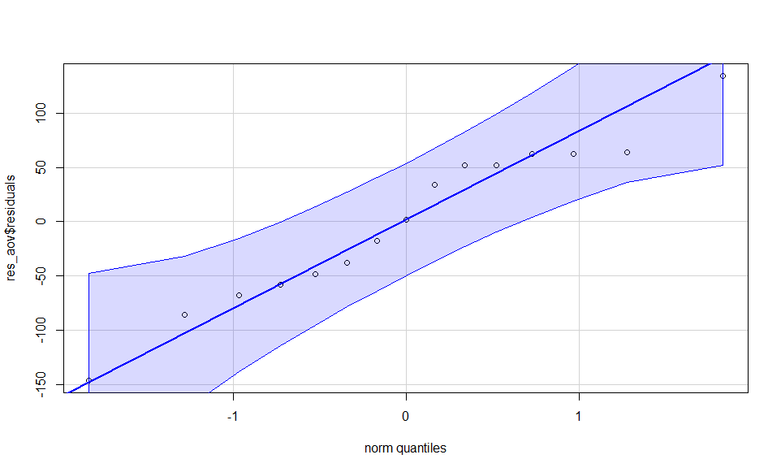
ANOVA Example
library(car)
rm(list=ls())
dat<-read.csv("F:/IDS462/Spring2023Redo/Week11/ANOVAExampleData.csv")
res_aov <- aov(WORDS ~ GROUP,data = dat) #Get residuals from ANOVA
qqPlot(res_aov$residuals,id = FALSE) #visual inspection for Normality
shapiro.test(res_aov$residuals) #test for normality. If p-value is high, then normality is OK
Shapiro-Wilk normality test
data: res_aov$residuals
W = 0.96325, p-value = 0.7487

Slide 42
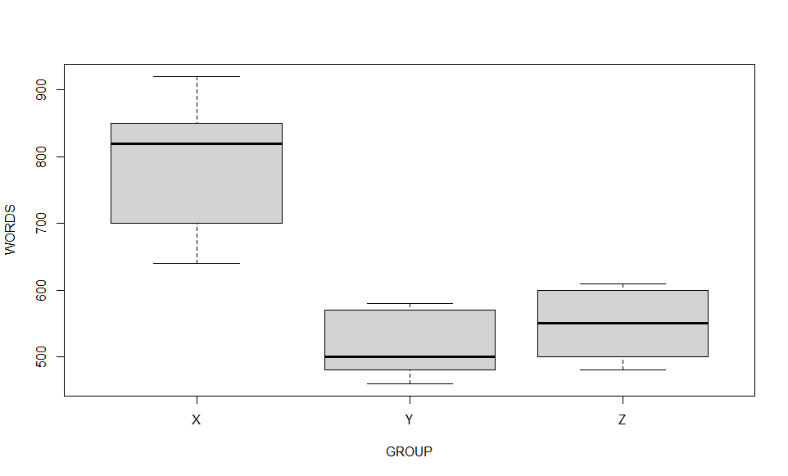
ANOVA Example Continued
boxplot(WORDS ~ GROUP,data = dat) #visual inspection for Homogenous variances
leveneTest(WORDS ~ GROUP,data = dat) #test for homogeneity. If p-value is high, then homogeneity is OK
Levene's Test for Homogeneity of Variance (center = median)
Df F value Pr(>F)
group 2 1.2632 0.3178
12
Warning message:
In leveneTest.default(y = y, group = group, ...) : group coerced to factor.

Slide 43
Final Results
> summary(res_aov)
Df Sum Sq Mean Sq F value Pr(>F)
GROUP 2 215613 107807 16.78 0.000334 ***
Residuals 12 77080 6423
---
Signif. codes: 0 ‘***’ 0.001 ‘**’ 0.01 ‘*’ 0.05 ‘.’ 0.1 ‘ ’ 1
The dependent variable is number of
words read
So clearly bigger is better
So the best teaching method is X
And we can conclude that the increase
in number of words read is not due to
random chance because…

Slide 44
But Wait! There’s More!
Some research uses questions that are along the lines of ‘check all that apply’
Sometimes called Multi-Response data
So I might check one of 6 options while you check four of the 6
This can be tricky to handle because that data can be stored with many ‘blanks’

Slide 45
Data Format for Multi Response
Gender | Resp1 | Resp2 | Resp3 | Resp4 | Resp5 | Resp6
M | 1 | 3 | 6
F | 2 | 3
M | 1 | 5 | 6
F | 4 | 5 | 6
M | 5 | 6
F | 6
M | 1
F | 2 | 3
M | 2
F | 4
M | 4 | 5
F | 1 | 2 | 3
M | 1 | 2 | 3 | 4 | 5 | 6
F | 1 | 5 | 6
How prepare this data for processing?

Slide 46
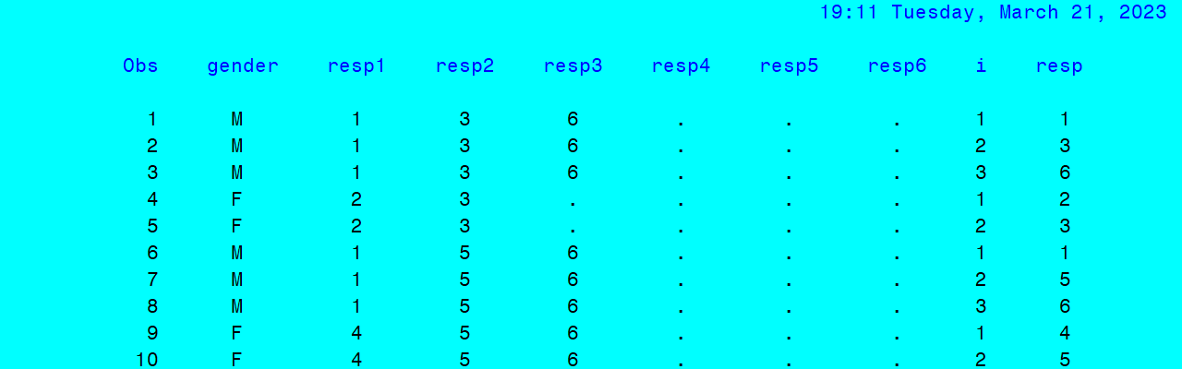
Aside: Much Easier in SAS
Write a looping program to create a row for each non-blank piece of data
data MultRespArray;
set MultRespRaw;
array R[6] Resp1--Resp6;
do i=1 to 6;
resp=r[i];
if r[i] ne . then output;
end;
run;

Slide 47
Aside SAS Continued
proc format;
value class
1='Micro-Computers'
2='Intro To SAS'
3='Advanced SAS'
4='JCL'
5='FORTRAN'
6='PASCAL'
;
run;
proc freq data=MultRespArray;
tables resp;
title "Count Report";
format resp class.;
run;
title;
resp Frequency Percent Frequency Percent
ƒƒƒƒƒƒƒƒƒƒƒƒƒƒƒƒƒƒƒƒƒƒƒƒƒƒƒƒƒƒƒƒƒƒƒƒƒƒƒƒƒƒƒƒƒƒƒƒƒƒƒƒƒƒƒƒƒƒƒƒƒƒƒƒƒƒƒƒ
Micro-Computers 6 18.18 6 18.18
Intro To SAS 5 15.15 11 33.33
Advanced SAS 5 15.15 16 48.48
JCL 4 12.12 20 60.61
FORTRAN 6 18.18 26 78.79
PASCAL 7 21.21 33 100.00
SAS also has a Format function that allows
you to store your data as numbers and
then display it as strings
This can save a large amount of storage

Slide 48
Can We Mimic This in R?
R does have a way to store data as numbers and display it as strings: factors
You may have noticed that within a data frame, data can be stored as integers, numbers, characters or also factors
ClassList<-read.csv("F:/IDS462/Spring2023Redo/Week11/ClassesList.csv“
,stringsAsFactors=TRUE)
str(ClassList)
'data.frame': 33 obs. of 1 variable:
$ Course: Factor w/ 6 levels "Advanced SAS",..: 5 1 6 3 1 5 2 6 4 2

Slide 49
Apply to Our Data
Choices<-read.csv("F:/IDS462/Spring2023Redo/Week11/ClassChoicesOrig.csv")
Choices$Resp1<-as.factor(Choices$Resp1)
str(Choices)
Choices$Resp1<-factor(Choices$Resp1,levels=c("Micro","Intro SAS","Adv. SAS","JCL","FORTRAN","PASCAL"))
table(Choices$Resp1)
Micro Intro SAS Adv. SAS JCL FORTRAN PASCAL
0 0 0 0 0 0
Well, clearly that did not work as intended
I also tried it another way and it failed because no one picked ‘Advanced SAS’
as their first choice so the factor only had 5 levels
So that was the end of that

Slide 50
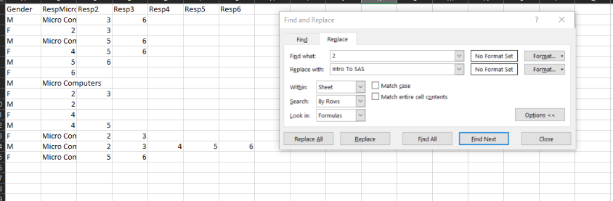
Replace Values At Source
I ended up using Replace menu in Excel

Slide 51
Google, Google, Search, Search
I did A LOT of searching to find similar functionality in R
library(expss) had some of what is needed
CountsAndCases<-calc_cro(Classes, mrset(Resp1 %to% Resp6), total(label = "Count"))
CountsAndCases<-data.frame(CountsAndCases)
row_labels Count
1 51
2 Advanced SAS 5
3 FORTRAN 6
4 Intro To SAS 5
5 JCL 4
6 Micro Computers 6
7 PASCAL 7
8 #Total cases 14

Slide 52
Counted Blanks– Not Helpful
row_labels Count
1 51
2 Advanced SAS 5
3 FORTRAN 6
4 Intro To SAS 5
5 JCL 4
6 Micro Computers 6
7 PASCAL 7
8 #Total cases 14
| | Percent of responses |
| --------------- | -------------------- |
| | 60.7 |
| Advanced SAS | 6.0 |
| FORTRAN | 7.1 |
| Intro To SAS | 6.0 |
| JCL | 4.8 |
| Micro Computers | 7.1 |
| PASCAL | 8.3 |
The whole point is to get the percentages
without the missing values
Hurrumph.

Slide 53
Coding Solution
> CountsAndCases<-calc_cro(Classes, mrset(Resp1 %to% Resp6), total(label = "Count"))
Warning message:
'calc_cro' and 'calc_cro_cases' were renamed to 'cross_cases’…
them with 'cross_cases' in your code.
> CountsAndCases<-data.frame(CountsAndCases)
> CountsAndCases<-CountsAndCases[CountsAndCases$row_label>'',]
> colnames(CountsAndCases)[1]="Class"
> Responses<-sum(CountsAndCases$Count[1:length(CountsAndCases$Count)-1])
> CountsAndCases<-CountsAndCases%>%mutate(PctOfResponses=percent(CountsAndCases$Count/Responses))
> Cases<-CountsAndCases$Count[length(CountsAndCases$Count)]
> CountsAndCases<-CountsAndCases%>%mutate(PctOfCases=percent(CountsAndCases$Count/Cases))
> CountsAndCases
Class Count PctOfResponses PctOfCases
2 Advanced SAS 5 15.2% 35.7%
3 FORTRAN 6 18.2% 42.9%
4 Intro To SAS 5 15.2% 35.7%
5 JCL 4 12.1% 28.6%
6 Micro Computers 6 18.2% 42.9%
7 PASCAL 7 21.2% 50.0%
8 #Total cases 14 42.4% 100.0%

Slide 54
Game Plan For Rest of Semester
Quiz/Exam
Homework Due

